Slide 1
The Media Player

Slide 2
The Media Player
The media player has four major jobs to do:
Manage the user interface
Handle Transmission Errors
Decompress the content
Eliminate Jitter
If a TCP-based transport is used, there are no errors for the media player to correct because TCP provides reliability with retransmissions.
If a UDP-based transport is used, there are no retransmissions. This means that packet loss due to congestion or transmission errors will mean that some of the media won’t arrive.
Two ways to reduce the impact of packet loss are FEC and interleaving.

Slide 3
Forward Error Correction
FEC is the error-correcting coding applied in the application level. Parity across packets provides an example. For every four data packets sent, a fifth packet can be sent. The information in the fifth is redundant information from the exclusive-OR sums of the first four bits.
Occasionally, a packet mad be lost during transmission, like in figure 7-52(right). B can be reconstructed based on the information in packets A, C, D, and P, the fifth redundant packet.
FEC can reduce the level of loss seen by the media player, but it has limitations, such as the increased bandwidth required to send the extra packet, or the lack of failsafe if more than one packet is lost during transmission.

Slide 4
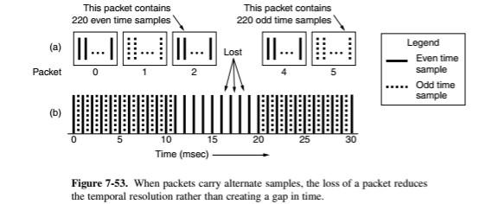
Interleaving
This method is based on mixing up or ‘interleaving’ the order of the media before transmission and unmixing or ‘deinterleaving’ it on reception. This means that if a packet is lost, the loss will be spread out over time, instead of one large gap when the media is being played.
This method usually only works on uncompressed sampling. However, interleaving over short periods of time (not individual samples) can also be applied after compression as long as there’s a way to find sample boundaries in the compressed stream.
Unlike FEC, interleaving is an attractive technique because it requires no additional bandwidth to be carried out.

Slide 5
Decompression
Decompression, while computationally intensive is very straightforward. The issues arise when talking about how to decode media if the network protocol doesn’t correct transmission errors.
In many compression schemes, later data can’t be decompressed until the earlier data has, because the later data is encoded relative to the earlier data. For a UDP-based transport, there can be packet loss. This means that the encoding process must allow for decoding despite packet loss.
This is the reason that MPEG uses I-, P- and B- frames.
Each I-frame can be decoded independently of the other frames to recover from the loss of any earlier frames.

Slide 6
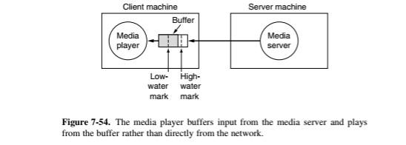
Buffering
To eliminate jitter, the generally accepted solution is to use a playout buffer. All streaming systems start by buffering 5-10 seconds worth of media before playing (seen in figure 7-54).
Playing drains media from the buffer so that the audio is clear and the video is smooth. The startup delay gives the buffer a chance to fill to the low-water mark. The data should now arrive regularly enough to ensure the buffer is never emptied.
If a UDP-based transport is used, little buffering is needed, even if interleaving or FEC occurs, assuming there are no bandwidth constraints. Some jitter might also occur with UDP.
If a TCP-based transport is used, jitter may be more common, but since TCP sends data as fast as the network carries it, the buffer will often fill up much faster than can be emptied, even if retransmissions are needed.

Slide 7
Question
What are some of the jobs that the media player carries out?

