Slide 1
7.5 Content Delivery

Slide 2
Early Content Delivery
The internet used to consist of only the telephone network.
Then people used email to communicate with each other for a very long time. Then moving to videos calls.
But it’s more than that, the internet has grown and is all about content and entertainment than communication.
Lots of people use the internet to look up information.
The majority of the internet bandwidth is now for videos.

Slide 3
Content Senario
There are many different scenarios for communication and distributing content.
If someone wants to stream a basketball game, then the device doesn’t really matter as long as the device has service.
Location isn’t a factor for watching content. However it may affect performance.

Slide 4
Rise of Platforms
In recent years there have been many sites or platforms that have become popular in distributing content.
YouTube is a big example of sharing videos. So many people will watch these videos everyday. A lot of the popular videos getting millions of views.
There are limitless videos with so many different ideas. You can look up a video for anything and something will most likely come up.
YouTube takes up for about ten percent of the internet traffic today. Which goes to show how popular some of the big platforms are.
Big content platforms will have their own content distribution networks to keep up with the demand.

Slide 5
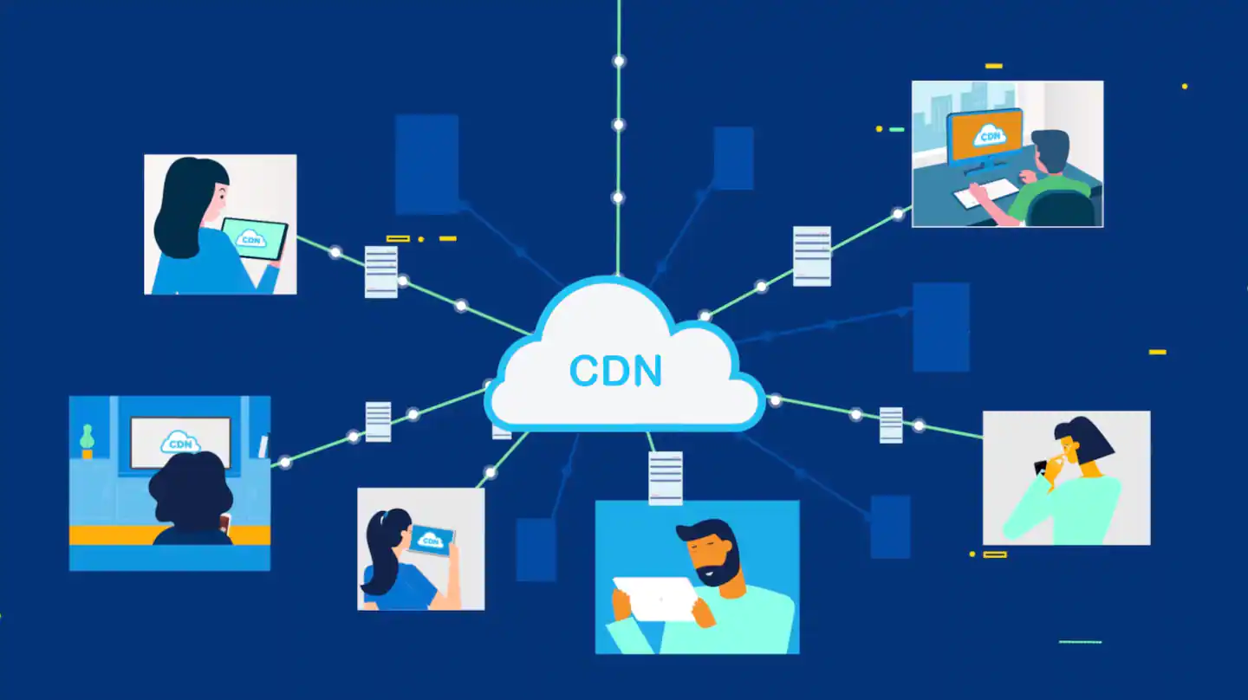
CDN
(Content Distribution Network)
A CDN is a type of architecture where a provider will set up a distributed collection of machines and uses them to serve content.
Many large content providers will do this for large platforms such as YouTube.
When using a CDN, it will make your website perform faster.
Since server locations are not directly connecting to each other, it makes for an increase in security for your platform.

Slide 6
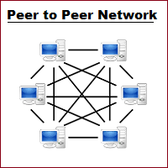
P2P
(Peer-to-Peer)
This is another type of architecture for the smaller platforms.
There will be a pool of resources that will serve content with other computers.
There is no central point of control which is why working together has helped the smaller platforms.

Slide 7
Question
What does CDN stand for?

