Slide 1
7.4 Streaming Audio and Video
Digital Audio & Video
For many people, audio and video are the holy grail of networking.

Slide 2
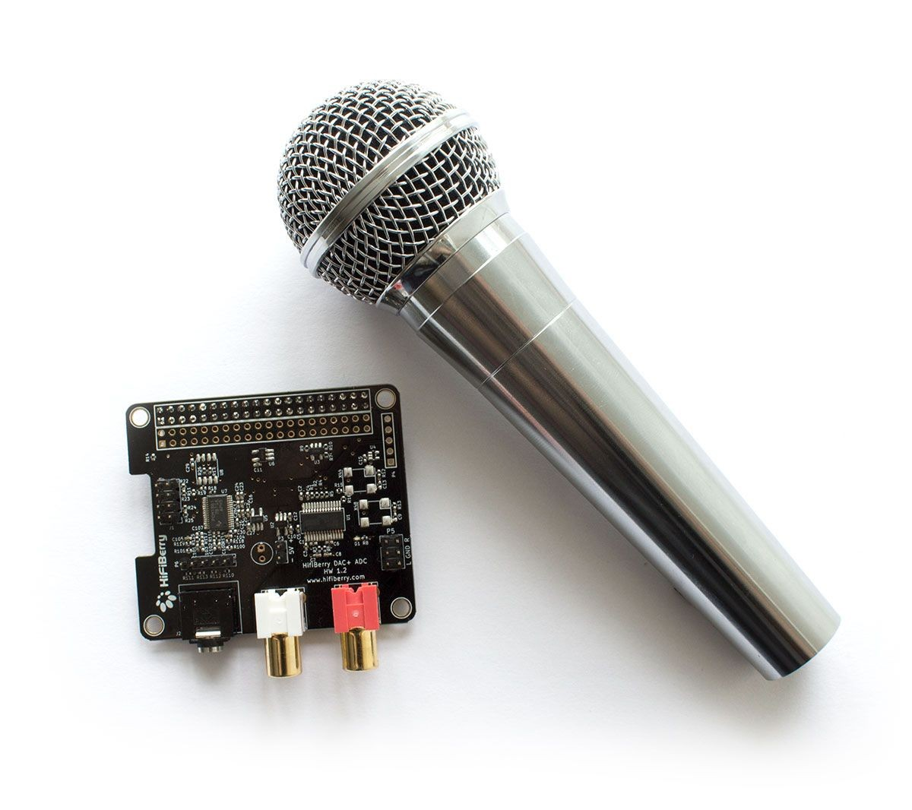
Digital Audio
Audio waves can be converted to digital form.
This requires an ADC is an Analog-to-Digital Converter.
Send some positive waves to someone!
For example: A microphone would create electrical currents from your audio, and send to the built in ADC. The ADC reads and translates the current into a binary number.
Microphone with ADC+DAC converter
Then a DAC (Digital-to-Analog Converter) is used to reverse the conversion and send it so you can hear it. An example would be a speaker.

Slide 3
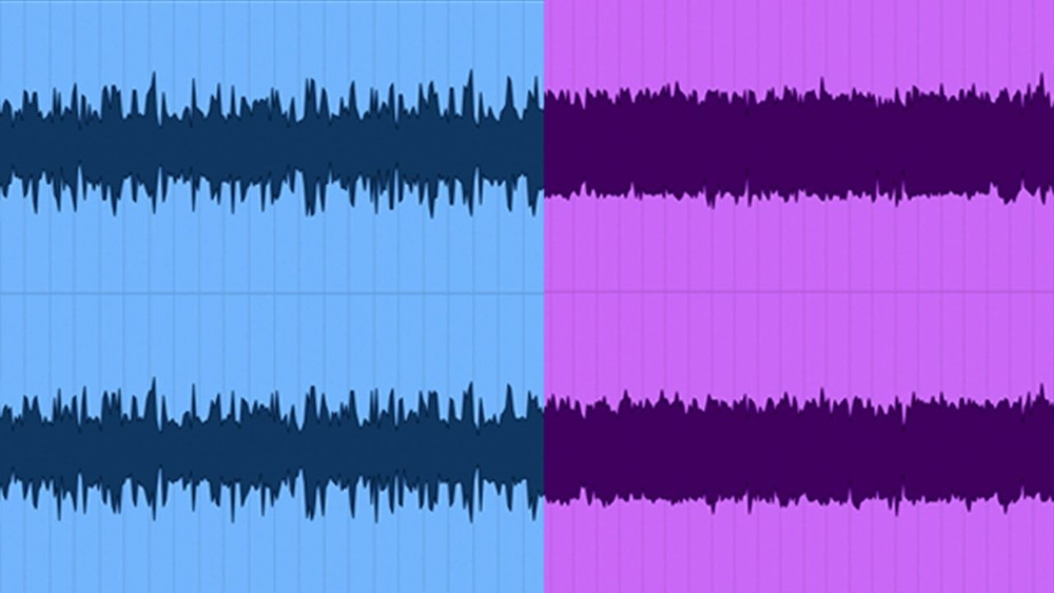
Digital Audio - Audio Compression
Audio usually needs to be compressed to save on bandwidth and transfer times.
Setting limitations
This requires two algorithms. One to compress the data before sending (encoding), and the other to decompress the data at the destination (decoding).
Uncompressed
Compressed
MPEG audio layer 3 (MP3) is a common form of converted and compressed audio.
Advanced audio coding is another example, although it is not as well known.

Slide 4
Digital Video
A sequence of frames that are shown quickly is the simplest form of digital video.
Sticky note animations!
For example, watching a youtube video at 60fps. 60fps means, 60 frames per second.
These frames contain little pixels on a grid. Our eyes cannot distinguish all the pixels present on this monitor.
Example of frames - Spread the love
Our brains like to take the “big picture” of images, avoiding the individual pixels.

Slide 5
Digital Video - Video Compression
When sending videos, it is important to compress them. Even a small video can reach over 100 MB.
This is due to a number of factors, including:
Shrek the movie is 5GB!
Pixel frames (X by Z)
24 bits of color information per pixel
Framerate
Recorded on Android
This can cause an exponential growth in size.
For example, a 2 second, 480p video at 30fps can reach 6 MB in size.
That is almost enough to reach the compression limit on discord (8 MB standard).

Slide 6
Digital Video - Standards of JPEG & MPEG
JPEG:
The standard for compressing continuous-tone still pictures.
JPG
JPEG
People need standards!
There are other versions, but they are not as common.
MPEG:
Original
JPEG Conversion
Motion picture compression, an MPEG can compress both audio and video.
MP3 (Audio)
MP4 (Video)
All previous versions are too old to really matter today.

Slide 7
Question, True or false?
MP3 is an example of a converted video.

Slide 8
End

Slide 9
Citations
All information was retrieved from the textbook.

