Slide 1
Streaming Audio and Video

Slide 2
What is Streaming?
Streaming is a method of transmitting or receiving of media content over a continuous flow over the internet
Made possible through the application layer
Allows users to view or listen to media over the internet in real-time.
Three approaches to streaming media:
Using a web server
Using a web server with metafile
Using a media server

Slide 3
Different Types of Streaming Media
Common forms of streaming media include:
Stored Media
Pre-recorded videos (YouTube)
Streaming of media already stored in files
Video on Demand (VoD)
Live Media
IPTV, Twitch, Instagram Live, Internet Radio
Real-time conferencing
Zoom, Discord, Skype

Slide 4
Streaming Live Media
Live media streaming is a very popular form of streaming. It has great commercial, entertainment, educational and personal uses.
A digital video signal is broadcasted online to any number of video players globally.
The video signal can be very large, and must be compressed using an encoder. The compressed file is packaged for a streaming protocol and transferred to a media server. The media server can convert the content to allow it to be available for several different devices, resolutions, bitrates, and internet speeds.
CDN’s (Content Delivery Network) are used to reduce latency for audiences around the world.

Slide 5
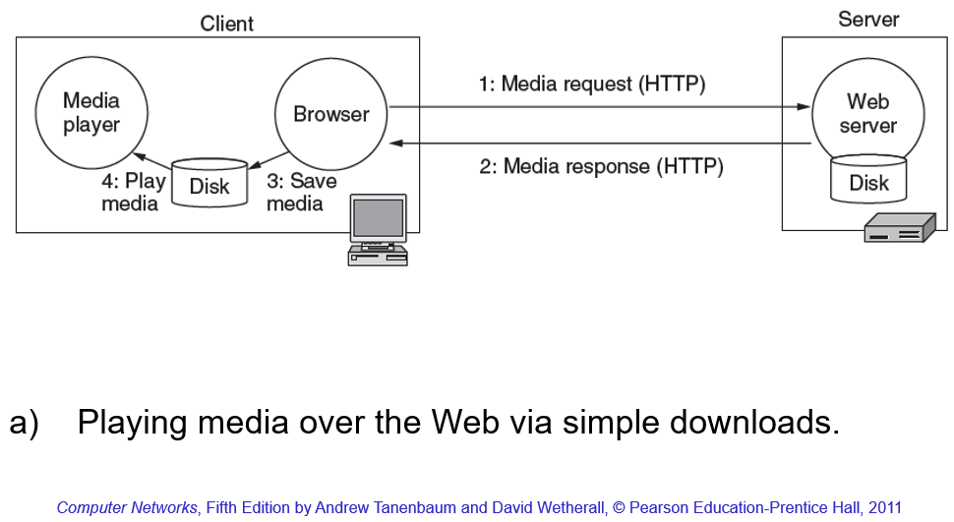
Streaming Using a Web Server
User selects video from a website
Browser sends a GET message to web server to request the specific file
Web server responds with a compressed file sent to the browser
The file is stored on a scratch file on the disk
Media player decodes and plays the file
This approach is a file download, and there will be no real-time network issue
Entire video must be downloaded before viewing the media

Slide 6
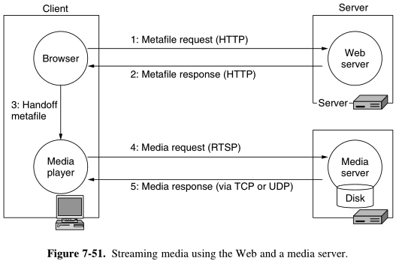
Streaming Using a Media Server
User selects video from website
Browser sends GET message to the web server to get the metafile
Web server responds with metafile information (URL, media name)
Browser forwards the metafile to the media player
GET message is sent to the media server to get the media file
Media server responds with the media file
Media player plays the video/audio
Web server uses TCP, while the media server uses UDP
Media server responds with UDP because TCP is slower due to error correction/flow control. TCP features may cause delay.

Slide 7
Question:
What does VoD stand for?

