Slide 1
Streaming Audio and Video,
Content Delivery
Presented By: Group 8
Notes:
Sections:
7.4 Intro, 7.4.1: Meng Lee 7.4.2, 7.4.3 Azhar Toqeer 7.4.4, 7.4.5 Dev Girish Takle 7.5 intro: Madeline Swaim 7.5.1, 7.5.2 Va Cha 7.5.3, 7.5.4 Sarntorn Saephan

Slide 2
Outline
Streaming Audio and Video
Digital Audio
Digital Video
Streaming Stored Media
Streaming Live Media
Real-Time Conferencing
Content Delivery
Background
Content and Internet Traffic
Server Farms and Web Proxies
Content Delivery Networks
Peer-to-Peer Networks

Slide 3
Streaming Audio and Video

Slide 4
Digital Audio
Digital Audio is a digital representation of an audio wave that can be used to recreate it. Audio waves can be converted to digital form by an ADC (Analog-to-Digital Converter).
An ADC takes an electrical voltage as input and generate a binary number as output.
The reverse process takes digital values and produces an analog electrical voltage. It is done by a DAC (Digital-to-Analog Converter). A loudspeaker can then convert the analog voltage to acoustic waves so that people can hear sounds.
To reduce bandwidth needs and transfer times, audio is often compressed which are referred to as encoding and decoding algorithms.
I.E. of audio compression algorithms : MP3 (MPEG audio layer 3) and AAC (Advanced Audio Coding)

Slide 5
Digital Video
video is a sequence of frames, each consisting of a rectangular grid of picture elements, or pixels.
24 bits per pixel, there are about 16 million colors, which is more than the human eye can distinguish.
computer monitors and televisions, each discrete pixel is made up of closely spaced red, green and blue subpixels.
Many formats are used for the videos that is sent over the internet. Some proprietary and some standard

Slide 6
Streaming Stored Media
Mostly people use VOD which is run through internet.
There are three type of Media streaming applications
RealPlayer
Media Player
QyickTime
Notes:
https://www.youtube.com/watch?v=AeJzoqtuf-o&feature=youtu.be

Slide 7
Streaming Live Media
Live media streaming began with radios and tv stations, it has expanded to music, games and videos by large corporations as well as users at home. A great example is IPTV.
When streaming live, a buffer is still needed to smooth out network jitter.
Viewers tune in to an ongoing media stream, just like turning on the television. However, media players provide the added features of letting the user pause or rewind the playout. The live media will continue to be streamed and will be buffered by the player until the user is ready for it. From the browser’s point of view, it looks exactly like the case of streaming stored media.
As there are many viewers, multicasting is used.
The server sends each media packet once using IP multicast to a group address. The network delivers a copy of the packet to each member of the group. All of the clients who want to receive the stream have joined the group. The media is carried in packets over a UDP transport. FEC is used to reduce media loss.

Slide 8
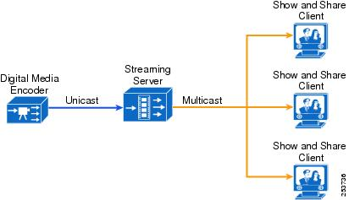

Slide 9
Real-Time Conferencing
Voice is now carried over the Internet because of the growth of data traffic over voice traffic. This is VoiP or internet telephony. One form is to have what look like regular telephones that plug into the Ethernet and send calls over the network.
The form of voice over IP that is likely the most visible to users: using one computer to call another computer. The best known example is Skype.
With good compression algorithms and more bandwidth, audio calling over the internet expanded to video calling.
In order to ensure a smooth experience, we need to have low latency, which has to be in milliseconds.

Slide 10
VoIP systems use shorts packets to reduce latency at the cost of efficiency. This means they use up more bandwidth by using more packets of short size, but reduce latency by a large amount.
Companies decided to use a common standard for real-time conferencing. They issued H.323, more of an architecture than a protocol. At the center of it is the gateway that connects the Internet to the telephone network.
H.245 is used to decide which compression algorithm to use. Q.931 for connections, H.225 for talking to the gatekeeper.

Slide 11
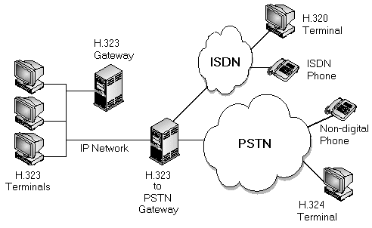

Slide 12
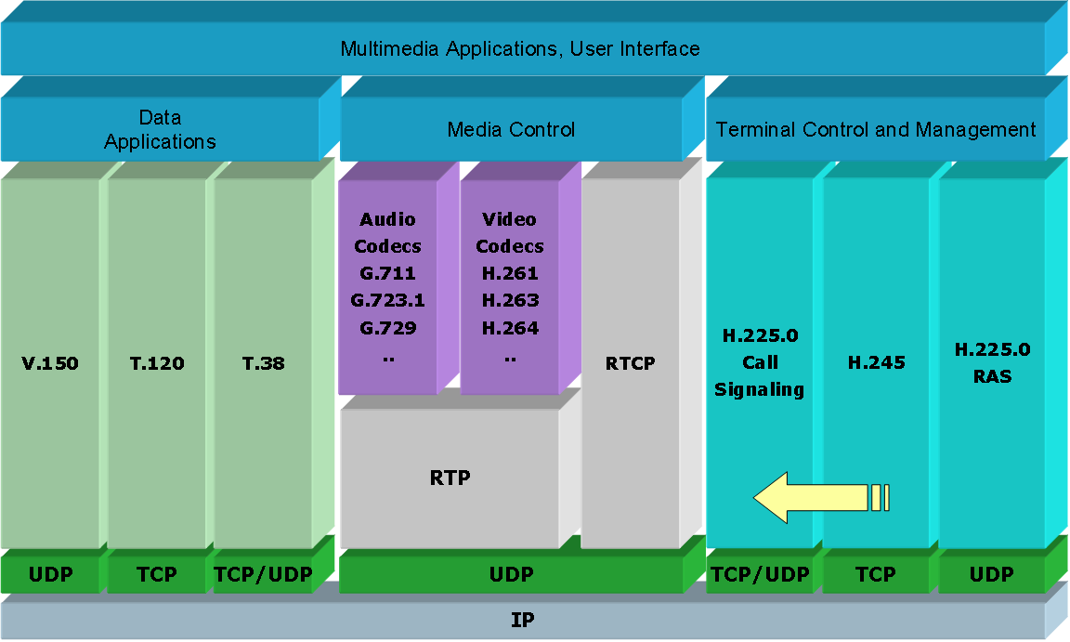

Slide 13
SIP Protocol
As H.323 was viewed as a Big Telecom product, a simpler Session Initiation Protocol was introduced. This protocol describes how to set up Internet telephone calls, video conferences, and other multimedia connections.
In contrast top H.323, SIP is a typical Internet protocol that works by exchanging short lines of ASCII text. H.323 has well defined protocols, for which the price of using a complex and large architecture is paid.

Slide 14
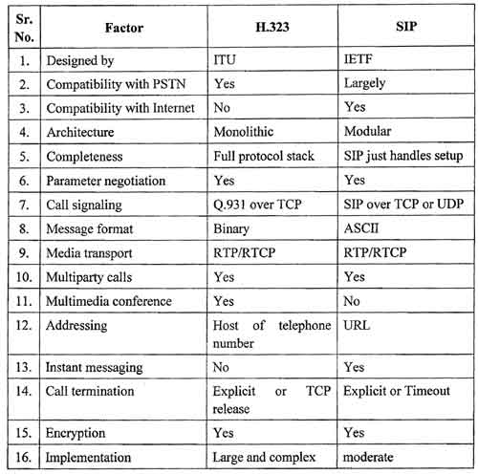

Slide 15
Content Delivery

Slide 16
Content Delivery Background
Internet was all about communication
Now, Internet is more about content
Finding info
Peer-to-peer file sharing
Deliver stored videos
Distributing content is different than communication
Location isn’t important for content
May affect performance

Slide 17
Content Delivery Background
Consumer Demand -> Researchers developed different network architectures.
Youtube accounts for 10% of internet traffic
Content Distribution Networks
Uses data centers all over the world to provide content
Sets up distributed collection of machines at locations inside the internet
Peer-to-Peer Network
A collection of computers that shares content without servers or a central point of communication.

Slide 18
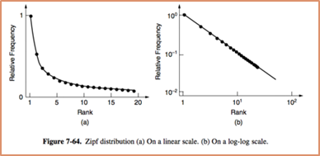
Internet Traffic
-Traffic is highly skewed, small amounts of websites have large amounts of traffic, while large amounts of websites have small amounts of traffic.
- Later work spoke of long traffic flows as elephants and short traffic flows as mice.
Zipf’s law -> C = 1/(1 + 1/2 + 1/3 + 1/4 + 1/5 + ... + 1/N)

Slide 19
Servers Farms and Web Proxies
Server farm – collection of computer servers that provide functionality far beyond that of a single machine. Main problem with server farms With server farms, we map using load balance to evenly distribute the workload. Proxy server – Computer that acts as mediator between a web browser and the Internet. Web proxies are used to fetch web requests on behalf of users, and are more beneficial for popular requests. Proxies are popular because they can also be used to filter content.

Slide 20
Content Delivery Networks
CDNs, Content Delivery Networks, allow providers to place a copy of the page in a set of nodes at different locations that direct clients to use it.
By doing this it clients can connect to a nearby node rather than connect to a server far away.
Another similar way for distribution is using mirrors. The origin server set up links to different mirrors with their location that clients themselves can pick whichever one is closer to them and use it to access the content.
A browser can use DNS redirection to redirect clients to different nodes that are closer to them. When a client tries to access a site, DNS will return the IP address of the CDN nearest to the client.

Slide 21
Peer-to-Peer Networks
Being able to set a big network of CDNs around the world can be very hard. As an alternative, a P2P network can be used.
P2P networks came to be in 1999 due to Napsters where 50 million users were exchanging copyrighted songs.
Idea of P2P file-sharing network is that many people came together and shared their resources to form a content distribution system. Everyone’s computer are considered peers and other people can fetch its content and use it as a server.
BitTorrent (most popular P2P protocol application)
The computer connects to many different peers where they can download the content simultaneously making it faster and easier than using a large CDN.

Slide 22
Questions?

