Slide 1
Streaming Audio and Video Content Delivery
Group 8 - Chapter 7.4-7.5

Slide 2
Digital Audio & Video Streaming .
Real time streaming becomes possible around 2000
Two things happened to enable growth
More powerful computers
Higher bandwidth
Network delay must be small
More importantly, minimize jitter (variation in delay)
Compression is necessary
Without it, video is much too large to stream
Encoding can be expensive, decoding must be cheap

Slide 3
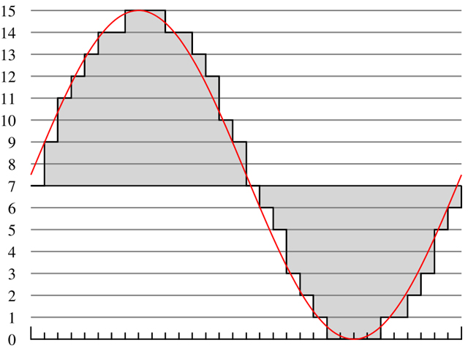
Digital Audio .
Converted from analog to digital and vice versa (ADC, DAC converters)
Ear is much more sensitive to jitter than the eye High quality audio is important
Audio waves are quantized into discrete bits
Vocoders can compress speech very well
Many audio compression algorithms exist MP3, AAC
Perceptual coding exploits flaws in human hearing Some sounds can mask others Masked out sounds are eliminated

Slide 4
Digital Video .
Video is a sequence of frames of pixels
Each pixel has values for RGB
More bits for each color results in higher number of colors
Several frame rate standards exist
24 fps (35 mm film), 25 fps (PAL), 30 fps (NTSC)
Low frame rate videos use interlacing
Two half resolution fields are broadcast sequentially, giving the appearance of double the fps
Videos must be compressed
A 640 x 480 video at 30 fps, using 24-bit color, takes over 200 Mbps of bandwidth
What is jitter?

Slide 5
Video Compression
MPEG (Motion Picture Experts Group) is the main video compression standard
Compresses both audio and video How to synchronize the two data streams? A single clock records timestamps for each portion, which is used to sync the streams
Evolution: MPEG-1 -> MPEG-2 -> MPEG-4 -> H.264 -> H.265
Two types of redundancies in video: spatial and temporal Spatial redundancies are blocks of similar or identical color within a frame Temporal redundancies are blocks of similar color that persist through several frames
Decoding MPEG video is much faster than encoding it Encoded once, decoded up to billions of times
Next: Streaming Media .

Slide 6
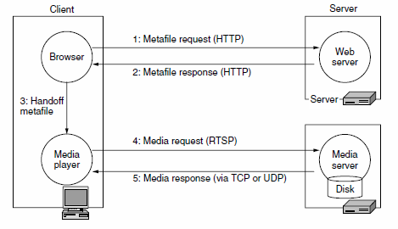
Streaming Stored Media .
Most common form of watching videos of the internet
VoD (Video on Demand)
Two forms
Download and watch Easiest but entire video must be downloaded before Downloads media and then is sent to media player
Watch while downloading Uses a metafile - very short file that is just the name of the video file Files are sent to immediately media player
What does VoD Stand for?

Slide 7
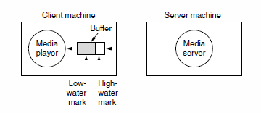
Media Player .
Four Jobs Manage the user interface Usually a GUI that interacts with the user
Handle transmission errors FEC (Forward Error Correction) Adds additional bandwidth and latency
Interleaving (uncompressed sampling) No additional bandwidth but adds latency Only works with uncompressed sampling
Decompress the content
Eliminate jitter Uses Buffering

Slide 8
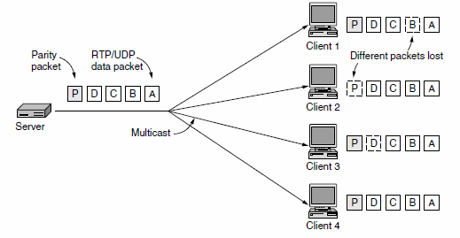
Streaming Live Media .
Uses IPTV -Live streaming by major television stations. And Internet Radio- broadcast radio stations
Approaches
Record programs to disk- Let viewers connect to server and access a program Like streaming media
Broadcast live over the Internet Just like TV but can you can rewind or pause
Multicast one-to-many delivery service Server sends each media packet once using IP multicast to a group address. The network then delivers a copy of the packet to each member of the group. Best way is to use UDP transportation but most common is TCP (requires lots of bandwidth)

Slide 9
Streaming Live Media Video.
Next: Real Time Conferencing.

Slide 10
Real Time Conferencing .
VoIP Services:
•Regular telephone service.
•Long-distance telephone service.
•Voice/Video calls through computers.
–i.e. Skype
Problems:
•Much more constrained than streaming a stored file or live event.
•Low latency is needed:
–Acceptable usage on the telephone network is up to 150 ms, anything above results in delays.
Notes:
In the beginning, voice traffic primarily ruled network traffic through PSTN, which used circuit-switched telephony between two phones. When internet came along, voice traffic made a shift towards internet telephony and became known as VoIP.

Slide 11
Real Time Conferencing - On Latency...
•UDP is favored rather than TCP because TCP retransmissions introduce at least one-round trip worth of delays.
•Latency is related to packet size.
–Smaller packets > larger packets.
* When a packet takes too long to arrive, the player will skip over the missing samples = jitter.
Helping latency:
1)DS (Differentiated Services)
2)Sufficient Bandwidth
Notes:
However, even with UDP, some forms of latency can’t be reduced. For example, sending data across massive distances. Propagating delay will be longer through the network because of the distance.
Although large packets are more efficient for network bandwidth, they take longer to fill, which means more delay between each packet. Shorter packets reduce latency at the expense of bandwidth. Packets fill faster and delay shortened.
Jitter = Ambient noise, frozen/repeated frames. ‘Lag Spikes’

Slide 12
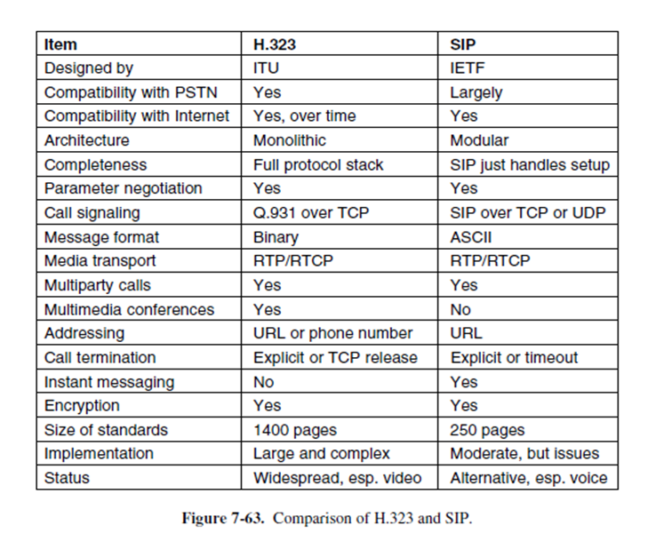
H.323 /SIP Protocols
Notes:
Specializes in multimedia communication over IP networks.

Slide 13
Next: Content and Traffic.

Slide 14
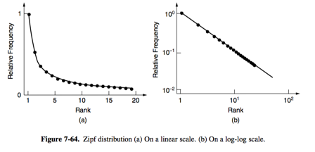
Content & Internet Traffic .
Increase in number of Internet data centers
Renting virtual servers are easier and cost effective
(1994) FTP → (2016) YouTube
FTP → Web (Forums, Email, E-Commerce)→ P2P File Transfer → Websites
Internet traffic is highly skewed
Zipf’s Law → C = 1 / (1 + 1/2 + 1/3 + 1/4 + 1/5 + . . . + 1/N)
Content distribution systems
Next: server farms .

Slide 15
Server Farms & Web Proxies .
Server Farm: A cluster of computers that acts as a single server
Web Proxies: A large shared cache for a group of clients

Slide 16
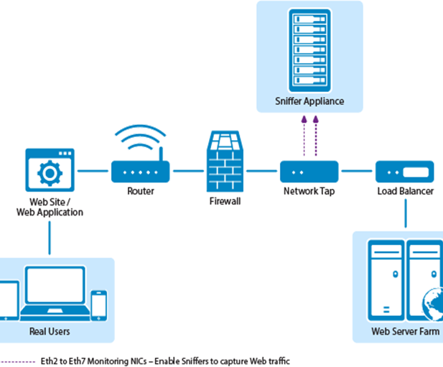
Server Farms - DNS and Front End Spray Methods .
Problem: The set of computers that make up the server farm must look like a single logical website.
DNS Solution: Each server has a copy of the website. When a DNS request is made for the Web URL the DNS server returns a rotating list of the IP addresses of the servers
Effect: Different clients contact different servers to access the same Web site.
Front End solution: the front end sprays incoming requests over that pool of servers in the server farm
Effect: Each server answers only a fraction of the requests by prior agreement

Slide 17
Server Farms and Load Balancing .
In general designs, the front end may inspect the IP TCP and HTTP headers of packets and map them to a server. This process is called Load Balancing and its goal is to balance the workload across servers.
Why does the front end inspect these headers? One IP address may represent an entire company and make many requests. By looking at the TCP or higher layer information, these requests can be mapped to different servers. HTTP is used when a Web interaction accesses and updates a database, such as when a customer looks up her most recent purchase. It is useful to direct subsequent requests to the same server, because that server already has the cache information about the user.

Slide 18
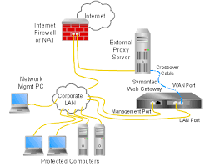
Web Proxies - The Basics .
Problem: Loading web sites from various servers takes time.
Solution: cache responses and reuse them to answer future requests.
Effect: Caching Improves performance by shortening the response time and reducing the network load.
Next Step: A Web Proxy is used to share cache among multiple users. The cache in one computer can be accessed and used by another computer. Combining caches lessens the load on single machines and expands the amount of cached information for all.

Slide 19
Web Proxies - Setup, Limitations, and Benefits .
Setup: Each browser is configured to make page requests to the proxy instead of the pages real server. If the proxy has the page it returns it, if it does not it fetches the page from the server and caches it for future use.
Limitations: Shared caching is beneficial until the number of users reaches the size of a small company (100 people). Too many unpopular requests and one time visits cannot be cached due to lack of storage space.
Benefits: Filtering content - the administrator may configure the proxy to blacklist sites or filter requests. Anonymity – the proxy can shield the identity of the user from the server.
Next: CDN .

Slide 20
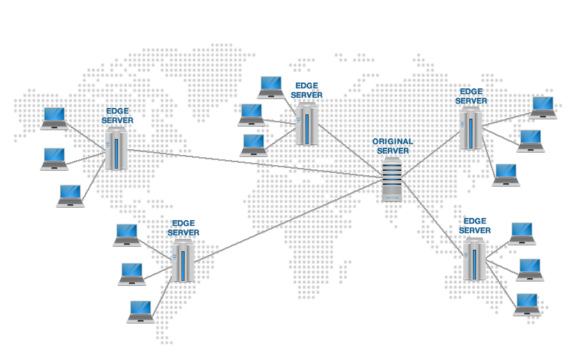
Content Delivery Networks .
When Server Farms and web proxies aren’t sufficient.
Creates a tree structure. Reduces load and latency
Reaching the closest node, 3 methods Web Proxies Mirroring DNS redirection Name server redirects to node

Slide 21
Content Delivery Networks - Redirection and Providers .
DNS redirection uses two factors - Geographical Distance - Capacity/Use
Benefits the ISP - Less upstream bandwidth
Providers Akamai - first major provider Google Amazon Many others

Slide 22
Peer-to-Peer Networks .
Primarily file sharing, using pooled individual resources.
No dedicated infrastructure.
No central point of distribution.
Surprising capabilities of storage and distribution
First major example, Napster.
Lack of organization makes efficient use difficult

Slide 23
Peer-to-Peer Networks - BitTorrent .
2001 Protocol that allows peers to share files quickly and easily.
Solves 3 Issues. Finding peers with the content. Replicating at high speeds. Encouraging Participation.
More efficient with popularity.
Uses a tracker to point to lead to peers

Slide 24
What Questions Do You Have For Us?
Take a minute to discuss your group question, let’s see our coding project now.

