Slide 1
TRANSMISSION CONTROL PROTOCOL
TEAM 7

Slide 2
What is TCP
Transmission Control Protocol, or TCP, is a set of rules used to govern how data is transmitted between devices on an interconnected network.
It was designed to be a reliable method of transferring data from point to point, even if the network itself isn’t deemed reliable.
TCP is designed to send data quickly enough to make use of the capacity of the network it’s on, but not to the point where it could cause congestion, and it is designed to time out an attempt to re-send any data that does not make it to the destination on the first attempt

Slide 3
The TCP Service Model
TCP is designed to be a point-to-point connection between two devices, a sender and a receiver and cannot be used for broadcasting or multicasting.
Both devices create a numbered endpoint called “sockets” which are used to send and receive data as needed.
Each socket contains the IP address of the device it’s hosted by, and a 16 bit number that’s local to that specific host called a “port.
Port numbers below 1024 are reserved for standard services started by privileged users, and are referred to as “well known ports”

Slide 4
Question #1
What happens to data that fails to send over a TCP connection?

Slide 5
The TCP Protocol
Each Byte contained in a TCP connection has its own 32-bit sequence number.
TCP sends and receives data segments in a format that consists of a twenty Byte header, followed by whatever data bytes are being sent.
Size limits of Segment sizes
No segment can exceed 65,515 Bytes, and this number includes the twenty byte header.
Each link has a Maximum Transfer Unit (MTU) and each segment needs to be able to fit in the MTU at both the sender and the receiver.

Slide 6
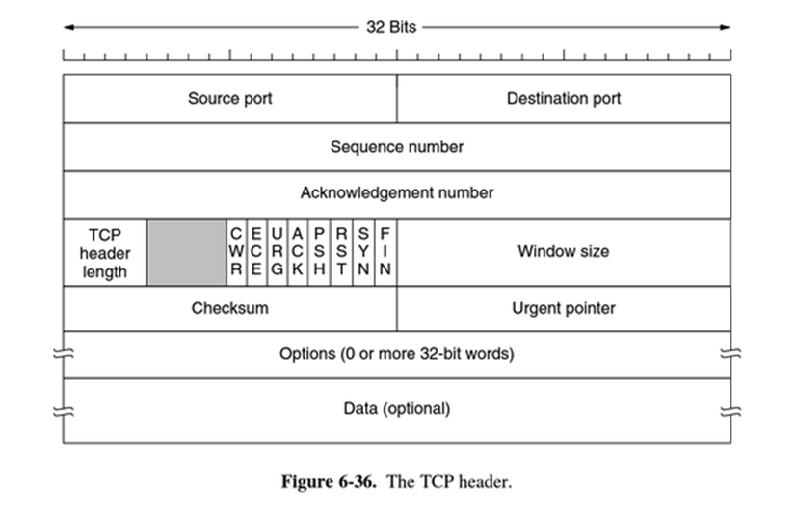
TCP Segment Headers
Each TCP segment begins with this 20 byte header
The Source and Destination Port fields identify the end-points of the connection, and help to identify the connection itself.
The Sequence number keeps track of the data sent by helping to identify each byte.
The Acknowledgement number Specifies the next Byte in the sequence
The TCP header length tells how many 32-bit works are in the TCP header

Slide 7
TCP Segment Headers (cont.)
The gray section is an unused 4 bit field.
The 8 smaller sections beginning with CWR and ending with FIN are 1 bit flags which each contain information regarding the connection such as troubleshooting steps.
The Window Size states how many bytes will be sent after it has been acknowledged.
Options provides a place to store data not covered by the other headers.
This video give a little more information about what each section does when transporting information.
https://www.youtube.com/watch?v=ADiuHeoT2GA

Slide 8
Question #2
What is the purpose of the source and destination ports in a TCP Segment Header?

Slide 9
The TCP Protocol
Each Byte contained in a TCP connection has its own 32-bit sequence number.
TCP sends and receives data segments in a format that consists of a twenty Byte header, followed by whatever data bytes are being sent.
Size limits of Segment sizes
No segment can exceed the IP Payload of 65,515 Bytes, and this number includes the twenty byte header.
Each link has a Maximum Transfer Unit (MTU) and each segment needs to be able to fit in the MTU at both the sender and the receiver.

Slide 10
TCP Connection Establishment
TCP connections are “duplex connections”, meaning that there are two data streams in every connections. Each stream moving in the opposite direction.
Connections are established using a “three-way handshake”
A reliable connection needs to be established before any data can be sent.
First, a “SYN segment” (synchronization segment), is sent from the sender (Host 1) of the information to the receiver (Host 2).
In return, the Host 2 replies to Host 1 with a “SYN + ACK” (synchronization and Acknowledgement) segment.
Finally, Host 1 returns an “ACK” segment to Host 2 to finalize the connection and data transfer can begin.

Slide 11
TCP Network Performance
TCP is not a perfect system and still has room to improve.
While being reliable, TCP doesn’t provide all of the transport semantics that all applications want, which leaves the applications themselves to resolve these issues for the time being.
TCP also can have issues with congestion control, as it does not manage high speed and high bandwidth connections well.

Slide 12
Question #3
What is the definition of a Dupex connections?

Slide 13
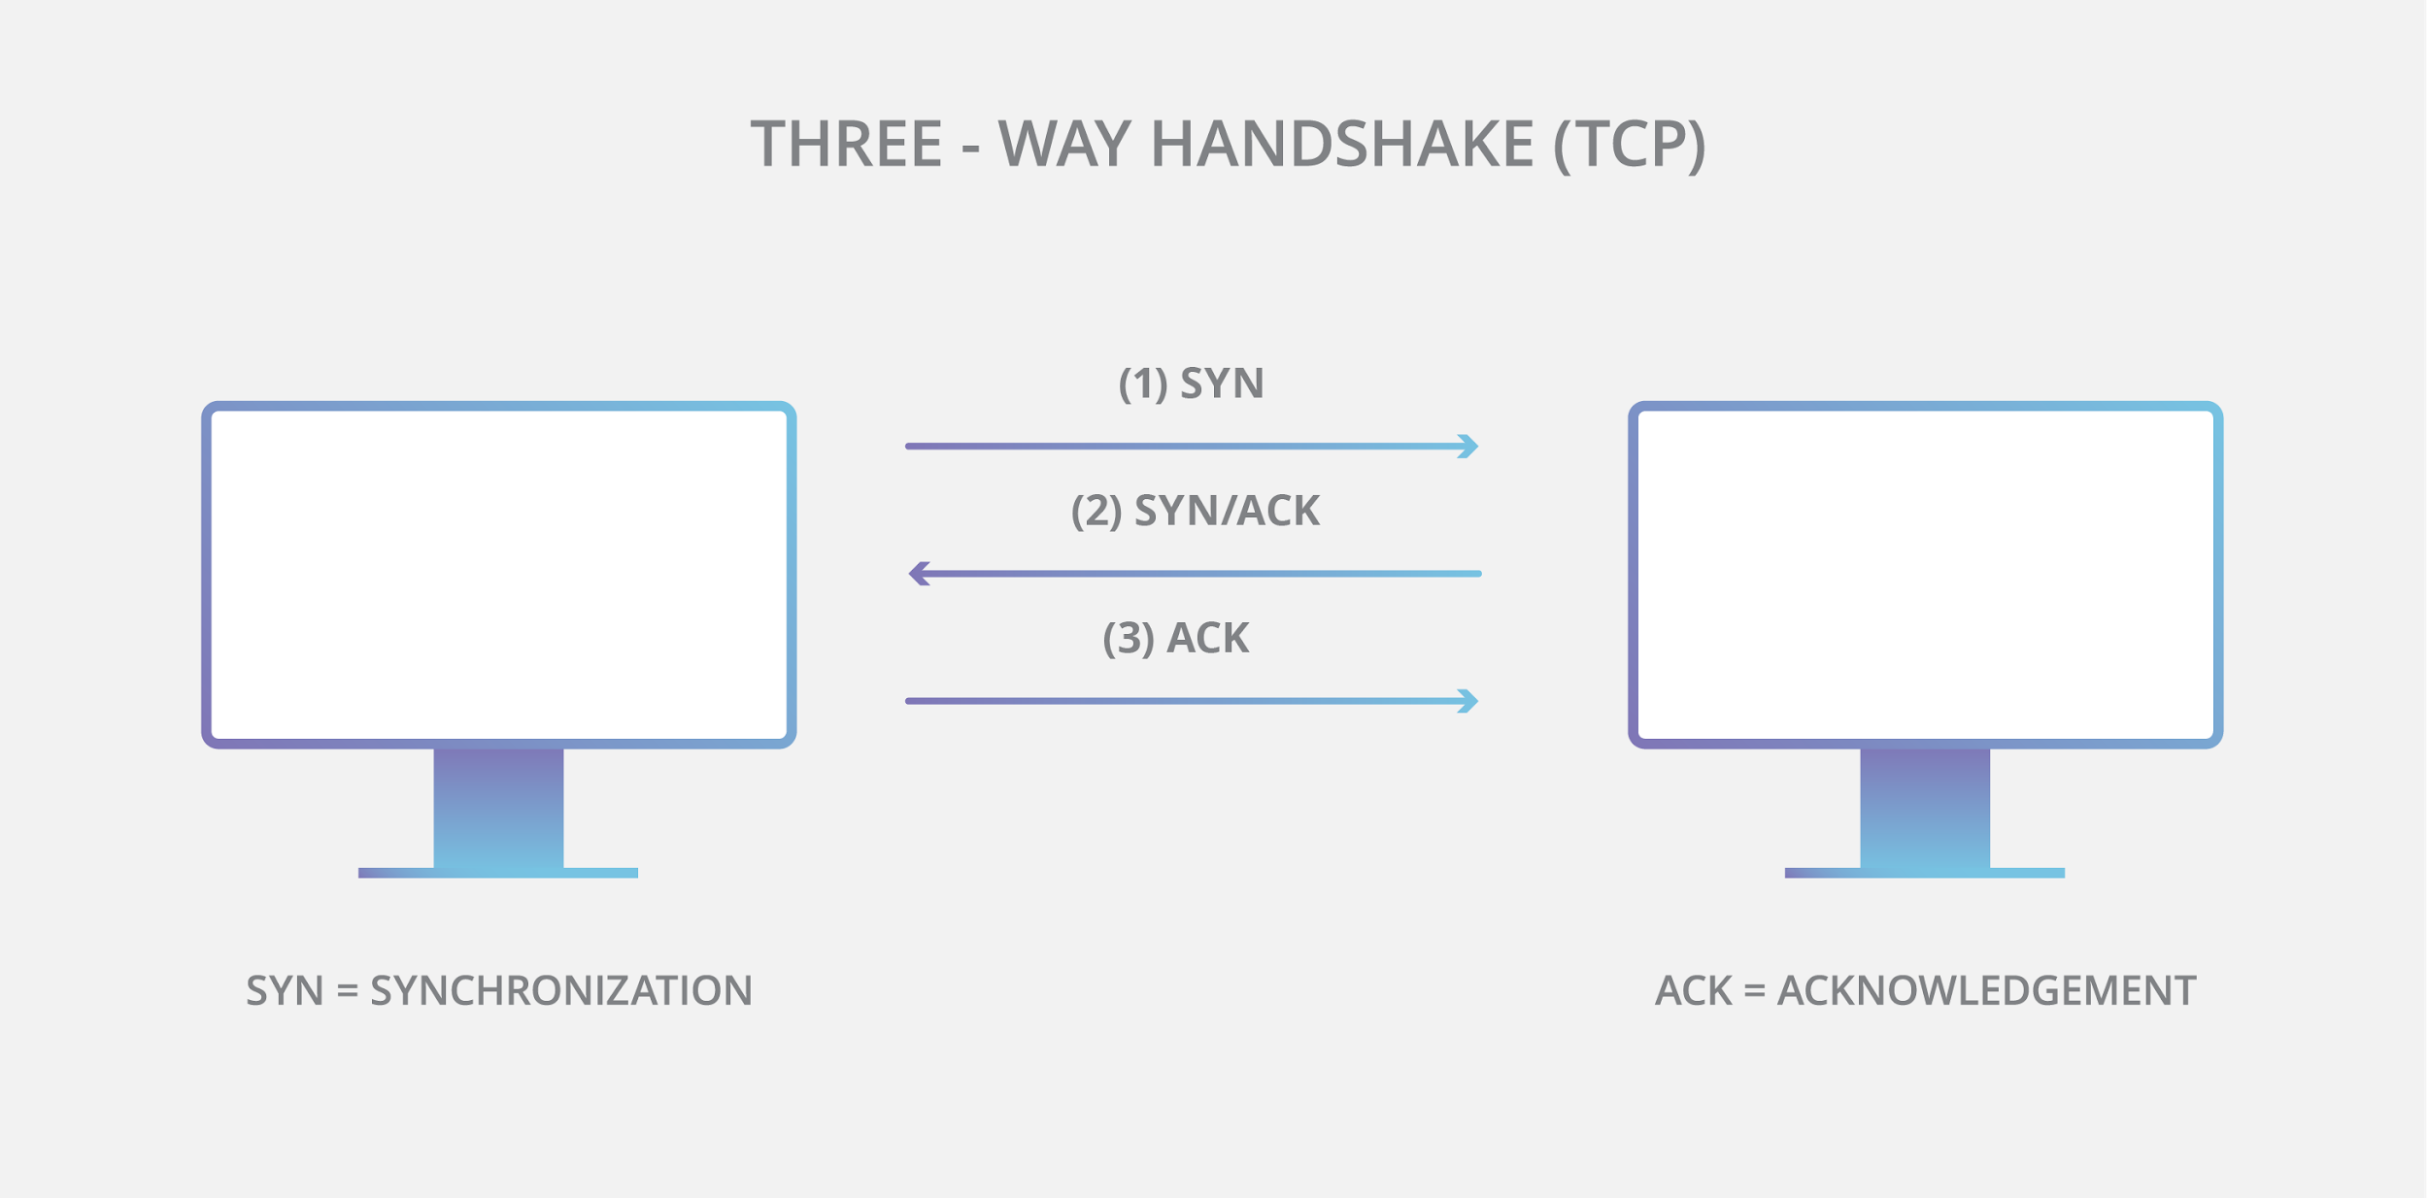
TCP Code
With our code we created a server and client to send data back and forth. We implemented a port number and IP address to make sure that the server and client made a connection with each other so that it doesn’t connect to a different computer or machine. The code that we made is basically a chatbox which deals with port numbers, IP addresses and three-way handshake.

Slide 14
Question 4
What is a three-way handshake?

