Slide 1
TCP, Performance and Delay

Slide 2
Introduction to TCP
Why was TCP designed?
Different networks, standards, computers and operating systems.
It was designed to provide a reliable ned-to-end byte stream over an unreliable internetwork.
TCP was formally defined in RFC 793 in September 1981.

Slide 3
Each machine supporting TCP has a TCP transport entity, either a library procedure, a user process, or most commonly part of kernel. In all cases, it manages TCP streams and interfaces to the IP layer.
It is up to TCP to send datagrams fast enough to make use of the capacity but not cause congestion, and to time out and retransmit any datagrams that are not delivered.
It is also up to TCP to reassemble datagrams that arrive in wrong order.
In short, TCP must furnish good performance with the reliability that most applications want and that IP does not provide.

Slide 4
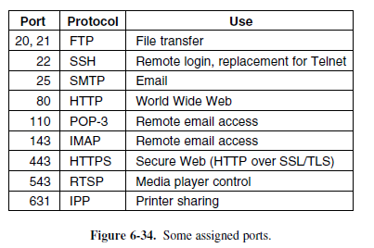
THE TCP SERVICE MODEL
TCP service is obtained by both the sender and receiver creating end points, called sockets.
Each socket has a socket number, consisting of the IP address of the host and a 16-bit number local to that host, called a port.
Port numbers below 1024 are reserved for standard services, started by privileged users. They are known as well-known ports.

Slide 5
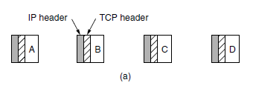
The TCP Service Model
All TCP connections are full duplex and point-to-point. TCP does not support multicasting or broadcasting.
A TCP connection is a byte stream, not a message stream. Message boundaries are not preserved end to end.
When an application passes data to TCP, TCP may send it immediately or buffer it, at its discretion. However, at times, data need to be immediately send right away, so to force data out, TCP has the notion of a PUSH flag that is carried on packets.
One feature of TCP service rarely in use, is urgent data.

Slide 6
The TCP Protocol
Each byte on the TCP connection has its on 32-bit sequence number.
The sending and receiving TCP entities exchange data in the form of segments which consists of a fixed 2-byte header followed by zero or more data bytes.
Two limits restrict the segment size
Each segment, including the TCP header, must fit in the 65,515 byte IP payload.
Each link has a Maximum Transfer Unit (MTU) and each segment must fit in the MTU at the sender and receiver. It defines the upper bound on segment size.
Modern TCP implementations perform in path MTU discovery.
The basic protocol used by TCP entities is the sliding window protocol.

Slide 7
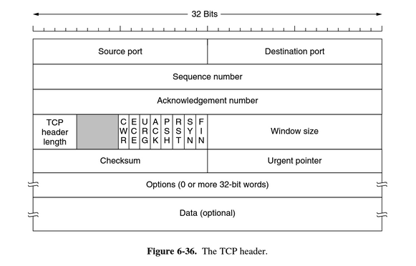
TCP Segment Header

Slide 8
TCP Segment Header
Every TCP segment begins with a fixed format 20 byte header
Source port and Destination port fields identify the local end points of the connection
TCP port plus it’s host IP forms a 48-bit unique endpoint
Source and destination endpoints identify the connection
5 tuple consists of:
protocol (TCP)
Source IP
Source Port
Destination IP
Destination Port

Slide 9
TCP Segment Header
Sequence Number - keeps track of data sent by identifying each byte
Acknowledgement Number - specifies the next in order byte
cumulative acknowledgement
TCP Header Length - tells how many 32-bit words are contained in the TCP header

Slide 10
TCP Segment Header
Unused 4-bit field
1-bit flags:
ECN
CWR
URG
ACK
SYN
PSH
RST
FIN

Slide 11
TCP Segment Header
Window size - tells how many bytes may be sent starting at the byte acknowledged
Checksum - checksums the header, the data, and a conceptual pseudoheader
Options - provides a way to add extra facilities not covered by the regular header
MSS
window scale
timestamp
PAWS
SACK

Slide 12
TCP Connection Establishment
Connections are full duplex
Connections are established using a three-way handshake.
Host 2 executes the LISTEN primitive
Host 1 executes the CONNECT Primitive:
Specifies IP address and port, maximum TCP segment size, and user data (optional).
Sends a TCP segment with SYN bit on and ACK bit off.

Slide 13
TCP Connection Establishment (Cont’d)
Segment arrives at the destination and checks for a process that has done LISTEN on destination port.
If a process is listening to the port, the process receives the TCP segment.
If it accepts the connection, an acknowledgement segment is sent back from Host 2 to Host 1.
Connection is established once Host 1 responds with an acknowledgement segment to Host 2.

Slide 14
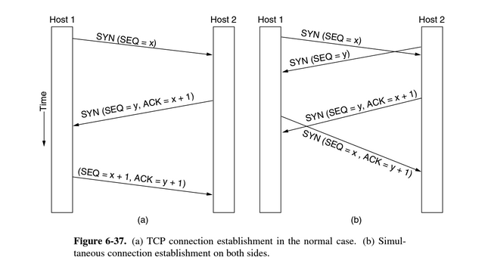

Slide 15
TCP Connection Establishment (Cont’d)
The listening process must remember its sequence number as soon as it responds with its own SYN segment.
SYN Flood - where a sender ties up resources on a host by sending a stream of SYN segments and never completing the connection
SYN cookies - cryptographically generated sequence number that a host sends on an an outgoing segment. The host then forgets the sequence number which is returned only if the three-way handshake completes

Slide 16
TCP Connection Release
Host 1 sends a TCP segment with FIN bit set
Host 2 acknowledges and that direction is shut down for new data (Host 1 to Host 2)
Data can still travel in the other direction
Connection is released once both directions are shut down

Slide 17
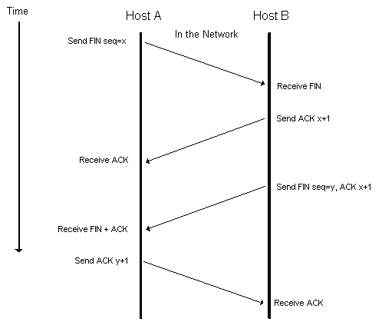

Slide 18
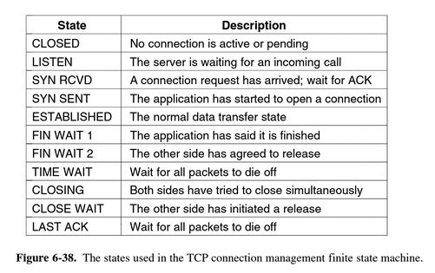
TCP Connection Management Modeling

Slide 19
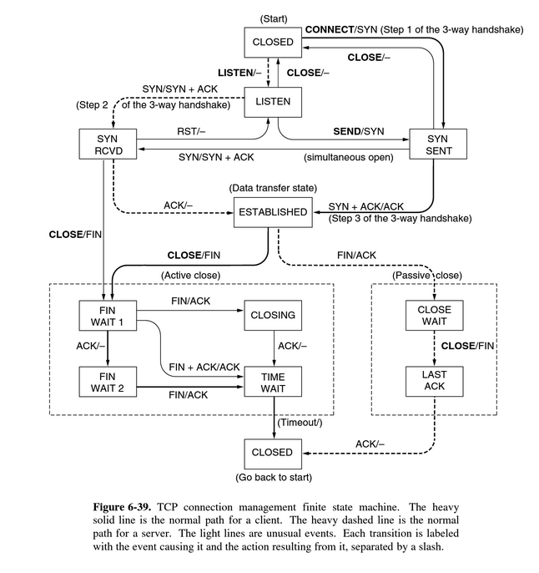

Slide 20
Sliding Windows
TCP decouples the issues of acknowledgment of the correct receipt of segments and the receiver buffer allocation
To prevent deadlock when a window updates, TCP uses a window probe
A window probe could also be used for:
Urgent data may be sent
Sender sends 1-byte segment to force the receiver to re-announce the next byte and window size

Slide 21
TCP Optimizations
Delayed Acknowledgments
It delays acknowledgments and windows updates for up to 500 milliseconds
Nagle’s Algorithm
When data comes in small pieces, just send the first piece and buffer the rest
When the acknowledgment comes in for the first piece, send the rest in one big segment

Slide 22
Silly TCP Problem
A problem that could degrade TCP performance is called Silly Window Syndrome
This happens when you send data in large blocks but the receiver’s application only reads the data 1 byte at a time
To fix this the receiver can’t send a window update until it can handle the large block

Slide 23
Cumulative Acknowledgement
When data comes in out of order it could cause the sender to retransmit unwanted segments
To help stop this the receiver could use Cumulative Acknowledgement
The receiver acknowledges all the segments up until the missing segments and buffers all the rest after it
When the sender times out, it retransmits the missing segment
Then the receiver acknowledges the retransmitted segment along with the ones in the buffer

Slide 24
EWMA (Exponentially Weighted Moving Average)
It uses the following formula
SRTT = α SRTT + (1- α) R
SRTT (Smoothed Round-Trip Time) measures how long it takes to send a segment and receive an acknowledgement
It would use this to update the timer after every round trip
But this formula doesn’t work well during periods of high load

Slide 25
RTTVAR (Round-Trip Time VARiation)
To fix this problem it was decided to keep track of the variance in round-trip time along with smoothed round-trip time
They used this new formula to find the new variable
RTTVAR = β RTTVAR + (1 – β) |SRTT – R|
The new EWMA is this
RTO = SRTT + 4 x RTTVAR

Slide 26
Karn’s Algorithm
When a segment is timed out and retransmitted, how do you know the next acknowledgement is for the segment or the retransmitted one
To fix this it was decided not to update the estimate of any retransmitted segments
They would also double the timeout every time a segment is retransmitted until it finally gets through

Slide 27
Timers
RTO (Retransmission TimeOut)
When a segment is sent out a timer is started and If they sender gets a acknowledgement, the timer is stopped
But if the timer expires before an acknowledgement is received, the segment is sent again
Persistence Timer
Made to prevent deadlock
Receiver sends an acknowledgement to the sender saying to wait
Receiver sends an update but it is lost
Once this timer expires the sender sends a probe asking if it can send or not
Keepalive Timer
When a connection has been idle for a long time this timer goes off
One side sends a message asking if the other side is still there
If no response is received, the connection is terminated

Slide 28
Congestion Control
It uses AIMD (Additive Increase Multiplicative Decrease)
It uses a congestion window whose size is the number of bytes the sender may have in the network
It was added to TCP because of congestion collapse during the early years of the Internet
It was a prolonged period when goodput was more than 100%

Slide 29
Slow Start
It is an algorithm to help the AIMD rule reach a good operating point faster on a fast network
The sender starts with a small window and every time it receives an acknowledgement before the retransmission timer goes off, it adds one to the window
So it isn’t really a slow start, it grows exponentially
To keep it under control it has a threshold
When packet loss is detected the threshold is set to half of the window

Slide 30
Duplicate ACKs & Fast Retransmission
One problem with this scheme is waiting for the timer to expired
It could be a long time before the sender could retransmit the packet
To fix this the receiver sends a Duplicate Acknowledgement
This tells the senders that one of the packets is lost
Now the sender can send a Fast Retransmission before the timer expires
This is called TCP Tahoe

Slide 31
Fast Recovery & Sawtooth
When a Duplicate Acknowledgements arrives, it activates Fast Recovery
It maintains the ACK clock with the window that is the new threshold or the window at the time of Fast Retransmissions
This helps TCP avoid a slow start by using a Sawtooth pattern
Additive Increase and Multiplicative Decrease
We have finally reach an AIMD rule
It is called TCP Reno

Slide 32
Two Recent Changes
SACK (Selective ACKnowledgements) can list up to three ranges of bytes that the receiver has received
This helps the sender better keep track of what packets have been lost or not
TCP can also now use ECN (Explicit Congestion Notification) as an congestion signal
This signal is better than packet loss since no harm comes to any packet to signal congestion

Slide 33
Future of TCP: Ever Evolving Workhorse
TCP does not provide the transport semantics that all applications want - application must handle the burden of resolving problems not solved via TCP
Congestion control - currently packet losses are the signal of Congestion, this model does not hold up well on high speed and high bandwidth networks, where other sources of loss (such as packet transmission error) can be the primary limitation of throughput

Slide 34
Performance Issues
Interconnected, Complex Interactions yields unforeseen consequences, this complexity yields poor performance
Network Performance more art than science
Application performance relies on combined performance of the transport, network and link layers

Slide 35
Performance Problems in Computer Networks
Structural Resource Imbalance: Gigabit Ethernet connected to 1982 Commodore 64
Synchronously Triggered Overload:
Broadcast Storm - a message broadcast across a network or segment results an increasing amount of responses, blocking or delaying legitimate packets (UDP and Wireless Networks)
Electrical Outage - machines reboot on network and overwhelm DHCP and File Servers
System Tuning:
Machine has sufficient resources, but not enough buffer space has been reserved (Virtual Machines)
Timeouts - set too short and have unnecessary retransmissions, too long and delays occur after loss

Slide 36
Network Performance Measurement
Ensure Sample Size is Large: a large sample reduces the uncertainty in the measured mean and standard deviation
Representative Samples: different locations and times have effect on network quality
Caching can wreak havoc with measurements: data cached and buffered in the network may effect automated performance tests
The Unexpected: tests are best run on an del network to provide a baseline. Video Conferences, Automated Services (backups and Virus Scans), or heavy web traffic can occur during your testing and skew results
Coarse-Grained Clock: not always as accurate with precision with which time is returned when they are read
Extrapolating the Results: performance may not scale linearly

Slide 37
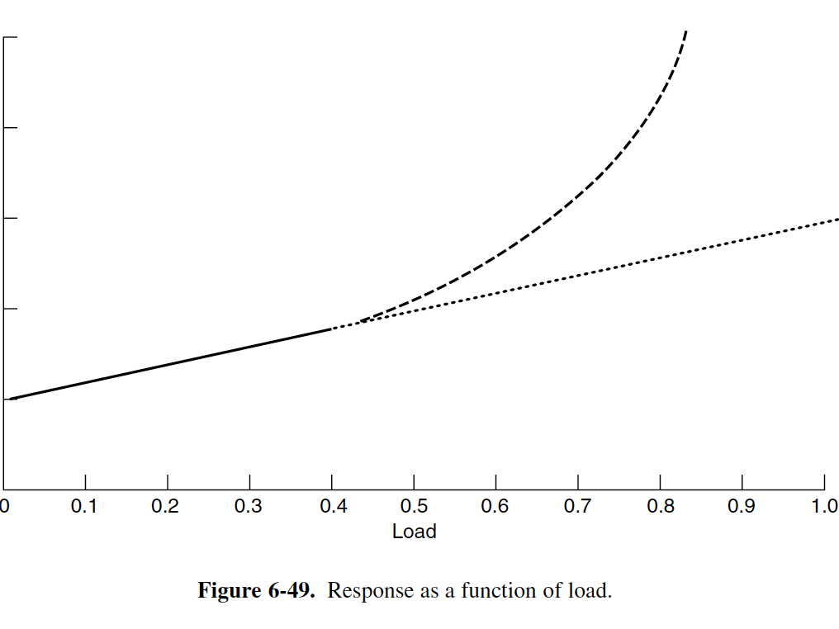

Slide 38
Host Design for Fast Networks
Hosts are often the source of performance bottlenecks
NICs and routers have to be engineered to run at “wire speed”, that is process packets as quickly as they arrive on the link
The relevant performance measurement is that which applications obtain, it is not link capacity, but throughput and delay after network and transport processing

Slide 39
General Guidelines for Software Implementation of Network Protocols on Hosts
Host speed is more important than Network Speed: operating system and protocol overhead dominate
Reduce Packet Count to reduce Overhead: poor at multitasking, send packets are as large as will pass along the network without fragmentation
Minimize Data Touching: instead of each layer coping that data, combine the processing of several layers together

Slide 40
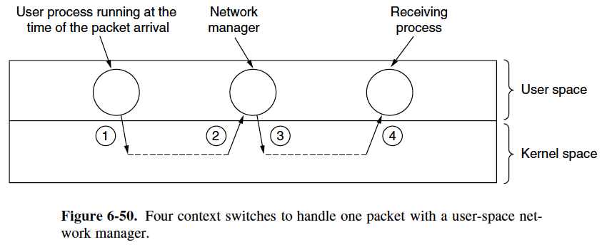
Minimize Context Switches: Switching from User Mode to Kernel Mode slows down processing
Avoid Timeouts: set timers conservatively to not waste resources
Avoiding Congestion is Better than Recovering from It

Slide 41
Fast Segment Processing
Two Components
Overhead per segment
Overhead per byte
The key is to separate out the normal, successful case (one-way data transfer) and handle it specially
Aim to minimize processing time when everything goes right. Minimizing processing time when an error occurs is secondary.

Slide 42
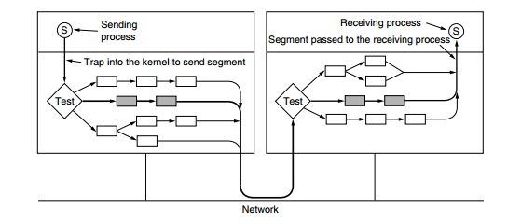
sending process traps into the kernel to do the SEND
The first thing the transport entity does is test to see if this is the normal case
neither side is trying to close the connection, a regular full segment is being sent, and enough window space is available at the receiver
If all conditions are met, no further tests are needed and the fast path through the sending transport entity can be taken

Slide 43
Header Compression
Now consider performance on wireless and other networks in which bandwidth is limited
Reducing software overhead can help mobile computers run more efficiently, but it does nothing to improve performance when the network links are the bottleneck.
Header compression is used to reduce the bandwidth taken over links by higher-layer protocol headers
Obtains large gains by using knowledge of the protocol format

Slide 44
Protocols for Long Fat Networks
Long fat networks got their name because of their combination of being a fast network with long delays.
When these networks arose, peoples first reaction was to use the existing protocols on them, but problems arouse.

Slide 45
Problems for Lf Network protocols
Long fat networks have problems:
The first is that many protocols use 32- bit sequence numbers.
The second problem is that the size of the flow control window must be greatly increased.
The third and related problem is that simple retransmission schemes, such as the go-back-n protocol, perform poorly on lines with a large bandwidth-delay product.
The forth problem is that gigabit lines are fundamentally different from megabit-lines in that long gigabit lines are delay limited rather than bandwidth limited.
The fifth problem is that communication speeds have improved faster than computing speeds.

Slide 46
Dealing with these problems
The basis principle that all high-speed network designers should learn:
Design for speed, not for bandwidth optimization
A tempting way to go fast is to build fast network interfaces in hardware.
The best approach is to make the protocols simple and have the main CPU do the work.
Packet layout is an important consideration in gigabit networks.
The maximum data size should be large, to reduce software overhead and permit efficient operation.
Feedback should be avoided: it takes to long for the receiver to signal the sender.

Slide 47
Delay- Tolerant Networking
Uses a method called message switching, which uses nodes to store information for forwarding later when a working link can be established.
Examples of use:
Submarines, buses, mobile phones, which all have intermittent connectivity due to their mobility or extreme conditions

Slide 48
DTN History
Work on DTNs started in 2002 when IEFT set up a research group.
DTN was inspired by the efforts to send packets in space.
Space networks deal with intermittent communication and very long delays.
Kevin Fall observed that the ideas for these Interplanetary Internets could be applied to networks on earth, where intermittent communication was the norm.

Slide 49
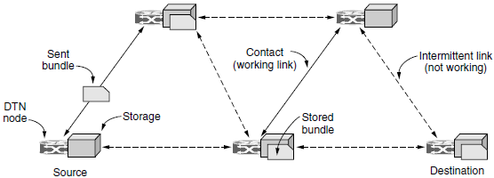
DTN Architecture
DTN tries to relax the assumption that an end-to-end path between the source and destination exist for the entire duration of a session.
When this is not the case, normal internet protocols fail.
DTN gets around this lack of ETE connectivity using an architecture that is based on message switching.
Delay-tolerant networking architecture

Slide 50
Differences Between Routers and DTN
In routers queuing occurs for milliseconds to seconds.
DTN could store bundles for hours.
A node in a DTN architecture may move, while they hold the stored data, this process is know as: Store-carry forward.
Routers and the Internet are not allowed to move.

Slide 51
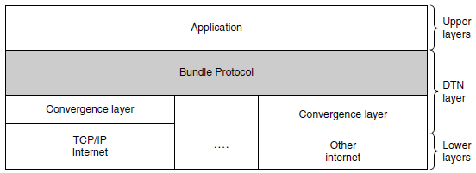
The Bundle Protocol
The bundle protocol is responsible for accepting messages from the application and sending them as one or more bundles via store-carry forward to the destination DTN node.
This runs above the level of TCP/IP
This raises the issue of whether the bundle protocol is a transport layer protocol or an application layer protocol.
Delay-tolerant networking protocol stack

Slide 52
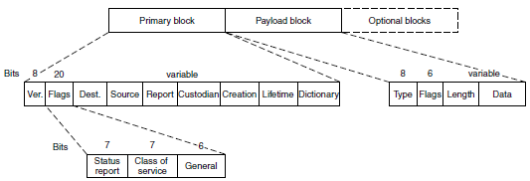
The Bundle Protocol Cont.
Each message consists of:
Primary block which can be thought of as the header.
A payload block, for the data.
Optionally other blocks, for the carrying of other things, such as security parameters.
The format of Bundle protocol message

