Slide 1
Congestion Control, Internet Transport Protocols: UDP

Slide 2
Congestion Control
Congestion occurs when a machine sends too many packets into the network too quickly
This can lead to the performance beginning to degrade as the packets are delayed and lost.
Congestion is ultimately cause by traffic sent into the network by the transport layer.
The most effective way to control congestion is to for the transport protocols to send packets into the network more slowly.

Slide 3
Desirable Bandwidth Allocation
This is used to regulate traffic. The goal of this is to simply avoid congestion as much as possible.
The purpose is to find aa good allocation of bandwidth to the transport entities that are using the network.
A good allocation will deliver good performance because it uses all the available bandwidth but avoids congestion.
This will create fair competing transport entities and quick track changes in traffic demands.

Slide 4
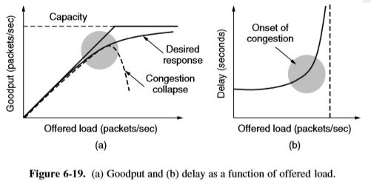

Slide 5
What is used to regulate traffic?

Slide 6
Power = load/delay cont. Kyle
In 1979, Kleinrock proposed the metric of power, where power will initially rise with offered load, as delay remains small and roughly constant, but will reach a max. And fall as delay grows rapidly.
The load with the highest power represents an efficient load for the transport entity to place on the network.
The delay cannot go to infinity, except in a model with routers have infinite buffers. Instead, packets will be lost after experiencing the maximum buffering delay.

Slide 7
Max/Min Fairness and Convergence cont. Kyle
The form of fairness that is often desired for network usage is max-min fairness. Meaning, increasing bandwidth of a flow will make the situation worse for flows that are less well off.
Congestion control algorithm converge quickly to a fair and efficient allocation of bandwidth. A good congestion control algorithm should rapidly converge to the ideal operating point.
Convergence is too slow, the algorithm will never be close to changing operating point. Algorithm is not stable, it may fail to converge to the right point, or even oscillate around the right point.

Slide 8
Question?
What does the congestion control algorithm do?
Congestion control algorithm converge quickly to a fair and efficient allocation of bandwidth.

Slide 9
Regulating the Sending Rate
Two Factors can limit the sending rate: flow control and congestion
Flow control: the buffers at the receiving end are not sufficient for the amount of data being delivered.
Congestion: the network does not have enough capacity for the data being transmitted across it
The transport layer deals with these problems in different ways depending of the feedback it receives from the network

Slide 10
Regulating the Sending Rate
There are two types of feedback implicit and explicit and they can be either precise or imprecise
ECN(Explicit Congestion Notification): in this design the router sets flag bits on packets to tell the sender to slow down but not how much (explicit,imprecise)
TCP with drop-tail: the systems infers packet loss and then signals the network is congested
There are a number of other systems for congestion control these are collectively known as control laws.

Slide 11
Regulating the Sending Rate
The control law used by TCP is AIMD
AIMD( Additive Increase Multiplicative Decrease): this basis of this design is that the sending rate is increased slowly(additive) and when congestion is detected it is decrease quickly(multiplicative)

Slide 12
Wireless Issues
Most control laws including AIMD use packet loss as a signal for congestion however on a wireless network packet loss is very high due to transmission error.
The solution to this problem involves masking the the transmission errors and sending them
Retransmission occurs on a scale of microseconds while the loss timers are on a scale of milliseconds, this difference in time allows for retransmission to fix transmission errors before they register as a congestion problem.

Slide 13
Question?
What two factors are to be considered when addressing sending rates?

Slide 14
UDP (User Datagram Protocol)
UDP is the connectionless protocol of the transport layer consisting of an 8-byte header followed by the payload.
Compared to the connected protocol, TCP (Transmission Control Protocol) UDP is fast and unreliable.
Compared to raw IP, UDP provides source and destination ports
The ports are used to denote source and destination. This is useful when a reply must be sent back to the source
Kevin Metz

Slide 15
UDP (cont.)
UDP does not do flow control, congestion control, or retransmission upon receipt of a bad segment
UDP supports applications that need to have precise control over the packet flow, error control, or timing, and broadcasting to multiple hosts
Some examples of appropriate applications for UDP include email, stock and weather updates, and user login
Kevin Metz

Slide 16
Question?
TCP and UDP are protocols used in what data of protocols?
Transport Layer

Slide 17
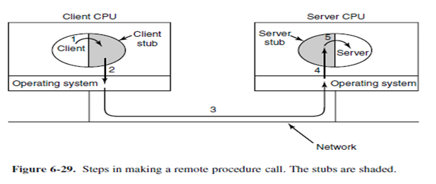
Remote Procedure Control (RPC)
The basis for many networking applications
It allows a computer program to execute procedures in a different address space. (Ex: a different computer on a network).
This allows actions to occur at Runtime letting the programmer write the same code whether the procedure local or remote to the executing program
Notes:
How RPC Works:
Client calls Stub
Client Stub packages parameters into a message, system calls to send them
OS sends packets from Client to Server
Server OS passes the packets to the Server Stub
Server Stub unpacks message
Server Stub calls unpacked procedure
Server reply is carried out in the same way in reverse order

Slide 18
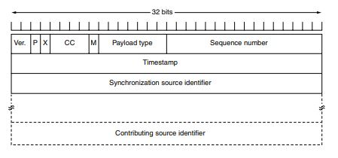
Real-Time Transport Protocol (RTP)
RTP is meant to multiplex several real time data streams onto a single stream of UDP packets.
Each packet sent in an RPT stream is given a number one higher than its predecessor and allows the destination to see if any packets are missing. The header consists of 3 32 bit words sometimes with extensions The first word is the version field, the P Indicates that the packet has been padded To a multiple of 4 bytes. The x Indicates a Extension header is present. CC tells how Many contributing sources are present (1-15) M bit is application specific, Sequence num is A counter that increments on each rtp packet Timestamp can help reduce timing variability SSI tells which stream the packet belongs to CSI are used when mixers are present

Slide 19
Playout with Buffering and Jitter Control
Packets reach the receiver at different times, the variation is called jitter. This will make video jerky at times.
You solve this by introducing buffering; in which you delay the packets at the receiver to reduce the amount of jitter.
Applications can measure the jitter and find a good playback point by looking at the differnece between the RTP Timestamps and the arrival time

Slide 20
Playout cont.

Slide 21
Question
Why is a buffer necessary?
To prevent jitter

