Slide 1
Congestion Control, Internet transport protocols: udp

Slide 2
Congestion control
Congestion occurs when machines send too many packets to a network too quickly from the transport layer.
Performance will become degraded as packets are dropped and lost.
The only effective way to control congestion is for the transport protocols to send packets into the network more slowly.
How can we regulate traffic? Bandwidth allocation.

Slide 3
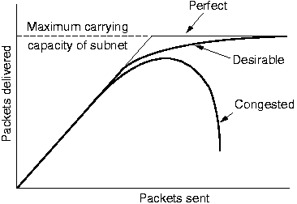

Slide 4
Power = load / delay
In 1979, Kleinrock proposed a metric of power in which the load with the highest power represents an efficient load for the transport entity to place on the network.
IP routers often have connections competing for the same bandwidth.
Congestion control mechanisms assist in allocation.

Slide 5
Max/min fairness and convergence
Resources are allocated in order of increasing demand
No source gets a resource share larger than its demand
Source with unsatisfied demands get an equal share of the resources
Congestion control algorithm must converge quickly to a fair and efficient allocation of bandwidth through different types of networks.

Slide 6
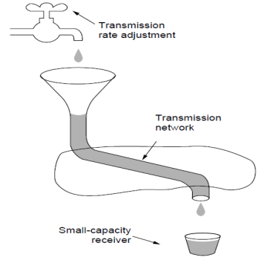
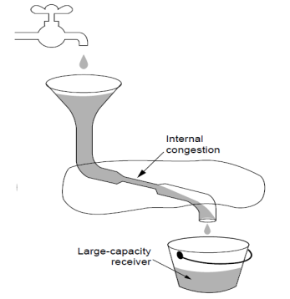
Regulating the Sending Rate
Sending rate is limited by two factors
Flow Control (insufficient buffering at the receiver)
Congestion (insufficient capacity in the network)

Slide 7
Regulating the Sending Rate
The transport protocol regulates the sending rate based on feedback from the network
Feedback can be:
Explicit, precise would be when routers tell the sources the rate at which they may send
An example of explicit, imprecise would be ECN(Explicit Congestion Notification)

Slide 8
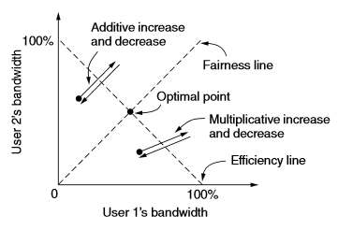
AIMD
Additive Increase Multiplicative Decrease
Congestive control law to arrive at the efficient and fair operating point

Slide 9
Wireless Issues
Transport protocols such as TCP that implement congestion control should be independent of the underlying network and link layer technologies.
Good theory, but in practice there are issues with wireless networks.
Main issue is that packet loss is often used as a congestion signal. Wireless networks lose packets all the time due to transmission errors.

Slide 10
Wireless Issues
With the AIMD control law, high throughput requires very small levels of packet loss.
Analyses by Padhye et al. (1998) show that the throughout goes up as the inverse square-root of the packet loss rate.
What this means in practice is that the loss rate for fast TCP connections is very small; 1% is a moderate loss rate, and by the time the loss rate reaches 10% the connection has effectively stopped working.
However, for wireless networks such as 802.11 LANs, frame loss rates of at least 10% are common. This difference means that, absent protective measures, congestion control schemes that use packet loss as a signal will unnecessarily throttle connections that run over wireless links to very low rates.

Slide 11
Wireless Issues
To function well, the only packet losses that the congestion control algorithm should observe are losses due to insufficient bandwidth, not losses due to transmission errors.
One solution to this problem is to mask the wireless losses by using retransmissions over the wireless link.
For example, 802.11 uses a stop-and-wait protocol to deliver each frame, retrying transmissions multiple times if need be before reporting a packet loss to a higher layer.

Slide 12
Wireless Issues
Another issue with congestion control over wireless links is variable capacity. That is, the capacity of a wireless link changes over time, sometimes abruptly, as nodes move and the signal-to-noise ratio varies with the changing channel conditions. This is unlike wired links whose capacity is fixed.
One solution: don’t worry about it!
No need to worry because congestion control algorithms must already handle the case of new users entering the network or existing users changing their sending rates.

Slide 13
UDP (User Datagram Protocol)
Connectionless transport layer protocol
It provides a way for applications to send encapsulated packets without an established connection.
Each segment sent by UDP consists of 4 parts.
Source
Destination
Length
Checksum
Segments are sent without previous connection attempts and missing segments are not re-sent.

Slide 14
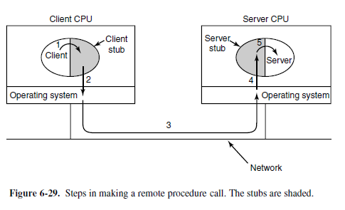
Remote Procedure Call (RPC)
The basis for many networking applications
Allows a computer program to execute procedures in a different address space, such as another computer on a network
All of the actions occur at Runtime and thus, the programmer can write the same code whether the procedure is local to the executing program or remote.

Slide 15
How RPC Works
Client calls the Stub
Client Stub packages into a message, system calls to send
OS sends packets from Client to Server
Server OS passes the packets to the Server Stub
Server Stub unpacks the message
Server Stub calls the unpacked procedure
Server reply is carried out in the same way in reverse
order

Slide 16
RPC Disadvantages
Remote calls can fail due to unpredictable network issues
Callers have to deal with these failures without knowing if the remote procedure was actually invoked or not

Slide 17
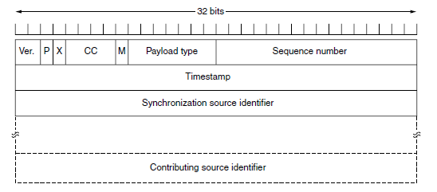
Real-time Transport Protocol (RTP)
Transport-layer protocol that is designed for end-to-end transfer of streaming media. (Skype, Discord, Twitch, Google Hangouts, etc.)
Provides facilities for jitter compensation and detection of out of sequence arrivals of data.
Multiplexes multiple data streams onto a single stream of UDP packets
Multicast, sends to a group of hosts on a network

Slide 18
RTP Continued
RTP placement in protocol stack (Built into OS) Payload nesting within packets

Slide 19
Real-Time Transport Control Protocol (RTCP)
Sister protocol of RTP
RTCP does not send data itself, it only facilitates with the delivery of audio and video data within RTP
Serves to provide useful feedback on the data delivered
Quality of service: packet counts, delay, packet loss, etc.

Slide 20
The end

