Slide 1
Congestion Control: UDP

Slide 2
What is Congestion Control?
Refers to the management of packet loss and signal degradation
Handled by both Network and Transport layers
Provide efficiency and power to bandwidth
Allocates resources based on usage

Slide 3
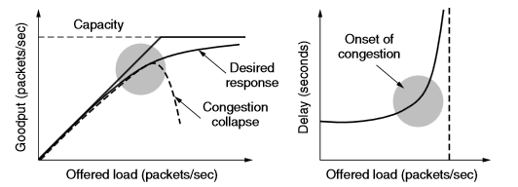
Elements of Congestion Control
Efficiency and Power
Power = Load/Delay
Max-Min Fairness
Convergence

Slide 4
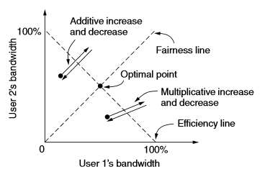
AIMD (Additive Increase Multiplicative Decrease)
Congestive control law for appropriate operation
Balance between fairness and efficiency

Slide 5
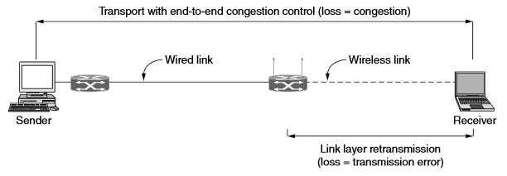
Congestion and Wireless
Higher loss rate than wired connections
leads to unnecessary throttling
Goal: Bridge gap between packet loss and bandwidth errors

Slide 7
UDP (User Datagram Protocol)
Transport layer protocol
Connectionless
Provides means for sending encapsulated packets without an established connection

Slide 8
UDP Structure
Each segment sent by UDP consists of 4 parts
Source
Destination
Length
Checksum
Segments are sent without previous connection attempts.
Missing segments are not re-sent

Slide 9
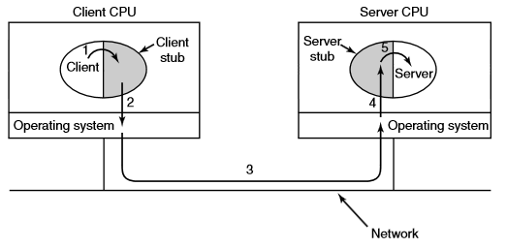
Remote Procedure Call (RPC)
Allows execution on different address spaces from a source
Request-Response Execution
Used as basis for many network applications

Slide 10
RPC Drawbacks
Pointers are always required
Data type ID’s are sometimes lost
Global variables are lost due to procedure operating on non-source machines

Slide 11
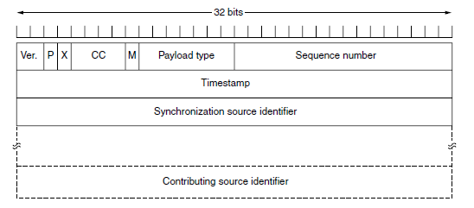
Real-Time Transport Protocol (RTP)
Multiplex real-time data streams onto single stream of UDP packets
Packets are not specially treated and have no guarantees about delivery
RTP header consists of three 32-bit words and potentially some extensions
Notes:
P = bit, indicates that the packet has been padded to a multiple of 4 bytes with the last padding byte telling us how many bytes were added. The X bit indicates whether an extension header is present. The CC field tells how many contributing sources are present (0-15). M is an application specific marker bit. The payload field tells us how the informations is encoded. Timestamp helps reduce timing variability also known as jitter.

Slide 12
RTP placement in the protocol stack (left)
Method of payload nesting within packets (right)

Slide 13
Real Time Transport Control Protocol
Handles feedback, synchronization, and the UI
Assesses network to adapt quality for the best performance
Means of controlling data output through the network

Slide 14
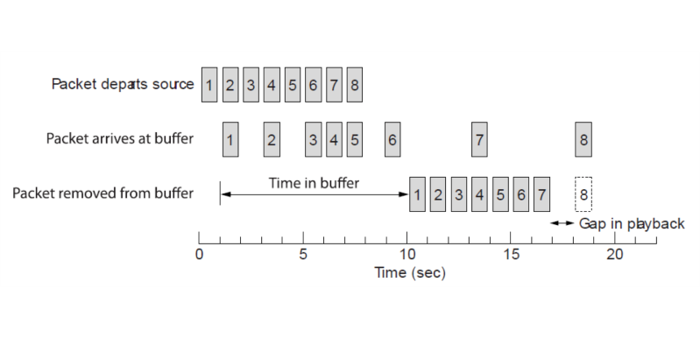
Playout with Buffering and Jitter Control
Jitter is the difference in relative delivery times among sent packets
Buffer stores packets for a given time period
Buffer then sends packets to receiver with a brief pause at the start to cover jitter
Packets that don’t reach the buffer on time are dropped

Slide 15
Implementation

Slide 16
Questions?

