Slide 1
Traffic Throttling
In networks, senders adjust their transmissions to send as much traffic as the network can readily deliver
This aims to operate just before there is congestion
When congestion occurs, it tells the senders to throttle back their transmissions and slow down
Congestion avoidance: used to contrast this operating point with the congested network
The queueing delay inside routers directly captures any congestion from the packets

Slide 2
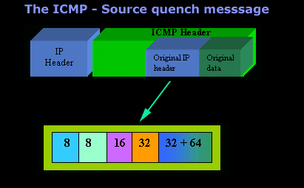
Choke Packets
Way to notify a sender of congestion directly
The router selects a congested packet and sends a choke packet back to the source host, destination found in the packet
To avoid increasing load on the network, the router may only send choke packets a low rate
Example of choke packet in early internet: SOURCE-QUENCH message

Slide 3
Explicit Congestion Notification (ECN)
Modern alternative to SOURCE-QUENCH message
It is a refinement of early congestion signaling protocols, notable the binary feedback scheme of Ramakrishnan and Jain in 1988
Two bits in the IP packet header are used to record whether the packet has experienced congestion
The packets are unmarked when they are sent
If any of the routers they pass through are congested, the packet is marked and the destination will echo any marks back to the sender

Slide 4
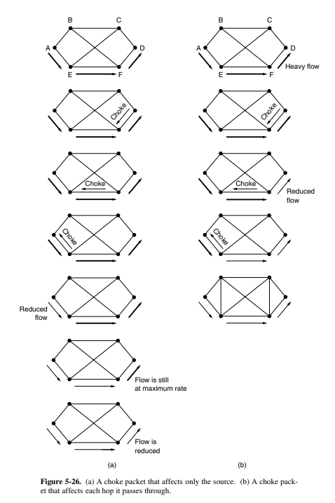
Hop-by-Hop Backpressure
This method is a faster way to signal congestion
It has the choke packet take effect at every hop it passes through
As soon as the choke packet reaches one destination, it is required to reduce the flow, giving immediate relief to the congestion

Slide 5
Load Shedding
When routers are being overwhelmed by packets that they cannot handle, and they throw them away
Example: utilities intentionally blacking out certain areas to save an entire grid from collapsing
Deciding which packets to drop can be situational, depending on the type of application
There are two main policies
Old is better than new - wine
New is better than old - milk
Most people would rather drink new milk and old wine rather than the alternative

Slide 6
Random Early Detection (RED)
Dealing with congestion when it first starts is more effective than letting it pile up
A way to help with congestion is having routers drop packets early before the situation becomes hopeless
RED (Random Early Detection): to determine when to start discarding, routers maintain a running average of their queue lengths, when the length exceeds a threshold, the link is labeled as congested and a fraction of the packets are dropped at random
Even though Explicit Congestion Notification (ECN) is the preferred method if available, RED works in the same manner except it losses the packets instead of sending a notification

Slide 7
What is the preferred method of congestion control when it’s available?

