Slide 1
Congestion Control, Quality of Service, and Internetworking

Slide 2
Congestion Control - Network Provisioning
Networks have a lot of traffic so there must be a controller that controls the congestion
Take preventative action in case of emergencies or failures
Spare router
Purchasing more bandwidth
Mostly used as a backup
Not necessary in immediate emergencies

Slide 3
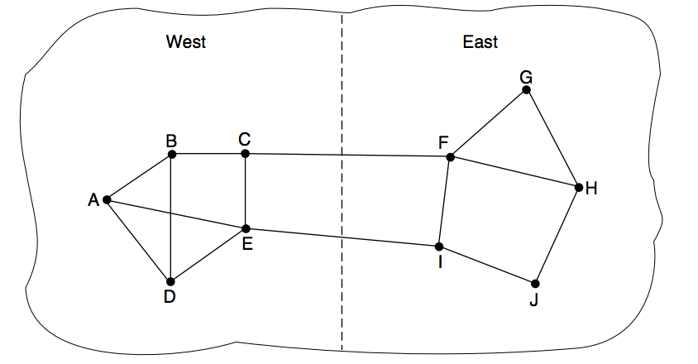
Congestion Control - Traffic Aware Routing
Force the traffic to go in a specific route
Main goal is to shift the traffic away from the “hotspot”
Example: radio station
Use helicopters to scan the area in a city to determine the amount of traffic on the roads and send messages through the radio to tell drivers which locations to avoid
It is also helpful to split traffic into multiple paths
Figure: If route CF has too much traffic, then traffic is directed to route EI. If route EI has too much traffic, then traffic is directed to route CF

Slide 4
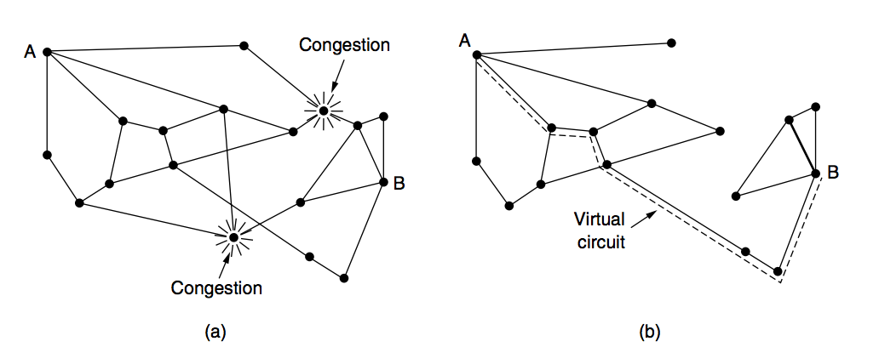
Congestion Control - Admission Control
Rejecting certain traffic from entering because there is too much congestion at the time
It’s better to reject people/objects from entering a network than to have a network that is too congested and inefficient
Example: phone calls
If you have ever experienced a delay from the moment you hit the call button on your phone to the moment you hear the first ring on your end of the call, then there was too much traffic on the network and your call was slightly delayed (even if it was only for a second)

Slide 5
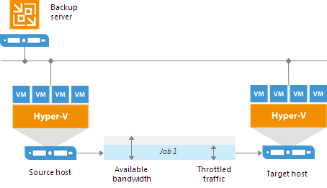
Congestion Control - Traffic Throttling
Traffic throttling is implemented through rules.
It checks the network traffic throttling rules against a pair of components which are assigned for a job. Next it checks if the source and target IP addresses are in the same IP range and if so, the rule is applied.
You can have several network throttling rules
If they have the same target IP addresses range but have different speed limits, it will take the lowest transfer speed instead
192.168.0.1-
192.168.0.225
source component 192.168.0.12
172.16.0.1-
172.16.0.255 target component 172.16.0.15

Slide 6
Congestion Control - Load Shedding
What routers do when they run out of buffers is that they simply discard packets.
Determining which packet is chosen to get discarded is highly dependent on the application itself and on the error strategy which is used in the data link layer.
Two types
File transfer→ cannot discard older packets because it will cause a gap in the received data
Real-time voice and video→ better to discard or throw away old data and keep the new packets
Ideally you want the application to mark packets with priority and it is better for the router to drop packets as soon as it seems like there is congestion

Slide 7
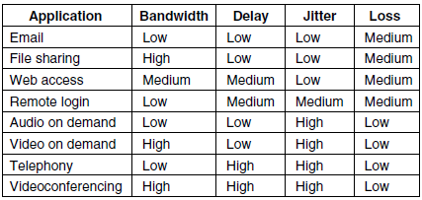
Quality of Service - Application Requirement
A stream of packets from a source to a destination is called a flow. For example, all the packets of a connection in a connection-oriented network, or all the packets sent from one process to another process in a connectionless network. A flow has parameters which determine QoS (Quality of Service):
Bandwidth 3. Jitter
Delay 4.Loss

Slide 8
QoS - Traffic Shaping
Traffic shaping is a way to help increase and network performance by controlling the amount of data that flows into and out of the network. Traffic is categorized, queued, and directed according to network policies.
Sometimes this technique is called an SLA (Service Level Agreement), especially when it is made over aggregate flows and long periods of time, such as all of the traffic for a given customer.
Traffic shaping reduces congestion and thus helps the network live up to its promise.
Monitoring a traffic flow is called traffic policing.

Slide 9
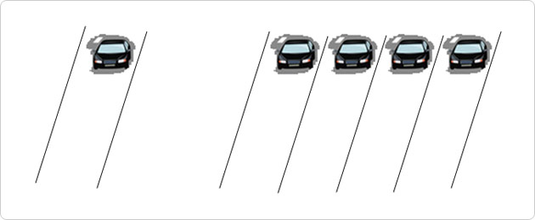
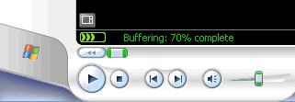
QoS - Packet Scheduling Algorithms
Packet scheduling algorithms allocate bandwidth and other router resources by determining which of the buffered packets to send on the output line next.
Three different kinds of resources can potentially be reserved for different flows:
1. Bandwidth. 2. Buffer space. 3. CPU cycles.
Packet scheduling algorithms allocate bandwidth and other router resources by determining which of the buffered packets to send on the output line next.
Some of the Algorithms used in QoS: FIFO (First-In First-Out), FCFS (First-Come First-Serve) and Round-robin and WFQ (Weighted Fair Queueing).

Slide 10
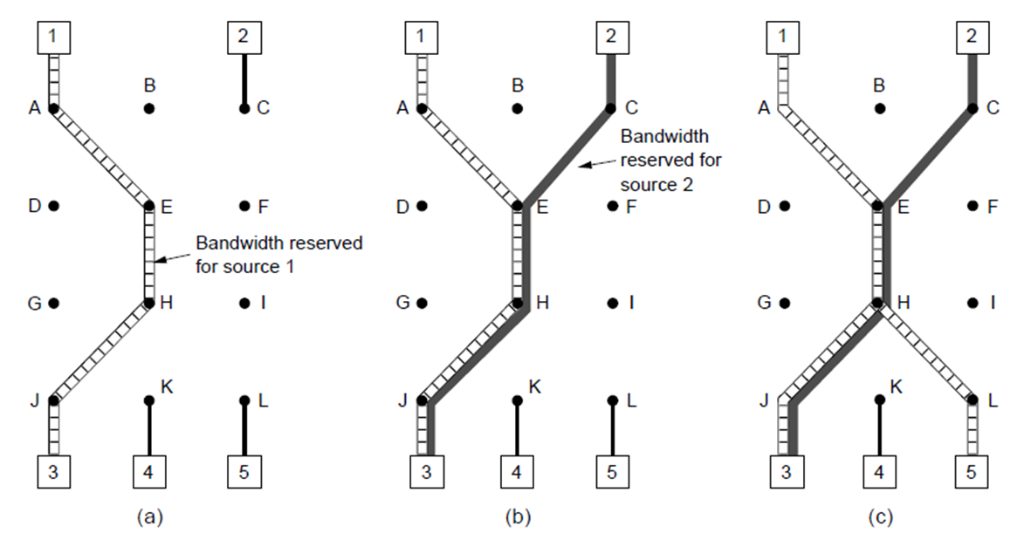
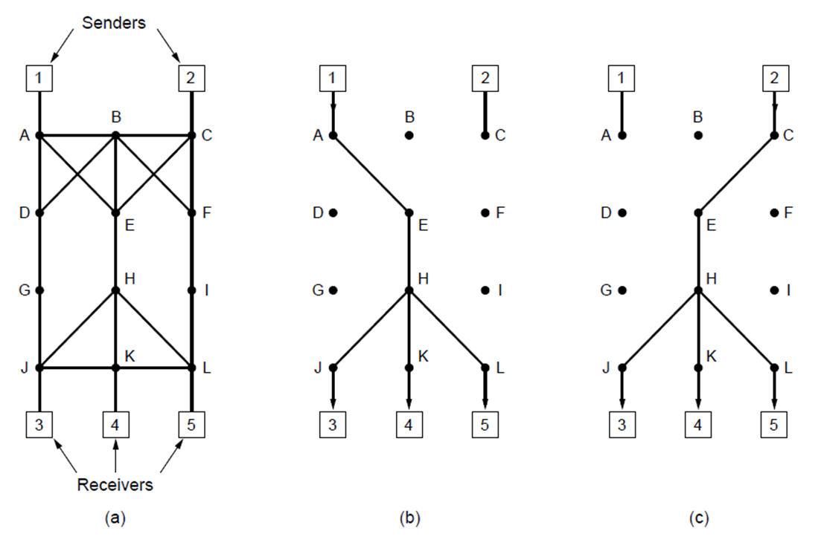
QoS - Integrated Services
Architecture for streaming media
Two different methods
Unicast - Single user streaming from a single source
Multicast - Multiple stations broadcasting to multiple users

Slide 11
QoS - Differentiated Services
Class based method to help QoS
Manages traffic on modern IP networks by assigning priorities to packets
Two types:
Expedited forwarding - simplest method, packets either have a priority of regular or expedited
Assured forwarding - Four priority classes, then four discard classes, each packet gets assigned both to assure the most important packets are sent.

Slide 12
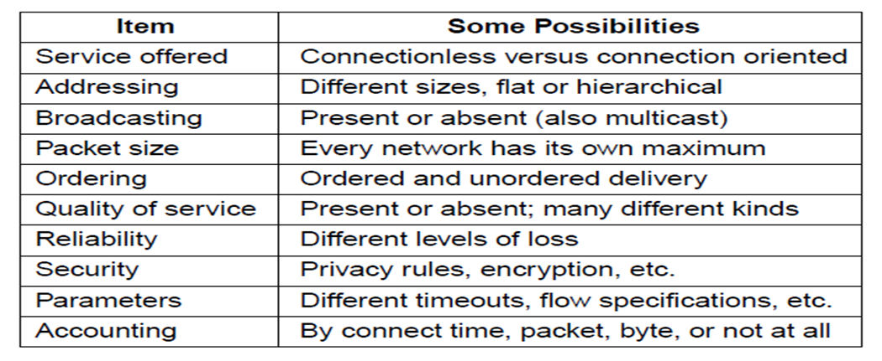
Internetworking - How Network Differ

Slide 13
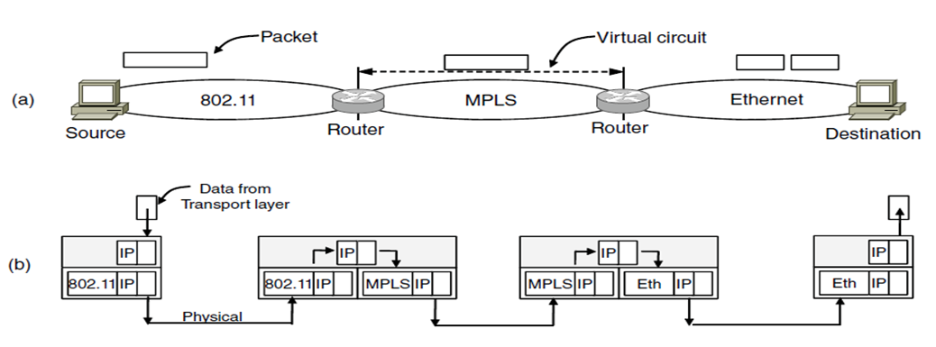
Internetworking - Network Connection
Two basic choices for connecting different networks
•Build devices that translate and convert packet from each kind of network
•Adding a layers of indirection and building a common layer on top of the different network
Device that connects networks are Repeaters, Hubs, Switches, Bridges,Routers,Gateways

Slide 14
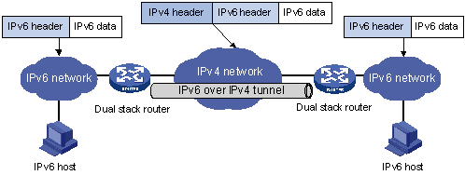
Internetworking - Tunneling
•Tunneling, also known as "port forwarding," is the transmission of data intended for use only within a private, usually corporate network through a public network in such a way that the routing nodes in the public network are unaware that the transmission is part of a private network.

Slide 15
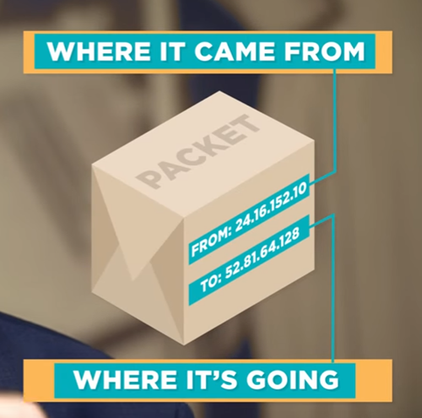
Internetworking - Packet Fragmentation
How is it possible to receive all the data sent to you reliably?
First the data is broken down into pieces called POCKETS
•If the data is too big it can not be passed in same route at the same time.
(example: cars are assembled in US even if they are built in a different country)
Each pocket contains two addresses
where it came from and
where it is going.
MTU- Maximum transmission unit

Slide 16
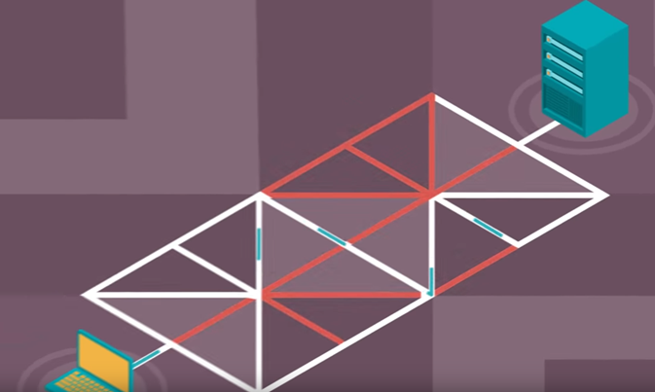
Internetworking - Routing
Then The pockets are sent through different routes depending on which routes is cheapest. (just like taking different road if there is accident on highway)

Slide 17
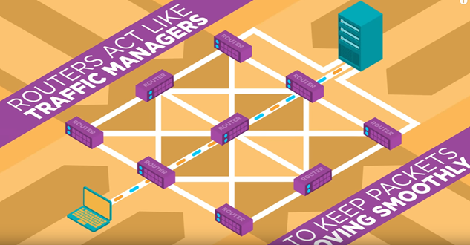
Internetworking - Routing

