Slide 1
The Medium Access Control Sublayer
Presentation By: Group 3

Slide 2
What is the Medium Access Control Sublayer?
Can divide networks into point-to-point and broadcast. Look at broadcast networks and their protocols.
When many stations compete for a channel (e.g., broadcast channel such as an Ethernet), an algorithm must arbitrate access to the shared channel.
Need a way of insuring that when two or more stations wish to transmit, they all wait until doing so won't interfere with other transmitters. Broadcast links include LANs, satellites (WAN), etc.

Slide 3
The Channel Allocation Problem
Static Channel Allocation
For N users, the bandwidth is divided into N equal-sized portions.
Works well with small, constant number of users with steady or heavy traffic.
Doesn't work well with large and varied number of users with bursty traffic.

Slide 4
The Channel Allocation Problem
Dynamic Channel Allocation
Stations will generate a frame and will do nothing else until that frame has been transmitted.
All stations/terminals are equal and thus all communication travels across a single channel.
Each station keeps track of collision and will retransmit the frame.
Frame transmission can occur instantly or on set intervals.
A station can sense if a channel is busy before sending the frame or it can transmit the frame and find out if it is busy or idle.

Slide 5
CSMA Protocol
What is CSMA (Carrier Sense Multiple Access)?
Protocols in which stations listen for the carrier and act accordingly.
Protocols:
1-Persistent - Station listens to channel activity, if channel is idle the station transmits, and if a collision is detected the station waits a random time before retransmitting.
Non-Persistent - Station senses for channel activity, if channel is free station sends a frame. If the known channel is in use the station stops sensing and waits a random time before re-sensing.
P-Persistent (Slotted channels) - Station senses if channel is free, if channel is idle the station transmits with a probability of q = 1 - p.

Slide 6
CSMA Protocol cont.
CSMA/CD
Is the basis of Ethernet LAN.
Similar to other protocols but with built in CD (Collision Detection).
A collisions occurs when a device or node tries to send data at the same time another device does.
Consists of 3 States: transmission, contention, or idle state.
Functionality:
Any device or node can try to send data to the channel at any time.
If a collision is detected the frame is discarded and the device then waits a random amount of time then resends the data.

Slide 7
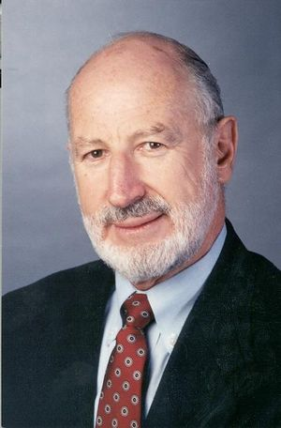
ALOHA
What is ALOHA?
A system for coordinating and arbitrating access to a shared communication network channel.
First Medium Access Control that was created in the early 1970s in Hawaii.
Created by Norman Abramson, a researcher at the University of Hawaii.
Uses short-ranged radios, with each user terminal sharing an upstream frequency to send frames to a central computer.
Two versions of ALOHA: pure and slotted.
Norman Abramson

Slide 8
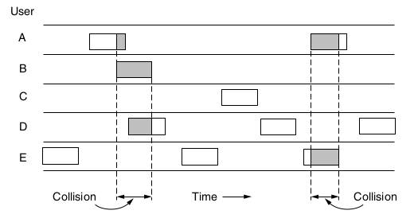
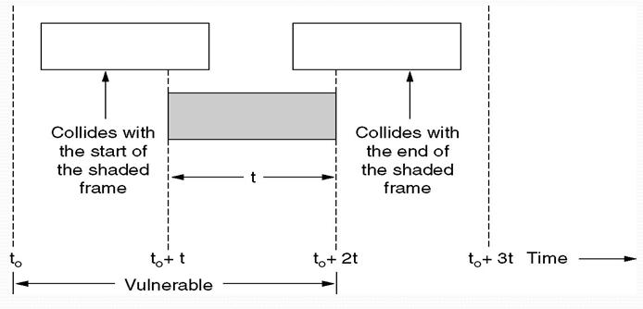
ALOHA continued...
Pure (Unslotted) ALOHA
Can transmit whenever something must be sent
User must listen for a repeated message, try again if not heard
Must wait a random amount of time before resending a transmission
As soon as a frame arrives in the channel, it is transmitted
Transmission time is continuous
Slotted ALOHA
Transmission time divided into discrete intervals called slots, each corresponding to a single frame
Users must wait to send a transmission if another user has taken that particular time slot, they must wait for the next slot
Halves the amount of collisions occurring
Used for cable and RFIDs

Slide 9
Collision-free Protocols
Bit-map protocol
Transmission protocol with N slots
During the contention period, each station announces whether they have data to send during the Nth slot by sending a 1 bit
After this, each station that sent a 1 bit sends their frame
This is done in numerical order

Slide 10
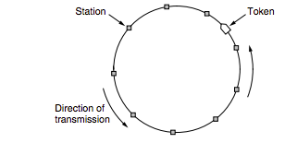
Collision-free Protocols
Token Passing
Each station passes a token from one to the next station in a predefined order
This token represents permission to send a frame
If a station does not need to send any frames, it can just pass the token along to the next station
Token ring protocol
Each station passes the token and frames in a cyclical direction

Slide 11
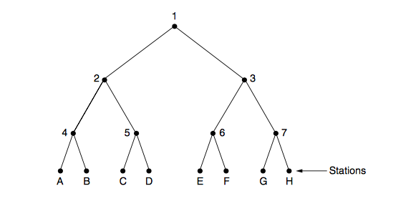
Limited Contention Protocols
Takes the best of contention and collision-free protocols
Collision based protocols are best when the network load = low
Collision-free based protocols are best when the network load = high
Adaptive Tree Walk Protocol
Partitions the groups of the station and then limits convention for each slot
Notes:
Treat stations as the leaf of a binary tree
First slot all stations can try to get the slot
If no conflict, fine
If conflict then only nodes under a subtree get to try for the next one

Slide 12
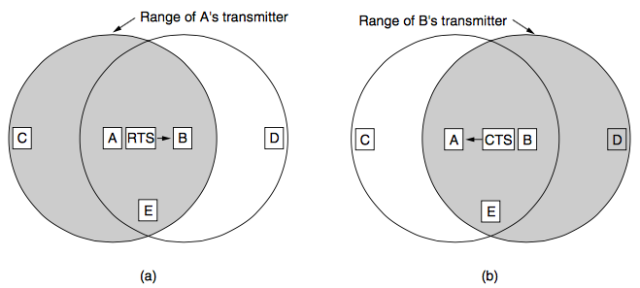
Wireless LAN Protocols
Wireless has complications that wired does not.
Collision detection is different than for wired, not nearly as easy.
Multiple Access with Collision Avoidance (MACA) helps reduce number of collisions
Sender sends Request to Send (RTS)
Receiver sends Clear to Send (CTS) which clears the station for the incoming transmission

Slide 13
Video
https://www.youtube.com/watch?v=nyYr3cR5BTw

