Slide 1
CHAPTER 4: THE MEDIUM ACCESS SUBLAYER
4.1: The Channel Allocation Problem
4.2: Multiple Access Protocols

Slide 2
4.1.1 The Channel Allocation Problem
Problem
How to allocate single broadcast channel among competing users?
Solutions -
Static Channel Allocation
Dynamic Channel Allocation

Slide 3
Static Channel Allocation
How? For N users, the Bandwidth is divided equally by N.
Works well with small, constant number of users with steady or heavy traffic.
Doesn’t work well with large and varied number of users, with bursty traffic. If user is dormant, then bandwidth is lost.

Slide 4
4.1.2 5 key Assumptions for Dynamic Channel Allocation
Independent Traffic - N independent stations, each generating frames for transmission. Once a frame is generated, the station is blocked and does nothing until the frame has been transmitted.
Single Channel - One channel is available for for all communication.
Observable Collisions - Two frames may be overlapped and signal garbled or result in a collision. Collisions must be transmitted again later.

Slide 5
5 key Assumptions for Dynamic Channel Allocation
Continuous Or Slotted Time - If time is continuous, transmission can begin at any time. If it’s divided into discrete intervals, transmission must begin at the beginning.
Carrier Sense Or No Carrier Sense - Can tell if channel is in use before trying to use it. Without carrier sense, stations transmit blindly and then check back later to see if transmission was successful.

Slide 6
4.2 Multiple Access Protocols
ALOHA
Carrier Sense Multiple Access
Collision-Free Protocols
Limited-Contention Protocols
Wireless LAN Protocols

Slide 7
1. ALOHA
The ALOHA system was established in 1970’s by Norman Abramson. It uses group based radio broadcasting where the users could send frames to the central unit.
Collisions is one problem that cannot be avoided but can be reduced.
Contention period: The time interval in which frames can overlap.
There are two versions of ALOHA:
Pure ALOHA that has continuous time
Slotted ALOHA that divides time into slots, and it was made to double the capacity of ALOHA

Slide 8
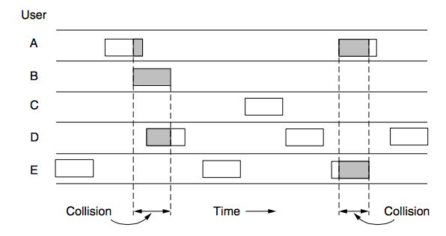
Pure ALOHA
Users transmit whenever they have data to be sent.
Stations listens to the channel to find out if the frame was broadcasted.
If frame was destroyed, sender must wait a random amount of time and send it again.

Slide 9
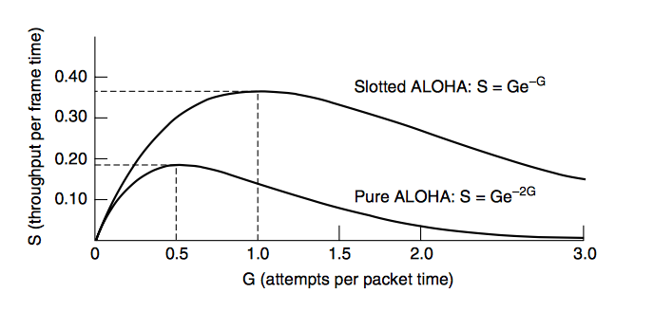
Slotted ALOHA
Each interval corresponds to one frame of data.
Users are required to agree on slots boundaries.
A station is required to wait for the beginning of the next slot to send a frame.

Slide 10
Pure ALOHA VS. Slotted ALOHA
TYPE | PURE | SLOTTED
TIME | Continuous | Intervals
BROADCASTING | At any time | Beginning of slot
MAX THROUGHPUT | 18.3 % | 36.8 %

Slide 11
2. Carrier Sense Multiple Access Protocols
ALOHA simply means goodbye… in this case.
Allows LANs achieve a much better utilization than ALOHA.
Carrier Sense Protocols.

Slide 12
Types of Carrier Sense Multiple Access (CSMA)
Persistent CSMA- Station listens to channel first, then transmits only if the channel is “idle”.
Collisions still an issue!
Bandwidth-Delay Product- The number of frames that fit on a channel.
Outperforms pure ALOHA.

Slide 13
Types of Carrier Sense Multiple Access (CSMA)
Nonpersistent CSMA- Similar to 1-persistent CSMA, but less greedy.
Sends a packet only when channel is idle.
If the channel is busy, then the station will check back later.
Higher channel utilization, but longer delays than 1-persistent CSMA
P-persistent CSMA- A little bit of both.
Slotted channels.
If channel is idle, may or may not transmit immediately.
Repeats until transmission or another station transmits.

Slide 14
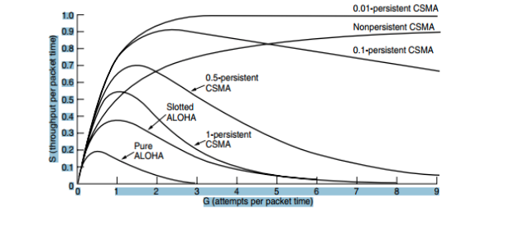
The 3 CSMA’s Vs. The ALOHA’s

Slide 15
CSMA with Collision Detection
CSMA/CD- Like other CSMA’s “listens” to signal, if it is different than the signal it is putting out, it knows a collision is occurring.
Is the basis of the classic Ethernet LAN.
Collision detection is an analog process.
If a collision is detected, transmission is aborted.

Slide 16
3. Collision Free Protocols
There are no collisions in CSMA/CD but…
Collisions still occur in contention period.
Collisions downgrade performance.
Solutions include:
Bit-Map Protocol: waiting list.
Token Ring Protocol: form a circle.
Binary Countdown Protocol: top dog takes priority.

Slide 17
Bit Map Protocol
Basic Bit-Map Method: Waiting List
During contention period, stations are divided into slots.
Each station can say it has frames to send during its slot only.
Once all slots are known, they transmit is numerical order.
After all transmissions, another contention period occurs.
This is a Reservation Protocol - reserving the ability to transmit before doing so.

Slide 18
Token Ring Protocol
Basic Token Ring Method: Form a Circle
Pass a small message called a token from one station to the next in a predefined order.
Token represents permission to send.
Order is determined by topology of a network.
Frames sent in the same direction of the token.
Physical Ring not necessary. Can be in a line or bus, known as a Token Bus.
What’s Different from Bit-Map:
All positions are equal, no bias on high or low numbered stations.
Each token does not need to propagate to all stations before the protocol advances to the next step.

Slide 19
Binary Countdown Protocol
Basic Binary Countdown Method: Top Dog Takes Priority
A station wanting to transmit broadcasts its address as a binary string.
Implicitly assumes that the transmission delays are negligible.
All stations see bits essentially instantaneously.
Bidding for the channel, higher addressed stations have priority over the lower numbered stations.
Simple and very efficient.

Slide 20
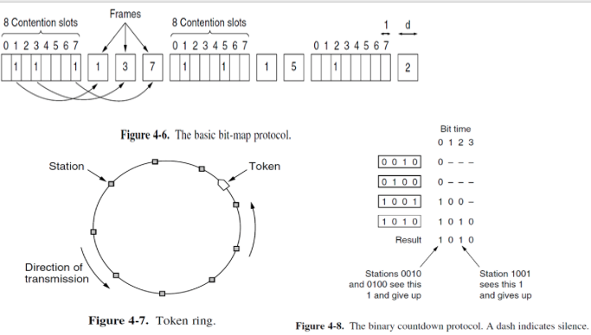

Slide 21
4. Limited-Contention Protocols
Contention (pure or slotted ALOHA) is preferable under conditions of light load due to its low delay (since collisions are rare).
Collision-free protocols are favorable at high load because of the improved channel efficiency (since overheads are fixed).
Limited-contention protocols attempt to combine the best properties of contention and collision free protocols.

Slide 22
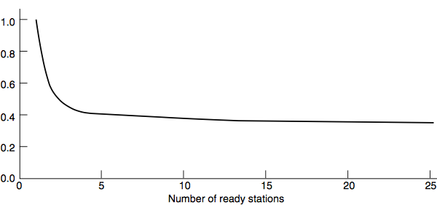
Acquisition probability for a symmetric contention channel

Slide 23
Limited-Contention Protocols
Stations get divided into groups.
Only members of group 0 can compete for slot 0.
If successful, the member acquires the channel and transmits its frame.
If not, the members of group 1 compete for slot 1.

Slide 24
How to Assign Stations to Slots?
Special Cases:
Each group has one member. No chance for collision. (binary countdown)
Two stations per group. Little chance of collision.
As more stations are assigned to the same slot, the probability of collisions grows but the length of the bit-map scan needed to give everyone a chance shrinks.

Slide 25
How to Assign Stations to Slots
Limiting Case: Single group containing all stations. (slotted ALOHA)
What we need:
A method to assign stations to slots dynamically, with many stations per slot when the load is low and few (or even just one) station per slot when the load is high.

Slide 26
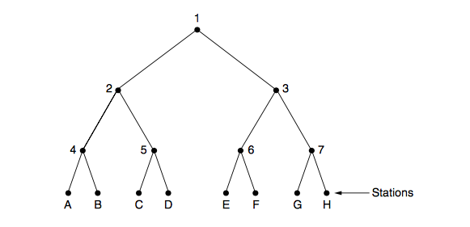
The Adaptive Tree Walk Protocol
Tree for 8 stations

Slide 27
5. Wireless LAN Protocol
Wireless LAN protocol are the rules that govern the interactions between wireless devices.
When dealing with wireless LAN the distance between access points has to be taken into consideration.
Wireless communications can overlap and cause collisions between packets being sent.
Problems such as these are resolved by using various protocols to regulate these interactions.

Slide 28
Terminal Problem
When transmitters check to see if a collision can occur at the receiving end one of two problems can occur:
Hidden terminal problem - the transmitter cannot detect the interfering transmitter since it is out of range and thus causes interference.
Exposed Terminal Problem - The transmitter does detect another signal that can cause collisions and does not transmit even though the problematic signal does not reach the intended receiver.

Slide 29
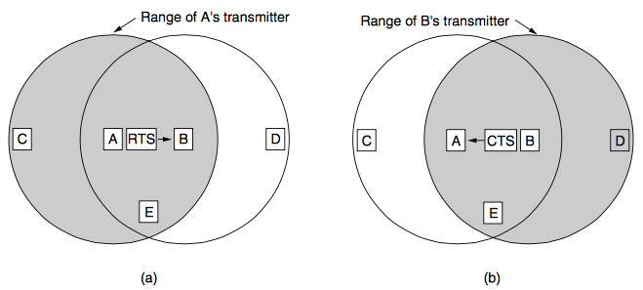
MACA
MACA ( Multiple Access with Collision Avoidance ) – MACA is a protocol designed to reduce the number of collisions by having transmitters first send a short frame to the receiver an: RTS (Request to Send) which entails the length of the data frame which is to be sent.
The receiver then returns a CTS (Clear to send) frame which clears the station to transmit.

Slide 30
MACA
Upon Receiving A RTS, a station will remain silent to allow for a CTS to be sent out to prevent collision.
Upon Receiving a CTS, the station realizes it is close to a receiver about to receive information and will defer sending anything until the frame is expected to finish.
Despite all this, Collisions can still occur in the case of MACA.

Slide 31
THANK YOU FOR YOUR ATTENTION!
QUESTIONS?

