Slide 1
The Physical Layer
Chapters 2.5 - 2.8

Slide 2
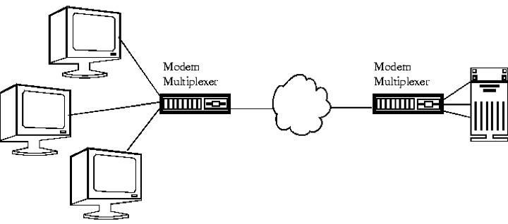
Digital Modulation and Multiplexing
Digital Modulation - converting between bits and the signals that represent them
Multiplexing - this is the process of compressing various signals into the form of a single, complex signal and then sending that off to the carrier. Once recovered, the complex signal splits back to the original for of the signals.
Below are the 5 types of Multiplexing:
Frequency Division Multiplexing- divides the spectrum into frequency bands. Each user will have a given band they will use to send their signal. Example: AM Radio
Time Division Multiplexing- Method of putting multiple data streams in a single singla by separating them into many segments.
Code Division Multiplexing- Allows multiple signals from different users to the share the same frequency band and makes it more tolerant of interference.
Statistical Division Multiplexing- method to transmit several types of data simultaneously across a single transmission cable.
Orthogonal Frequency Division Multiplexing- divides the channel bandwidth into subcarriers which then send the data.

Slide 3
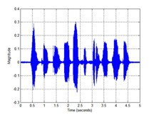
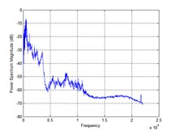
Types of Transmission
Baseband transmission- sends the signal without changing any frequency.
Passband Transmission- whereas passband shifts the signal to a higher frequency then what it transmits. Once the signal is received, it is shifted back to the original frequency.

Slide 4
Question
Name one of the different types of Multiplexing.
Notes:
Baseband Transmission Passband Transmission Frequency Division Multiplexing Time Division Multiplexing Code Division Multiplexing

Slide 5
Public Switched Telephone Network
Fully interconnected network
Centralized switch
Two level hierarchy

Slide 6
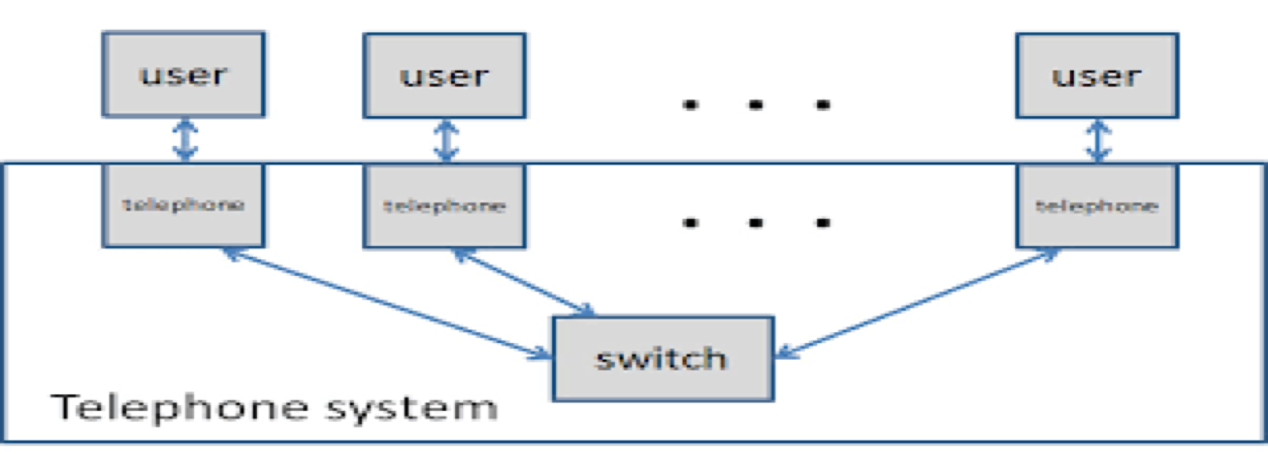
The Telephone System
The Telephone system is comprised of multiple different telephones which are then simultaneously used in an interconnected fashion that allows for advanced communication features such as call handling and transferring, conference calls, and privately shared voice calling/videos.
The Telephone system consists of three major components:
Local Loops ( analog twisted pairs going into houses and businesses)
Trunks (digital fiber optics connecting the switching offices)
Switching offices(where calls are moved from trunk to another)
Phone systems can function over the Public Switched Telephone Network, over the internet or even both at the same time. Business telephone systems can be delivered the hosted network.

Slide 7
Question
The telephone system consists of which three components?
Notes:
Local Loops, Trunks, Switching Offices

Slide 8
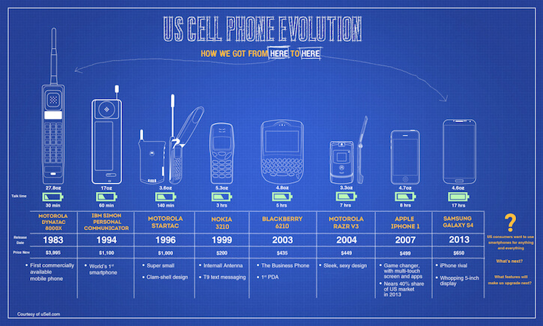
The Mobile Telephone System
Used for wide are voice and data communication
First Generation (1G) - Analog Voice
Push-to-talk system
Uses separate frequencies for each conversation (needed lots of bandwidth)
Advanced Mobile Phone System (AMPS) - analog mobile phone system standard
Second Generation (2G) - Digital Voice
Global System for Mobile Communication (GSM) - standard developed by European Telecommunications
Same mobile phone can be used in any country that implements GSM
Third Generation (3G) - Digital Voice and Data
Smart Phones
Internet Access
Video and Audio Applications

Slide 9
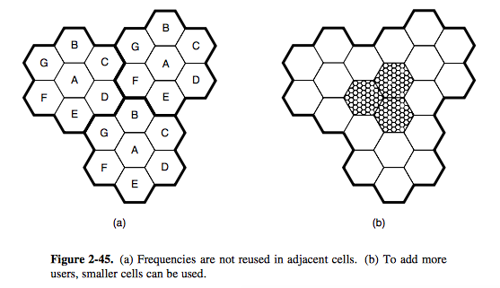
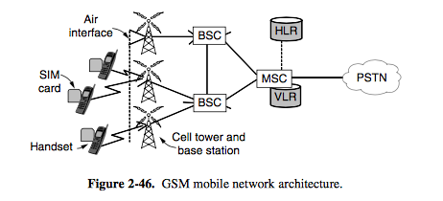
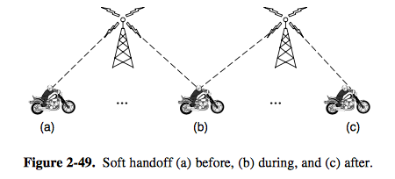
2G - Global System for Mobile Communication (GSM)
1G - Advanced Mobile Phone System (AMPS)
3G - CDMA Softhand
Notes:
Analog Voice

Slide 10
Question
What are the three phone generations?
Notes:
Analog Voice, Digital Voice, Digital Voice and Data

Slide 11
Cable Television
Is a system of delivering television broadcasting and other services to paying customers via Radio Frequency signals and then which are transmitted through the form of Coaxial cables. This form of networking is different from Telephone lines.
Community Antenna Television- The original name of cable television when it was invented in 1948. Intended to provide people that lived in rural areas with better reception since they were so isolated from urban areas.
Internet over Cable- Many cable providers have recently elected to provide internet access along as well. A system with material that is built for long haul runs and coaxial cable to the houses within an area is called a Hybrid Fiber Coax(HFC) system.
Spectrum Allocation- If cable providers threw off all of the TV channels and used the cable infrastructure strictly for internet access then most cable users wouldn’t be happy. Most cities control what is displayed on the cable networks, so the cable operators wouldn’t be able to make this change even if they wanted to.

Slide 12
Cable Modems- Devices that allow high speed access to networks such as the internet same we use for cable television.
ADSL Versus Cable- The answer to which one’s better between ADSL and cable depends on who you ask. Cable uses coax while ADSL uses twisted pair on the edge. Since the carrying capacity of coax is significantly greater than that of twisted pair cable should be able to store more data. However, cable doesn’t use maximum capacity because it’s bandwidth is used on television channels as well.
Cable Spectrum
Notes:
(Spectrum allocation)This picture of a cable spectrum demonstrates the frequency allocation within a typical cable television system that is used for internet access

Slide 13
Question
What was cable television originally called and what year was it invented in?
Notes:
Community Antenna Television and 1948

Slide 14
How Telephone Communication Works
Video:

