Slide 1
Digital Modulation, Telephone, Cable Television

Slide 2
Digital Modulation and Multiplexing

Slide 3
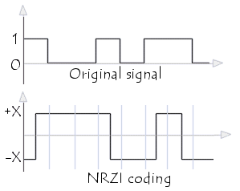
NRZ and NRZI and Balanced Signals
NRZ has a positive voltage represented by 1 and a negative voltage represent by 0.
NRZI has a transition represented by 1 and a 0 represents no transition.
A balanced signal has an average voltage of 0 or having as much positive voltage as negative voltage. If the average is not 0, energy is wasted in the form of heat.

Slide 4
Baseband and Passband
Baseband sends the signal without changing any frequency.
Passband shifts the signal to a higher frequency then transmits it. When the signal gets to the receiver, it is shifted back to its original frequency.
When a baseband of B Hz is sent and is shift up to occupy a passband of S, the frequency will become S + B Hz.

Slide 5
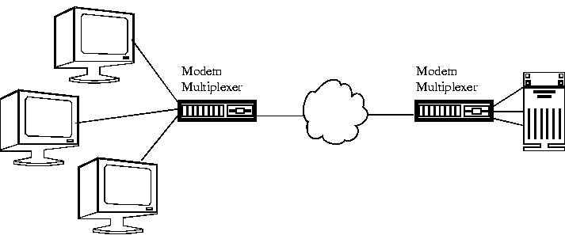
Multiplexing
Multiplexing is the process of compressing multiple signals into the form of a single and complex signal and then sending that signal on a carrier. When it is recovered, the complex signal splits back to the original form of the signals.
There are 5 types of multiplexing.
Frequency Division Multiplexing
Orthogonal Frequency Division Multiplexing
Time Division Multiplexing
Statistical Time Division Multiplexing
Code Division Multiplexing

Slide 6
Frequency Division and Orthogonal Frequency Division Multiplexing
Frequency Division Multiplexing divides the spectrum into frequency bands. Each user will have possession of a given band which they will use to send their signal. AM radio broadcasting uses Frequency Division Multiplexing
Orthogonal Frequency Division divides the channel bandwidth into subcarriers. These subcarriers then send the data.

Slide 7
What type of radio signal uses frequency division multiplexing?

Slide 8
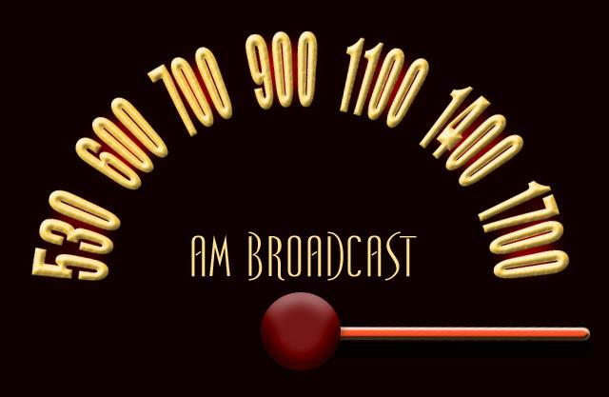

Slide 9
Time Division Multiplexing (TDM)
Used widely as part of telephone and cellular networks
Method of putting multiple data streams in a single signal by separating them into many segments
Bits from each stream are taken in a fixed time slot
Uses guard time in order for the stream to transmit simultaneously without interfering with one or another
Notes:
What type of networks use time division multiplexing?

Slide 10
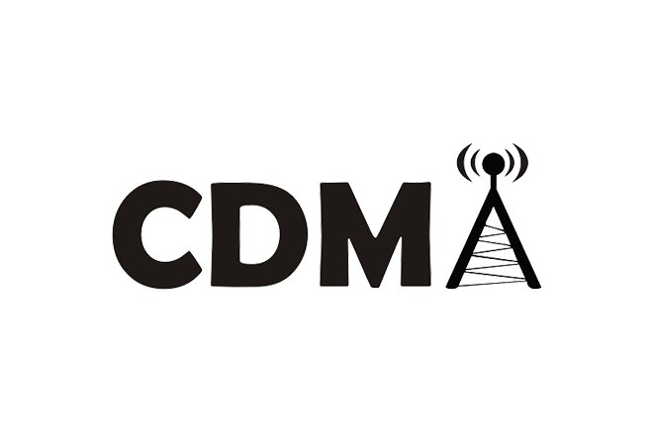
Code Division Multiplexing
A form of spread spectrum communication where a narrowband signal is spread out over a wider frequency band
Allows multiple signals from different users to share the same frequency band and makes it more tolerant of interference
Key to CDMA is the ability to extract a desired signal while ignoring everything else
Chips – Each bit time is subdivided into m short intervals
Each station is assigned a unique m-bit code called a chip sequence
Notes:
Also code division multiple access, typically 64 or 128 chips per bit, How many chips are there per bit

Slide 11
Code Division Multiplexing
0 Bit Chip Sequence – (-1-1-1+1+1-1+1+1)
1 Bit Chip Sequence – (+1+1+1-1-1+1-1-1)
Uses 1MHz
The chip rate is 100 chips per bit and has a bit rate of 10kbps across the channel.
Notes:
Using an example where there are 8 chips/bit

Slide 12
Statistical Time Division Multiplexing
A method to transmit several types of data simultaneously across a single transmission cable
Used for managing data being transmitted through a LAN or WAN network
Analyzes statistics related to the typical workload of each device
Considered to be more efficient than the TDM method
Notes:
Similar to TDM and allows users to transmit or receive data simultaneously by assigning each device the same, fixed amount of time
Determines whether or not a device such as a printer would need more bandwith based off of its current transmission needs

Slide 13
The telephone system

Slide 14
Structure of the telephone system
The initial market was for the sale of telephones, which came in pairs. It was up to the customer to string a single wire between them
Then came the single switching office
Then came the need to connect the switching offices
Second-level switching offices were invented and after a while, multiple second-level offices were needed - the hierarchy grew to five levels

Slide 15
The Telephone System
Telephone system comprises multiple telephones used in an interconnected fashion that allows for advanced telephony features such as call handling and transferring, conference calling, call metering and accounting, private and shared voice message boxes, and so on.
In summary, the telephone system consists of three major components:
Local loops (analog twisted pairs going into houses and businesses).
Trunks (digital fiber optics connecting the switching offices).
Switching offices (where calls are moved from one trunk to another).

Slide 16
Structure of the Telephone System
Fully interconnected network.
Centralized switch.
Two-level hierarchy

Slide 17
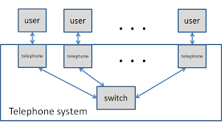
The Telephone System
Phone systems can function over the Public Switched Telephone Network , over the internet or over a combination of the two. Business telephone systems can also be delivered as a hosted.

Slide 18
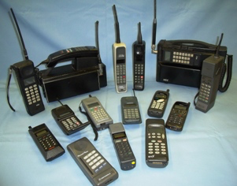
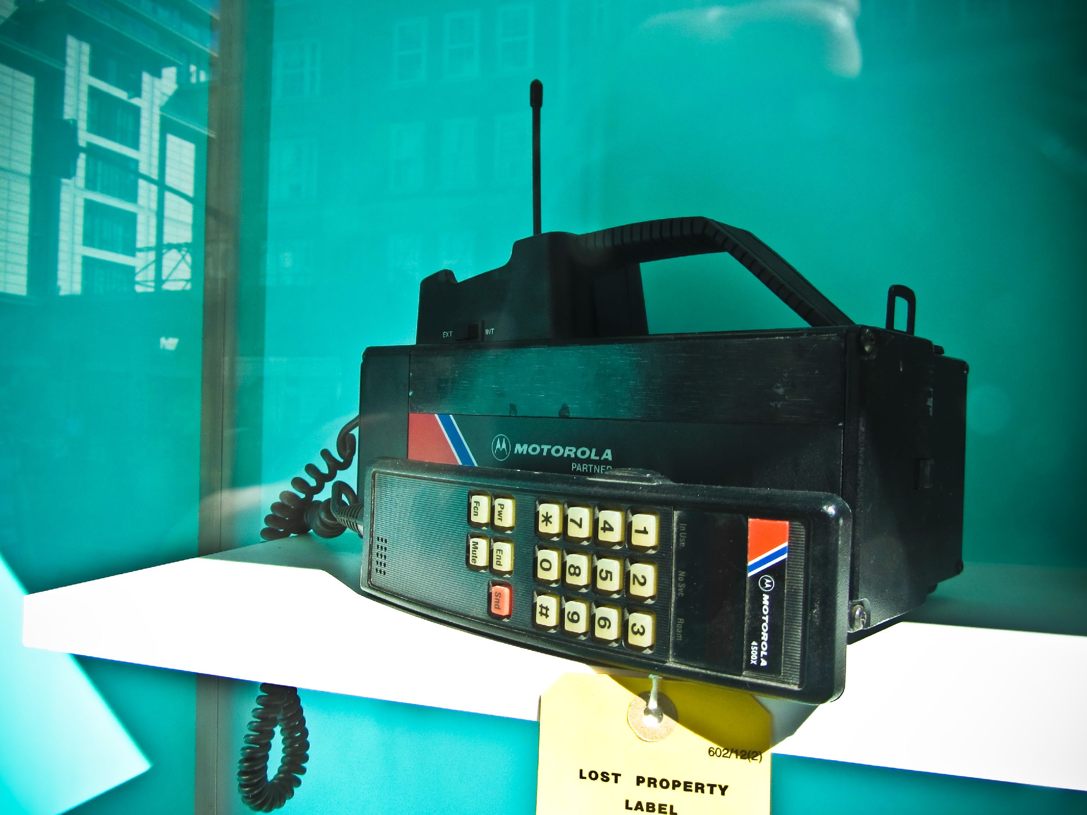
First Generation (1G) Mobile Phones
Established in the late 70’s and 80’s.
Mobile phones in 1st G was used for public service with a speed of 2.4kps.
Radio signals that 1G networks use are analog system.
AMPS(Advanced Mobile Phone Service) was invented at Bell labs.
AMPS was first launched in the United States.
The main idea of 1st G of cellular networks is that geographical area is divided into cells. Basically every 10-25Km. Each served by a base station.
1G can only be used for voice service.

Slide 19
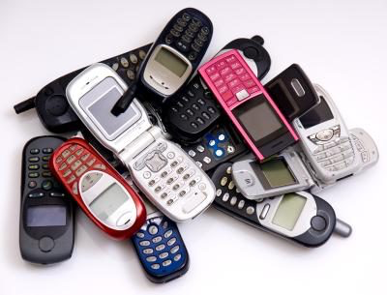
Second Generation (2G) Mobile Phones
Established in the early 1990’s.
The second generation introduced GSM which stands as Global System for Mobile Communications. Can be used in many countries supporting GSM.
Radio signals that 2G networks use are digital.
Data speed was up to 64Kps.
2G systems provide encryption to secure and have more data transmitted.
Digital traffic in 2G allows to detect and correct giving clear voice transmitted.
Availability of digital data services, such as SMS and email.

Slide 20
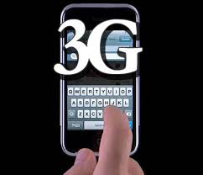
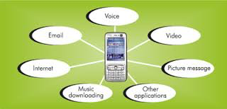
Third Generation (3G) Mobile Phones
3G technology was Established in 2000’s.
Data speed 144Kps-2Mbps.
Typically called Smart Phones.
The third generation of mobile phones made it possible for users to use video applications and audio.
Public service usage – Higher capacity and broadband data.
Many benefits of 3G are High Speed web, advanced security and faster communications.

Slide 21
Summary
Question(1):What are the three telephone system major components?
Question(2): Radio signals that 1G networks uses is?

Slide 22
Answer:
Q(1): 1-Local Loops
2-Trunks
3-Switching Offices
Q(2): Analog system

Slide 23
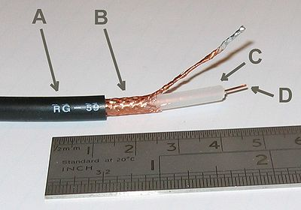
Coaxial/Cable service
A- Outer plastic sheath
B- Woven copper shield
C- Inner dielectric insulator
D- Copper core
Cable television is a system of delivering television programming and other services to paying subscribers via radio frequency (RF) signals transmitted through coaxial cables. This form of networking differs greatly from telephone lines and has advantages and disadvantages

Slide 24
Internet over cable
Internet over cable widely available internet service available to many in the country
Cable Internet connection is a form of broadband access. Through use of a cable modem, users can access the Internet over cable TV lines. Cable modems can provide some of the fastest speeds that are widely available to customers.
Single cable system can grow and expand easily because of their design. One cable run can provide service to many locations via ‘taps’ in the cable line

Slide 25
Coaxial for internet
Original implementation of cable internet used only downstream data on the coaxial or cable network. A dial up connection was required for upstream data. Eventually, a spectrum of the cable frequency was dedicated for upstream data but this spectrum is smaller than the downstream spectrum, resulting in the difference we see in upload/download speeds in regular cable internet.

Slide 26
Cable modems
Cable modems are devices that allows high speed access to networks such as internet via the same connection we use for cable television
This physical device separates the computer data from the cable television video signal, but many people refer to the entire system a cable service
Modem is short for ‘modulize/demodulize’ which is the process the cable modem uses to convert data from a frequency in the the coaxial cable into data that can be transferred over ethernet or other media

Slide 27
Hybrid Fibre/Coxial
Some modern cable systems use fibre to carry the bulk of data from the service provider to a ‘node.’ From the node, coaxial cable is used to carry signal to the clients. Fibre is used to carry signal to the node because of its higher bandwidth, eliminating the need to run multiple coaxial cables to the node. This is called FttN or ‘fibre to the node.’ Cable is not the only system that can uses FttN

Slide 28
Television and Internet in one cable
Cable offers the ability to provide television, phone service and internet over on cable line. This is possible because of the broad spectrum of frequency that can be carried on Coaxial cable. Different frequencies, or ‘spectrums’ are reserved for specific services, allowing multiple signals to exists alongside each other without interfering. See the below image for reference

Slide 29
Video on mobile networks and their technologies
https://www.youtube.com/watch?v=ODB6d6MHAY8

