Slide 1
Section 2.5 - 2.8

Slide 2
Balanced Signals
having as much positive voltage as negative voltage (averaging to 0)
with a nonzero average, energy will be wasted in the form of heat

Slide 3
NRZ vs. NRZI
NRZ: a positive voltage represented by 1 and negative voltage represented by 0 NRZI: a transition represented by 1 and no transition as 0

Slide 4
Baseband vs. Passband
Baseband: Sends the signal as it is, without modulation (without frequency shifting)
Passband: Shifts the signal to be transmitted in frequency to a higher frequency and then transmits it, where at the receiver the signal is shifted back to its original frequency.

Slide 5
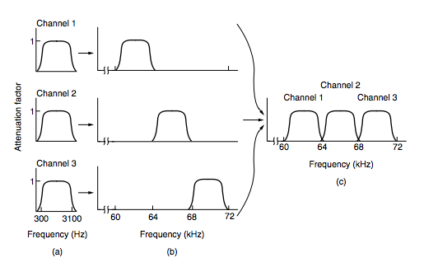
Multiplexing
Sending multiple signals on a carrier at the same time in the form of a single, complex signal and recovering the separate signals at the receiving end.

Slide 6
Types of Multiplexing
Frequency Division Multiplexing
Orthogonal Frequency Division Multiplexing
Time Division Multiplexing
Statistical Time Division Multiplexing
Code Division Multiplexing

Slide 7
FDM, OFDM
Frequency Division Multiplexing
Divides the spectrum into frequency bands, with each user having exclusive possession of some band in which to send their signal.
AM radio broadcasting illustrates FDM.
Allocated spectrum is ~1 MHz, roughly 500 - 1500 kHz.
Orthogonal Frequency Division Multiplexing
The channel bandwidth is divided into many subcarriers, packed tightly together, that independently send data.

Slide 8
Time Division Multiplexing
Alternative to FDM
Telephone and cellular networks
Users take turns with bandwidth (round-robin)
Bits from the steams are taken in a fixed time slot.
Guard time is sometimes added to accommodate time variations.

Slide 9
Code Division Multiplexing
CDM is a form of spread spectrum communication (narrowband spreads out over wider frequency band)
Benefits: tolerant of interference and allows multiple signals from different users to share the same frequency band.
Another name for CDM is Code Division multiple Access
Airport Analogy: “CDMA is comparable to each pair of people talking at once, but in a different language. The French-speaking couples hones in on the French, rejecting everything that is not French noise.”
Key to CDMA is to extract desired signal, while rejecting the rest.

Slide 10
Code Division Multiple Access
Chips – each bit time subdivided into m short intervals.
Stations are assigned a unique m-bit code call a chip sequence.
1 bit transmission example: (on next slide)

Slide 11
Code Division Multiple Access
0 Bit (chip sequence)
1 Bit (chip sequence)
(-1 -1 -1 +1 +1 -1 +1 +1)
(+1 +1 +1 -1 -1 +1 -1 -1)
M = 8
No other patterns are permitted
CDMA uses the 1MHz
Chip rate is 100 chips per bit, with a bit rate of 10kbps across the channel

Slide 12
Code Division Multiple Access
Symbol S is used to indicate the m-chip vector for station S
All chip sequences are pairwise orthogonal, which means the product of any two distinct chip sequences (S and T) is = 0.
Walsh Codes:

Slide 13
Code Division Multiple Access

Slide 14
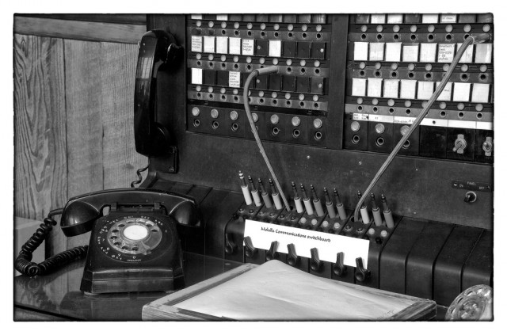
Public Switched Telephone Network (PSTN)
telecommunication facilities

Slide 15
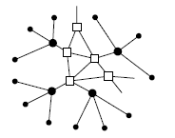
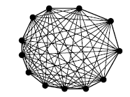
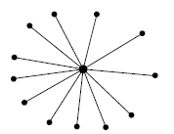
Structure of the Telephone System

Slide 16
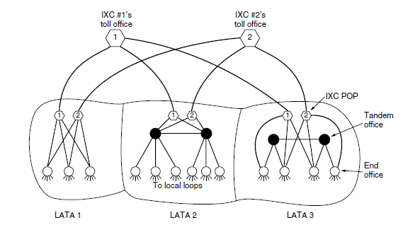
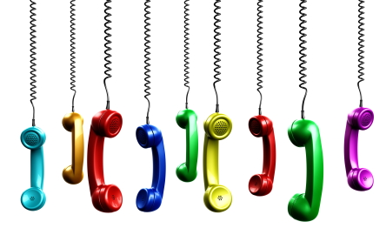
Politics of Telephones

Slide 17
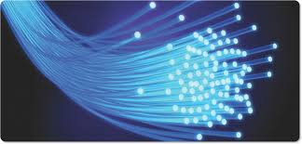
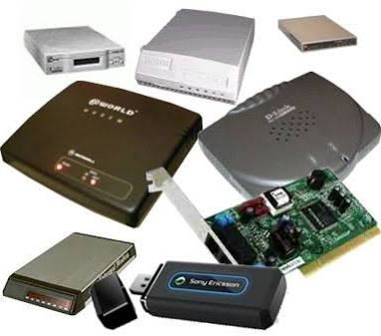
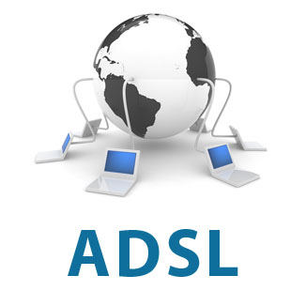
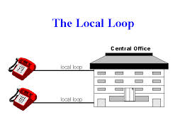
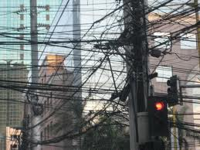
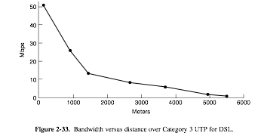
The local loop: Modems, ADSL, and Fiber

Slide 18
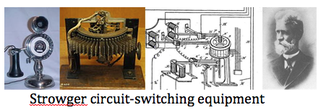
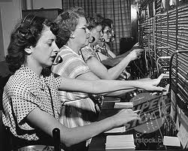
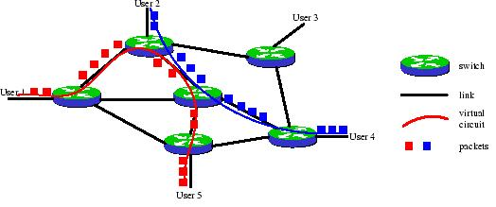
Circuit vs. Packet switching

Slide 19
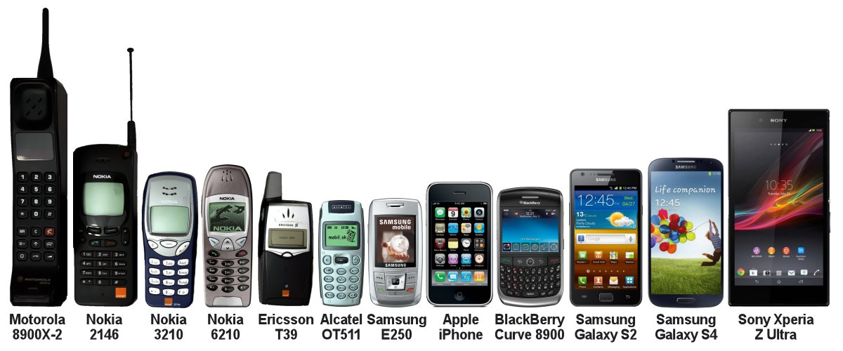
Mobile Telephone System

Slide 20
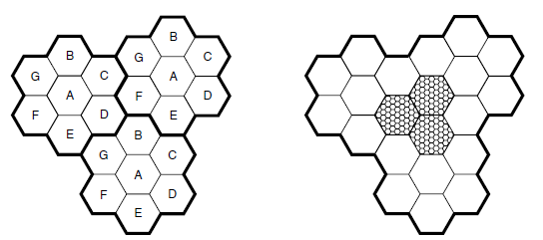
First Generation (1G) Mobile Phones
Started out with PTT systems (Walkie Talkie), only one person talking during communication. Analog systems.
AMPS (Advanced Mobile Phone System) revolutionize mobile phone system by using cell system which allows the reuse of frequency, and has the capability to host 10-15 calls on each frequency.
By making smaller cells each cell can host more users and thus allowing more users to use the system with an equivalent size transmitter or smaller.

Slide 21
Second Generation (2G) Mobile Phones
Second generation of mobile phones transmit and receive voice data using digital signal.
Digital signal allows the voice data to be encrypted and compressed providing better security and more data to be transmitted. And has the ability to transmit text messages.
Introduces GSM(Global System for mobile communications). Global standards for mobile phones, meaning you can use the same mobile phone in any country that supports GSM.
GSM uses SIM cards or (Subscriber Identity Module), a removable chip that identifies the user and encrypts voice data. By using sim cards, GSM became versatile thus quickly became the global standard system for mobile phones.

Slide 22
Third Generation (3G) Mobile Phones
Third generation mobile phones transmit and receive digital voice and data. 3G mobile phones can transmit more data at a much faster rate than 2G mobile phones and uses better encryption algorithms thus dramatically improve security.
3G mobile phones revolutionize the 21st century by granting people the ability browse to the internet thus allowing people to transmit and receive videos, music, pictures, video call, etc.
3G mobile phones also have the capability to use GPS.

Slide 23
Cable Television
2.8.1

Slide 24
Community Antenna Television
Cable TV started in the late 1940s
Provided reception to people living in rural & mountainous areas
Consisted of a big antenna on top of a hill, headend (amplifier), and coaxial cable

Slide 25
Community Antenna Television
When number of subscribers grew additional cables were spliced onto the original cable and amplifiers were added as needed
Transmission was one way, from the headend to the user
In 1974, Time Inc. started a new channel, Home Box Office, with new content distributed only on cable
Large corporations began buying up existing cable systems and laying new cable to acquire new subscribers
The need to connect multiple system rose, to distribute new cable channels to distant cities
Cable companies began to lay cable between cities, to connect them into a single system

Slide 26
Internet over Cable
2.8.2

Slide 27
Internet over Cable
Cable systems grew and the cables between cities were replaced by high-bandwidth fiber (Hybrid Fiber Coax systems)
Cable operators decided to get into the Internet access business as well as the telephone business
Cable and telephone plants had one-way amplifiers in the system that had to be replaced by two-way amplifiers to support upstream as well as downstream

Slide 28
Internet over Cable
Early internet over cable systems used the cable TV network for downstream transmission and a dial-up connection via the telephone network for upstream transmission
For cable, a single cable is shared by many houses, whereas in telephone system every house has its own private local loop

Slide 29
Spectrum Allocation
2.8.3

Slide 30
Spectrum Allocation
Having TV and Internet peacefully coexist on the same cable was in demand
Solution was to build on frequency division multiplexing
Cable TV channels in North America occupy 54-550 MHz region, these channels are 6-MHz wide, including guard bands
Can carry one traditional analog TV channel or several digital TV channels
Upstream channels in the 5-42MHz band & use the frequencies at the high end for the downstream signals were introduced

Slide 31
Spectrum Allocation
Tv signals are all downstream, its possible to use upstream amplifiers that work only in the 5-42 MHz region and downstream amplifiers that work at 54 MHz and up
We get an asymmetry in the upstream and downstream bandwidth because more spectrum is available above Tv than below it

Slide 32
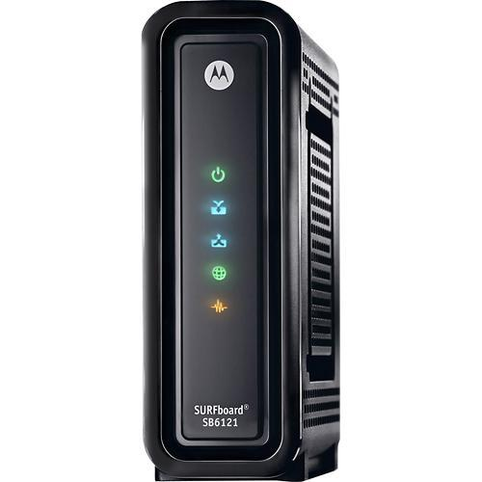
Cable Modems
Internet access requires a Modem, a device that has two interfaces on it: one interface to the computer and the other to the cable network.
Initially each cable internet provider had a proprietary modem with a closed standard.
The larger cable companies teamed up with a company called CableLabs to create a new standard for modems and test them for compliance.
This standard is called DOCSIS (Data Over Cable Service Interface Specification), it has replaced almost all proprietary modems and has allowed external companies to create modems for cable internet use.

Slide 33
Upstream and Downstream
An image explaining the process that takes place between the Internet Service Provider and the Modem in terms of upstream and downstream in North America

Slide 34
ADSL Vs Cable, Which is Better?
ADSL (Asymmetric digital subscriber line )
Pros
Bandwidth is consistent.
Existing users are not affected with new users join as each user has a dedicated connection.
ADSL is a point to point medium, which makes it more secure than cable.
Most ADSL providers offer more than just one internet service provider.
Cons
Bandwidth is noticeably less than cable.
Not as widely available as cable.
Sometimes has installation issues , in particular when trying to deploy on an existing telephone line.
The farther you are from the providers central location, the slower the speed.

Slide 35
ADSL Vs Cable, Which is Better?
Cable
Pros
Cable has more bandwidth than ADSL.
Performance is not affected based on distance from the provider’s central location
Cable is more widely available.
Mush faster upload speeds when compared to ADSL.
Cons
Bandwidth not consistent.
As more users join the Internet service, performance will drop for existing users.
Not as secure as ADSL since all users connect to the same shared Channel.

Slide 36
https://www.youtube.com/watch?v=0MwMkBET_5I

