Slide 1
ECGR4161/5196 – Lecture 15 – August 7, 2012
Today:
Presentations – SLAM (recorded in two sessions, with a break in the middle).
Quiz 13
Discussion - Exam

Slide 2
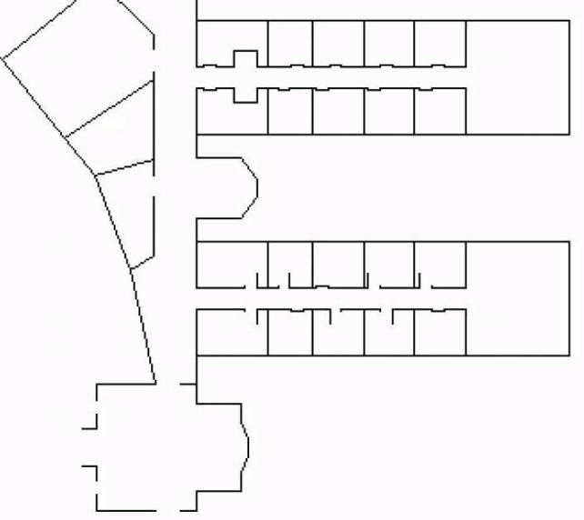
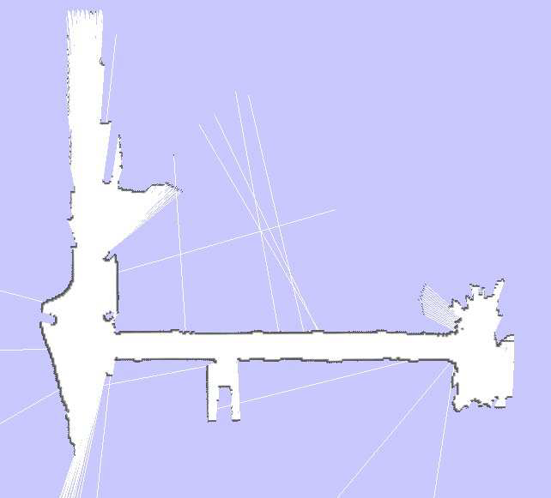
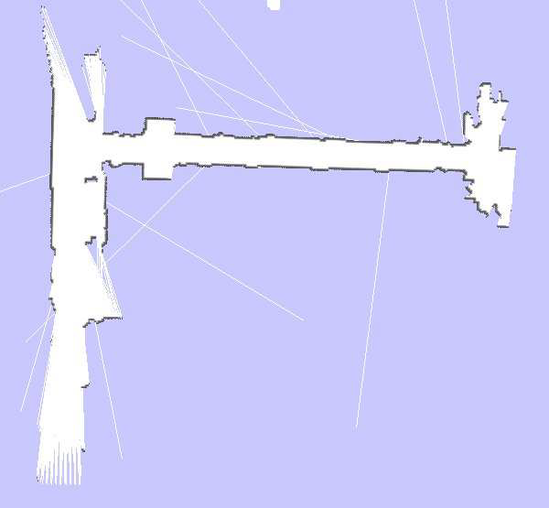
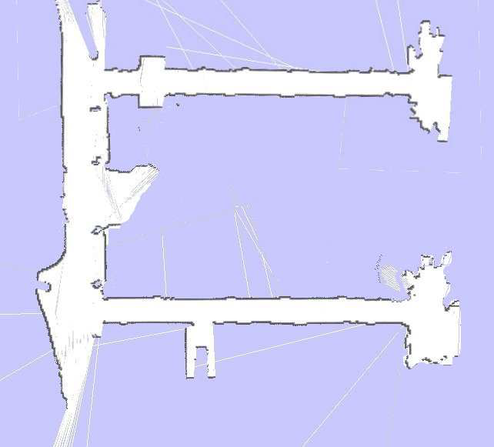
Multi Robot SLAM and Map Merging
Need for Map Merging
Scan Matching SLAM
The main aim is to find the most likely global map.
Define map m based on the laser scan, pose and time.
Take various laser measurements and odometry readings for different time slots.
Reference
http://tv.uvigo.es/uploads/material/Video/2662/P05.pdf

Slide 3
SLAM with RFID Technology
Technique:
Laser range scanner and two RFID antennas.
Uses “map previously learned from laser range data.”
Estimate location of RFID tags.
Apply Monte Carlo localization to estimate location
Benefits:
Reduces time required for localization of robot.
Accurately localize moving objects.
Low cost to implement.
[1] Dirk Hahnel, Wolfram Burgard, Dieter Fox, Ken Fishkin, Matthai Philipose. “Mapping and Localization with RFID Technology.” Intel Research. December 2003. <http://edge.rit.edu/content/P12015/public/Referenca%20Materials/RFID%20READER%20SKYTEK%20M9%20Module/Mapping%20and%20Localization%20with%20RFIDs.pdf>
Notes:
Cons – materials (metals) absorb RFID energy, angle of tag affects energy

Slide 4
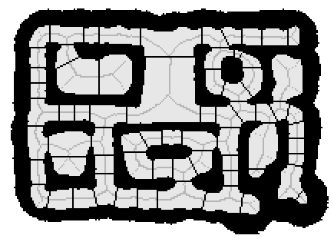
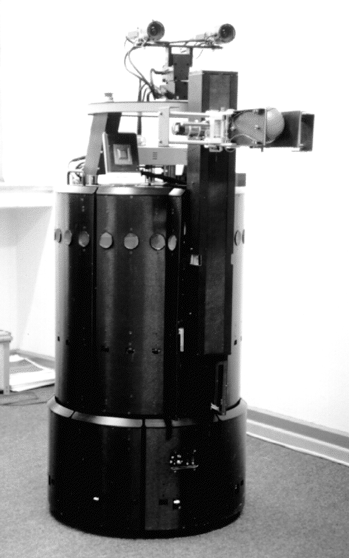
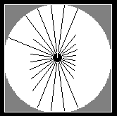
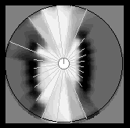
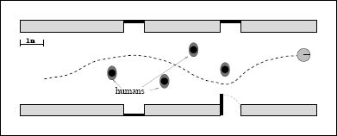
RHINO High-Speed Mapping and Navigation
Mapping
Grid-Based Maps
Ultrasonic Sonar
Stereo Camera
Integration
Topological Maps
Localization
Wheel Encoders
Map Matching
Sonar Modeling
Maneuverability
Wall Orientation
Landmarks
Navigation
Global Planner
Collision Avoidance
Hard Constraints
Soft Constraints
Figure 2: Example of Topological Mapping
(a) (b)
Figure 1: Bird’s Eye View of (a) Ultrasonic Sensor and (b) Occupancy Mapping
Figure 3: Example of Navigation
Reference
Thrun, Sebastian, et al. "Map Learning and High-Speed Navigation in RHINO." http://www-home.fh-
konstanz.de/~bittel/robo/thrun_MapLearningAndNavigationInRhino.pdf (accessed July 7, 2012).

Slide 5
Stanley – Stanford University DARPA Challenge
Probabilistic Terrain Analysis Algorithm (Enabled High Speed Desert Driving).
5 LIDAR Units used for 3D Mapping.
Inertial guidance system (3 gyroscopes and 3 accelerometers).
GPS Waypoints.
Color Video Camera.
Output data from the 3D LIDAR was compressed into a 2D map divided into a grid of 30 x 30 cm cells.
Cells are then designated as either: drivable, obstacle, or unknown.
Software algorithm compares samples of video deemed to be “drivable” by the LIDAR map and uses this “knowledge” to determine the “drivable surface in the remainder of the video.

Slide 6
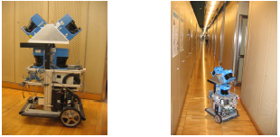
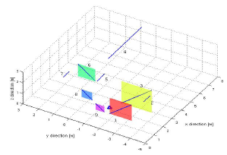
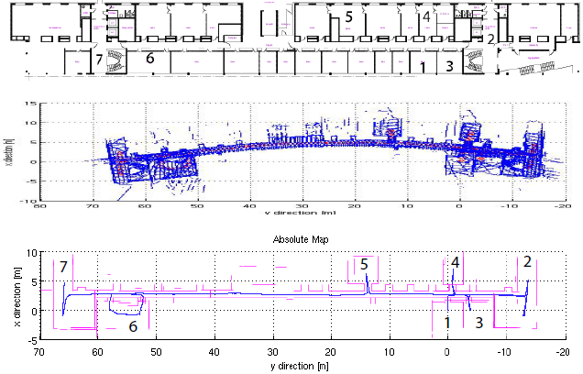
A Lightweight SLAM Algorithm for Indoor Environment
Assumptions: Orthogonality
Most indoor major structures can be represented by sets of parallel or perpendicular lines or planes. Only map planes verifying the Orthogonality constraint.
Removes estimation of the robot’s 3D orientation
Reduces mapping of the orthogonal planes to a linear estimation with one parameter per plane
Divides planes into three groups: X-Planes, Y-Planes and Z-Planes
Within a group, the orientation of the planes is known. Only need to estimate the distance from the origin to the plane.
Pros: Simple, fast and reduced processing power
Cons: Orthogonality assumption, does not work well in outdoor environment or with complex surfaces
Reference:
A Lightweight SLAM Algorithm using Orthogonal Planes for Indoor Mobile Robotics, Nguyen, V; Harati, A; Siegwart, R. Autonomous Systems Laboratory. Swiss Federal Institute of Technology

Slide 7
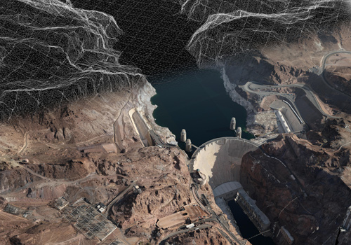
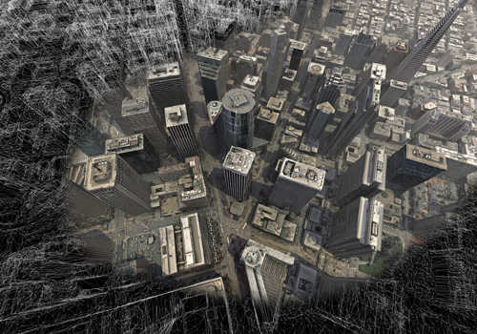
Slam – Rapid 3D Mapping
SLAM is the problem of building a map of an unknown environment while at the same time navigating the environment, using the unfinished map
3D maps give you an overhead view of a location, like a traditional paper map. 3D maps give you a schematic, angled view of the route ahead of you, as if seen from the air above you.
http://www.saabgroup.com/Global/Documents%20and%20Images/Campaigns/Rapid%203D%20Mapping/Hoover_Dam_Rapid_3D_Mapping_small.jpg
3 Steps to Superior Awareness
Fly
Generate
View
3D Mapping Applications Videos
http://www.saabgroup.com/Global/Documents%20and%20Images/Campaigns/Rapid%203D%20Mapping/SanFransisco_small.jpg
http://www.youtube.com/watch?v=s6odzWGqi70&feature=player_embedded
http://www.youtube.com/watch?v=CNemPTHOKWg&feature=player_embedded
Notes:
SLAM in the mobile robotics community generally refers to the process of creating geometrically consistent maps of the environment. Topological maps are a method of environment representation which capture the connectivity (i.e., topology) of the environment rather than creating a geometrically accurate map. As a result, algorithms that create topological maps are not referred to as SLAM.
For SLAM, two tasks have to be solved: First reliable feature extraction and data association, second the optimal estimation of poses and features. These two parts are often referred to as SLAM frontend and backend
3D mapping makes it easier to visualize your next move along the way

Slide 8
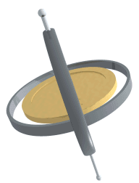
IMU and Lidar J. Scot Collins
IMU – Inertial Measurement Unit
3 Gyroscopes
Measures the rotation around/about an axis.(Pitch, Roll, Yaw)
The rate of change of the angle.
3 Accelerometers
Measure the acceleration indirectly through a force that is applied to one of its walls/springs.
Videos:
http://youtu.be/cquvA_IpEsA - gyro
http://youtu.be/sieBqVxTz2c - IMU/LIDAR
LIDAR – Light Detecting and Ranging
Emits laser light and detects the light reflected back by objects. Based on the time to return distance can be determined.
Can scan up to 360 degrees continuously.
References:
Livesay, Ed. “Accelerometer spring model.” Drawing. The Traffic Accident Reconstruction Origin 6 Aug. 2012. <http://tarorigin.com.>
Kieff. From Wikimedia Commons. <http://en.wikipedia.org/wiki/File:Gyroscope_precession.gif.>http://absoluteastronomy.com
Tandy, Michael. From Wikimedia Commons.<http://upload.wikimedia.org/wikipedia/commons/c/c0/LIDAR-scanned-SICK-LMS-animation.gif.>
Gadget Gangster. “Accelerometer & Gyro Tutorial.” Instructables. 6 Aug. 2012. <http://www.instructables.com.>

Slide 9
iRSP SLAM 3D Execution
This PowerPoint is about the demonstration of 3D SLAM capability of a robot using iRSP(intelligent Robot Software Platform). The map data for the demonstration is updated from the calculated position of the robot using simulated onboard range sensors.
Simulated robot:
Motor: 2 DC Motors
Sensors:
1D range sensor: 8 Sonar sensors
3D range sensor: Xtion-Pro
Direction sensor: Absolute Compass Sensor
Video: http://www.youtube.com/watch?v=AByETaadky4

Slide 10
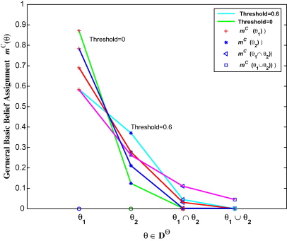
Intelligent Technologies for SLAM
Spiking neural network human localization
Mapping in unknown locations
Neural gas
Evidence supporting measure of similarity
Unified fusion approach
http://www.sciencedirect.com/science/article/pii/S002002551000530X

Slide 11
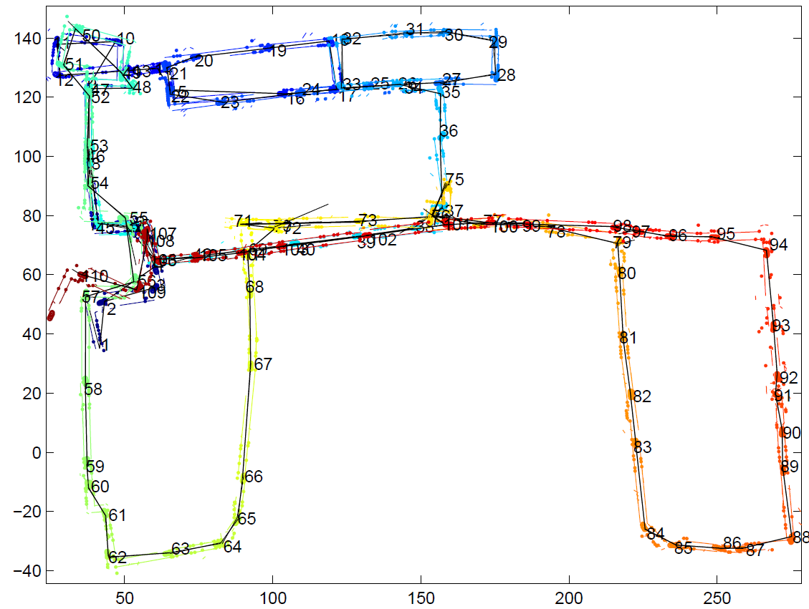
Atlas – mapping of large-scale environments
Algorithm: Dijkstra
Shortest Path
Results:
101 map-frames
15 mapped line segments
Starts at a source vertex
Creates a tree to other vertices
Ordered by distance
Method of Storage:
Local Region SLAM
Map-frame hypotheses
Juvenile
Mature
Dominant
Retired
Visualization:
Global Optimized Map
Atlas graph
Bosse, Newman, Leonard, et al. International Conference on Robotics and Automation, TBipei, Taiwan, September 2003, pp. 1899-1906

Slide 12
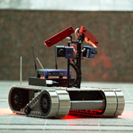
MITRE
-Improving design on UGA’s and UAV’s
-Now 2D Frames of video
-Moving to 3D Virtual Mapping on the move
-For use in Military situations
-city streets -building interiors
-Uses stereo vision and flash LIDAR
http://www.mitre.org/news/digest/advanced_research/06_08/a_situation.html

Slide 13
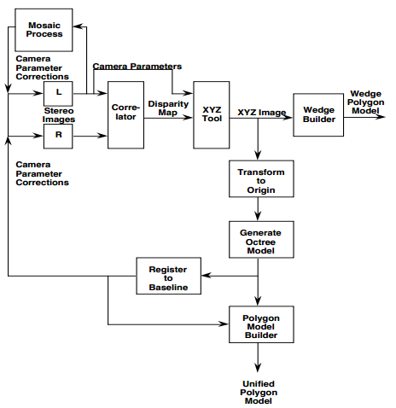
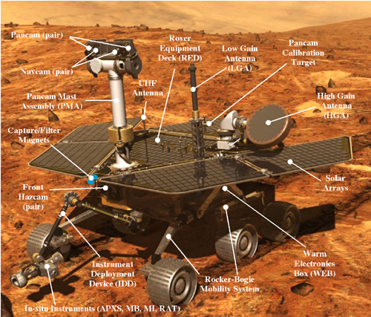
Mars Rover – SUMMITT/Waypoint and Frames
System for Unifying Multi-resolution Models and Integrating Three-dimensional Terrains
Utilizes 3 sets of fixed cameras with each in stereo
Each camera produces a disparity map that identifies matching features in each image
Computes the range to a pixel in one image to its matching pixel in the other image
Used to create XYZ point cloud model_{[2]}
IMU and motor encoder
Rover Motion Counter for vehicle moves
RMC resets when a site frame is made
SUMMITT Flow Diagram [1]
Site frame created when the total localization error is at a point that targeting accuracy suffers
Many site frames can be combined in order to form a comprehensive operational map_{[3]}
MER [2]
[1]http://wwwdial.jpl.nasa.gov/public_html/john/papers/SMC_Hawaii/SMCpaper.pdf
[2]http://marsrover.nasa.gov/mission/spacecraft_surface_rover.html
[3]http://wwwrobotics.jpl.nasa.gov/publications/Mark_Powell/IEEE_IRI_06_Targeting.pdf

Slide 14
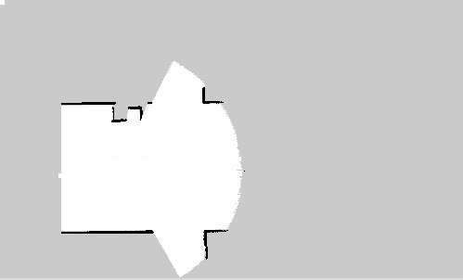
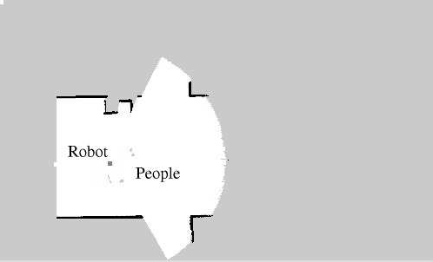
Online SLAM in Dynamic Environments
Uses Kalman Filter to estimate robot position and landmarks
Uses 3 occupancy grids static, dynamic, and location
Static map is created first then dynamic
Dynamic objects must move at least once
Third map used for location of landmarks for localization
Static Map Dynamic Map Combined Map
Source:http://cres.usc.edu/pubdb_html/files_upload/378.pdf

Slide 15
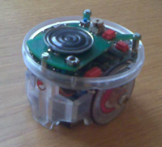
Occupancy Grid Mapping (OGM)
Occupancy grids were first popularized by Hans Moravec and Alberto Elfes at CMU, Pittsburgh, PA.
Maps the environment in a 2D array.
The Robot knows its location at all times.
Each cell holds a probability value that the cell is occupied.
Bayes Law: p(A | B) = p(B | A) * p(A)
p(B)
Typical sensors: Sonar, Laser, IR, Bump, etc.
http://www.ikaros-project.org/articles/2008/gridmaps/
Map-Making Robots
http://www.ikaros-project.org/articles/2008/gridmaps/
E-puck robot (www.e-puck.org)

Slide 16
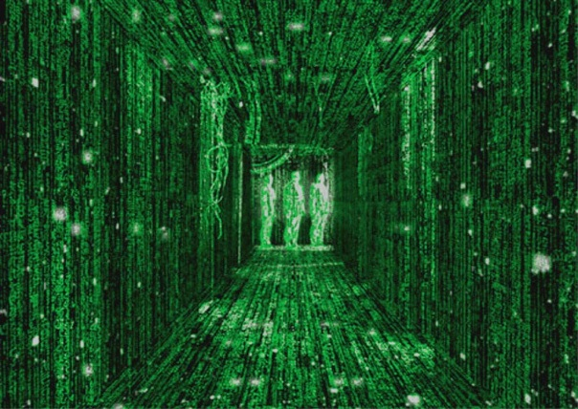
R.O.A.M.S.
[3]
R.O.A.M.S. is an acronym for Remotely Operated and Autonomous Mapping System
ROAMS uses a unique 3-axis rotary actuator to enable the LIDAR to be used both as 2D (Obstacle avoidance) and 3D (Mapping)
Students at Stevens have developed their own software based Operator Control Unit (OCU) so anyone from any network connected PC can control the ROAMS robot
ROAMS is only capable of acquiring 3D LIDAR scans while it is stationary
[1]
Multiple Path Planning sensors are used such as IR, GPS, and real time video
Video registration is used for texturing of scan points to provide photo realistic 3D maps
What will this mean for the Future?...
[2]
[4]
Ergonomically designed to fit into most commercial office/building spaces
[5]
References:
[1] (2011). Remotely Operated and Autonomous Mapping System (ROAMS) (2011).
[Web Photo]. Retrieved from http://www.ballos.com/tepraconnect_interface/TePRA09/335.pdf/
[2] (2012). Remotely Operated Autonomous Mapping System: (2012).
[Web Photo]. Retrieved from http://www.dmi.stevens-tech.edu/index.php /
[3] (2012). Stevens (Stevens IOT LOGO)(2012).
[Web Photo]. Retrieved from http://www.stevens.edu/sit/
[4] (2011). The World OF Matrix (2011).
[Web Photo]. Retrieved from http://blogs.cornell.edu/newmedia11jz387/2011/04/13/the-world-of-matrix/
[5] (2011) Reflection intensity panorama produced by ROAMS scanner. In complete darkness.(2011).
[Web Photo]. Retrieved from http://www.dmi.stevens-tech.edu/index.php
Enter the Matrix…
Reflection intensity panorama produced by ROAMS scanner. In complete darkness.
Presented by: Benjamin B. Rhoades
Date presented: 8-7-2012

Slide 17
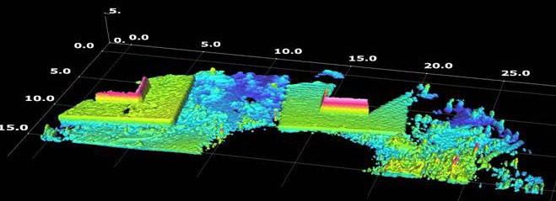
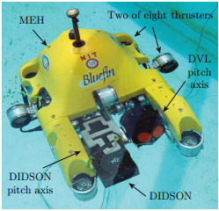
SLAM using DIDSON-Acoustic Imaging Sonar
Figure 1: 3D Ocean Floor Mapping [2]
Figure 2: HAUV with DIDSON [1]
Applications: ship hull and infrastructure inspection, marine structure inspection, under water survey and navigational based mapping
Sensors:
DVL (Doppler Velocity Log) – navigation “underwater GPS”, under water current tracking
Depth Sensor
DIDSON 1.8MHz (Dual frequency Identification Sonar) – uses sound waves to map and create an image of the ocean floor or the hull of a ship
Procedure:
SLAM uses the data and statistics acquired from the on board sensors and DIDSON
Sensors and DIDSON combine to create 2D and 3D maps of unknown objects/environments
Improves accuracy of existing maps by localization and not relying on external infrastructure
Works Cited:
[1] Publication: “SLAM for Ship Hull Inspection using ESEIF” Massachusetts Institute of Technology, Walter, M.; Franz, H.; Leonard, J. (pages 1-8). http://people.csail.mit.edu/mwalter/papers/walter08a.pdf
[2] http://www.oceanmarineinc.com/sonar-systems/didson-software_P1019

Slide 18
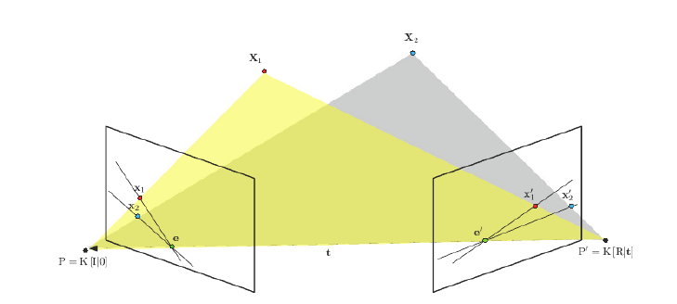
Real-Time Stereo Visual SLAM
-What is simultaneous localization and mapping?
-Most common sensors used for SLAM:
-Laser ranging
-Sonar
-Inertial
-Vision
Why are vision based sensors superior in a SLAM application?
Why stereo visual slam?
Processing stereo SLAM:
-images are captured using two cameras
-converted to gray scale
-scale spaces are created
-correspondences are estimated using
camera projection matrixes
-based off of initial calibration of cameras
P. Elinas, J. Little, R. , " Stereo vision SLAM: Near real-time learning of 3D point-landmark and 2D occupancy-grid maps using particle filters.," University of British Columbia
S. Thomas, "Real-time Stereo Visual SLAM," Heriot-Watt University

Slide 19
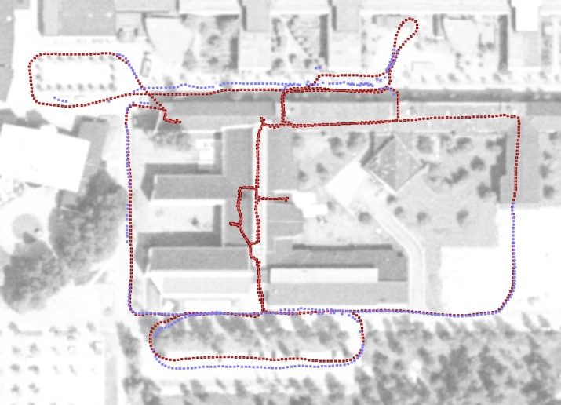
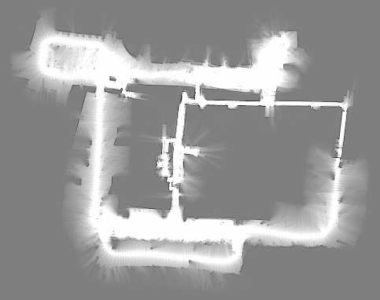
Mini-SLAM
Hardware uses odometry and an omnidirectional camera.
The camera supplies information used by SLAM algorithm.
More consistent maps created.
Map estimations done by a linear time SLAM algorithm using graph representation.
Scales better due to not estimating landmark locations
Instead, object similarity used to determine landmark locations.
Uses Multilevel Relaxation algorithm to determine that objects in images are the same.
“Mini-SLAM: Minimalistic Visual SLAM in Large-Scale Environments Based on a New Interpretation of Image Similarity.” Henric Andreasson, Tom Duckett, and Achim Lilienthal. <http://aass.oru.se/~han/papers/icra07andreasson.pdf>.
19

Slide 20
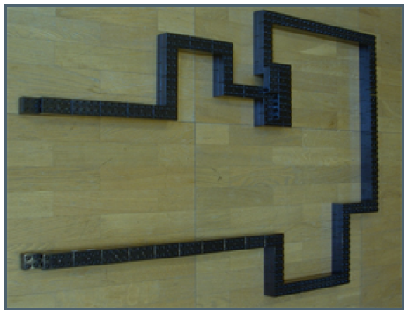
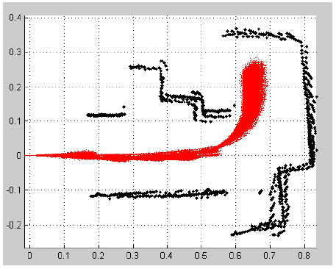
Particle Filter Based SLAM
2 reference frames
Robots
Sensor ex: Odometer
World
Sensor ex: laser rangefinder
Example Algorithm Psuedo Code
For Each line in logfile
If logfile line = odometer entry
-predict particle
If logfile line = laser rangefinder
For Each particle in particle set
-Extract corners & decide if new
if corner has been seen previously
compute new weight of corner
else
add new corner to particles
Top: Course Bottom: Particle filter calculations[1]
[1] Luciano, S. Xavier. P. Exercise 4: Particle Filter Based Slam, 2008, Autonomous Systems Lab Swiss Federal Institute of Technology, Zurich

Slide 21
SLAM Robot: Laser Range Finder and Monocular Vision
Harbin Institute of Technology
Autonomous Robot
Weighted least square fitting
Canny Operator
Kalman filtering (KF): localization & grid map building simultaneously
Experiment Robot:
CMOS camera and optic mica
Radio Ethernet
Reference: SLAM for Mobile Robots Using Laser Range Finder an d Monocular Vision, Sheng, F.; Hui-ying, L.; Lu-fang, G.; Yu-xian, G.; 2007 IEEE

