Slide 1
ECGR4161/5196 – Lecture 9 – July 10, 2012
Today:
Presentations – Robots (recorded in two sessions, with a break in the middle).
Lab questions/time (Sam)
Quiz 6

Slide 2
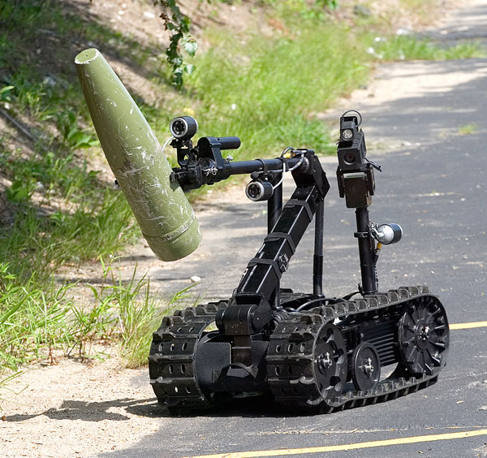
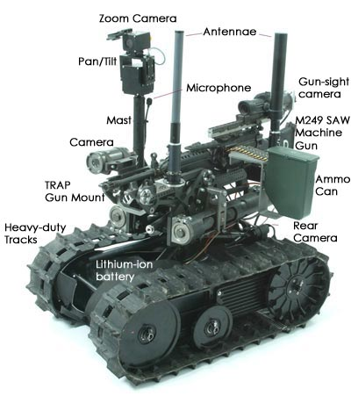
Foster- Miller TALON
most common robot in use by the military
RF or Fiber-optic link from an Operator Control Unit
travel through sand, water, snow, and up stairs
color, b/w, infrared, and night vision cameras
8.5 hour; 2 lead, 1 Li-ion
4 versions: IED/OED, SOTAL, SWORDS, HAZMAT
IED/EOD TALON
controllable arm
100 pounds
SWORDS TALON
guard/combat roles on the frontline
M16, M240, M249, 50-caliber, M202 –A1
IED/EOD TALON [1]
[1] http://www.qinetiq-na.com/products/unmanned-systems/talon/#!prettyPhoto[success1]/0/
[2] http://science.howstuffworks.com/military-robot2.htm
SWORDS TALON [1]

Slide 3
Adept AIV
Autonomous indoor vehicle designed to deliver materials.
25 kg Payload
Uses
lasers for distance measurements and object avoidance
sonar for object avoidance
Differential Drive System
Mapped paths taught by user
http://go.adept.com/autonomy
http://www.adept.com/products/mobile-robots/mobile-transporters/sph-2200/general
Image:http://www.globenewswire.com/newsroom/prs/?pkgid=13576

Slide 4
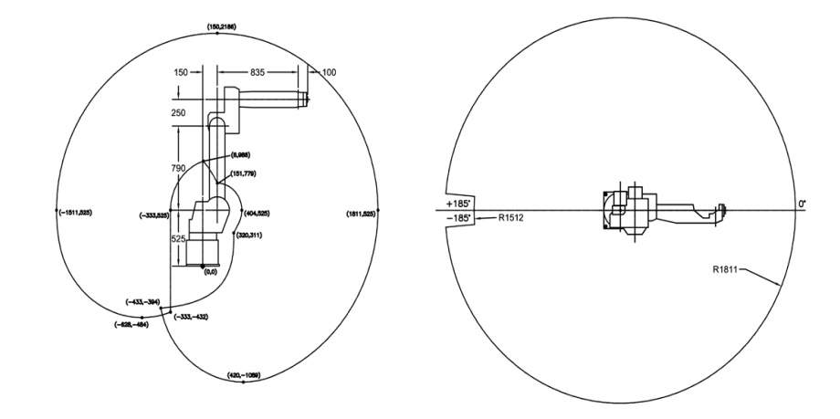
FANUC ArcMate 120i Robot (RobotWorx)
Advantages:
Improve quality
Conserve paint
Safety
Save Energy and Space
Features:
Degrees of freedom: 6
Electric servo motors
Horizontal reach: 1811mm
Payload: 20Kg
Mounting: F, C, W, A
Integrated Controller
http://www.robots.com/blog/viewing/5-reasons-buy-a-robotic-spray-painting-arm/453
http://www.robots.com/fanuc/arcmate-120ic/657

Slide 5
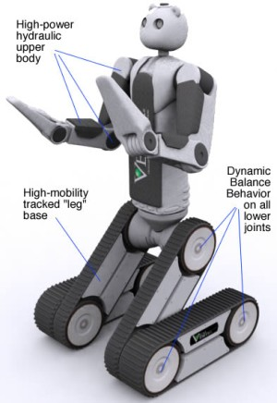
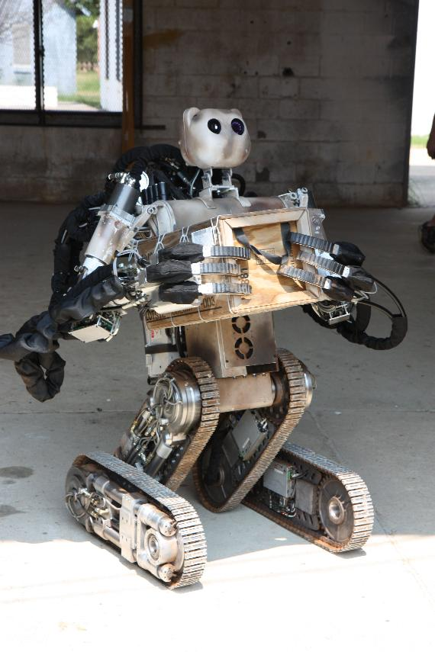
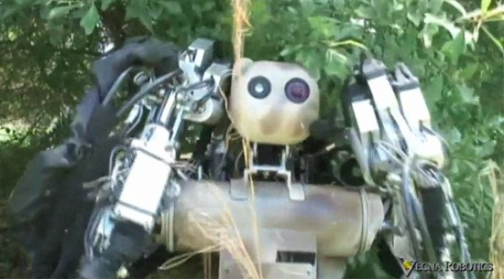
“B.E.A.R” Robot
The B.E.A.R is an acronym for Battlefield Extraction-Assist Robot
Currently a semi-autonomous robot that can rendezvous at GPS locations or specific mapped out targets
Unique form of locomotion that includes tracks and a biped design that work in unison to enable to Bear to traverse all terrain types
Current sensors on the bear include:
Tactile sensors on fingers
360° IR and color situational awareness camera’s
Newly developed Micro-Hydraulics used for precision handling
The Bear’s three fingered hands have 6 degrees of freedom
[3]
[1]
The Bear is suppose to have a “friendly” appearance… I will let you be the judge of that!
Currently under proof-of-concept phase of development
Next Phase is BEAR 8.0 due to debut in late 2012
[4]
References:
[1] (2010). Andrew Allen of the Bear Robot Program is Interviewed by Sander Olson(2011).
[Web Photo]. Retrieved from http://nextbigfuture.com/2010/09/andrew-allen-of-bear-robot-program-is.html
[2] (2012). The Bear™ Vecna Robotics LOGO. . (2012).
[Web Photo]. Retrieved from http://www.vecna.com/robotics/solutions/bear/index.shtml
[3] (2012). New Robots Navigate by “Guessing” What’s Ahead before Seeing (2007).
[Web Photo]. Retrieved from
http://news.softpedia.com/newsImage/New-Robots-Navigate-by-Guessing-What-039-s-Ahead-before-Seeing-2.jpg/
[4] (2012). Bear Robot Designed to Save Lives, Looks Like It Will Kiss Us All (2010).
[Web Photo]. Retrieved from http://technabob.com/blog/2010/09/05/vecna-bear-robot/
Demo Video
[2]
Presented by: Benjamin B. Rhoades
Date presented: 7-10-2012

Slide 6
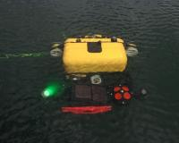
HAUV (Hovering Autonomous Underwater Vehicle)
Program: autonomous survey operation uploaded via “intuitive mission planning tool” software that enables dives, data retrieval, and reporting to occur automatically
Applications: ship hull and infrastructure inspection, unexploded ordnance, scientific research, mine countermeasures, security
Energy: 1.5kWh Lithium-Polymer battery pack
Propulsion: 5 thrusters for stability and control
Sensors:
IMU (Inertial Measuring Unit) - velocity, orientation, gravitational forces
DVL (Doppler Velocity Log) – navigation “underwater GPS”, under water current tracking
Depth Sensor
DIDSON 1.8MHz (Dual frequency Identification Sonar) – uses sound waves to map and create an image of the ocean floor or the hull of a ship
Figure1
Figure 2
Works Cited:
[1] http://www.bluefinrobotics.com/products/hauv/

Slide 7
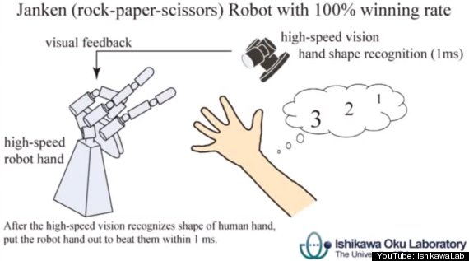
Rock, Paper, Scissors Robot
Developed by researchers at Sensor Fusion Lab in Tokyo, Japan
100% success rate against humans
Uses a robotic actuator that represents a human hand (with three fingers and a movable wrist joint)
The wrist angle of the robot will mock the humans during the initial counting. (1,2,3, shoot)
Implements a high-speed camera that is programed to recognize hand shapes.
The response time of the actuator is within 1ms after the hand shape recognition has determined the shape of the humans hand
As a result, it is undetectable by the human eye that the robots hand shape is formed after the humans.
Why is this relevant?
This project is an excellent example of robotic and human interaction that has a very small time-delay
Therefore with this technology, robots are able to react to human motions in real time.
http://www.huffingtonpost.com/2012/06/27/rock-paper-scissors-robot-video_n_1631359.html

Slide 8
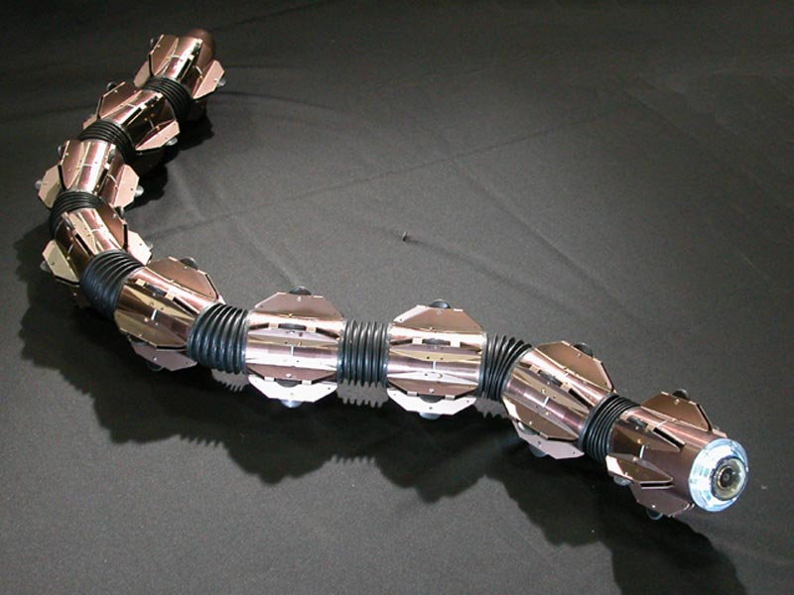
Amphibious Snake
By Alex Moster
Uses snake like movements to move over land or through water
Though it has what looks like wheels, they are not motorized
Each of the joints on the robot has a CPU, battery, and motors
Each joint can move independently and communicate with the rest
It is not remote controlled but rather moves freely on its own
http://www.youtube.com/watch?v=LZJslSbsLOU
All images from: http://www-robot.mes.titech.ac.jp/robot/snake/acm-r5/acm-r5_e.html
8

Slide 9
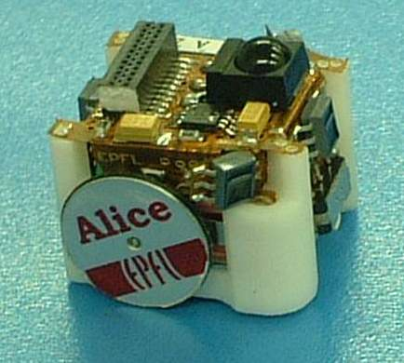
ALICE Micro Robot
Very small (2x2x2cm)
Up to 10 hours of autonomous life
2 motors to power each wheel individually
Goal of this robot was to:
Design an intelligent robot as cheap and small as possible
Provide a hardware platform for further research
Study how they react with one another in a massive quantity
On-board Modules: Linear Camera, Radio Communication, Tactile Sensors
http://www.hizook.com/projects/alice
http://www.hizook.com/files/users/3/Alice_Micro_Robot.jpg

Slide 10
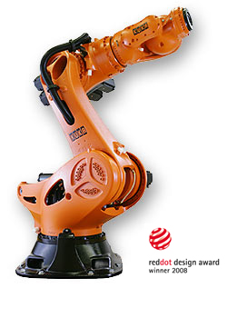
KUKA KR 1000 TITAN
Heavy Duty 6-axis Industrial Robotic Arm
Withstands static torque: 60,000 N-m (44,253.7 lb-ft)
Payload: 1000 kilos(2,204.6 lbs)
Weight : 4700 kilos (10,361.7 lbs)
Reach : 3.2 meters (10.5 ft)
9 motors = power of a car
axes 1 & 3 = two motors feed into a single
gear
axis 2 = powered by two large motors w/
own gear
PC based control platform
Arm in action: http://www.youtube.com/watch?v=aZRT1MpTkQk&feature=related

Slide 11
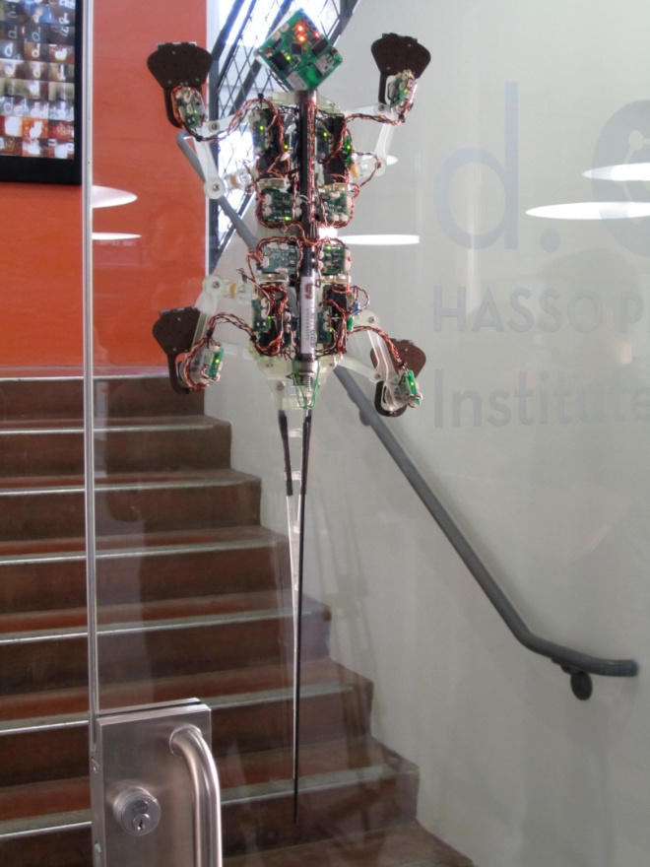
Stickybot III
Features
Uses Directional dry adhesion
4 DoF
16 Servo motors
Climbs at 5 cm/sec
Sensors
Hall Effect
Youtube Videos
http://www.youtube.com/watch?v=odAifbpDbhs
http://www.youtube.com/watch?v=0y2MVuSyQlg&feature=relmfu
Reference
http://bdml.stanford.edu/twiki/bin/view/Rise/StickyBotIII.html
R.J. Full and M.R. Cutkosky, "From Bio-Inspiration to Robotic Implementation," joint presentation at IEEE ICRA07 Workshop [SF-1] on Biomimetic Robotics. Saturday, 14 April, 2007, Rome, Italy.

Slide 12
Robot Fish (University of Essex)
Autonomous, battery-powered robot
5-foot-long
Fins constructed using oscillating servomotors
Proximity sensors
Depth and pitch sensors
Chemical sensors
Wireless internet signal transmission
monitor oxygen levels in the water, detect oil slicks spilled from ships or contaminants pumped into the water from underground pipes
http://news.nationalgeographic.com/news/2005/10/1007_051007_robot_fish.html
http://news.bbc.co.uk/2/hi/sci/tech/4313266.stm
Video Link: http://www.metacafe.com/watch/1424021/robot_fish/

Slide 13
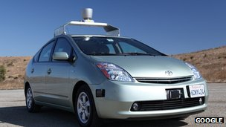
Google’s Driverless Car (Stanley)
Car that drives to a location by itself.
Utilizes Google Maps and sensors on the car.
Sensors:
Video cameras
LIDAR
GPS
Radar sensors
Movement:
Uses motor, tires, brakes, steering, etc. already in car.
Has been implemented on Toyota Prius, Audi TT, and Lexus RX450h.
Uses:
Decrease amount of traffic accidents and deaths.
Increase efficiency on the roadway.
http://www.bbc.co.uk/news/technology-17989553

Slide 14
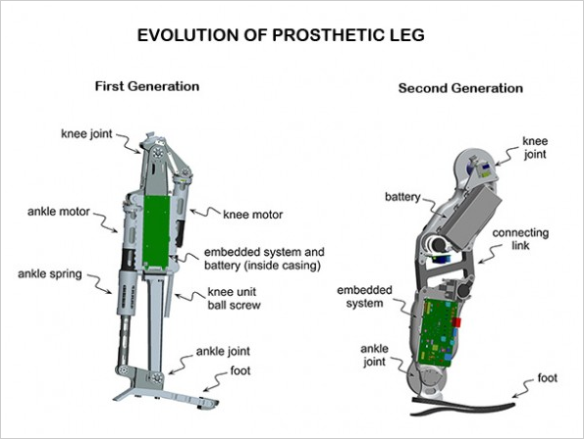
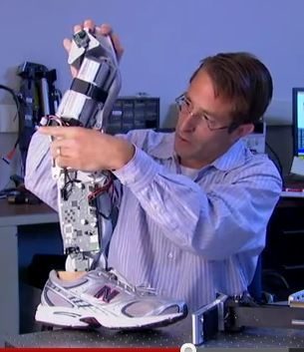
Vanderbilt University - Bionic Leg
Major Features
Computer
Performs several tasks simultaneously
Technology based off of microcontrollers in smart phones
Sensor
Stair ascent
Anti-stumble routine
Electric Motor
Knee joint
Ankle joint
Battery
Operates for approximately 3 days of normal activity or 13 to 14 kilometers of continuous walking
Other
Currently working on noise reduction
About 9lbs.
(1)
“A passive leg is always a step behind me. The Vanderbilt leg is only a split-second behind.”
-Craig Hutto
References
http://news.vanderbilt.edu/2011/08/bionic-leg/
http://nanopatentsandinnovations.blogspot.com/2012/01/bionic-man-amputee-faster-on-his-feet.html
Mechanical Engineer Michael Goldfarb
(2)

Slide 15
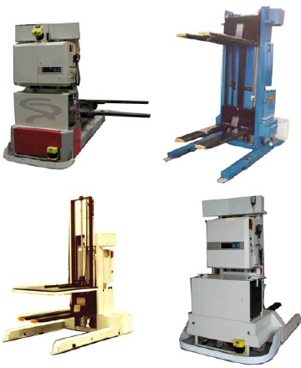
Automatic Guided Vehicle - Forklift
Mechanical: Vehicle chassis made of steel plate at the base of the vehicle. Low center of gravity for stability
Drive Unit: Combination drive/steer wheel includes drive motor, steer motor, potentiometer, encoder (measures the movement of the lift), fail-safe brake
Lift Unit includes a ball screw driven by an electric motor, fail-safe brake and encoder to measure lifting movements
Control:
Automatic: wire guided and laser
Manual: Hand held controller, display panel
Handle complex navigation with multiple AGVs
Communications: WiFi 802.11(b) or wireless spread spectrum
Software: De’Carte – Vehicle offboard control system based on Windows 2000 or XP and MS Visual Studio.net
Power/Electrical System:
Motor – 48 VDC
Control – 24 VDC, +/- 12 VDC, 5 VDC
Batteries last for 16-24 hours
http://www.amerden.com/AmerdenWeb/Documents/AGVSpecs/FLA.pdf

Slide 16
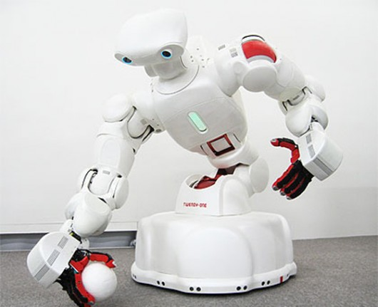
Twendy-One
PHYSICAL DIMENSIONS
Total of 47 degrees of freedom.
It measures 1.46m (4.8 feet) high and 73.4cm (2 feet) wide.
Weights 250lb
soft silicone skins and force sensors that detect physical contact with a person on any part of its body. This is a key component of a “passive impedance mechanism” that enables the robot to adapt to unexpected external forces on the fly.
MOBILITY
omni-directional wheel-based mechanism for mobility that allows the robot to move around efficiently even if the robot is in a narrow space.
twelve ultrasonic sensors and a six-axis force sensor to detect objects and humans near the robot and avoid collisions.
1
Notes:
PHYSICAL DIMENSSIONS
Total of 47 degrees of freedom.
It measures 1.46m (4.8 feet) high and 73.4cm (2 feet) wide.
Weights 250lb
soft silicone skins and force sensors that detect physical contact with a person on any part of its body. This is a key component of a “passive impedance mechanism” that enables the robot to adapt to unexpected external forces on the fly.
MOBILITY
omni-directional wheel-based mechanism for mobility that allows the robot to move around efficiently even if the robot is in a narrow space.
twelve ultrasonic sensors and a six-axis force sensor to detect objects and humans near the robot and avoid collisions.
FINGERS & HAND
4 fingers per hand that has 13 degrees of freedom.
In the fingertip, a six-axis force sensor and distributed force sensors are installed.
Each hand contains 241 pressure sensors, while the palm of the hand is covered in a 108 and the fingers contain a further total of 133.
ARM
shoulder and elbow have 7 degrees of freedom with a small and lightweight passive impedance adjusting mechanism.
The force sensors installed on the surface of the whole arm also enable the robot to recognize if it is holding a human or another heavy object under its arm.
TRUNK
four degrees of freedom in total with high power actuators installed into the joints enabling it to pick up a heavy object on the floor and even support a human body weighing up to 35kg (77-lb).
HEAD
two CCD cameras surrounded by LEDs, a speaker, and a six-axis force sensor
The head has three degrees of freedom - roll, pitch and tilt.
COST
Upon release the finalized robot is expected to cost between (approx. US$110,350 to US$220,700)

Slide 17
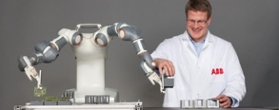
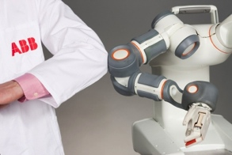
ABB FRIDA, PICK AND PLACE ROBOT J. Scot Collins
Friendly Robot for Industrial Dual-arm Assembly
Designed to work with humans, safety is a major priority.
Equipped with 2 arms, each with 7 axis and a servo controlled gripper lined with vacuum controlled suction cups.
Has the control system in torso, powered by single phase power.
Lightweight, portable and easily placed (clamped to a workbench) in a space of small size human worker.
Can be connected to vision cameras for optical awareness.
Limited power motor drives and software collision detection reduces danger to humans.
Ideal for small electronic assembly line production.
Video: http://youtu.be/9iYg9Vhg3OQ
Information
And Images: http://www.abb.com

Slide 18
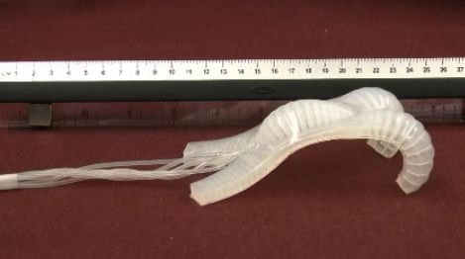
‘Gumby’ Robot
‘Gumby’ robot was built by Harvard scientists. It’s the cutting edge robot technology. The length of this robot is only 5” include 4 legs. This device has no hard materials and all the stiffness are coming from air pumping in from the tube. The possibilities for this device could be ENDLESS.
First rubberized robot
Built by silicon with mini chambers
Currently using remote control
Flexible
No sensors
Purposes:
Crawl in tight space
Clamp things
Explore and etc.
http://phys.org/news/2011-11-gumby-like-flexible-robot-tight-spaces.html

Slide 19
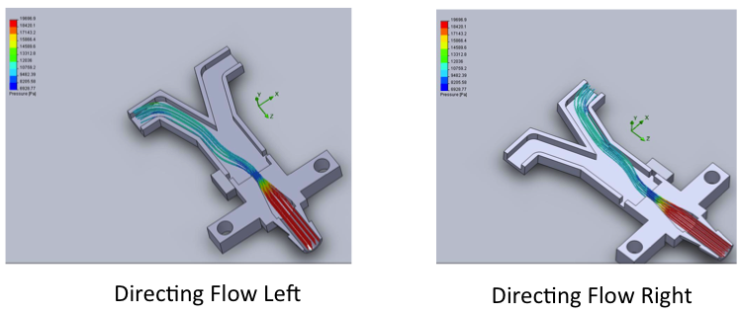
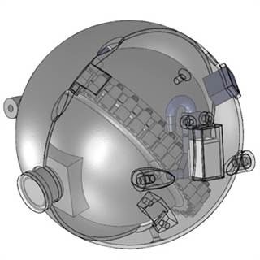
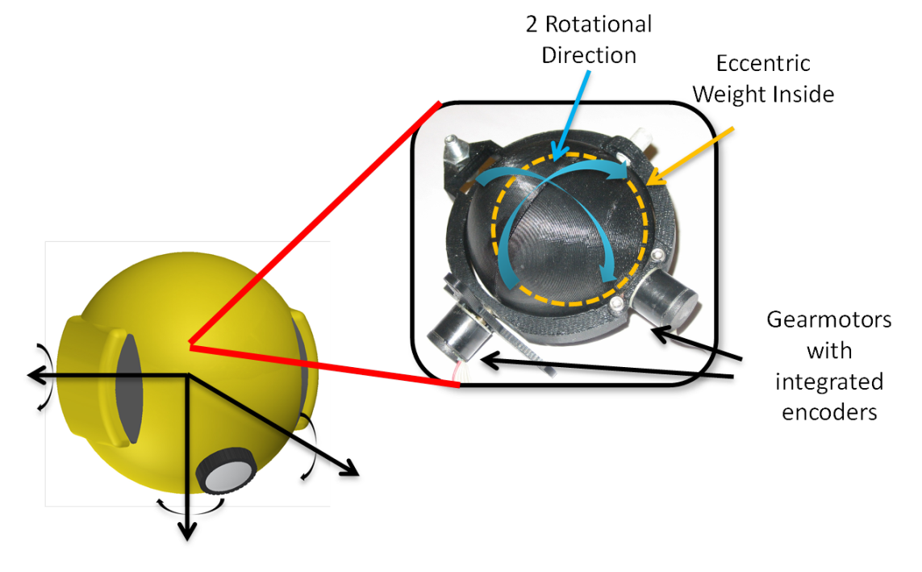
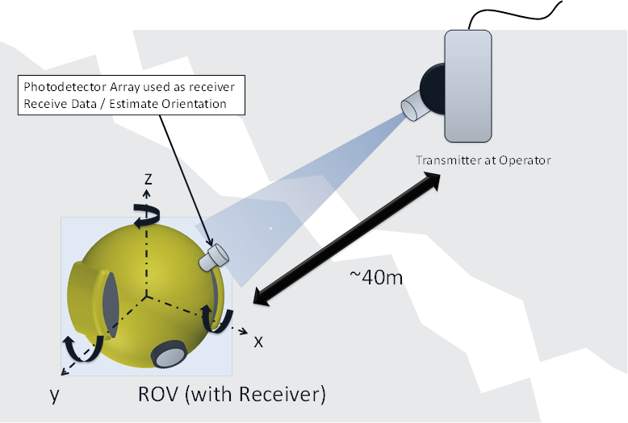
Nuclear Reactor Inspection Robotics
d'Arbeloff Laboratory
Harry Asada
Coanda Jet Actuators
http://www.futureoftech.msnbc.msn.com/technology/futureoftech/robot-may-monitor-nuke-plants-121504
Localization Using Visible Light Fields
Eccentric Mass Steering
http://darbelofflab.mit.edu/?q=node/13

