Slide 1
ECGR4161/5196 – Lecture 6 – June 14, 2012
Today:
Presentations - Robots
Wheel calculation
Exam preparation
Lab time

Slide 2
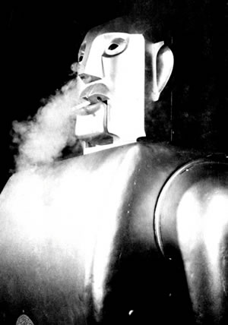
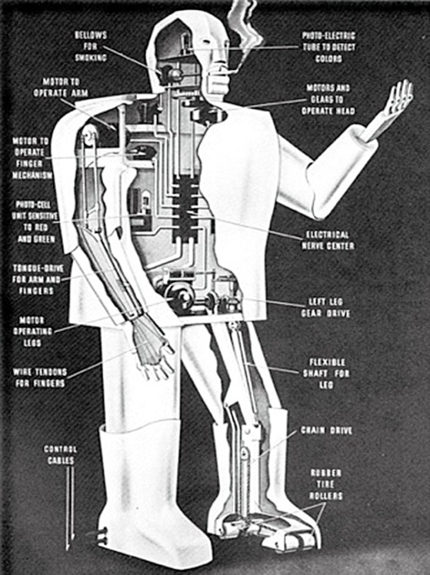
Elektro – The Motoman of the Future
Built by Westinghouse Corp. in 1937
Showcased at the New York World’s Fair
Able to talk, walk, smoke, and blow up balloons
Mostly used as a promo to sell appliances
http://davidszondy.com/future/robot/elektro3.htm
7 ft. tall, 265 lbs., hollow aluminum frame
Voice-activated
Record player used to store responses
Photoelectric tubes for eyes
Bellows used as “lungs”
Elektro in action:
http://www.youtube.com/watch?v=T35A3g_GvSg#t=01m16s
http://www.rps.psu.edu/probing/robots.html

Slide 3
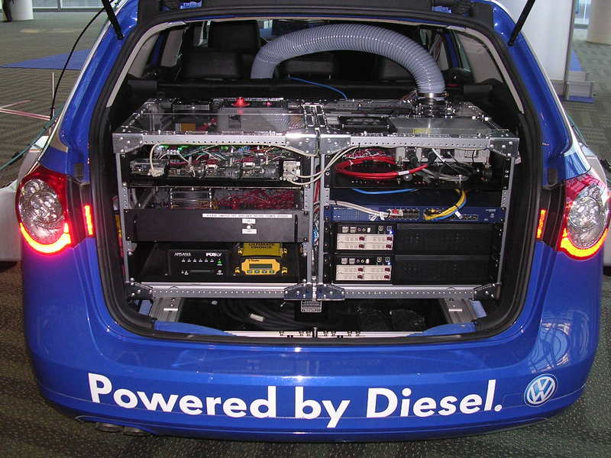
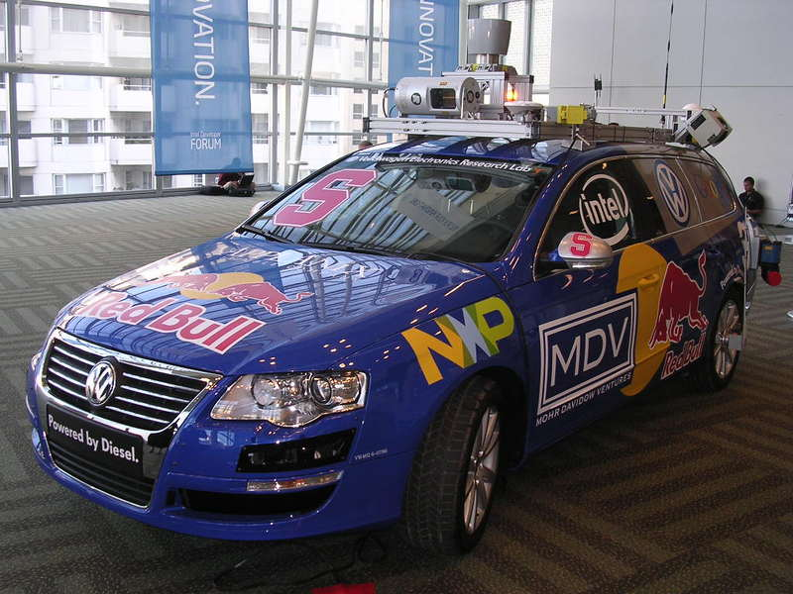
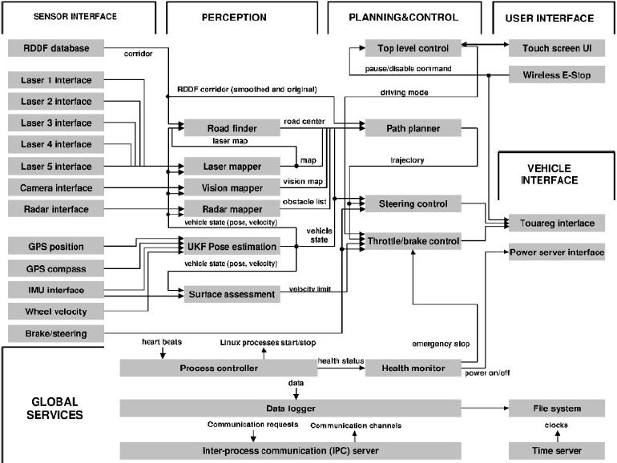
STANLEY: The DARPA Grand Challenge
Volkswagen Touareg R5
Diesel-powered
Four wheel drive
Electronic steering control
Custom roof rack
Computing System
Six Pentium M computers
Gigabit Ethernet switch
Custom Interface – Actuators
500 W power requirement
Environment Sensor Group
Five SICK laser range finders
Color Camera
Two 24 GHz RADAR sensor
Software Architecture
Positioning Sensor Group
GPS Antennae
GPS positioning system
Two GPS compass
Inertial measurement unit
http://www.getrobo.com/getrobo_blog/2007/09/post-1.html
http://www-robotics.usc.edu/~maja/teaching/cs584/papers/thrun-stanley05.pdf

Slide 4
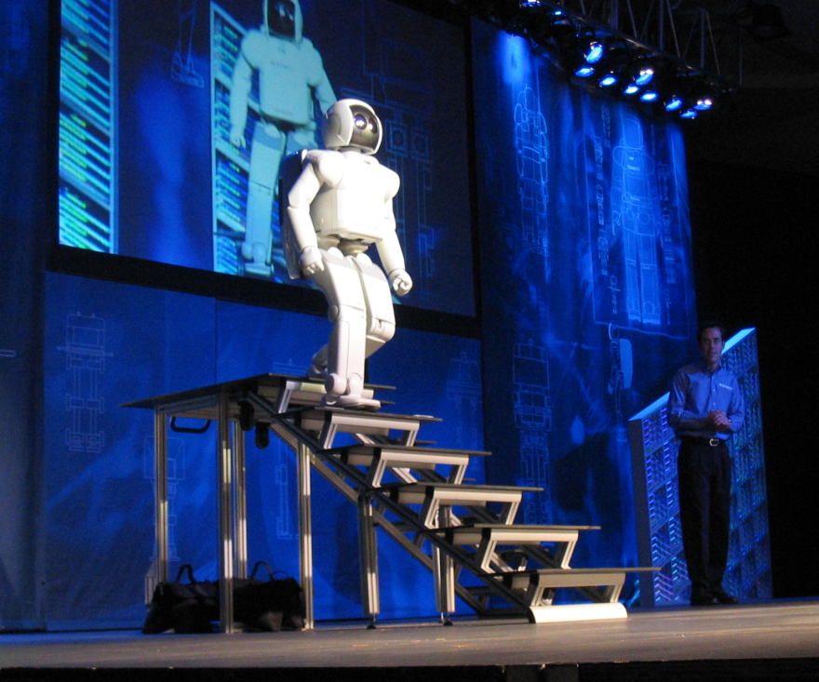
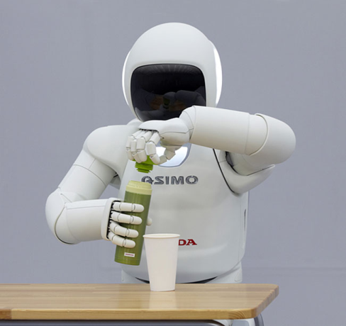
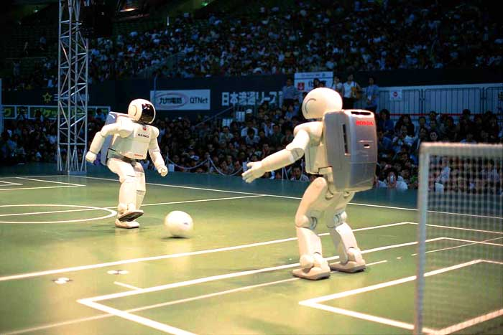
Honda ASIMO Autonomous Robot
Avoid Objects
Walk Over Uneven Terrain
Voice Recognition
People like Extrimities
Hopping and Jumping
http://en.wikipedia.org/wiki/File:Honda_ASIMO_Walking_Stairs.JPG
http://www.geeky-gadgets.com/hondas-new-asimo-robot-in-action-videos-08-11-2011/
http://oneoman.com/2011/11/08/honda-shows-smarter-asimo-robot-that-hops-applying-technology-to-help-in-nuclear-crisis/

Slide 5
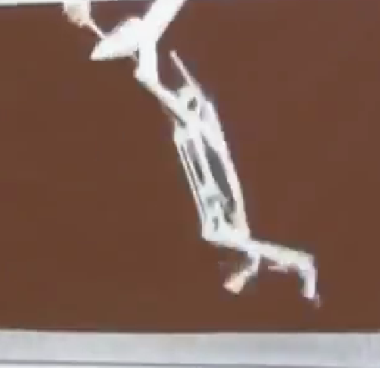
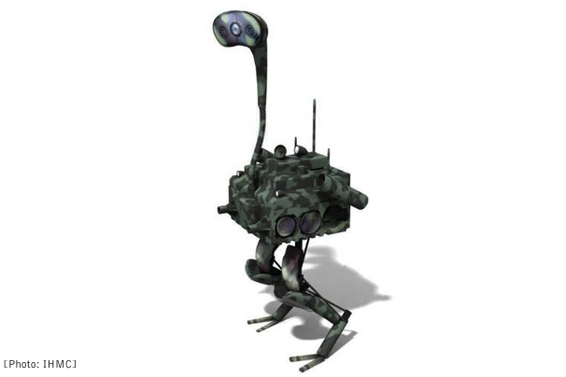
Robot Ostrich (FastRunner)
The Robot Ostrich(FastRunner) is a bipedal robot, which was developed at IHMC. FastRunner is a fast, extremely efficient and be able to maintain a high speed while being self-stabilizing. But this project is still under developing.
Can achieve 20, 30 even 50 mph
One actuator per leg
Recovers itself from small step down disturbances
Reaching 22mph in less than 6s
Lightweight
Open-loop stable

Slide 6
da Vinci Robotic Surgery System J. Scot Collins
A robotic surgical system made,
developed by Intuitive Surgical and
designed to facilitate complex surgery
using a minimally invasive approach
Controlled by doctor, seated, in the same room at console.
Not autonomous
Actuation by pulleys, gears, motors, etc..
Benefits
Quicker recovery
Filters out hand tremors
More degrees of freedom than human wrist, 7 total.
Drawbacks
Cost
Learning curve
Images/Video: http://www.davincisurgery.com
http://www.youtube.com/watch?v=C17-bGquIjI
Information: http://www.hmutx.com/davinci.php
http://en.wikipedia.org/wiki/Da_Vinci_Surgical_System

Slide 7
Sony QRIO (Quest for cuRIOsity)
MOTION & POWER
38 Joints & servo motors.
12V Lithium Ion pack, 1 hour battery life
Can run at 23 cm/s
SENSORS
2 CCD cameras
7 Microphones
3 Accelerometer, 1 in torso 2 in the feet.
CONTROL & COMMUNICATION
1 Speaker
3 Microprocessor with 64Mb memory each.
1
(1)http://preview.turbosquid.com/Preview/2012/05/30__11_10_14/Sony_Qrio_Robot_Static_000.jpg57231851-d6c2-444a-adbb-fc126691833fLarge.jpg
Notes:
Can handle inclines of up to 10-15 degrees
Height= 2 ft , Weight= 7.3 Kg
- It has 38 separate motors, 10 dedicated for the hands. All ten fingers are independently actuated
- CCD= Charge Couple Device
- guiness record (2005) for 1st n fastest bipedal robot capable of running
1 hour battery
2 CCD cameras and stereoscopic vision for image recognition and to detect the location of objects n navigate around them
- 7 microphones inside the head to detect voice, sound and sound source direction voice & face detection
- 3 microprocessors each with 64Mb memory, one for motion, one for speach n synthesis , one for visual data

Slide 8
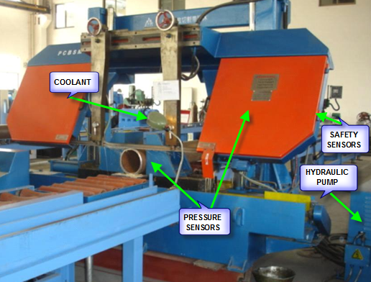
Autonomous saw
Inputs: Pressure sensors, touch sensors, position sensors, position sensor, safety sensors, Variable Frequency Drive (VFD) speed feedback (4-20 mA) for saw blade
Outputs: Open/Close clamps command, Raise/Lower saw, Move pipe Forward/Backward, coolant pump On/Off, saw blade speed command (4-20 mA)
Controller: Allen Bradley Programmable Logic Controller (PLC)
Application: Cut long pipes into specified length. Tolerance is +/- 0.005 in.
Sequence:
Select length and press Start
Close rear clamps
Close front clamps
Lower saw and cut
Retract pipe
Raise saw and open front clamps
Index pipe
Close from clamps
Repeat the sequence until end of pipe
http://www.google.com/imgres?q=pipe+cutting+saw+machine&um=1&hl=en&biw=1024&bih=562&tbm=isch&tbnid=WliuZzoKoLVvgM:&imgrefurl=http://www.ecvv.com/product/1872085.html&docid=OFdWWiTxazEgzM&imgurl=http://upload.ecvv.com/upload/Product/20093/China_Highly_efficient_Pipe_Cutting_Band_Saw_Machine20093111546170.jpg&w=1024&h=768&ei=-NTgT4KvK8ry0gHP0oG3Dg&zoom=1

Slide 9
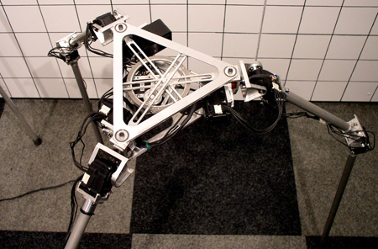
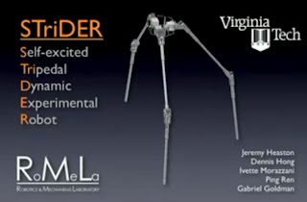
STriDER
Developed by RoMeLa (Robotics & Mechanisms Laboratory at Virginia Tech)
Three points of contact with the ground. Utilizes novel locomotive design.
http://www.ted.com/talks/dennis_hong_my_seven_species_of_robot.html
http://www.ted.com/talks/dennis_hong_my_seven_species_of_robot.html

Slide 10
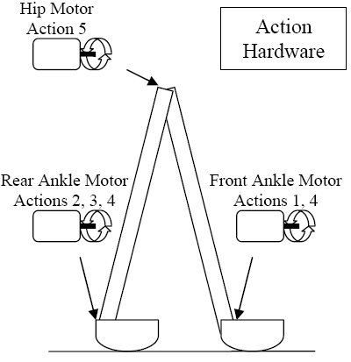
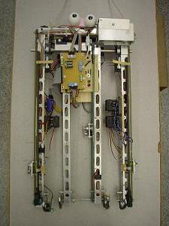
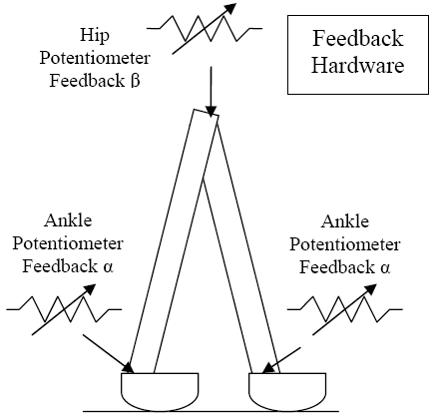
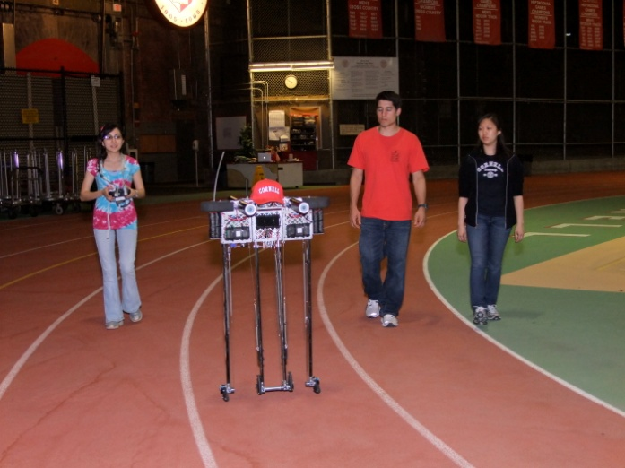
Ranger Walking Robot
2005
39 steps/12 m in 26.5 secs (2)
2006
2,868 steps/1003m+20m in 40 mins
2008
27,724 steps/9.07km in 5.5 hrs
2010
65,185 steps/23km in 10.68 hrs
2011
186,076 steps/65.24 km in 30.81 hrs
(2a)
(6)
References
http://ruina.tam.cornell.edu/research/topics/locomotion_and_robotics/ranger/Ranger2011/index.html
http://ruina.tam.cornell.edu/research/topics/locomotion_and_robotics/ranger/marathon_walker/report.pdf
http://ruina.tam.cornell.edu/research/topics/locomotion_and_robotics/ranger/ranger2006.php
http://ruina.tam.cornell.edu/research/topics/locomotion_and_robotics/ranger/ranger2008.php
http://ruina.tam.cornell.edu/research/topics/locomotion_and_robotics/ranger/Ranger2010/
http://ruina.tam.cornell.edu/research/topics/locomotion_and_robotics/ranger/marathon_walker/index.php
http://ruina.tam.cornell.edu/research/topics/locomotion_and_robotics/ranger/Ranger2011/pictures/DSCF3674.JPG
(7)
(2b)

Slide 11
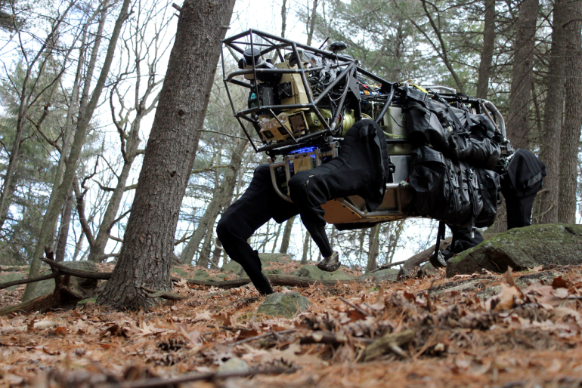
Legged Squad Support Systems (AlphaDog)
Robot that is able to a follow a soldier anywhere he/she can go.
Three settings: leader-follower tight, leader-follower corridor, and go-to-waypoint.
Carries up to 400 lbs of gear for soldiers.
For missions up to 20 miles and/or 24 hours.
Mobile power source.
Inputs and Sensors Used:
LIDAR
Camera
GPS
Gyro
Microphone (upgrade)
http://www.bostondynamics.com/robot_ls3.html

Slide 12
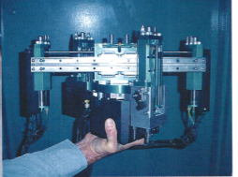
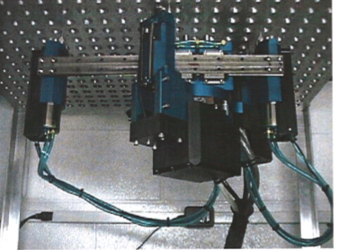
Pegasys: Westinghouse Nuclear Robot
Tubesheet Walker for Steam Generator inspecting at a Nuclear Power Plant
Reduced radiation exposure
Lightweight, Safer, Quick setup and installation
Designed for RSG-type programs
Pegasys Robot, Steam Generator
Source: Westinghouse Electric Company

Slide 13
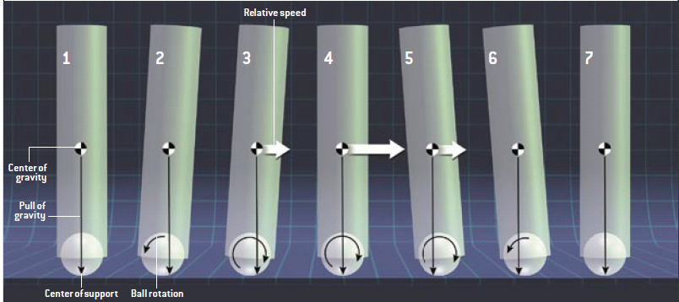
Ballbots
Sensors
Gyroscope
Optical encoders
Angular motion sensors
Travelling from A to B
http://www.youtube.com/watch?v=39zeZwlVaN0
[http://www.cs.virginia.edu/~robins/Ballbots.pdf]

Slide 14
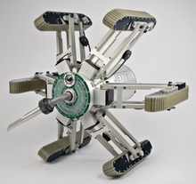
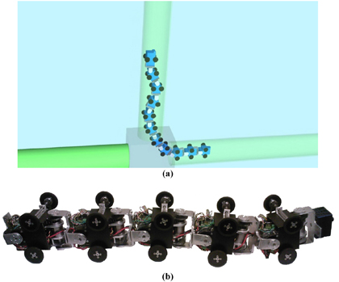
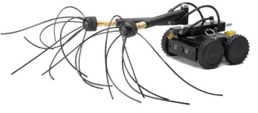
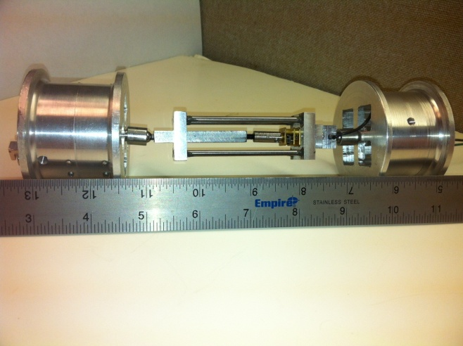
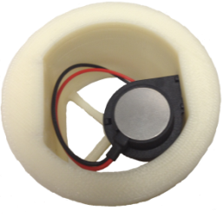
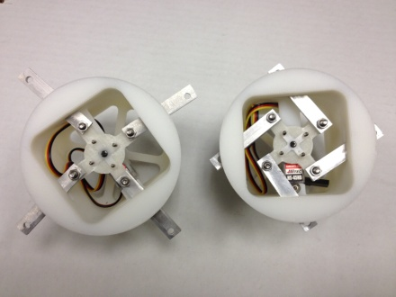
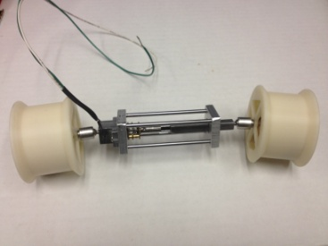
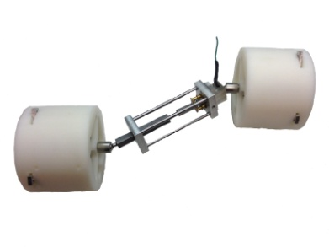
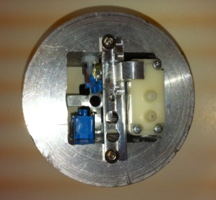
Pipe Traversing Robot
PATENT PENDING
Common Applications:
Detecting cracks in industrial pipes
Cleaning horizontal ventilation systems
Common Designs:
http://www.genomicon.com/
http://www.bbsteamatic.com
http://spie.org/x34544.xml
New Purpose: traverse and clean Dryer Ventilation systems
New Design:
Linear Motion Device Beta:
http://www.youtube.com/watch?v=1btjbMVNvlA&feature=plcp

Slide 15
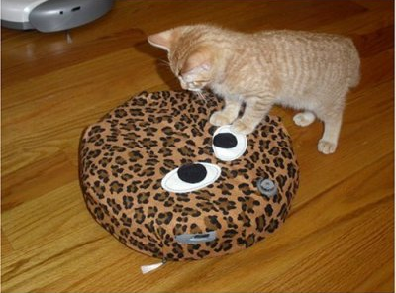
iRobot Roomba
Features of the Roomba 500:
Dirt Detect
Wall Follow
Cliff Detection
Light-Touch Bumper
Soft-Touch Bumper
Escape Behavior
Anti-Tangle Technology
Sensors: Bump Sensor, Ultrasonic Sensor, IR Sensor, Walls/Objects Sensors
Algorithm designed by MIT
http://http://www.irobot.com/us/robots/home/roomba.aspx
http://punkrockor.wordpress.com/2010/06/08/roomba-algorithms/
http://dailylifehri.files.wordpress.com/2011/04/roomba_cat.jpg

Slide 16
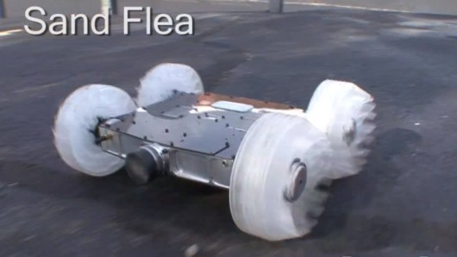
Sand Flea
By Alex Moster
11lb robot
Also can be remotely controlled
Can jump 30ft in the air
Internal stabilization system
https://www.youtube.com/watch?v=6b4ZZQkcNEo
16

Slide 17
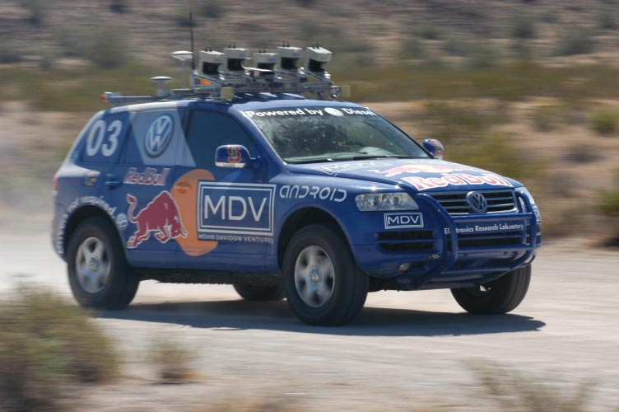
Stanley
Autonomous vehicle created by the Stanford Racing Team to compete in the 2005 DARPA Grand Challenge that uses programed reasoning and artificial intelligence to plan its future path.
The body of a Volkswagen Touareg was used because of its extensive integrated computer system.
Used five LIDAR sensors that were mounted on the roof to build a 3D map of its surroundings.
Six 1.6GHz Intel Pentium M based computers in the trunk running Linux.
Over 100,000 lines of code were written to give the robot power to analyze its LIDAR data in order to maneuver around obstacles and to achieve its desired position.
http://thefutureofthings.com/articles/1001/darpas-urban-challenge-2007.html

Slide 18
R.O.B. (Robotic Operating Buddy)
Accessory for the NES released in July 1985 as the “Family Computer Robot”.
R.O.B. receives up to 6 commands via optical flashes from TV screen.
Specifications:
Operates on (4) AA Batteries
9.5” Height x 6” Width
Head Movement Range: 45 degrees tilt up/down
Arm Movement Range: 240 degrees left/right (5 stopping points),
7 cm/2.75in up/down (six stopping points), 7 cm/2.75 in between hands when open
- 5 accessory slots around hexagonal base
Figure 1: http://en.wikipedia.org/wiki/R.O.B.
http://www.youtube.com/watch?v=08VrKFl6vJ8
http://www.youtube.com/watch?v=08VrKFl6vJ8

Slide 19
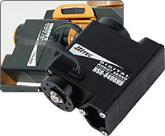
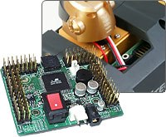
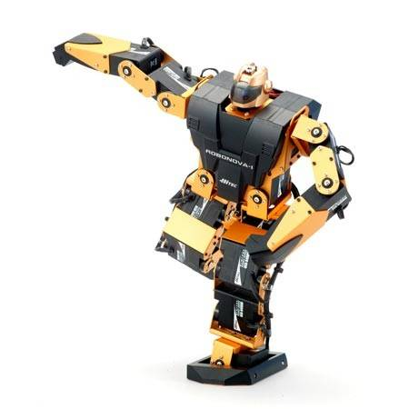
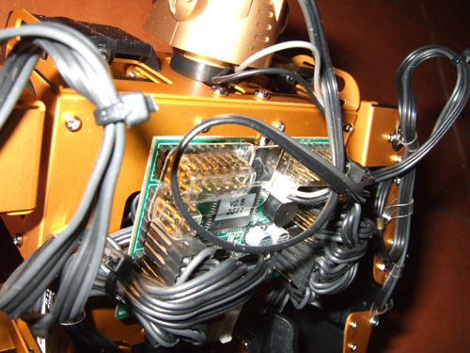
ROBONOVA
ROBONOVA-1 is a fully programmable and customizable humanoid robot
[4]
Utilizes 16 digital servos to move in almost anyway you can imagine!
ROBONOVA has ATMega128L Microcontroller with 64k of onboard EEPROM
Can be expanded to include peripherals such as sonar, light, gyro, and sound sensors
[1]
ROBONOVA has 16 degrees of freedom!
Has 40 ports on post connectors, of which 24 are servo ports and 8 A/D converters
[2]
Can be yours today for 48 easy payments of $19.99!
[3]
References:
[1] & [4] (2011). ROBONOVA-I (Ready-To-Walk). (2011).
[Web Photo]. Retrieved from http://www.robonova.de/store/product.php?productid=16136&cat=2&page=1
[2] (2012). Cool RC Robot Toys. . (2012).
[Web Photo]. Retrieved from http://rcvehicles.about.com/od/rcgadgets/tp/RC_Robots.01.htm.
[3] (2012). ROBONOVA-1 – humanoid robot Kit (unassembled). (2012).
[Web Photo]. Retrieved from http://robosavvy.com/store/product_info.php/products_id/79
Demo Video:
http://www.youtube.com/watch?v=yr-zX8AXKqE&feature=player_embedded
Presented by: Benjamin B. Rhoades
Date presented: 6-19-2012

Slide 20
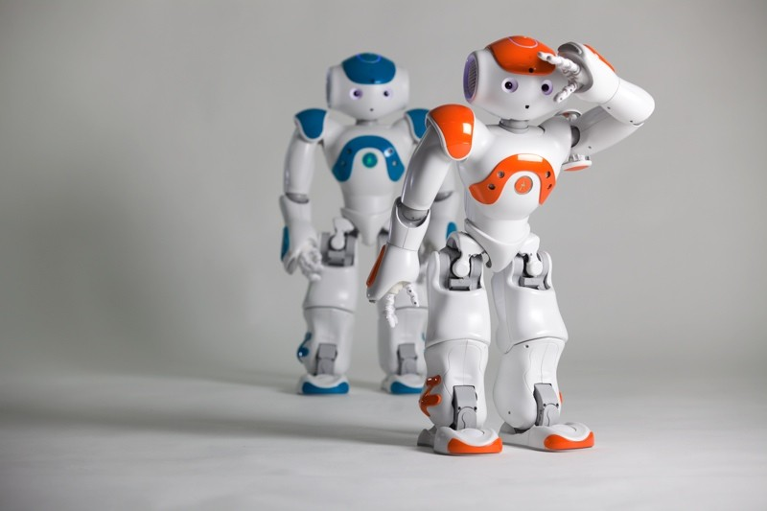
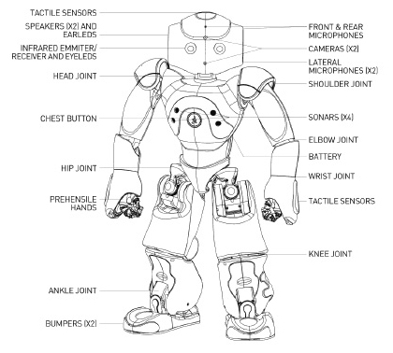
Nao Robot
Onboard computer powered by 1.6 GHz Intel Atom processor.
2 HD cam, 4 microphones, 2 speakers.
Tactile and 4 sonar sensors among others.
21 to 25 DoF
Has 27 6-watt/hr battery for 1.5 or more hr. of autonomy.
Connectivity: Ethernet and Wi-Fi.
Features: Omnidirectional walking, whole body motion, fall manager system, object, face and, sound recognition, up to 9 languages.
Price: $16,000.00.
http://www.robotshop.com/productinfo.aspx?pc=RB-Ald-01

Slide 21
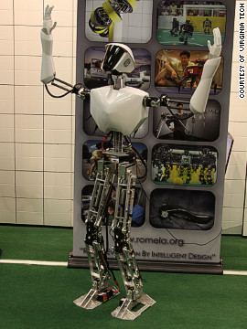
SAFFiR (Shipboard Firefighting Robot)
Designed to navigate autonomously through ships
Uses vision, gas sensors, and IR camera
Extinguishes fires using PEAT grenades
Designed to work as part of a team

Slide 22
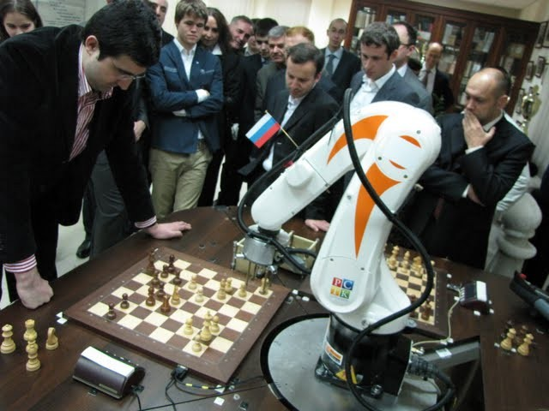
The Chess Terminator
The chess terminator was built to allow true chess competition against a robot. Previously most chess playing "robots" did not actually move the piece or press the button on the clock to signify a turn ending. The board used incorporates sensors in each piece to determine where all the pieces are.
http://www.gizmag.com/chess-terminator-robot-takes-on-kramnik-in-match/16996/picture/124697/

Slide 23
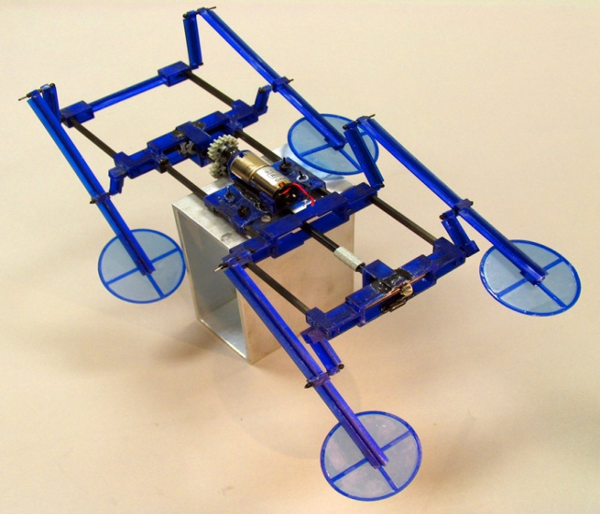
Water Running Robot
Can run on top of the water
Modeled after the lizard
1.5 m/s
5-10 Hz stepping motion per leg
Four Factors that allow the robot to run on water
Body Mass
Length
Speed
Shape of foot
http://nanolab.me.cmu.edu/projects/waterrunner/

