Slide 1
ECGR4161/5196 – Lecture 3 – May 31, 2012
PARO “Baby Harp Seal Robot(?)”
http://www.youtube.com/watch?v=oJq5PQZHU-I&NR=1&feature=fvwp
LegoMindstorm – Rukic’s Cube solver: http://www.youtube.com/watch?v=3QOvEG27Gt4
Tree climbing robot: http://www.youtube.com/watch?v=zmqDePXM89Y&feature=player_embedded
Today:
Presentations
Locomotion
Lab time

Slide 2
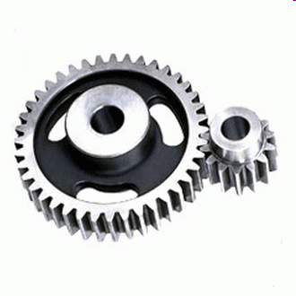
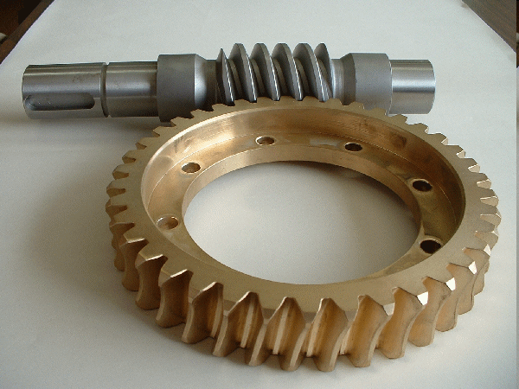
Types of Gears
Spur Gears
Helical Gears
Worm Gears
Rack and Pinion gears
http://www.geardesign.co.uk/spur-gears.htm
Bevel and Miter Gears
Carson Carpenter
http://www.premier-gear.com/worm_gears.htm

Slide 3
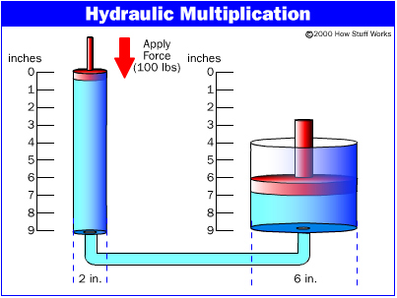
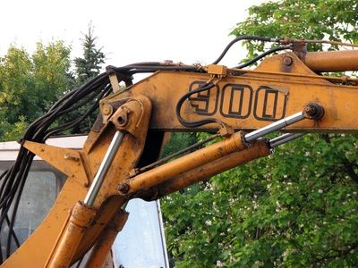
Hydraulics
Linear actuators that use liquid in order to
pressurize a movable piston.
This fluid is sent from a hydraulic pump
through hoses to the cylinders.
Capable of lifting high amounts of weight.
Oil is often used because it is very hard to
compress.
Pascal's Principle- pressure exerted on a fluid
is distributed equally throughout the fluid.
If pressure stays constant –
F1/A1 = F2/A2
F2 = (F1*A2)/A1
http://ffden-2.phys.uaf.edu/212_spring2005.web.dir/annie_weber/page2.html
http://ffden-2.phys.uaf.edu/212_spring2005.web.dir/annie_weber/page2.html
http://www.ehow.com/how_7589692_do-project-robotic-arm.html

Slide 4
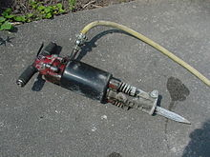
Pneumatics
It’s a technology that deals with the study and application of pressurized gas to effect mechanical motion.
Pneumatic systems are commonly combined with electrical components.
Applications:
  Dentistry
  Mining
  Petrochemical industry
  Defense
  Entertainment
http://www.articlesbase.com/advertising-articles/pneumatic-jackhammers-251199.html

Slide 5
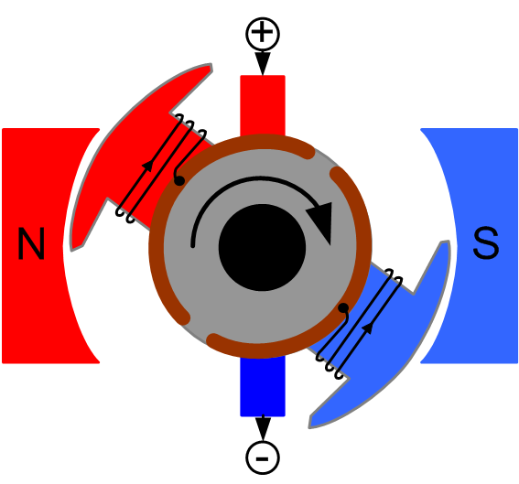
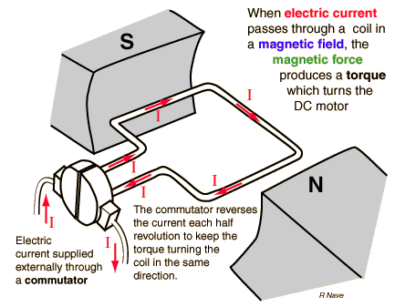
DC Motor Fundamentals
P. Finnie
Key Physical Principal at Play = Lorentz Force (Any current-carrying conductor placed within an external magnetic field experiences a torque)
Basic Components ->
1. Stator
2. Rotor/Armature
3. Commutator
4. Brushes or Controller-(Brushless)
Variants ->
1. Brushed (Mechanically Commutated)
2. Brushless (Controller Provides Commutation)
3. Homopolar (No commutation required)
sigma.ontologyportal.org
Commutator – A commutator is a rotary electrical switch in that periodically reverses the direction of current between the rotor and the external circuit.
Credits:
http://en.wikipedia.org/wiki/DC_motor
hyperphysics.phy-astr.gsu.edu

Slide 6
Stepper Motors
J. Scot Collins
Brushless, electric motor that converts pulses into mechanical shaft rotation.
Utilizes an open loop control system, meaning there is no feedback as to motors position.
Very accurate, within 3-5% normally.
Micro-stepping is a way to vary current using a sine/cosine waveform to decrease vibration from jumping to new positions. Effectively increases number of steps.
Ascending torque drive order – wave, half-step, micro-step, full step
Figure 1: 90 degrees resolution (Wave drive, less torque)
Figure 2: Series of mini-poles on stator and rotor.
Figure 3: Half Stepping (doubles resolution, considerably less torque at half step position)
Images: http://www.imagesco.com/articles/picstepper/02.html#fig3
Information : http://www.imagesco.com/articles/picstepper/02.html#fig3
http://en.wikipedia.org/wiki/Stepper_motor

Slide 7
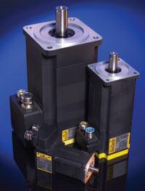
Servo Motors
Motor with built in encoder
Negative feedback for position and speed
Outputs pulses that can be counted to find position and speed
Applications:
  Industrial robotics and automation
  Autonomous robotics
  Automotive
  Machine Tools
  References:
  http://en.wikipedia.org/wiki/Servo_motor
  http://www.baldor.com/products/servomotors/c_series/bsm_cseries.asp

Slide 8
Traction Control
Usable Traction = Coefficient of Traction x Weight
where Coefficient of Traction is dependent on:
- Material composition of each surface
- Normal force pressing contact surfaces together
- Contaminants at the material boundary including lubricants and adhesives.
Mechanisms to obtain Traction Control
Breaks
http://www.youtube.com/watch?v=Z1TP3NHtmJI&feature=youtu.be
Control Engine Power
http://www.youtube.com/watch?v=28PO6QMzcsU

Slide 9
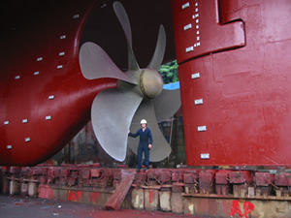
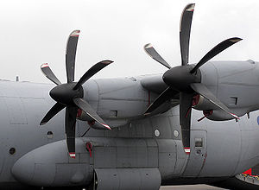
Propeller
-A type of fan that converts the rotational motion of the blades into thrust.
-Two main type of propellers are marine and aircraft.
-Marine: Controllable pitch, skewback, and modular.
-Aircraft: Fixed pitch, in-fight adjustable, ground adjustable, and constant speed.
http://upload.wikimedia.org/wikipedia/commons/3/35/Ship-propeller.jpg
http://upload.wikimedia.org/wikipedia/commons/c/c3/Hercules.propeller.arp.jpg

Slide 10
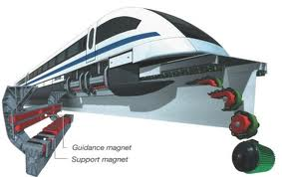
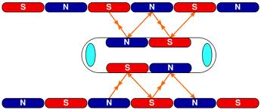
MAGNETIC LEVITATION (MAGLEV)
Concept first thought of for transportation in early 1900’s by Bachelet (France) & Goddard (U.S.)
2 Main types of MAGLEV
  EMS (Attractive)
  EDS (Repulsive)
Most commonly used for trains today (Germany & Japan)
Highest recorded speed of 361mph achieved by Japan in 2003
Does not rely on wheels, axels, or bearings (essentially frictionless)
Less maintenance required
Source: <http://www.theenterprisectr.org/high-speed-ground-transportation/maglev-technology.html >
Source: <http://en.wikipedia.org/wiki/Maglev >

Slide 11
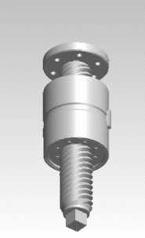
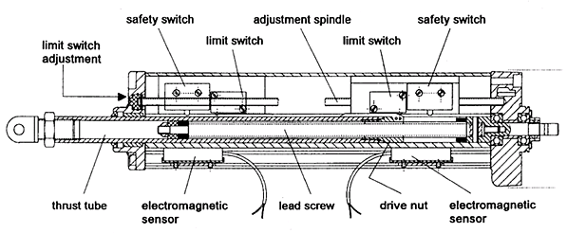
Linear Motion - Screw
Screw actuator is a type of mechanical linear actuator that converts rotary motion into linear motion.
Different type of screw actuators are lead screw, screwjack, ball screw and roller screw.
Screw actuator can be mechanical (manual) or electro-mechanical (motor driven).
http://en.wikipedia.org/wiki/Linear_actuator#Linear_motors
http://www.concisemotion.com/Flexline/Flex1-EZ.htm

Slide 12
Different Linear Actuator Types

Slide 13
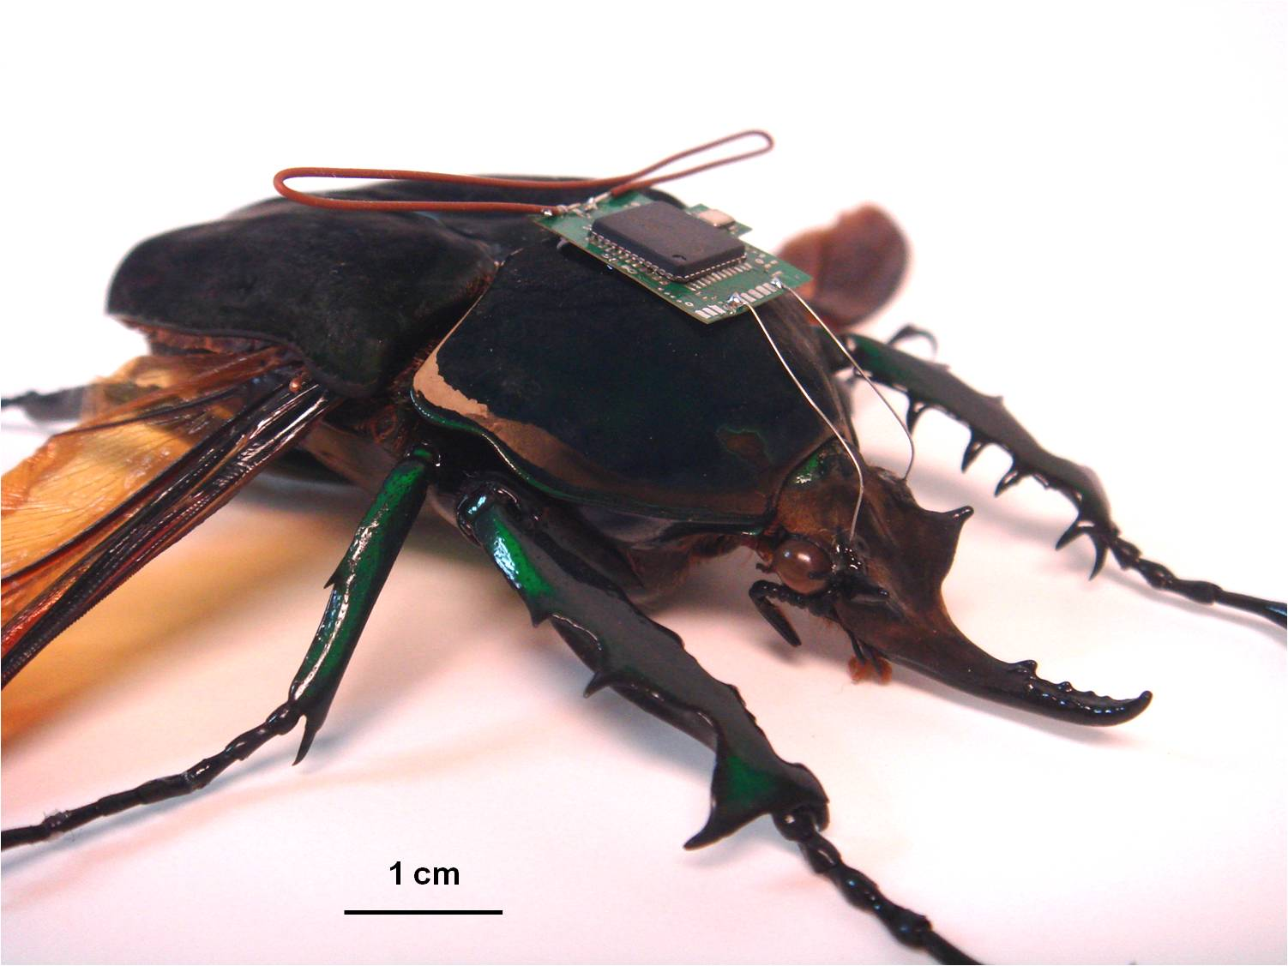
MEMS - Microelectromechanical systems
Size: 1 – 100 micrometers
Technology is still advancing.

Slide 14
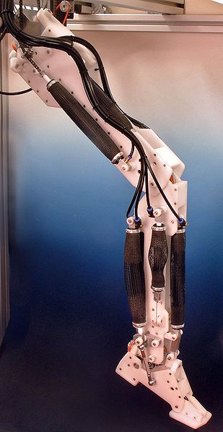
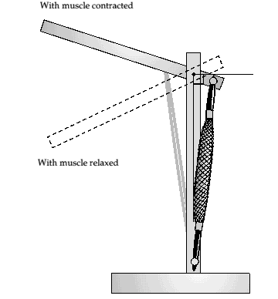
Robotic Leg Power by Air
Actuators: Pneumatic artificial muscles (PAMs)
  Contracting and extending devices operated by pressurized air filling a pneumatic bladder
  Light weight, easy to build, low cost, powerful, smooth, flexible
Degrees of freedom: 6
Control System:
  Potentiometers for positioning feedback
  Muscle Pressure monitored by air delivery system
  Simulates the Normal Human walking speed
  It has the strength of 1kg load at the ankle
http://www.davidbuckley.net/FR/ShadowLeg/ShadowLeg.htm#leginframe
Made by Shadow Robot Co.

Slide 15
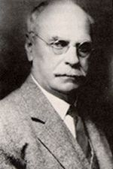
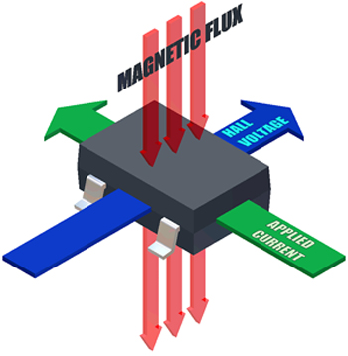
The Hall Effect
Who: Discovered by physicist Edwin Hall
What: The increase/decrease in voltage perpendicular to a path of current due to the presence of a magnetic field
(a)
When: Discovered in 1879
Where: Johns Hopkins University in Baltimore, Maryland.
Why: Originally used to classify chemical samples, but is now used in probes and transducers
How: http://www.magnet.fsu.edu/education/tutorials/java/halleffect/index.html
(b)
(a) http://www.magnet.fsu.edu/education/tutorials/java/halleffect/index.html
(b) http://www.ecnmag.com/articles/2009/03/sensor-zone-april-2009
(c) http://www.melexis.com/Assets/What-is-the-Hall-Effect-3720.aspx

Slide 16
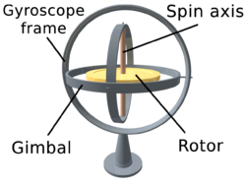
Gyroscope Technology
A gyroscope is a device for measuring and/or maintaining the orientation of a device.
  This is done with principles of angular momentum.
There are multiple kinds of gyroscopes.
  An easy form is a fast spinning mass that points in a fixed direction
Uses can include compasses, computer pointing device, and more.
An example of uses for gyroscopes: http://www.youtube.com/watch?v=BpYwgvLQRlM
http://en.wikipedia.org/wiki/File:3D_Gyroscope.png
Notes:
An example being a attitude reference gyroscope used to sense or measure pitch, roll, and yaw of an aircraft.
Some other gyroscopes are the MEMS (Micro Electro-Mechanical system), FOG (fiber optic gyro), VSG (vibrating structure gyro), DTG (dynamically tuned gyro), and London moment gyro.

Slide 17
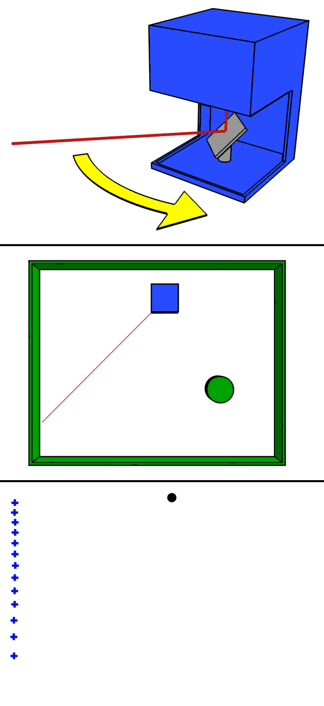
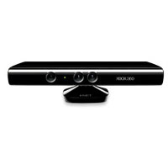
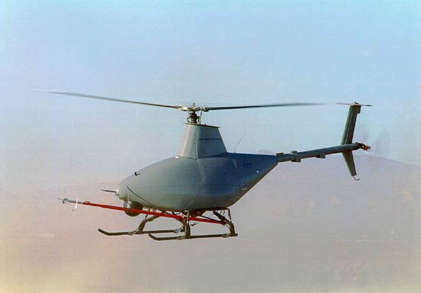
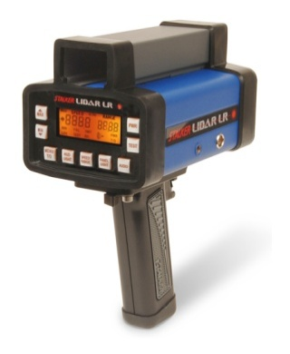
LIDAR (Light Detection and Ranging)
LIDAR is the use of electromagnetic waves within the 600nm-1000nm range to measure distance. LIDAR units are generally comprised of:
  laser photo sensor
  optics GPS/IMU
Used in robotics as a way to map the environment and classify objects. LIDAR has applications such as:
  generating topographical contour maps
  threat detection
  automated transportation
  3D point cloud
Basic LIDAR system [1]
Microsoft Kinect [3]
[1]http://en.wikipedia.org/wiki/LIDAR#Design
[2]http://www.stalkerradar.com/lidar_lr.shtml
[3]http://www.xbox.com/en-US/Xbox360?xr=shellnav
[4]http://www.naval-technology.com/projects/fire-scout-vtuav/fire-scout-vtuav6.html
Police LIDAR [2]
Navy Fire Scout [4]

Slide 18
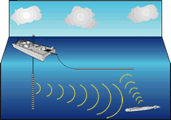
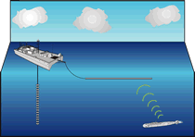
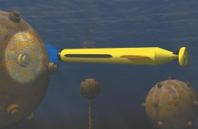
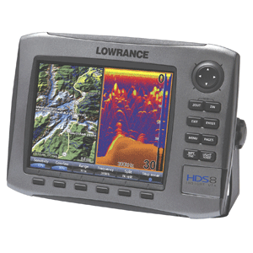
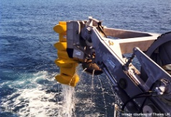
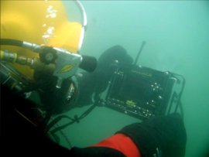
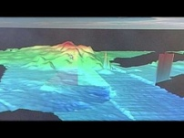
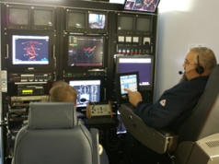
SONAR
SOund Navigation And Radar
→ uses sound propagation to navigate, communicate with, or detect objects
Active SONAR
Passive SONAR
http://www.surtass-lfa-eis.com/Highlights/index.htm
APPLICATIONS
Warfare
Civilian
Scientific
http://www.naval-technology.com
http://www.blueview.com
http://www.fishfindersdirect.com/

Slide 19
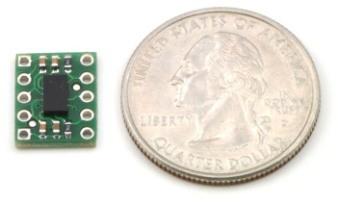


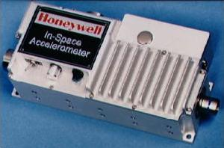
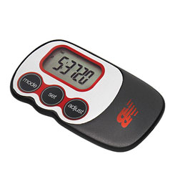
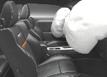

Accelerometers
Who invented it?
What do they look like?
First Accelerometer invented in 1783 by George Atwood
Called the “Atwood Machine”
Accelerometers vary in package size and functionality
[4]
When do we use them?
Where can they be found?
From around your
waist to outer space!
[2]
[3]
[1]
[5]
Why do we need them?
How would we survive without them?
No Planes, Trains, or Automobiles
[7]
[6]
References:
[1] (2011). Mengenal Kecanggihan Teknologi Accelerometer iPhone. (2011). [4] (2012). Mma7361l/mma7341l 3-axis accelerometer with us quarter for size reference. . (2012).
[Web Photo]. Retrieved from http://portal.paseban.com/article/4088/accelerometer-iphone- [Web Photo]. Retrieved from http://www.pololu.com/catalog/product/1247
[2] (2009). Wii therapy: Using the wii and wii fit in special education . (2009). [5] The appliance of rocket science? An accelerometer developed by Honeywell in the 1980s for use on the space shuttle. Photo by courtesy of NASA Johnson Space Center (NASA-JSC).
[Web Photo]. Retrieved from http://nolimitstolearning.blogspot.com/2009/02/wii-therapy-using-wii-and-wii-fit-in.html [6] (2012). Planes, Trains, and Automobiles (and Boats): Transportation Industry Back on Track. (2012).
[3] (2012). New balance via slim pedometer. (2012). [Web Photo]. Retrieved from http://www.forbes.com/sites/sageworks/2011/07/05/planes-trains-and-automobiles-and-boats-transportation-industry-back-on-track
[Web Photo]. Retrieved from http://www.campmor.com/balance-slim-pedometer.shtml [7] (2012). Below front airbags deployed. (2012). [Web Photo]. Retrieved from http://www.dashwarninglights.co.uk/1199.html
Presented by: Benjamin B. Rhoades
Date presented: 5-31-2012
Notes:
Who invented it?
The person who invented the first known accelerometer was George Atwood in 1783. It was first known as the Atwood machine…
Applications:
Automobiles:
Planes:
Trains:
Measure vibrations of the MEMS tains
Steve Martin and John Candy

Slide 20
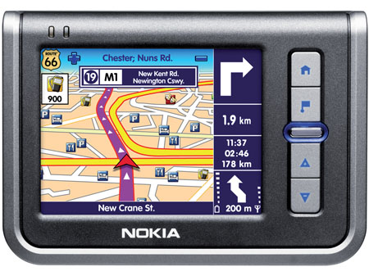
Global Positioning System
Space-based satellite navigation system
Works in any weather
Free to access
Must be visible by four or more satellites
Works by receiving signals from different satellites and timing each signal
Speed of satellite orbit is taken into account when calculating position of receiver
User device never sends signals.
http://web.archive.org/web/20061111202317/http://www.gpsworld.com/gpsworld/article/articleDetail.jsp?id=154870&pageID=6
http://www.gpshacks.com/images/3627-GPS.jpg

Slide 21
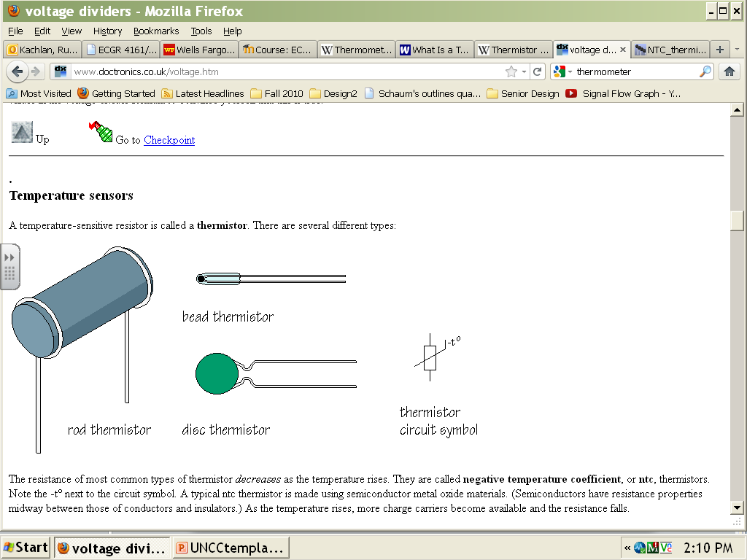
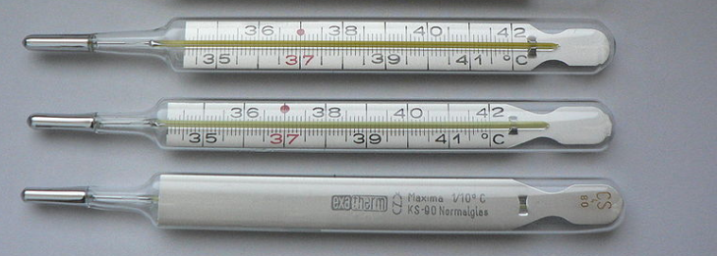
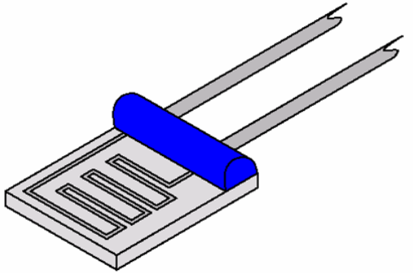
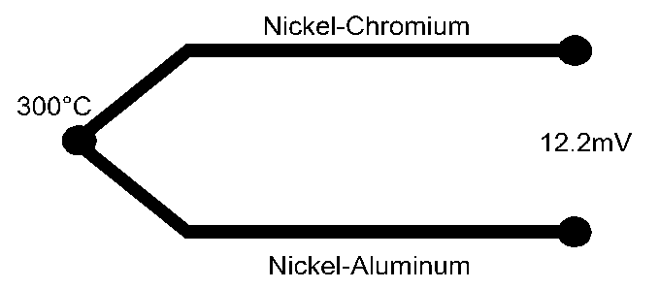
Temperature Sensor
Technology that serves the purpose of measuring the temperature (coolness or warmth) of an object or substance
Thermistor
http://www.doctronics.co.uk/voltage.htm
Thermometer
http://earth911.com/wp-content/uploads/2011/02/Thermometer.jpg?84cd58
Resistance Temp. Detector
http://en.wikipedia.org/wiki/File:Thin_Film_PRT.png
Thermocouple
http://www.picotech.com/applications/thermocouple.html
Ruba Kachlan. ECGR 4161. 05/31/2012

Slide 22
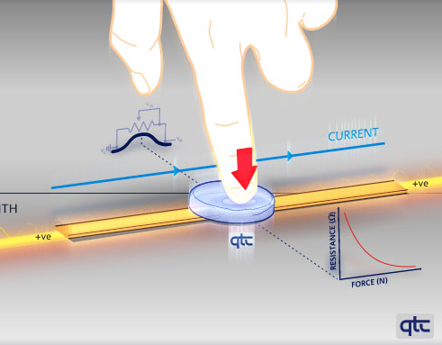
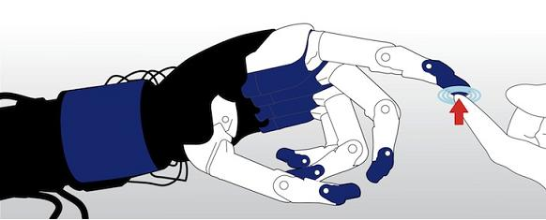
Quantum Tunneling Composite
More accurate than resistive.
Less power consumption than capacitive.
Can provide 3 dimensions of interaction
1
Will be helpful in designing machines that have better grasping capabilities, and for developing more natural ways for machines to interact with humans.
2
Could let a robot know precisely where it has been touched, and with how much pressure.
(1)- http://cache.io9.com/assets/images/4/2010/01/touchytouchy.png (2)- http://singularityhub.com/wp-content/uploads/2010/02/QTC-sense-of-touch.jpg
Notes:
It is so sensitive that it can detect deflections of only a few microns so that the top surface can be rigid and robust, e.g. glass,
-unlike current Resistive designs that have to be soft enough to deform easily making them susceptible to damage.
-unique properties means that virtually no current flows unless a force is applied.
-This overcomes the drawbacks of Capacitive designs that constantly draw current and create design challenges to overcome EMI issues.

Slide 23
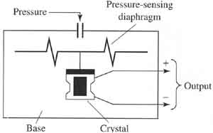
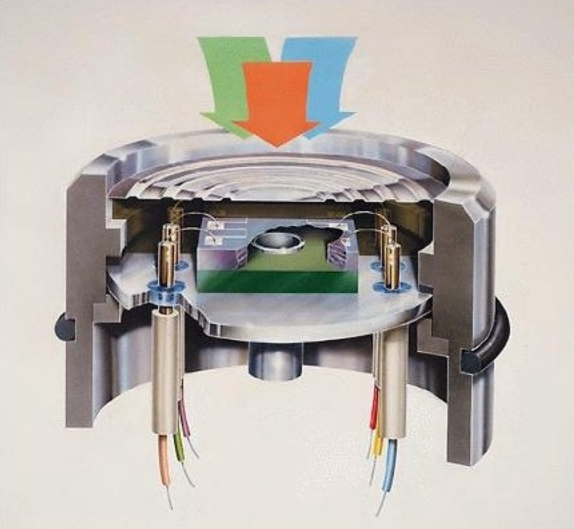
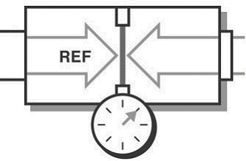
Pressure Sensing Technology
By Patterson C. Taylor III
These typically take the form of a differential pressure sensor that implements some sort of displaced diaphragm to measure a pressure difference between two sources.
Absolute
Vacuum
Gauge
Source: http://www.data-acquisition.us/industrial_electronics/input_devices_sensors_transducers_transmitters_measurement/sensors/Piezoelectric-Pressure-Sensors.jpg
Piezoelectric strain gauges utilize a change in voltage or current caused by physical deformation.
Electromagnetic and Capacitive sensors operate in a similar fashion, where the displacement of a diaphragm is measured using a form of strain gauge.
Source: http://www.ni.com/cms/images/devzone/tut/a/a851fe69743.gif
Source: http://www.emeraldinsight.com/fig/0870270304009.png

Slide 24
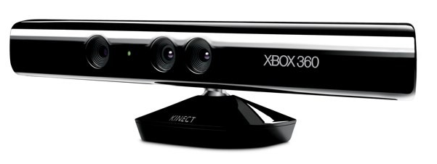
Robotic Use of Cameras
Robots use cameras as sensors.
- Image recognition
- Depth sensing
Cameras have many applications in robotics.
- Response to human interaction
- Mapping an environment
- Navigation
- Response to images or objects
Example:
1. http://spectrum.ieee.org/automaton/robotics/diy/top-10-robotic-kinect-hacks
http://www.engadget.com/2010/06/13/microsoft-kinect-gets-official/
1. IEEE, “Top 10 Robotic Kinect Hacks”, Evan Ackerman, 3/7/2011

Slide 25
Locomotion
From our book:
Legs
Wheels
Aerial
Missing is underwater, slithering, climbing, treads, others?

Slide 26
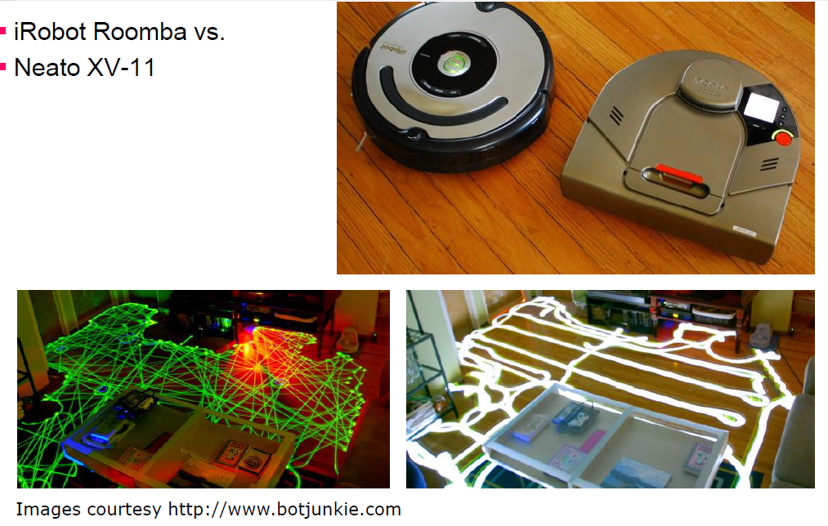
Wheeled Control – Case Study

Slide 27
