Slide 1
ECGR4161/5196 – June 21, 2011
YouTube Videos:
PCB Manufacture #1: http://www.youtube.com/watch?v=HFM4vXDjw9Q
PCB Manufacture #2: http://www.youtube.com/watch?v=H-_tibD0qjw
Kids doing robotics! http://www.youtube.com/watch?v=1bVcQBpKnd4

Slide 2
ECGR4161/5196 – June 21, 2011
Read Chapter 3
Exam 1 contents:
Labs 0, 1, 2, 3
Homework 1, 2, 3
Book Chapters 1, 2, &3
All class notes

Slide 3
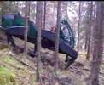
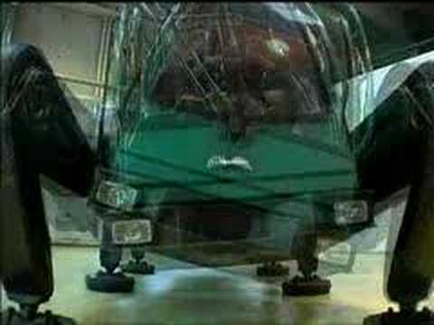
Timber Jack Hexapod
-A six-legged logging machine intended to reduce logging roads and increase access to steep terrain.
- While the vehicle navigation and cutting arm are directed by a human operator, the legs are autonomous.
http://i.ytimg.com/vi/CgBNjdwYdvE/2.jpg
http://www.youtube.com/watch?v=CgBNjdwYdvE
Length 0:15
New Horizon Media's promo video on the Plustech prototype Walking Machine used in to fell lumber.
Plustech is now Timberjack, a division of John Deere.
http://www.youtube.com/watch?v=CD2V8GFqk_Y
Length 1:32
http://i3.ytimg.com/vi/CD2V8GFqk_Y/0.jpg

Slide 4
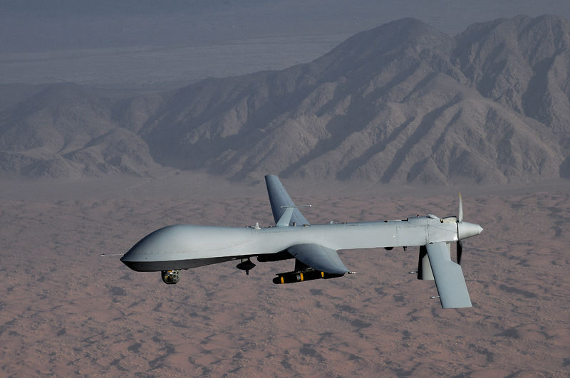
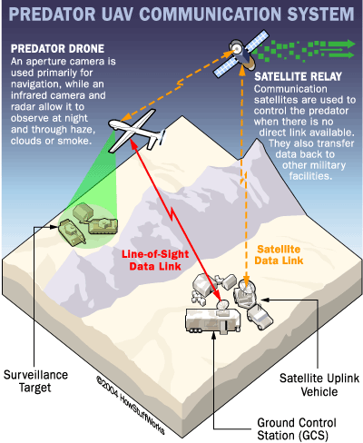
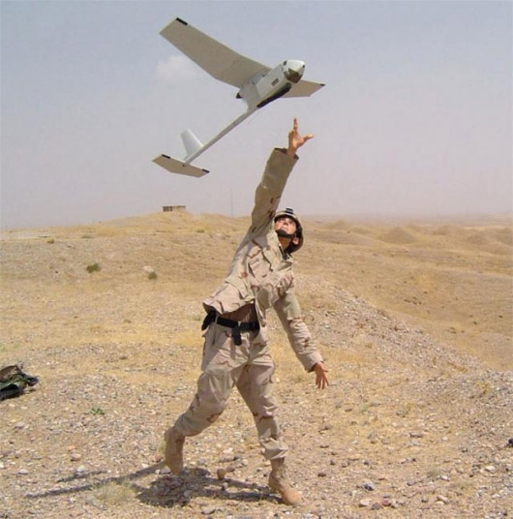
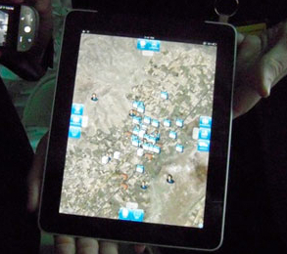
Unmanned Aerial Vehicles (UAV’s)
Over 10,000 unmanned systems in service
An aerial vehicle that is either remote control or autonomous (mixed)
GPS/INS
Camera System – zoom, IR
Communications
Weapons
Lifting the fog of war
Predator Drone in flight [2]
[4]
[1] “Wired for War”, P.W. Singer.
[2] http://en.wikipedia.org/wiki/General_Atomics_MQ-1_Predator
[3] http://science.howstuffworks.com/predator6.htm
[4] http://gizmodo.com/5673520/military-tactical-ipad-app-looks-like-a-real-life-starcraft-ii
[5] http://www.modelairplanenews.com/blog/2010/01/20/uavs-in-action/
Predator Comm Systems [3]
Raven Drone [5]

Slide 5
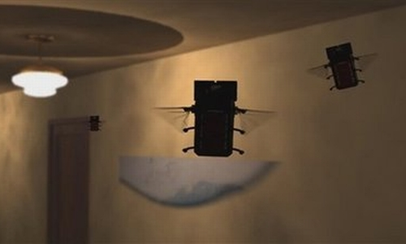
MAVs – Micro Aerial Vehicles
15 cm wingspan max
weight approx. under 20 grams
NAVs underway (7.5 cm)
(Yeah right DARPA)
Fixed wing (gliders, planes, etc.)
Rotary wing (helicopter, autogyro, etc)
Flapping wing (ornithopter)
Flapping wing insects are the future
Harness mechanical power to
reenergize
Delfly Micro (3 gm, smallest with camera)
SFD Lab (8 gm, smallest auton. flight)
Harvard (3 cm ornithopter, wire powered)
Major Issue
Weight (battery, transmission,
on-board devices, etc)
References:
http://en.wikipedia.org/wiki/Micro_air_vehicle
http://www.youtube.com/watch?v=L17Ox4FQTkM

Slide 6
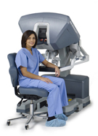
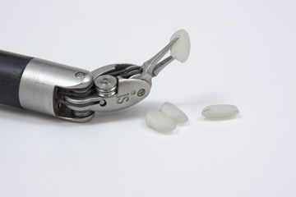
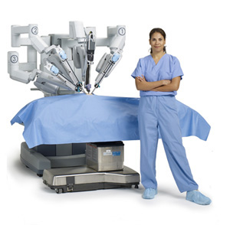
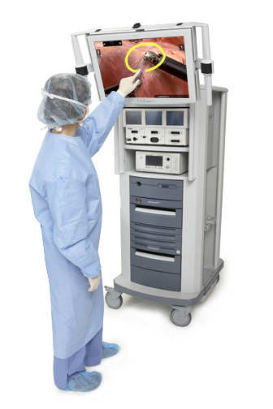
Surgical Robot : Da Vinci Surgical System
Increased Dexterity, Precision, Control, Minimally Invasive
3D, High definition vision system, 10X magnification
Bright crisp high resolution image
Endo-Wrist movement with 7 degrees of freedom
Reduces surgeons hand tremors
Ergonomic design – Surgeon
Reference - http://www.intuitivesurgical.com/products/davinci_surgical_system/

Slide 7
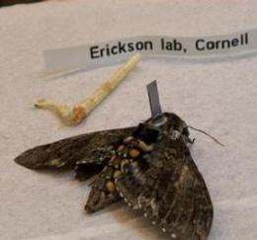
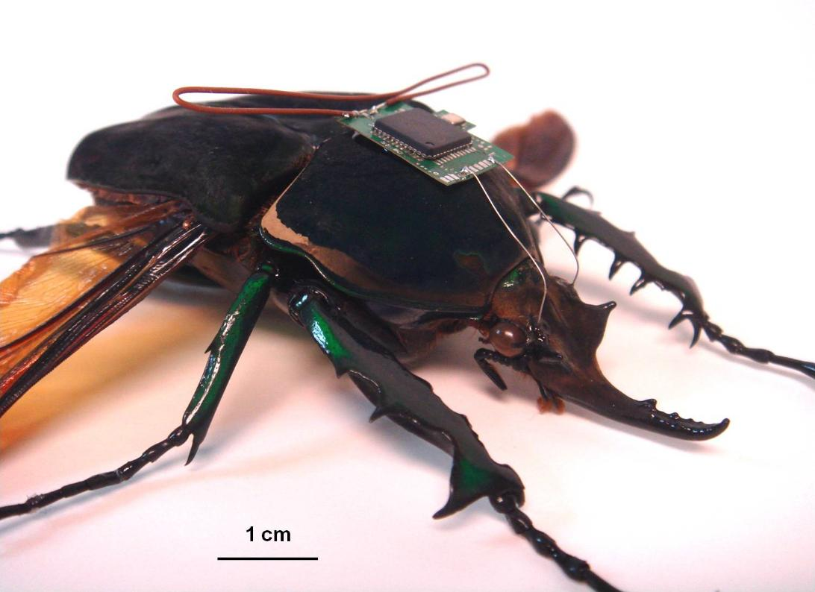
Hybrid Insect Micro Electromechanical Systems
Electronic payloads attached during metamorphosis
Late stage tissue development interfaces with electronics
Control over movement and sensors
Benefits of HIMEMS
Uses natures efficiency to outperform manmade microrobots
Can be used as a remote autonomous sensor
Can be directly controlled
HIMEM Moth
"Hybrid Insect Micro Electromechanical Systems (HI-MEMS)." Defense Advanced Research Projects Agency. Web. 21 June 2011.
<http://www.darpa.mil/Our_Work/MTO/Programs/Hybrid_Insect_Micro_Electromechanical_Systems_(HI-MEMS).aspx>.
Brandon McLean, June 2011

Slide 8
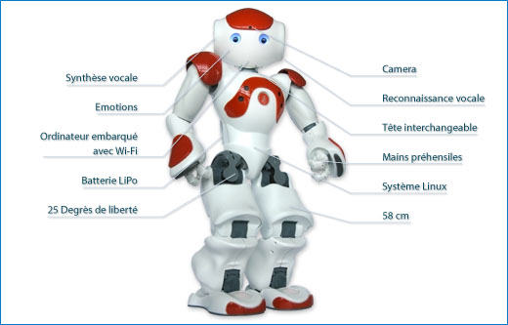
NAO Robotics Platform
The Nao is developed by Aldebaran Robotics. The Robo-cup Edition has
21 (DOF), while the Academics Edition has 25 DOF.
● GEODE 500Mhz CPU
● 256 MB SDRAM
● 2 GB Flash Memory
● Software Suite + SDK to program NAO
● 2 cameras
● 4 microphones
● 8 Force Sensitive Resistors
● 11 Tactile sensors
● 2 Infrared Sensors
NAO has a whole range of sensors to extract information from its environment. With its 2 cameras NAO can track, learn and recognize images, landmarks and faces. With its 4 microphones NAO can track sounds and recognize words in 6 different languages.
http://m.youtube.com/#/watch?desktop_uri=http%3A%2F%2Fwww.youtube.com%2Fwatch%3Fv%3D4t1NWH6G1f0&v=4t1NWH6G1f0&gl=US
[1] Wikipedia 2011, June 20. NAO (Robot) [Online] http://en.wikipedia.org/wiki/Nao_(robot)
[2] Anh Tran, 2011, June 2, NAO Robotics Platform Demo [online] [mailto:atran@aldebaran-robotics.com]

Slide 9
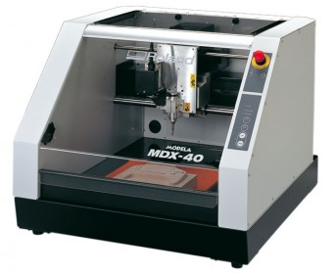
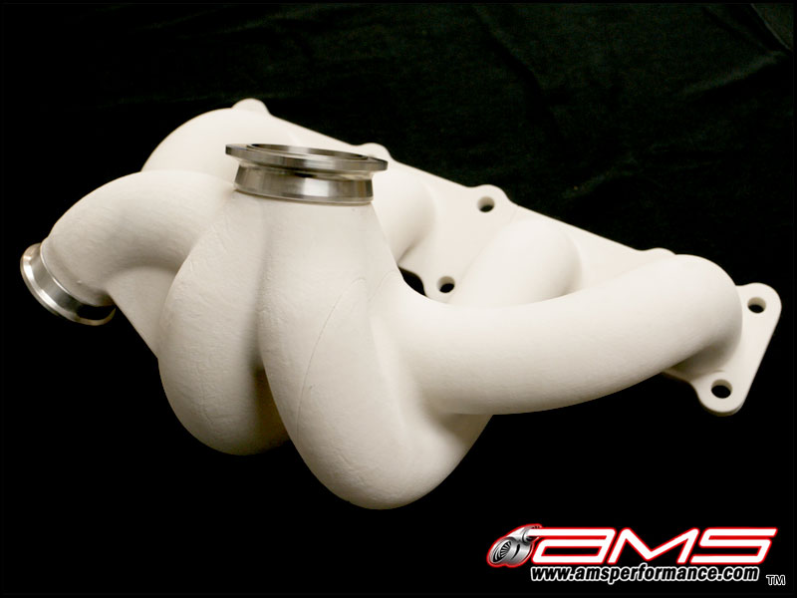
Three Axis Printer (Rapid Prototype)
Create a 3-D model of your object in a CAD program
AutoCAD/Pro-E or any other preferred program, tears apart the 3-D model into layers fractions of a millimeter thick
Separate materials are sometimes used, as a support frame for intricate designs
Fed by either metal or a polyurethane
Example, of a three axis printer at work
"AMS Genesis Turbo Kit First Rapid Prototype for Test Fitment. | AMSPerformance.com." AMSPerformance.com Blog. Web. 21 June 2011. <http://blog.amsperformance.com/2009/04/10/ams-genesis-turbo-kit-first-rapid-prototype-for-test-fitment/>.
"We Have Just Received Our Roland 3-axis CNC Machine | Canard Design." Product Design, Development, Prototyping and Engineering. Web. 21 June 2011. <http://www.canard-design.co.uk/product-design/product-design/we-have-just-received-our-roland-3-axis-cnc-machine/>.

Slide 10
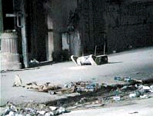
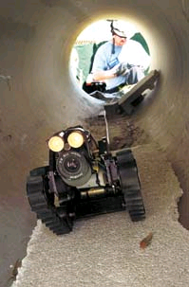
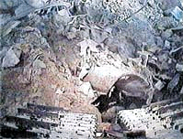
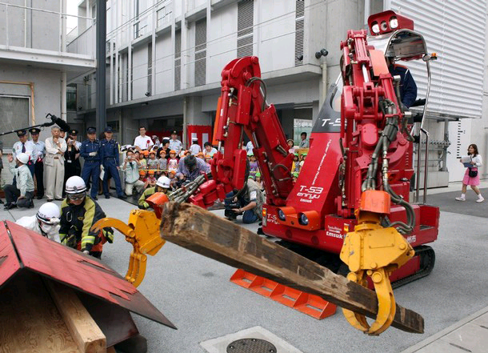
Robot Assisted Search and Rescue
Designed for the purpose of aiding rescue workers
Mining accidents, urban disasters, hostage situations, explosions, etc.
Advantages: Reduced personnel, reduced fatigue and access to unreachable areas
Disadvantages? 14k-80k price tag,
100 ft remote controlled, communication glitches
T-53 Enryu: Fukushima plant
5 tons, 9 foot tall
Two arms, six joints, hoists 440 lbs
Operated directly or remotely
http://news.cnet.com/8301-17938_105-20056667-1.html
http://www.sptimes.com/2003/03/02/Floridian/Robots_to_the_rescue.shtml

Slide 11
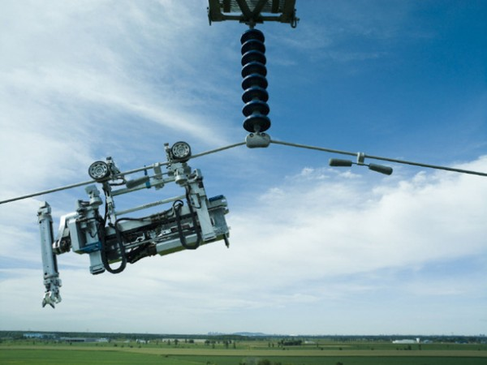
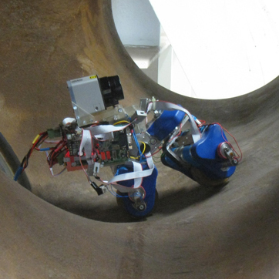
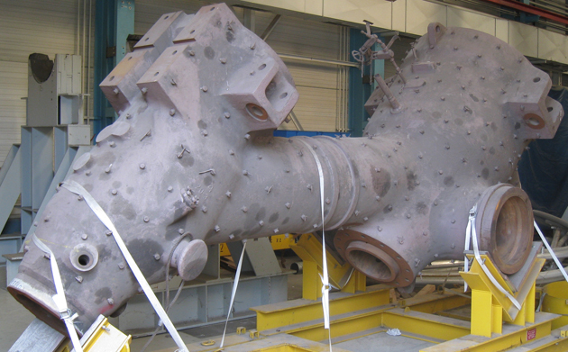
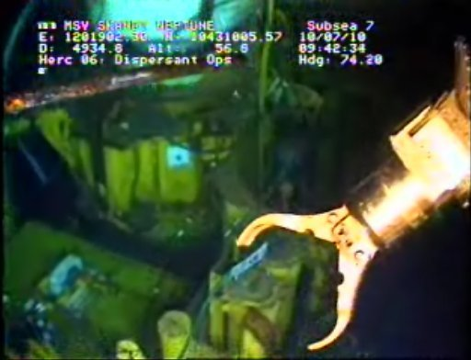
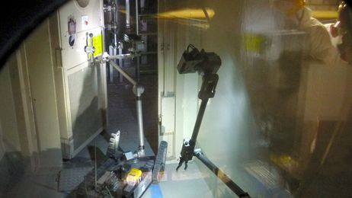
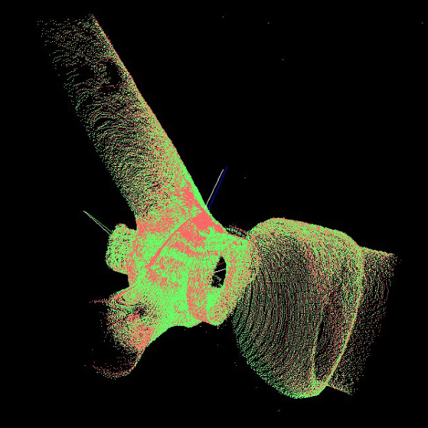
Industrial Applications – Remote Inspection
Mobile Inspection Robots are typically employed for safety critical or high value systems which are difficult or dangerous for human inspectors to access.
Recent Fame:
Fukushima Nuclear Disaster
Gulf Oil Spill
IEDs in Iraq and Afghanistan
Typical Applications:
Chemical or Radioactive Hazards
$ War is Expensive $
Underwater Environments
Confined Spaces (pipes, tanks)
[3] Magnebike: Compact Magnetic Wheeled Inspection Robot http://www.asl.ethz.ch/research/asl/alstom
High Voltage Electrical
iRobots PackBot inspecting one of the radioactive reactors at Fukushima
[1] http://ajw.asahi.com/article/0311disaster/fukushima/AJ201104181001
Battlefield
Linescout by HydroQuebec inspecting HV powerlines
[4] http://www.robotshop.com/blog/tag/hydro-quebec
Oceaneering ROVs working on the deep horizon spill
[2] www.nola.com/news/gulf-oil-spill/index.ssf/2010/07/undersea_robots_are_heroes_of.html

Slide 12
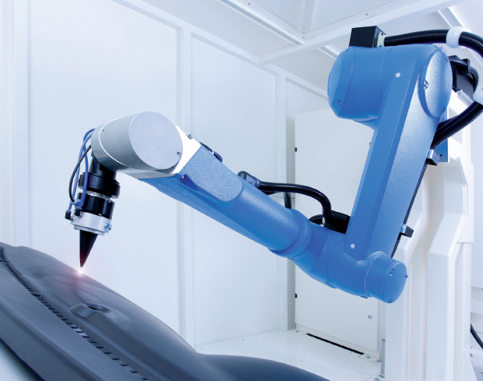
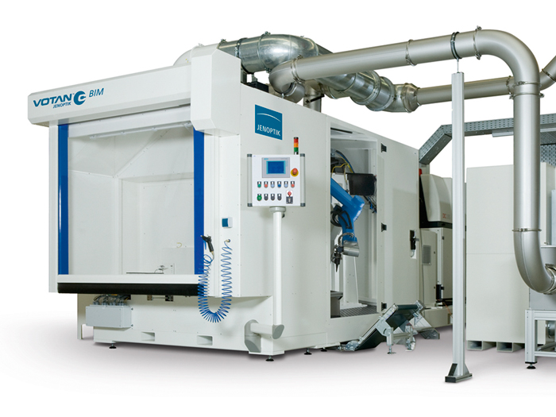
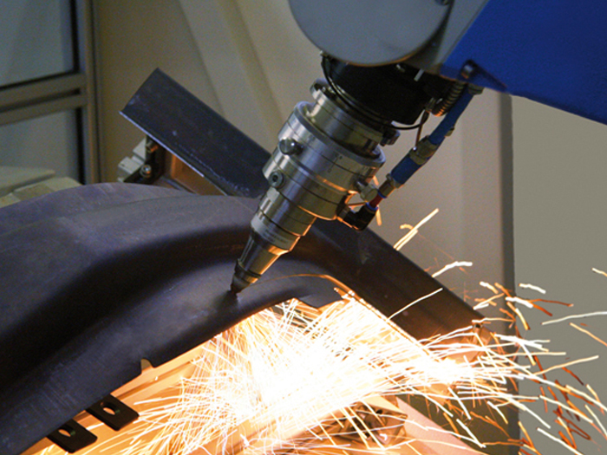
Jenoptik Votan Laser Cutting
Turn-key solution for
2D and 3D laser
Beam cutting of metals.
Can handle CO₂ as well
As solid state laser beams.
Has integrated laser beam
Directly on the robot arm
Applications
Car & Truck Manufacturing
General Metal Construction
Materials Manufacturing
Specifications
CO₂ laser up to 5kW
Fiber laser up to 2kW
.51 meter reach
.1mm accuracy
Jeffrey Skelnik ECGR 5196
http://www.beijing-essen-welding.german-pavilion.com/gp/bew11/exhibitors/dateien/05_JO-AT_01.11_2025.5_EN-20_Jahre.pdf
http://www.youtube.com/watch?v=9ZvcvppsdqE
Notes:
http://www.youtube.com/watch?v=LUx9r2wSuIE

Slide 13
The Use of Robots in Electronics Card Assembly. Link to robotic assembly [3] . http://video.google.com/videoplay?docid=3097498639904880738#
Notes:
Robots are all over in the card manufacturing processes. Such as arms to place devices on boards [3], or walking robots to transfer parts from one station to another. In the Mid 90’s we tried to use
Robots in the test area (to place board inside a fixture and test it) but wasn’t financially justifiable. Another example is a walking robot to transfer parts from one station to another.

