Slide 1
Quantitative Trading
William Beasley

Slide 2
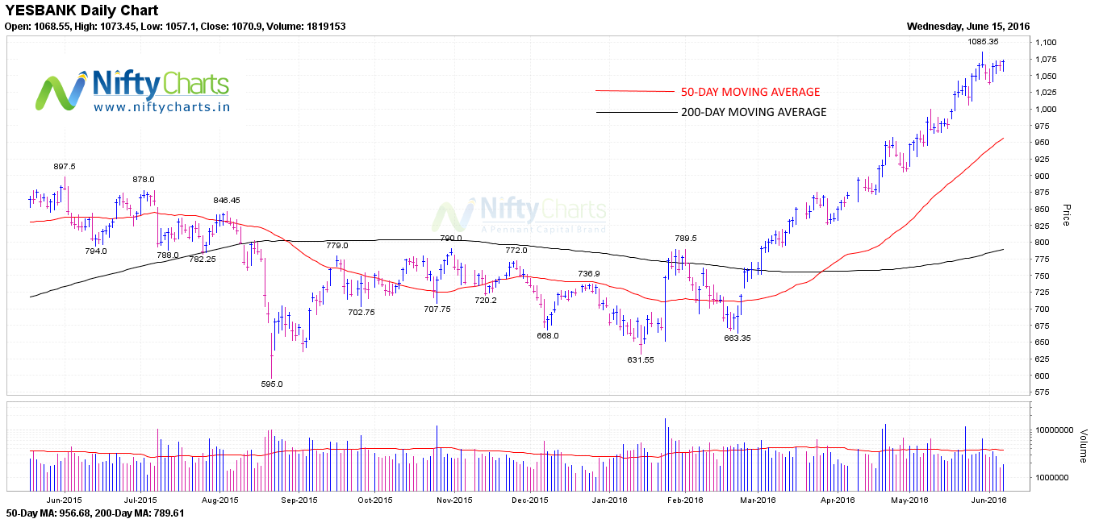
Quantitative Trading Basic Strategies
Momentum:
If the stock is above the SMA then buy, else if the stock is below SMA then sell.
Mean Reversion:
If the stock is below the SMA then buy, else if the stock is above SMA sell.

Slide 3
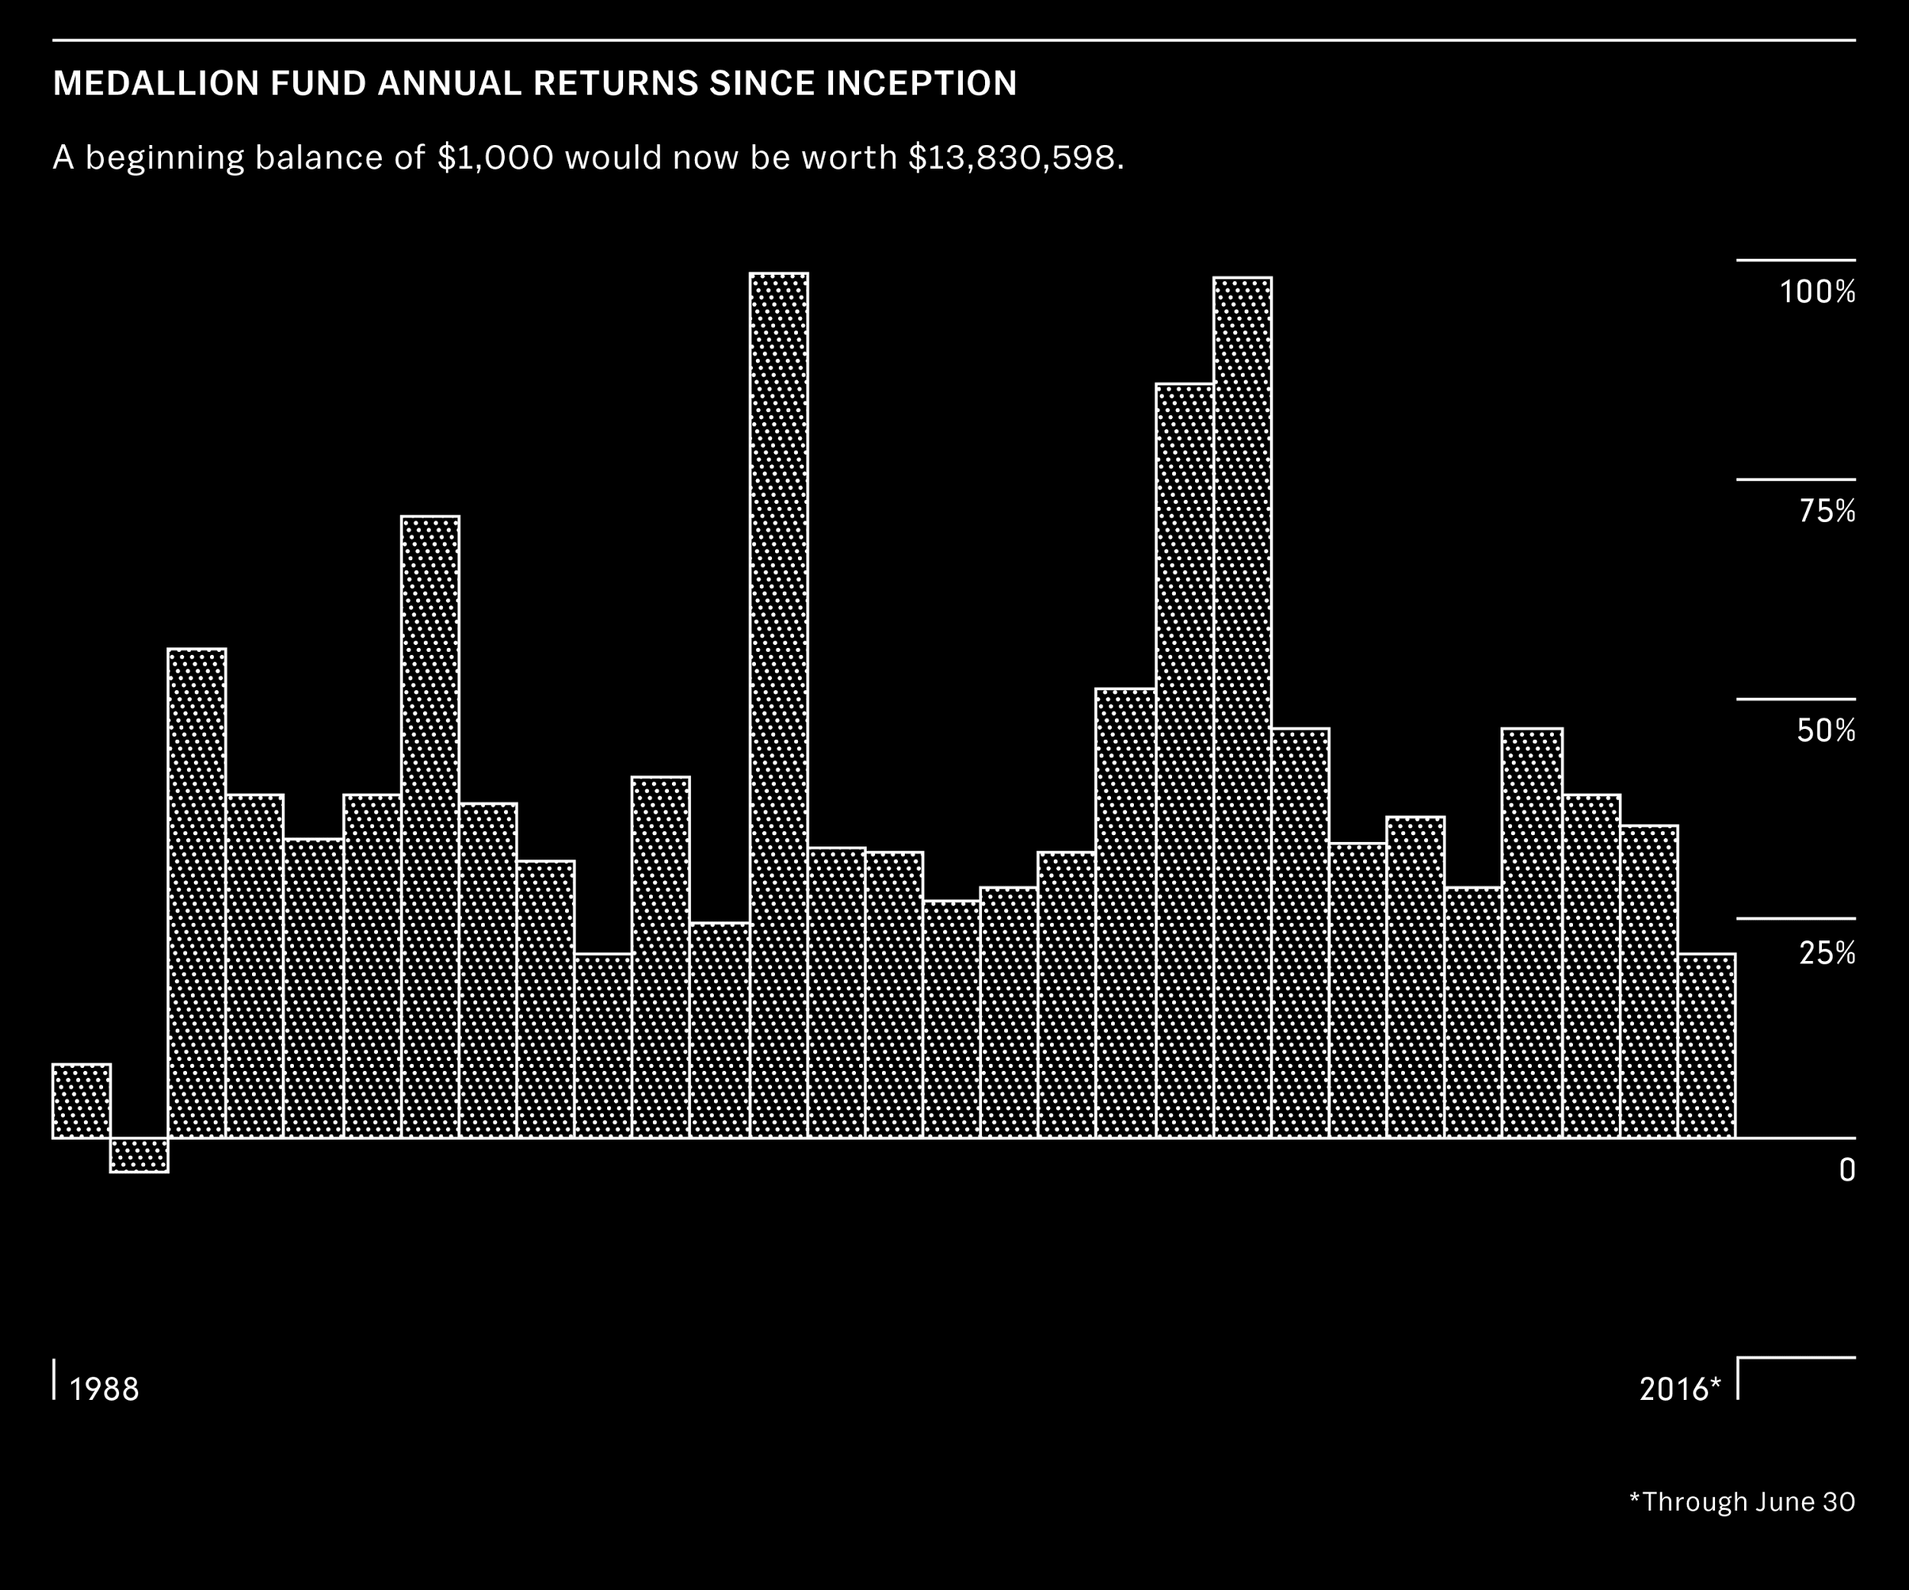
Renaissance Technologies
“Renaissance is the commercial version of the Manhattan Project.”
“They cap the fund’s profits at $9-$10 Billion a year.”
“If you have Wall Street on your resume, you will probably not be hired. These are Scientist.”
https://www.bloomberg.com/news/articles/2016-11-21/how-renaissance-s-medallion-fund-became-finance-s-blackest-box
Notes:
WHO WHERE WHAT WHEN HOW?

Slide 4
Easy to use stock trading IDE in Python
More than 50 datasets
Accurate backtesting
Large amounts of funding for good algorithms
Notes:
2011

Slide 5
Mean Reversion Example
Buys when below the SMA
Sells when above the SMA

Slide 6
Built for investors
Allows quantitative traders to sell their funds
Investors can compare algorithms

Slide 7
Works Cited
Burton, Katherine. "How Renaissance's Medallion Fund Became Finance's Blackest Box." Bloomberg.com. Bloomberg, 21 Nov. 2016. Web. 26 July 2017.
Christopher Krauss et al, Deep neural networks, gradient-boosted trees, random forests: Statistical arbitrage on the S&P 500, European Journal of Operational Research (2017). Web. 26 July 2017.
Cohan, William D. "Man vs. Machine on Wall Street: How Computers Beat the Market." The Atlantic. Atlantic Media Company, 29 Mar. 2011. Web. 26 July 2017.
Rosenbaum, Eric. "IBM's Watson Is Getting into ETF Business as Robot Attack on Stock Market Heats up." CNBC. CNBC, 16 June 2017. Web. 26 July 2017.

