Slide 1
9 pennies
9
A
8
7
6
B
7
6
5
4
3
A
B - wins
1
1
B - lost

Slide 2
13 pennies
13
A
10
11
12
B
7
8
9
10
11
A
B wins
If number of pennies is equal to 5 + n*4, then B always wins.

Slide 3
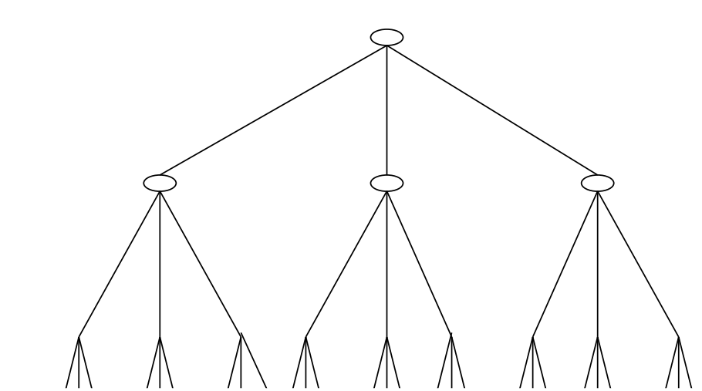
Explain the alpha-beta search procedure using the game tree below.
The root is a MAX node. How many nodes you do not need to visit?
max
min
max
1 7 3 9 1 6 2 4 1 1 3 5 3 9 2 6 5 2 1 2 3 9 7 2 16 6 4

Slide 4
A sliding block puzzle with the following initial and configurations:
1 2 3 4 5 6
w | w | w | b | b | b |  | Initial n1
b | b | b | w | w | w |  | Final
w | b | w | b | b |  | w | Initial n2
b | b | b | w | w | w |  | Final
f(n) = g(n) + h(n)
Pos 1 misplaced by 3
Pos 2 misplaced by 3
Pos 3 misplaced by 3
Pos 4 misplaced by 3
Pos 5 misplaced by 3
Pos 6 misplaced by 3
Total 18
h(n1)= 18/2= 9
Pos 1 misplaced by 3
Pos 3 misplaced by 2
Pos 4 misplaced by 3
Pos 5 misplaced by 2
Total = 10
H(n2)= 10/2= 5

Slide 5
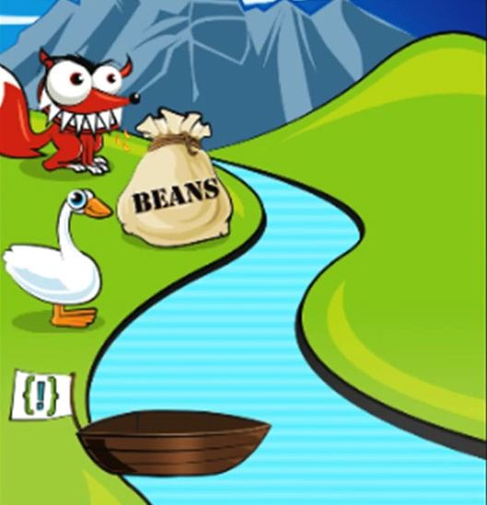
Homework 2:
Farmer went to a market and purchased a fox, a goose, and a bag of beans. On his way home, he came to the bank of a river and rented a boat. But crossing the river by boat, the farmer could carry only himself and a single one of his purchases: the fox, the goose, or the bag of beans. If left unattended together, the fox would eat the goose, or the goose would eat the beans.
Strategy:
Take the goat over (from left to right)
Return
Take the wolf or cabbage over
Return with the goat
Take the cabbage or wolf over
Return
Take goat over
N – node in the state space containing items tagged as “on the right site of the river”, “on the boat
moving right”, and “the left site of the river”. If N1 is a successor on N, then N1 contains items after
changes are done to state N as a result of crossing the river from left to right and next from right to left.
h(N) = number of items in N which are either on the left site of the river or on the boat.
h – admissible & monotonic

Slide 6
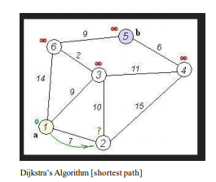
Homework 2
f(n)=g(n) + h(n) h(n)=0
Find the shortest path from node 1 to node 5.
 | mk | g(n)
 | y | 0
 | mark | dist
 |  | 7
 |  | 7
 |  | 2
 |  | 6
 |  | 2
 | mark | dist
3 |  | 9
3 |  | 10
1 |  | 9
3 |  | 11
5 |  | 9
 | mark | dist
6 |  | 14
4 |  | 15
2 |  | 10
2 |  | 15
1 |  | 14
 | mark | g(n)
4 |  | 11
N
N
1
2
2
1
3
6
4
5
5
6
3

Slide 7
Homework 2
f(n)=g(n) + h(n)
h(1)=20
h(2)= 18
h(3)=10
h(4)=5
h(5)=0
H(6)=8
Find the shortest path from node 1 to node 5.
 | mk | g(n)+h(n)
 | y | 0 + 20
 | y | 7+18
 | mark | dist
 | y | 7
 | y | 7
 |  | 2
 |  | 6
 |  | 2
 | mark | dist
3 |  | 9
3 |  | 10
1 |  | 9
3 |  | 11
5 |  | 9
 | mark | dist
6 |  | 14
4 |  | 15
2 |  | 10
2 |  | 15
1 |  | 14
 | mark | g(n)
4 |  | 11
N
N
1
2
2
1
3
6
4
5
5
6
3

