Slide 1
REDUCTS IN INCOMPLETE INFORMATION SYSTEMS
Zbigniew Ras

Slide 2
Information Systems
S = (X, AT) is an information system, where
X - objects,
AT-attributes (partial functions from X into 2^{Va} ∪ {*}),
V_{a} - set of values of attribute a.

Slide 3
Example 1:
S = ({1,2,3,4,5,6}, {Price, Mileage, Size, Accident}) defined below:
Car | Price | Mileage | Size | Accident
1 | {high} | {high} | {full} | {doors, engine}
2 | {low} | * | {full, compact} | {engine}
3 | * | * | {compact} | {doors}
4 | {high} | * | {full} | {doors}
5 | * | * | {full} | {doors}
6 | {low} | {high} | {full} | *
Let A ⊆ AT. By similarity relation based on A we mean:
SIM(A) = {(x,y) ∈ X×X: (∀a ∈A)[a(x) ∩ a(y) ≠ ∅ or a(x) = * or a(y) = *]}.
SIM(A) is a tolerance relation (reflexive, symmetric).
Let I_{A}(x) = {y∈X: (x,y) ∈ SIM(A)} - tolerance class for x with regard to A.
X/SIM(A) = {I_{A}(x) : x ∈X} – not a partition of X in general.

Slide 4
Definition:
A ⊆ AT is a reduct of information system S = (X, AT) iff
SIM(A) = SIM(AT) and
(∀B⊂A)[SIM(B) ≠ SIM(A)].
A ⊆ AT is a reduct of information system S=(X, AT) for x iff
I_{A}(x) = I_{AT}(x) and
(∀B⊂A)[I_{B}(x) ≠ I_{A}(x)].

Slide 5
Car | Price | Mileage | Size | Accident
1 | {high} | {high} | {full} | {doors, engine}
2 | {low} | * | {full, compact} | {engine}
3 | * | * | {compact} | {doors}
4 | {high} | * | {full} | {doors}
5 | * | * | {full} | {doors}
6 | {low} | {high} | {full} | *
x/y | 1 | 2 | 3 | 4 | 5 | 6
1 | -
2 | P | -
3 | S | A | -
4 | NIL | P, A | S | -
5 | NIL | A | S | NIL | -
6 | P | NIL | S | P | NIL | -
Removing M will
not change
discernibility matrix
Reduct={P, S, A} ??

Slide 6
Decision Systems
S = (X, AT ∪{d}) decision system, where
X - objects,
AT - classification attributes,
d - decision attribute,
where d(x) ∈ V_{d} (value is certain).
Car | Price | Size | Accident | d
1 | {high} | {full} | {doors, engine} | good
2 | {low} | {full, compact} | {engine} | good
3 | * | {compact} | {doors} | poor
4 | {high} | {full} | {doors} | good
5 | * | {full} | {doors} | excel
6 | {low} | {full} | * | good
T(1)={1,4,5}
T(2)={2,6}
T(3)={3}
T(4)={4,1,5}
T(5)={5,1,4,6}
T(6)={6,5,2}
System S has to be consistent!

Slide 7
Car | Price | Size | Accident | d
1 | {high} | {full} | {doors, engine} | good
2 | {low} | {full, compact} | {engine} | good
3 | * | {compact} | {doors} | poor
4 | {high} | {full} | {doors} | good
5 | * | {full} | {doors} | excel
6 | {low} | {full} | * | good
T(1)={1,4,5}, T(2)={2,6}, T(3)={3}, T(4)={4,1,5},
T(5)={5,1,4,6}, T(6)={6,5,2}
Car | Price | Size | Accident | d | δ_{AT}
1 | {high} | {full} | {doors, engine} | good | {good, excel}
2 | {low} | {full, compact} | {engine} | good | {good}
3 | * | {compact} | {doors} | poor | {poor}
4 | {high} | {full} | {doors} | good | {good, excel}
5 | * | {full} | {doors} | excel | {good, excel}
6 | {low} | {full} | * | good | {good, excel}

Slide 8
Example 2: Decision System S with “generalized decision” as the extra feature.
Car | Price | Size | Accident | δ_{AT}
1 | {high} | {full} | {doors, engine} | {good, excel}
2 | {low} | {full, compact} | {engine} | {good}
3 | * | {compact} | {doors} | {poor}
4 | {high} | {full} | {doors} | {good, excel}
5 | * | {full} | {doors} | {good, excel}
6 | {low} | {full} | * | {good, excel}
Definition:
Set A ⊆ AT is a reduct of S (relative reduct or d-reduct), iff
δ_{A} = δ_{AT} and (∀B⊆A)[ δ_{B} ≠ δ_{A} ].
Set A ⊆ AT is a reduct of S for x ∈ X (relative reduct for x or
d-reduct for x) iff
δ_{A}(x) = δ_{AT}(x) and (∀B⊆A)[ δ_{B}(x) ≠ δ_{A}(x) ].

Slide 9
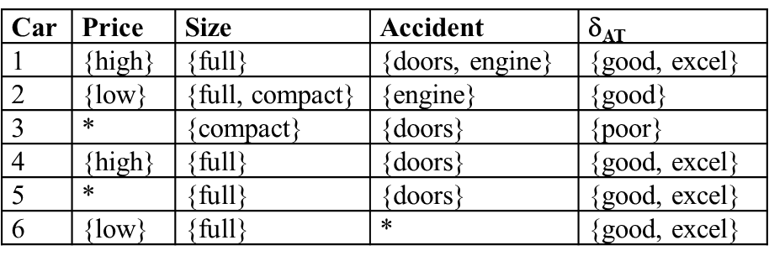
Computation of δ_{AT} -Reducts:
Discernibility table
x/y | 1 | 2 | 3 | 4 | 5 | 6
1
2 | P
3 | S | A
4 | - | P, A | S
5 | - | A | S |  | -
6 | - | NIL | S | P | - | -
Discernibility Function:
F(P,S,A) = P∧S∧A∧(P∨A) ∧ NIL = NIL
Reducts for objects: F(1)=P∧S, F(2)=NIL, F(3)=S∧A, F(4)=(P∨A)∧S∧P, F(5)=S∧A, F(6)=NIL.

Slide 10
Car | Price | Size | Accident | δ_{AT}
1 | {high} | {full} | {doors, engine} | {good, excel}
2 | {low} | {full, compact} | {engine} | {good}
3 | * | {compact} | {doors} | {poor}
4 | {high} | {full} | {doors} | {good, excel}
5 | * | {full} | {doors} | {good, excel}
6 | {low} | {full} | * | {good, excel}
Reducts for objects:
F(1)=P∧S, F(2)=NIL, F(3)=S∧A, F(4)=(P∨A)∧S∧P = P∧S, F(5)=S∧A, F(6)=NIL.
Rules:
(Price, high) ∧ (Size, full) -> good ∨ excel sup = 2
(Size, compact) ∧ (Accident, doors) -> poor sup = 1
(Price, high) ∧ (Size, full) -> good ∨ excel
(Size, full) ∧ (Accident, doors) -> good ∨ excel sup = 1

Slide 11
Thank You !

