Slide 1
Identifying Proactive Collaboration Strategies for Teacher Readiness For Marginalized Students
Paper by: Imani Akin, Ed.D., University of Phoenix, USA
Crystal Neumann, D.B.A., University of Phoenix, USA
Presentation by: Tyler Thomas

Slide 2
Introduction
The problem
The proposed solution
The study
The quantitative results
The discussion results

Slide 3
The Problem
13.2% of learners enrolled in school and aged 3 to 21 received services under the Individual with Disabilities Education Act
That means a lot of students need extra help.

Slide 4
Why (Good Reasons)?
1. They are physically handicapped. (Trouble hearing, seeing, speaking, development problems)
2. They are mentally handicapped (retardation (specialness), etc)

Slide 5
Why (Bad Reasons)?
They are lazy
Their home life is just….bad.
(Ever asked someone with dyslexia to explain dyslexia?)

Slide 6
Why do we care?
Often, being considered disabled results in taking specialized classes, which are essentially, slow moving classes which do not cover much material.
The student “graduates” but does not have a very good education and has very little hope of going to college.

Slide 7
How do you fix it?
Tough Question.
Proaction
2. Collaboration
3. Qualitative Data Collection
4. Reflective Analysis
Or so they say

Slide 8
Study Population
Nine educational staff and K-12 teachers.
The teachers had an average of 8 years teaching experience.
All participants in the study were employees of urban and suburban schools.

Slide 9
Data collection
Semi structured focus group which filled out a collaboration template based on a case study.

Slide 10
Research Questions
What student data can be used to identify collaboration strategies to enhance new teacher skills and knowledge to work with marginalized students?
How can patterns of behavior of low socioeconomic or marginalized students and their families be used to develop proactive collaboration strategies for student success?

Slide 11
Data analysis
Participants were able to reflect on personal and collective meaning of proactive collaboration.
Respondents started with identifying proactive strategies for student academic and social success.
Giving information and sharing resources was mentioned by 5 of the participants.
Part of sharing information would involve team meetings, reaching out to parents, planning, and anticipating as well as asking questions.

Slide 12
Hypothesis support
Participants filled out 4 tables and discussed case study

Slide 13
Table 1. I will plan to…

Slide 14
Table 2. I will collaborate with…
“Community Representative” is a former student who was marginalized or about to be marginalized but succeeded.

Slide 15
Table 3. I will begin to use

Slide 16
Table 4. I will use the data assessment/analysis to drive my…

Slide 17
Discussion Results
Use student strengths to build student confidence
Provide parental support
Conduct school socials, outside learning opportunities, and parent projects

Slide 18
Conclusion
The problem
The proposed solution
The study
The quantitative results
The discussion results

Slide 19
Case Study Example
Erika is a 12-year-old, Latina female in sixth grade, living with her father. Erika has not been completing her homework and does not always have school supplies. She is failing all of her core classes except math. She is generally very shy and quiet. Teachers report that she is usually inattentive in the morning and more attentive in the afternoon.

Slide 20
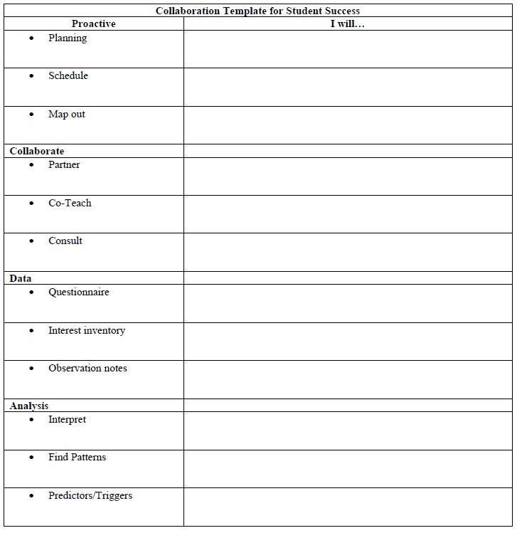
Case Study Example

