Slide 1
Strategies for Building Positive Student-Instructor Interactions in Large Classes
Oscar J. Solis and Windi D. Turner
Presented by Amy Stonger
April 21, 2016

Slide 2
Large classrooms
Most practical
Fosters disengagement in students
Attendance issues
Lack of student-instructor interactions
Purpose: “To investigate strategies available to instructors which can lead to positive student-instructor interactions in large classes”

Slide 3
Literature Review
Self-Disclosure: via personal and relevant stories
Increased participation
Improved retention
Build connections to prior knowledge
Caring Leadership: respectful and passionate
Positive learning environment
Reduced disruptions
Promotes a higher level of commitment
Making the class feel smaller
Develop supportive environment
Increased motivation and discipline

Slide 4
Effective Teaching
Engage students with faculty, the content, and their peers
Utilize discussions and interactive learning
Concern for students’ growth
Connect material to real life scenarios
Approachable and responsive

Slide 5
Data Collection
Two online surveys (SPOT and BPSIILC)
Two consumer studies courses (138 and 84 students)
Spring 2015
Two instructor-researchers
Combination of qualitative and quantitative data

Slide 6
SPOT survey
Student perceptions of teaching
Administered by university
Eight likert-type questions
Four open-ended questions
No demographic information
98 (48.1%) of students completed survey

Slide 7
BPSIILC survey
Building Positive Student-Instructor Interactions in Large Classes
Based on SPOT survey to provide more detail about each specific strategy and their effectiveness in promoting positive student-instructor interactions
Two goals:
Detect positive student-instructor interactions
Identify additional strategies for building positive relationships
Five likert-type questions
Two open ended questions
60 (27%) students participated

Slide 8
SPOT Survey Analysis
Via an open coding strategy
Identify three strategies: self-disclosure, caring leadership, and making the class feel smaller
Self-disclosure: storytelling to relate to course material, both personal and peer stories
Caring leadership: promoting mutual respect, valuing students’ opinions, connecting content to students on a personal level
Making the class feel smaller: learning students’ names, encouraging student participation

Slide 9
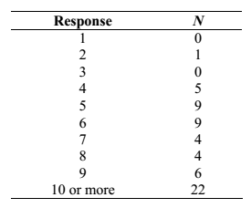
BPSIILC survey analysis
Via the same open coding strategy
18.9% male, 81.03% female
Question 1: How many classes with over 50 students have you been enrolled in, including this class?
-more than 50% attended 8 or more large classes

Slide 10
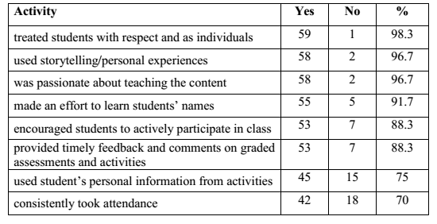
Question 2: Did your instructor do the following activity in your class?

Slide 11
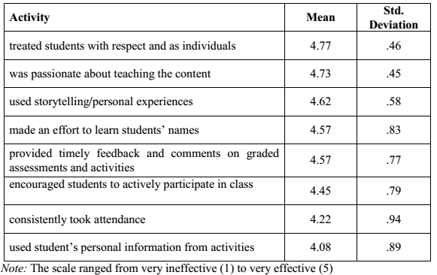
Question 3: How effective was the following activity in creating positive student-instructor interactions in this large class?

Slide 12
Question 4: What additional comments do you have pertaining to strategies and/or activities that the instructor used in order to create positive student-instructor interactions in this large class?
Sharing personal stories and encouraging students to do the same
Learning students’ names
Connecting course material to real life
Responsive and approachable
Passionate
Concern for students’ performance

Slide 13
Question 5: What additional strategies and/or activities do you feel instructors could use in order to create positive student-instructor interactions in large classes?
Offer options to the class
One-on-one interaction
Encourage students to use office hours and email communication for issues or questions

Slide 14
Discussion
Self-Disclosure
increased attendance and motivation to learn
greater understanding of course content
Caring Leadership
Passion resonates with students
Increased engagement and learning
Making class feel smaller
Setting clear expectations and outcomes for course increases participation and provide a positive outlook
Asking and encouraging questions

Slide 15
Challenges
Identifying relevant and relatable personal stories
Avoid veering off topic or losing students’ interest
Not all students comfortable asking questions or sharing stories
Finding time to memorize names or personal details about students
Any other challenges that you can think of?

Slide 16
Faculty Benefits
More attentive and engaged students
Students are more inclined to communicate freely with instructor
More interactive course
Student feedback provides opportunity for further improvements and refinement

Slide 17
Conclusion
Incorporate three strategies to build positive student-teacher interactions to increase student participation, engagement, and satisfaction
Discussion
Do you have any additional ways to encourage meaningful student-teacher interactions?

