Slide 1
“Would Someone Say Something, Please?” Increasing Student Participation in College Classrooms
Jane L. Kenney & Padmini Banerjee
Presented by Amy Stonger
March 11th, 2015

Slide 2
College Undergraduates
Considered ‘millennials’
Raised in digital age
Accustomed to 24/7 access to information
Focus on education as preparation for workforce
Have several roles that they must fulfill
Employee, child, parent, athlete, student
Effective teaching requires consideration of these factors
Switch to learner-centered classrooms from traditional content-centered classrooms
Notes:
No longer teacher driven but process driven
traditional lectures are non interactive, which fail to capture students attention or encourage active participation …. Both of which are required for successful learning
Preference for use of multimedia and collaborative learning with millennials…necessitating changes in classroom settings

Slide 3
Active Learning
Teachers share responsibility of instruction and learning with students
Engage students with reading and writing activities, class or group discussions, and collaborative problem solving sessions
Facilitates deeper learning
Associated with higher retention and comprehension of material
Notes:
exposes students to different viewpoints and ways of interpreting and applying course material
This participation allows teachers to gauge students understanding of the material and identify areas that may need additional time or focus
Insight into topics of interest

Slide 4
What influences classroom participation?
Class size
Faculty authority
Age
Gender
Level of preparation
Student emotions
Notes:
Teachers realize the importance of participation but struggle with getting consistent responses and engagement from students …
A variety of factors influence a students willingness to participate including but not limited to

Slide 5
Class Size
Less engagement in larger classes
Teachers more inclined to adopt traditional lecture styles
Increased fear of criticism from peers and professor=less inclined to participate
A small portion of students will always participate regardless of class size

Slide 6
Instructor characteristics
Teacher: expert, determines course content and performance assessments
Tendency to call on males more frequently
‘masculine’ style of learning
‘chilly’ classroom atmosphere
Notes:
hierarchical, competitive, and individualistic
A woman’s style of learning and teaching styles are in discord

Slide 7
Student Characteristics
Gender, age, culture/ethnicity, parents’ education, socioeconomic status, and personality traits
Anxiety associated with preparation
Confidence is the number one factor
Males: more confident and more involved
Females: more prepared, more interested
Perception of teacher
Notes:
Non traditional students have a higher tendency to participate
indirect effect on students’ reported participation by increasing prepared students’ confidence and decreasing their fear of disapproval
Approachable and available vs. aggressive

Slide 8
Instructional Style
In class questions and discussions
course link questions
brainstorm questions
direct link
Small groups learning exercises
Use of personal response devices
Hybrid courses
Interteaching method
Think-Pair-Share
Comfort level
Notes:
evaluate, instruct, and motivate” students and to encourage higher-order thinking with questions
Factual questions to gauge understanding less useful-lower level of thinking involved
Higher order questions involve interpretation reasoning and evaluation of course content-insight into what students are thinking and their views about the material
Course link-integration of specific course information into the topic of discussion
Brainstorm-any and all solutions open to discussion
Direct link-interpretation of a specific aspect of a topic
Allowing wait/think time to formulate response is critical
Starting with lower level questions that lead into higher level questions
Interteaching-by providing a list of questions or discussion topics ahead of time so that students can come prepared
Think pair share-students are asked a question, given time to formulate an answer, pair with a partner to discuss their responses, and share with the group … increase confidence by validating response with a small group or partner and familiarize themselves with classmates
Use names…more personal and build connection

Slide 9
Action Research Study
2 classes from medium sized state universities
Introductory educational psychology course
Predominantly caucasian
Larger classroom size
Upper-level psychology of education course
Predominantly African American
Smaller classroom size
Written survey
perceived frequency of participation
perception of factors that influence participation
classroom activities that might help encourage participation
In-class group discussion
Notes:
While teaching

Slide 10
Student Demographics from Survey
144 students in all
38 males
106 females
95% between ages 18 to 24
Most were freshman or sophomore
96% caucasian

Slide 11
Survey Results
14% talk on regular basis, always or usually
11% females, 21% males
50% seldom or never talk
54% females, 40% males
52% younger students
82% speak more frequently in smaller classes
86% females, 71% males
29% males and 14% females speak frequently regardless of class size
Majority of students recognize importance of participation
44% females, 24% males consider participation very important
Notes:
participation increases learning, understanding, and retention of information

Slide 12
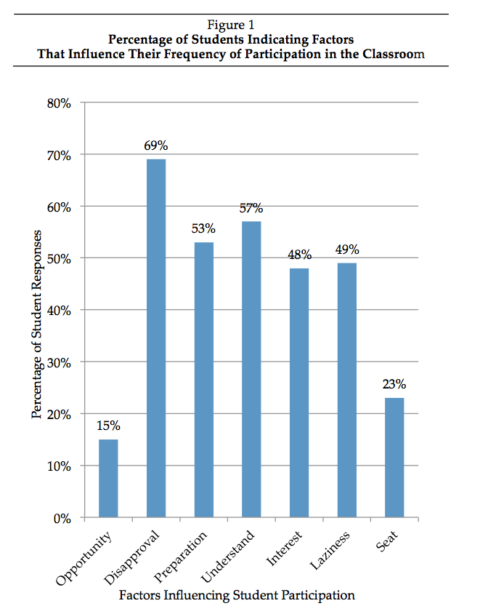
Factors Influencing Participation
26% females vs. 13% males indicate seat position as a factor
Not wanting to take up class time
Not wanting attention
Questions too easy
Social environment of class
General social anxiety

Slide 13
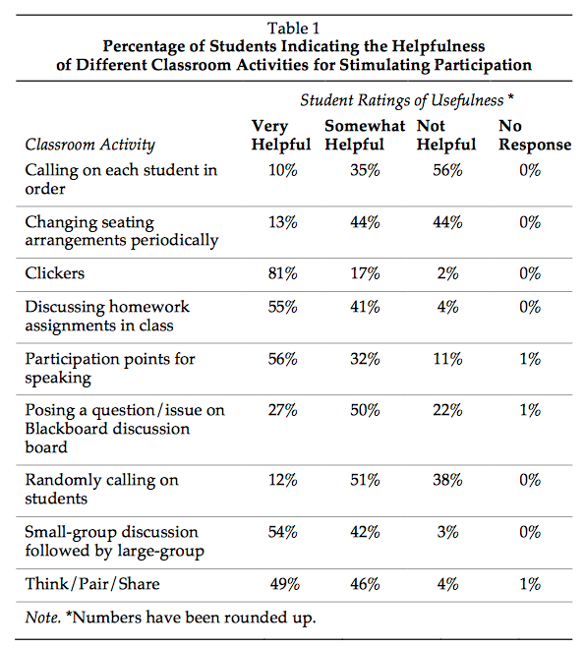
Types of Classroom Activities
Clickers most favored activity
Immediate feedback
Break up lectures
Comparison with other students
Allow anonymous expression of opinions
No fear of embarrassment

Slide 14
Types of questions
Opinion questions most favored by males and females
Application and evaluation questions preferred by 63% of males and 48% of females
Recall and recognition questions preferred by 83% females and 71% males
Spending more time on or leading up to question increases participation

Slide 15
Focused group discussion
14 students
3 males, 11 females
Traditional aged
Predominantly African American
Upper-classmen
5 dominant themes

Slide 16
Findings of Group Discussion
Won’t participate if have nothing significant to contribute or unsure of topic
Avoid questions that are too simple
Genuine interest in topic from professor
Smaller groups are preferred
Debates and watching videos
Short informal presentations
Notes:
Pique interest and motivate participation with higher level questions
Mutual interest from students and instructor lead to greater participation and discovery/development of topics and ideas

Slide 17
Discussion
Results from different settings were very similar
Providing a safe environment, free of criticism is important
Begin semester with activities designed to get to know classmates and professor
Promoting office hours to make students more comfortable and teacher more approachable

Slide 18
Learn and use students names
Utilize online tools-blogs, discussion boards, chat rooms
Stress importance of participation to effective learning and comprehension of material
Ask for opinions and personal experiences associated with topic
Active participation is beneficial to students and instructors

Slide 19
Limitations
Based on students perceptions of participation
Future work to define and measure participation levels
Best approach to combine surveys with discussions

Slide 20
Questions??
What factors weigh in on your decision to participate in a classroom?
What strategies have you seen teachers use to increase participation? What did you find most effective?

