Slide 1
Talking about Code: Integrating Pedagogical Code Reviews into Early Computing Courses Hundhausen et al. ACM Transactions on Computing Education 2013
Presented by Scott Spurlock
3/18/14

Slide 2
Research Problem
How to help computer science students develop soft skills
E.g., teamwork, collaboration, communication
Notes:
Soft skills are required in most of a practicing software engineer’s daily activities, far more than coding, but are typically not much taught in standard computer science curricula.

Slide 3
Proposed Solution
Pedagogical Code Review (PCR)
Small teams evaluate and discuss each other’s code
Notes:
Soft skills are required in most of a practicing software engineer’s daily activities, far more than coding, but are typically not much taught in standard computer science curricula.

Slide 4
Code Inspection Process
Identify code
Training
Individual review
Team review
Revise code
Gilb and Graham [1993] and Wiegers [1995]
Notes:
Plan the inspection of a specific piece of code.
Hold a kick-off meeting with an inspection team to distribute the code to be inspected, train the team on the process, and set inspection goals.
Have members of the inspection team inspect the code for defects on their own time.
Hold a moderated inspection meeting to log issues found by individual members’ inspections, and to find additional issues.
Edit the code to address the issues uncovered in the inspection, and verify that the issues have been resolved.

Slide 5
Pedagogical Code Review (PCR)
Small team of students, plus moderator
Walk through small code segment
Evaluate against checklist
Discuss and log issues

Slide 6
Code Review Team Roles
Author
Reader
Inspector
Recorder
Moderator
Notes:
—The author of the code solution under review, who may be called upon to clarify the code as needed.
—The reader reads the Author’s code solution aloud.
—The inspector takes a leading role in inspecting code against the code review checklist.
—The recorder logs the issues that arise in the review.

Slide 7
Code Review Issue Categories

Slide 8
Research Questions
Research questions:
Do PCRs work?
How should they be implemented?
Notes:
Soft skills are required in most of a practicing software engineer’s daily activities, far more than coding, but are typically not much taught in standard computer science curricula.

Slide 9
Pedagogical Goals
Improve code quality
Discuss coding practices
Develop soft skills
Develop positive self-efficacy
Develop positive sense of community
Notes:
2. not only surface-level issues such as variable naming and documentation, but also deeper issues such as modular design and defensive programming.
3. Students should develop “soft” skills in critical review, communication, and teamwork by providing constructive critiques of others’ code.
4. Develop positive self-efficacy [Bandura et al. 2001] by having opportunities to assess their work relative to that of their peers.
5. Students should develop a positive sense of community [Rovai 2002] and a positive attitude toward peer learning [Pintrich et al. 1991] by working on review teams with a shared purpose.

Slide 10
PCR Implementations

Slide 11
Applying Code Inspection Process

Slide 12
Applying Code Inspection Process

Slide 13
Applying Code Inspection Process

Slide 14
Applying Code Inspection Process

Slide 15
Evaluation
Notes:
Improve code quality
Discuss coding practices
Develop soft skills
Develop positive self-efficacy
Develop positive sense of community

Slide 16
Results: Pedagogical Goals
Improve code quality
Discuss coding practices
Develop soft skills
Develop positive self-efficacy
Develop positive sense of community
Notes:
2. not only surface-level issues such as variable naming and documentation, but also deeper issues such as modular design and defensive programming.
3. Students should develop “soft” skills in critical review, communication, and teamwork by providing constructive critiques of others’ code.
4. Develop positive self-efficacy [Bandura et al. 2001] by having opportunities to assess their work relative to that of their peers.
5. Students should develop a positive sense of community [Rovai 2002] and a positive attitude toward peer learning [Pintrich et al. 1991] by working on review teams with a shared purpose.

Slide 17
Results: Improve code quality
No significant differences in pre- to post-test improvement (Studies II, III, and IV).
No pre- to post-PCR improvement in solution grades (Study IV)
Notes:
No significant differences in pre- to post-test improvement between the courses with and without PCRs (Studies II, III, and IV).
No pre- to post-PCR improvement in solution grades (Study IV)

Slide 18
Results: Discuss Coding Practices
PCRs prompted students to consider a broad range of programming issues (Studies I, III, and IV).
Types of issues logged in PCRs shifted over the course of the semester from lower-level formatting issues to higher-level design and implementation issues (Studies I and III).
Notes:
PCRs prompted students to consider a broad range of programming issues (Studies I, III, and IV).
• Types of issues logged in PCRs shifted over the course of the semester from lower-level formatting issues to higher-level design and implementation issues (Studies I and III).

Slide 19
Results: Develop Soft Skills
Face-to-face PCRs: promoted skills in critical review, communication, and teamwork (Studies I and III).
Online PCRs: largely failed to promote such skills (Study IV).
Notes:
Analyses of video footage and exit surveys indicate that FTF PCRs promoted skills in critical review, communication, and teamwork (Studies I and III).
• Qualitative analysis ofPCR exit surveys suggests that online PCRs largely failed to promote such skills (Study IV).

Slide 20
Results: Self-Efficacy
Face-to-face PCRs
Self-efficacy unchanged
No PCRs (Study II) and Online PCRs (Study IV)
Self-efficacy decreased significantly
Notes:
• In course with FTF PCRs (Study III), students’ self efficacy did not significantly change from pre- to post-survey.
• In course with no PCRs (Study II) and course with Online PCRs (Study IV), students’ self efficacy decreased significantly.

Slide 21
Results: Sense of Community
Across studies: no significant change
Face-to-face PCR: Attitudes toward peer learning “increased at a level that approached significance”
Notes:
• In Studies II, III, and IV, students’ sense of community did not change significantly from pre- to post-survey.
• In course with FTF PCRs (Study III), students’ attitudes toward peer learning increased at a level that approached significance, as compared to the control course (Study II) and the course with Online PCRs (Study III).

Slide 22
Best Practices
Establish ground rules
Model the activity
Require both independent and team review
Avoid redundancy in reviewing
Use trained moderators
Require resubmission
Use online tools to support PCR process
Fully online model is possible

Slide 23
Questions and Discussion

Slide 24
More

Slide 25
Study Participants

Slide 26
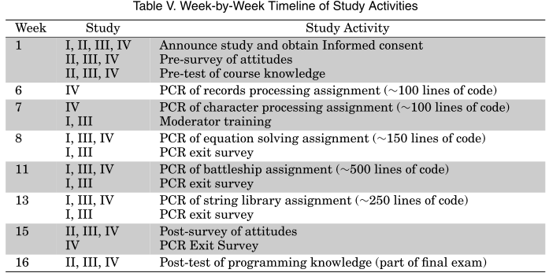
Timeline

