Slide 1
You Tube as a Learning Tool
Barbara Fralinger
RusseLL Owens
Presented By Laurel Powell

Slide 2
"You Tube as a Learning Tool". Fralinger, B., Owens, R., Journal of College Teaching and Learning (2009), 6(8), 15-28.
Notes:
Dr. Russell Owens holds a Doctorate in Instructional Systems Technology from Penn State University and a Supervisory Certificate in Education and a Masters Degree in Education from Millersville University. He is a full time faculty member at King’s College Wilkes Barre PA. in the Education Department. Dr. Owens has presented or published over 15 papers. He has also developed unique computer programs for the development of the Screen Printing USA printing franchisees. Furthermore, he is listed in the Who's Who of the Business World.
Owens was named to the top 500 franchises of Entrepreneur Magazine for 1994 and 1998 and the Platinum 200 of Income Opportunities for 1998. He was interviewed and featured in Impressions Magazine, Signs of The Times, Northeast Business Journal, and local newspapers. Dr. Owens is a 1999, 2000 and 2005 member of the multi-million dollar roundtable of ASI and Counselor Magazine.
Dr. Barbara Fralinger holds a Doctorate in Health Sciences from Seton Hall University and a Master of Education Degree in Health Science from The College of New Jersey. She is a full time faculty member at Rowan University in Glassboro, NJ in the Health and Exercise Science Department. Dr. Fralinger has presented or published over 10 papers and obtained a grant award to implement fitness programs in southern New Jersey. She received the Seton Hall University research award for outstanding scholarly research and has co-written three technology articles with Dr. Owens.

Slide 3
Cognitive Theory
Notes:
branch of cognitive psychology
Information intake, processing and responses
attention, perception, and memory

Slide 4
Cognitive Theory
Engagement
Notes:
Engagement: must have to make the
Short term to long term memory jump
Encoding: improves recall
Must be meaningful and prior knowledge

Slide 5
Cognitive Theory
Engagement
Short Term to Long Term Memory
Notes:
Engagement: must have to make the
Short term to long term memory jump
Encoding: improves recall
Must be meaningful and prior knowledge

Slide 6
Cognitive Theory
Engagement
Short Term to Long Term Memory
Encoding
Notes:
Engagement: must have to make the
Short term to long term memory jump
Encoding: improves recall
Must be meaningful and prior knowledge

Slide 7
Cognitive Theory
Engagement
Short Term to Long Term Memory
Encoding
Improves Recall
Notes:
Engagement: must have to make the
Short term to long term memory jump
Encoding: improves recall
Must be meaningful and prior knowledge

Slide 8
Cognitive Theory
Engagement
Short Term to Long Term Memory
Encoding
Improves Recall
Meaningful Information
Notes:
Engagement: must have to make the
Short term to long term memory jump
Encoding: improves recall
Must be meaningful and prior knowledge

Slide 9
Cognitive Theory
Engagement
Short Term to Long Term Memory
Encoding
Improves Recall
Meaningful Information
Prior Knowledge
Notes:
Engagement: must have to make the
Short term to long term memory jump
Encoding: improves recall
Must be meaningful and prior knowledge
Theory in this paper– animation equals more engagement

Slide 10
YouTube Usage
Notes:
92% of teens report going online daily — including 24% who say they go online “almost constantly,”
http://www.pewinternet.org/2015/04/09/teens-social-media-technology-2015/
Like many social networking sites, YouTube is widely used by younger users – 82% of 18- to 29-year-olds used YouTube in 2014, compared with 34% of those 65 and older.
About three-in-ten online adults (31%) posted a video to a website in 2013, up from 14% in 2009.
All figures and statistics provided by the Pew Research Center.
http://www.pewresearch.org/fact-tank/2015/02/12/5-facts-about-online-video-for-youtubes-10th-birthday/
Pew Research Center is a nonpartisan fact tank that informs the public about the issues, attitudes and trends shaping America and the world. We conduct public opinion polling, demographic research, content analysis and other data-driven social science research. We do not take policy positions.

Slide 11
The Study

Slide 12
The Study
61 Graduate Students and 20 Undergraduate Students
Notes:
Graduate Students King’s College, Undergraduate Students Rowan University

Slide 13
The Study
61 Graduate Students and 20 Undergraduate Students
Taught to use the software
Notes:
Microsoft MovieMaker, which is now know as Windows Live Movie Maker. 3 class sessions.

Slide 14
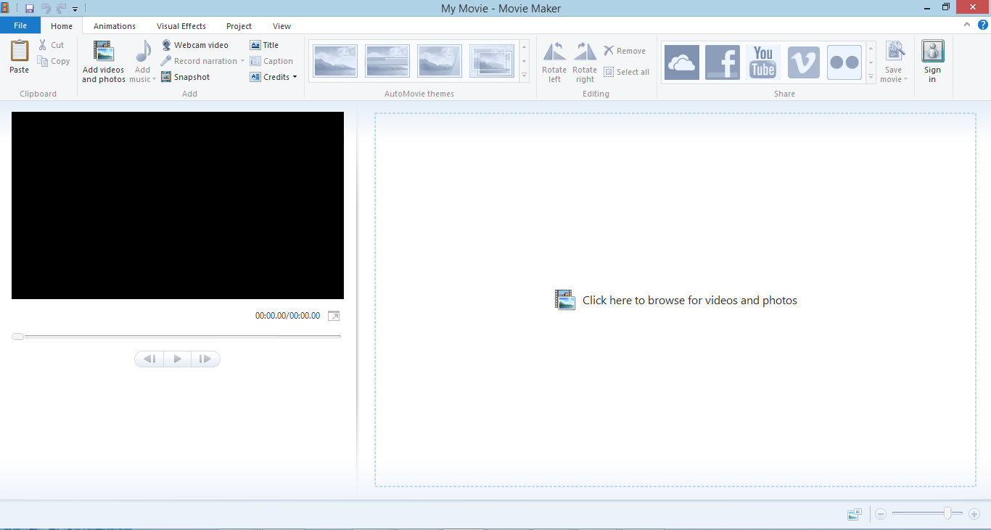

Slide 15
The Study
61 Graduate Students and 20 Undergraduate Students
Taught to use the software
Groups of 4 or 5

Slide 16
The Study
61 Graduate Students and 20 Undergraduate Students
Taught to use the software
Groups of 4 or 5
Assigned to Make 5-10 Minute Video
Notes:
Upload the video. The objective of the movie was to produce a distance education instructional tutorial to teach other students the educational content of topics covered over the course of the semester.

Slide 17
The Study
61 Graduate Students and 20 Undergraduate Students
Taught to use the software
Groups of 4 or 5
Assigned to Make 5-10 Minute Video
Assigned Topics
Notes:
The movies produced included but were not limited to the following:
1. Cellular metabolism
2. Reproduction
3. The Digestive System
4. The Urinary System
5. Education and Learning Theories
6. Technology and the Teacher
7. College Students Need to Vote
8. Diversity in the Classroom

Slide 18
Cellular metabolism
Reproduction
The Digestive System
The Urinary System
Education and Learning Theories
Technology and the Teacher
College Students Need to Vote
Diversity in the Classroom

Slide 19
The Study
61 Graduate Students and 20 Undergraduate Students
Taught to use the software
Groups of 4 or 5
Assigned to Make 5-10 Minute Video
Assigned Topics
6 75 minute class periods and approx. 30 hours outside class

Slide 20
Results

Slide 21
Results
Student Survey
Notes:
Online and anonymous
1. Was the You Tube tutorial design process interesting?
 YES  NO  Don’t know/Not applicable/Refuse
2. Did you understand what you were supposed to learn?
 YES  NO  Don’t know/Not applicable/Refuse
3. Were the materials directly related to the objectives?
 YES  NO  Don’t know/Not applicable/Refuse
4. Were the development exercises relevant?
 YES  NO  Don’t know/Not applicable/Refuse
5. Would you use You Tube in the classroom as a learning tool?
 YES  NO  Don’t know/Not applicable/Refuse
6. Did you expand your technology skills by using You Tube?
 YES  NO  Don’t know/Not applicable/Refuse
7. Did you receive sufficient feedback on your final results?
 YES  NO  Don’t know/Not applicable/Refuse
8. Did you feel confident working in groups?
 YES  NO  Don’t know/Not applicable/Refuse

Slide 22
Results
Student Survey
3 Options (Yes, No, Don’t Know/Not Applicable/Refuse)
Notes:
1. Was the You Tube tutorial design process interesting?
2. Did you understand what you were supposed to learn?
3. Were the materials directly related to the objectives?
4. Were the development exercises relevant?
5. Would you use You Tube in the classroom as a learning tool?
6. Did you expand your technology skills by using You Tube?
7. Did you receive sufficient feedback on your final results?
8. Did you feel confident working in groups?

Slide 23
Results
Student Survey
3 Options (Yes, No, Don’t Know/Not Applicable/Refuse)
8 Questions

Slide 24
Questions
Was the You Tube tutorial design process interesting?

Slide 25
Questions
Was the You Tube tutorial design process interesting?
Mean Score .93
Standard Deviation .26

Slide 26
Questions
Was the You Tube tutorial design process interesting?
Did you understand what you were supposed to learn?

Slide 27
Questions
Was the You Tube tutorial design process interesting?
Did you understand what you were supposed to learn?
Mean Score .95
Standard Deviation .22

Slide 28
Questions
Was the You Tube tutorial design process interesting?
Did you understand what you were supposed to learn?
Were the materials directly related to the objectives?

Slide 29
Questions
Was the You Tube tutorial design process interesting?
Did you understand what you were supposed to learn?
Were the materials directly related to the objectives?
Mean Score .99
Standard Deviation .11

Slide 30
Questions
Was the You Tube tutorial design process interesting?
Did you understand what you were supposed to learn?
Were the materials directly related to the objectives?
Were the development exercises relevant?

Slide 31
Questions
Was the You Tube tutorial design process interesting?
Did you understand what you were supposed to learn?
Were the materials directly related to the objectives?
Were the development exercises relevant?
Mean Score .91
Standard Deviation .29

Slide 32
Questions
Was the You Tube tutorial design process interesting?
Did you understand what you were supposed to learn?
Were the materials directly related to the objectives?
Were the development exercises relevant?
Would you use You Tube in the classroom as a learning tool?

Slide 33
Questions
Was the You Tube tutorial design process interesting?
Did you understand what you were supposed to learn?
Were the materials directly related to the objectives?
Were the development exercises relevant?
Would you use You Tube in the classroom as a learning tool?
Mean Score .73
Standard Deviation .44

Slide 34
Questions
Was the You Tube tutorial design process interesting?
Did you understand what you were supposed to learn?
Were the materials directly related to the objectives?
Were the development exercises relevant?
Would you use You Tube in the classroom as a learning tool?
Did you expand your technology skills by using You Tube?

Slide 35
Questions
Was the You Tube tutorial design process interesting?
Did you understand what you were supposed to learn?
Were the materials directly related to the objectives?
Were the development exercises relevant?
Would you use You Tube in the classroom as a learning tool?
Did you expand your technology skills by using You Tube?
Mean Score .94
Standard Deviation .25

Slide 36
Questions
Was the You Tube tutorial design process interesting?
Did you understand what you were supposed to learn?
Were the materials directly related to the objectives?
Were the development exercises relevant?
Would you use You Tube in the classroom as a learning tool?
Did you expand your technology skills by using You Tube?
Did you receive sufficient feedback on your final results?

Slide 37
Questions
Was the You Tube tutorial design process interesting?
Did you understand what you were supposed to learn?
Were the materials directly related to the objectives?
Were the development exercises relevant?
Would you use You Tube in the classroom as a learning tool?
Did you expand your technology skills by using You Tube?
Did you receive sufficient feedback on your final results?
Mean Score .94
Standard Deviation .24

Slide 38
Questions
Was the You Tube tutorial design process interesting?
Did you understand what you were supposed to learn?
Were the materials directly related to the objectives?
Were the development exercises relevant?
Would you use You Tube in the classroom as a learning tool?
Did you expand your technology skills by using You Tube?
Did you receive sufficient feedback on your final results?
Did you feel confident working in groups?

Slide 39
Questions
Was the You Tube tutorial design process interesting?
Did you understand what you were supposed to learn?
Were the materials directly related to the objectives?
Were the development exercises relevant?
Would you use You Tube in the classroom as a learning tool?
Did you expand your technology skills by using You Tube?
Did you receive sufficient feedback on your final results?
Did you feel confident working in groups?
Mean Score .78
Standard Deviation .42

Slide 40
Results
Student Survey
8 Questions
3 Options (Yes, No, Don’t Know/Not Applicable/Refuse)
Student Comments

Slide 41
Comments - Application
“I like doing the tutorials instead of just lecturing and tests. I would use You Tube in a classroom; it would be a good way to break up the class and keep students interested. There are many educational videos that would aid in teaching different lessons.”
Notes:
Summary of comments from grad students about application
interesting,
Breaks up class
Use of technology
Undergrads said less but similar

Slide 42
Comments - Application
“I like doing the tutorials instead of just lecturing and tests. I would use You Tube in a classroom; it would be a good way to break up the class and keep students interested. There are many educational videos that would aid in teaching different lessons.”
“I liked doing the You Tube as a student, but I do not see how it would help me in the classroom. I like when the teacher does the teaching standing in front of the class. I would not like watching a video.”
Notes:
Hard to Take Seriously
Distractions
Undergrads did not bring up these issues.

Slide 43
Comments - Strengths
“I like hands-on learning, so being able to do the You Tube project helped better my understanding of the material.”
“Making the You Tube video was a straight-forward process - develop an idea into an organized script, and then shoot the clip.”
Notes:
Summary of comments from grad students about strengths
Undergrads had similar things to say, but they talked a lot more about the enjoyment factor

Slide 44
Comments - Improvements
“More Introduction”
Technical Difficulties
Upload Problems
Notes:
Comments about instructor effectiveness (overlap between improvements and instructor – technical difficulties lack of direction). Undergrads did not mention this. Both groups like their instructors.
Summary of comments about improvements
“Uploading the video was not as simple as it initially seemed. Sometimes our group would get only video and no audio, and vice-a-versa. The technological mistakes and mishaps forced us to take several additional class periods to complete and upload the clip. I believe that the tutorial did not give effective solutions and strategies to solve this problem. If you give this particular project to your future classes please make sure that the group that provides the tutorial gives detailed instructions as to how to get around these problems. A broader recommendation would be to require that all tutorials are submitted to the instructor for approval before being uploaded to You Tube. “
Both mentioned technical difficulties and team problems. Undergrad mentioned the issues with membership.
Informal Statements about the needed time and effort being too burdensome on grad students.

Slide 45
Limitations
Software only worked on one computer
Need for technology such as digital cameras
Training in Video Production and Digital Picture Taking
Technical Difficulties

Slide 46
Conclusions
Increased Student Perceptions of Learning
Graduate Students saw greater opportunities to use YouTube tutorials in their classrooms

Slide 47
Questions
Have you used YouTube in your classes?
Was it a good experience?
If you use YouTube in your classes, how would you address some of the issues these researchers had?

