Slide 1
Can Reading Questions Foster Active Learning? A Study of Six College Courses
Laurel Powell

Slide 2
Authors
Can Reading Questions Foster Active Learning? A Study of Six College Courses
Tomas M. Koontz
Professor of environmental and natural resources policy at Ohio State University School of Environment and Natural Resources
Received College-level awards in recognition of teaching
Kathryn M. Plank
Associate director of University Center for the Advancement of Teaching and adjunct associate professor of education policy and leadership at the Ohio State University.

Slide 3
Student Reading
Students often do not complete their required reading.
A study by Clump, Bauer and Bradley (2004) determined that students often completed less than 30% of their required reading.
This author decided to provide students with a series of optional questions to encourage students to complete the required reading.

Slide 4
Active Learning
Promotes knowledge rather than the transmission of facts
Shown to be superior to lectures in promoting development
Defined as “instructional activities involving students in doing things and thinking about what they are doing”

Slide 5
Courses
Ohio State University
School of Environment and Natural Resources
Six courses
Sophomore to Doctoral
Smallest class 5-10
Largest 40-50
Readings are assigned
Readings are accompanied by 5 to 15 optional questions.
​ Making the questions required was a failure as student's felt like this was busy work.
Notes:
KK

Slide 6
Feedback
​Mid-Semester Student Feedback
Small Group Instructional Diagnostic
​Written comments, followed by group discussion.
​Submitted Anonymously
​End of Semester Assessment
​Anonymous end of semester feedback form
​Questions about the learning experience​

Slide 7
Results
How often did you complete the readings?
12% - less than 50% of the time
29% - 50% to 75%
59% - more than 75%
Similar across multiple class standings

Slide 8
How helpful were the questions?
0 – 2% of students
1 – 3% of students
2 – 15% of students
3 – 26% of students
4 – 54% of students
Higher usefulness linked to lower class standing
Used for:
Exam Study Guide – 71%
Track Main Ideas – 53%
Answered during or after assigned reading – 52%

Slide 9
Measurement
Svinicki's 6 Principles
​"Practical Implication of Cognitive Theories
​Described the processes that students use to learn
​
​"Learners (...) actively construct their own understanding"
​
​Discussion over which of the six principles is most important

Slide 10
Svinicki’s Principles
Principle 1. If information is to be learned, it must first be recognized as important. Implication: The more attention is effectively directed toward what is to be learned (that is, toward critical concepts and major areas), the higher the probability of learning.
Principle 2. During learning, learners act on information in ways that make it more meaningful. Implication: Both instructor and student should use examples, images, elaborations, and connections to prior knowledge to increase the meaningfulness of information.
Principle 3. Learners store information in long-term memory in an organized fashion related to their existing understanding of the world. Implication: The instructor can facilitate the organization of new material by providing an organizational structure, particularly one with which students are familiar, or by encouraging students to create such structures; in fact, students learn best under the latter condition.
Notes:
Principle 1. If information is to be learned, it must first be recognized as important. Implication: The more attention is effectively directed toward what is to be learned (that is, toward critical concepts and major areas), the higher the probability of learning.
Principle 2. During learning, learners act on information in ways that make it more meaningful. Implication: Both instructor and student should use examples, images, elaborations, and connections to prior knowledge to increase the meaningfulness of information.
Principle 3. Learners store information in long-term memory in an organized fashion related to their existing understanding of the world. Implication: The instructor can facilitate the organization of new material by providing an organizational structure, particularly one with which students are familiar, or by encouraging students to create such structures; in fact, students learn best under the latter condition.
Principle 4. Learners continually check understanding, which results in refinement and revision of what is retained. Implication: Opportunities for checking and diagnosis aid learning.
Principle 5. Transfer of learning to new contexts is not automatic but results from exposure to multiple applications. Implication: Provision must be made during initial learning for later transfer.
Principle 6. Learning is facilitated when learners are aware of their learning strategies and monitor their use. Implication: The instructor should help students learn how to translate these strategies into action at appropriate points in their learning

Slide 11
Svinicki’s Principles
Principle 4. Learners continually check understanding, which results in refinement and revision of what is retained. Implication: Opportunities for checking and diagnosis aid learning.
Principle 5. Transfer of learning to new contexts is not automatic but results from exposure to multiple applications. Implication: Provision must be made during initial learning for later transfer.
Principle 6. Learning is facilitated when learners are aware of their learning strategies and monitor their use. Implication: The instructor should help students learn how to translate these strategies into action at appropriate points in their learning

Slide 12
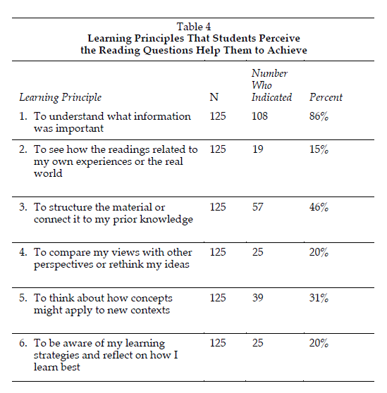

Slide 13
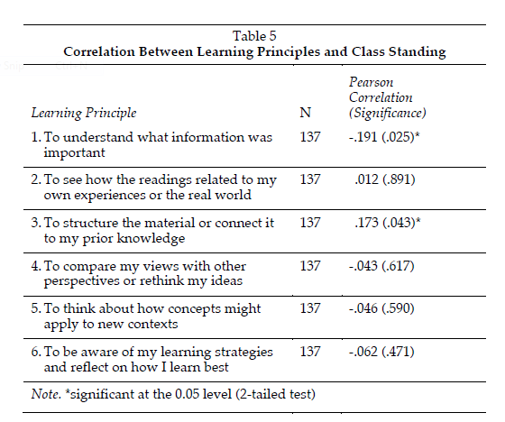
Notes:
Two significant parts. Higher class standing means less likely to use them for principle 1 but more likely to use them for principle 3. Other data, such as comparisons between different courses continue the theme that higher level students use principle 3 more.

Slide 14
Summary
75% across all levels completed reading
54% rated questions at highest level of helpfulness
Svinicki’s active learning principles 1 and 3 were most common.
Principle 6 also occurred in 20% which encourages even higher levels of understanding.

Slide 15
Source Paper
Koontz, T. M., & Plank, K. M. (2011). Can reading questions foster active learning? A study of six college courses. Journal on Excellence in College Teaching, 22 (3), 23-46.

