Slide 1
Caring in teaching
a complicated relationship
Margaret Barrow. The Journal of Effective Teaching, 15(2), 2015, 45-49.
Presented by Emmanuel Bello-Ogunu, Spring 2016.

Slide 2
DISCUSSIOn
Personal experiences with caring (or lack thereof) as a student? As an TA/instructor?
Other challenges to caring not discussed?
Takeaway that you want to apply to your own pedagogy?

Slide 3
“The Professor doesn’t care!”
“caring about is empty if
it does not culminate in caring relations”
nel noddings (2002)

Slide 4
traditional theories of care in education
Text
Often focus on K-12 teaching
Higher education traditionally centers on content area expertise
Often rigid and oppressive student-teacher relationship models
  Constructs barriers to students’ and teachers’ education and learning
To change the status quo requires attention to pedagogy at college level
  Especially important for students who find school challenging
  Statistical odds stacked against them, yet still deserve fair opportunities for success

Slide 5

“Caring for your students will only cause them more harm.”
Notes:
The idea that college professors should not care about their students is limiting and detrimental to the students, as it even undermines our teaching effectiveness

Slide 6
an ethic of care: Foundations
Three key factors as a guide: (from educational philosopher Nel Noddings)
  (1) Engrossment (2) Motivational Displacement (3) Reciprocity
Some critics question the need for observable reciprocity
  "Faith in humanity and faith in God can sustain one caring..." in the face of situational confusion, competing needs, and hostile opposition" (White, 2003)
Others call for a more "collaborative caring" (Bateson, 1989)
  “Empowerment that considers the needs of both persons within the relationship” (Sumsion, 2000)
Notes:
As we can see, there are various conceptions of caring in the classroom, with no single definition; what remains consistent, however, is the need to develop a relationship

Slide 7
Caring in postsecondary settings
Haskell-McBee (2007) collected data on “what caring in educational context means to respondents, how they show […] they care, and how they teach caring”
    “offering help”
    “showing compassion”
    “showing interest”
    “caring about the individual”
    “giving time”
    “listening”
    “getting to know students”
Meyers (2009) added “demonstrating concern for students,” “respectfulness and willingness to answer questions and foster interactions”
Notes:
78 characteristics narrowed down to top seven:

Slide 8
Caring in postsecondary settings
De Guzman et al. (2008) suggested that certain “acts of caring” are reflected when the teacher “makes use of class time productively, shares personal experiences”
  Study also revealed students’ self-esteem and self-evaluation were heavily influenced by the teacher’s caring behavior and attitude towards student
Foster (2008) found that students came to view teachers/admin as positively impacting their desire to succeed in school through a “nontraditional, intense, and personalized relationship”
Notes:
Foster (2008) studied 32 underserved and economically disadvantaged students in an early college high school program; initially, they admitted not wanting to be in school and believe their teachers felt the same;
“nontraditional…” offered teacher home visits, identified students’ learning styles, continued cell phone communication between teacher/student, and provided access to college campus and college life..

Slide 9

Close Encounters of the caring kind
Notes:
The author, who is an associate professor and deputy chair in the English department at an urban community college, uses three vignettes from her own teaching experiences to illustrate the different kinds of “caring” she’s exhibited and the profound impact it has had on her students

Slide 10
“I just don't feel like i belong here.”
vignette one
Meet “Marcus,” a 33-year old student who carried his belongings everywhere
Not all students feel comfortable expressing their needs
  Often characteristic of western education practices
  Instructors may have to rely on observable needs
Rather than wait for students to express a need, initiate with “one-on-one initial meetings” (O’Brien, 2010)
  Almost always find a point of connection; “someone we can know”
Schools are filled with outwardly unresponsive students (White, 2003); requires patience and persistence
Notes:
No longer view student success as the sole responsibility of the teacher, but of the college community as a whole

Slide 11
“Being here is not my choice.”
vignette two
Meet “Tanya,” African American student with excessive absences
As an instructor representing the college, the administration probably has certain expectations of you regarding retention
To show care of such a student was to see her specific need and problem, even if not in line with expected philosophy of school
  Leaving college is a reality for students
“Listening is an integral part of creating the caring experience” (Noddings, 2012)
Notes:
Tanya is a young African-American female student with excessive absences, and was not completing assignments
Author invited her to office hours, and Tanya explained she was force to attend college to study business so so she could take over the family real estate business; but she hated college, and wanted get her real estate license
So instructor sat with Tanya for over an hour, reading through real estate programs online to help her select one
Leaving college is a reality: responsibilities of college combined with challenging personal problems (i.e. sudden unemployment, homelessness, pregnancy, illness,

Slide 12
“We’re all in this together.”
vignette three
Meet the students of a diverse Development English class
In extending the moral climate and create a climate of care that will persist,
The impact of care was palpable
Today’s focus on education on measurable outcomes can easily ignore the power of care in learning
Sometimes the effect of the caring relationship can last long after they have left the classroom
Notes:
22 ethnically and linguistically diverse students enrolled; they test into this course if they fail the college entrance-writing exam, and they have two opportunities to pass the exam, so there is a lot of pressure (on both student and teacher)
Felt trusted

Slide 13

challenges

Slide 14
A Natural part of caring
challenges
Serious time and emotional commitment
“There is always the fear that with so much pressure the one caring may find herself facing the risk that she will cease to care” (Noddings)
  Conflict and guilt are inescapable risks of caring
Also, not all students are receptive to an approach built on developing a relationship
Occasionally, relationships cannot be sustained because of asymmetrical power dynamics
Notes:
The pressures to be a “good” and “effective” teacher is, at the very least, challenging
Some days Barrow would want to close her door and hide from Marcos to preserve a few minutes to herself and her duties … yet she understood Marcos had no one else

Slide 15
challenges
“failing a hard-working student […] after having established a close relationship with him/her can be painfully uncomfortable.”
margaret barrow
Notes:
“Failing a hard-working student who does not seem cut out for a particular field of study after having established a close relationship with him or her can be painfully uncomfortable.” (This makes intervention an important act of caring as well)
We have an evaluative and institutional roles that should not be diminished by the relationship we have with students.

Slide 16

boundaries:
what is real,
what is possible

Slide 17

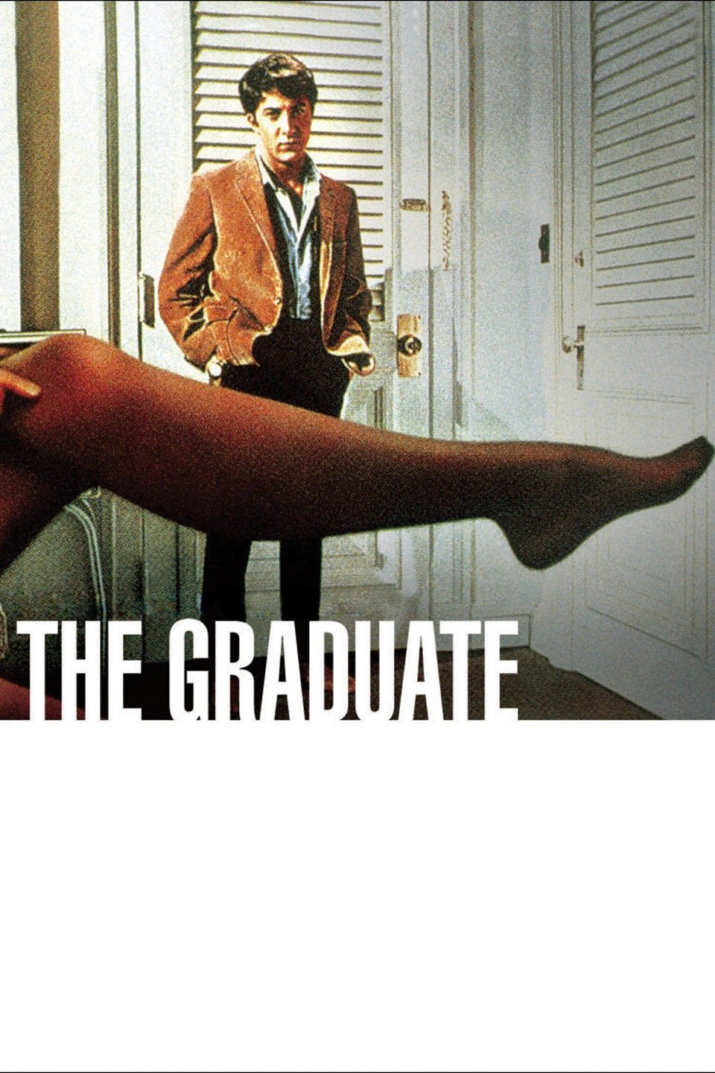

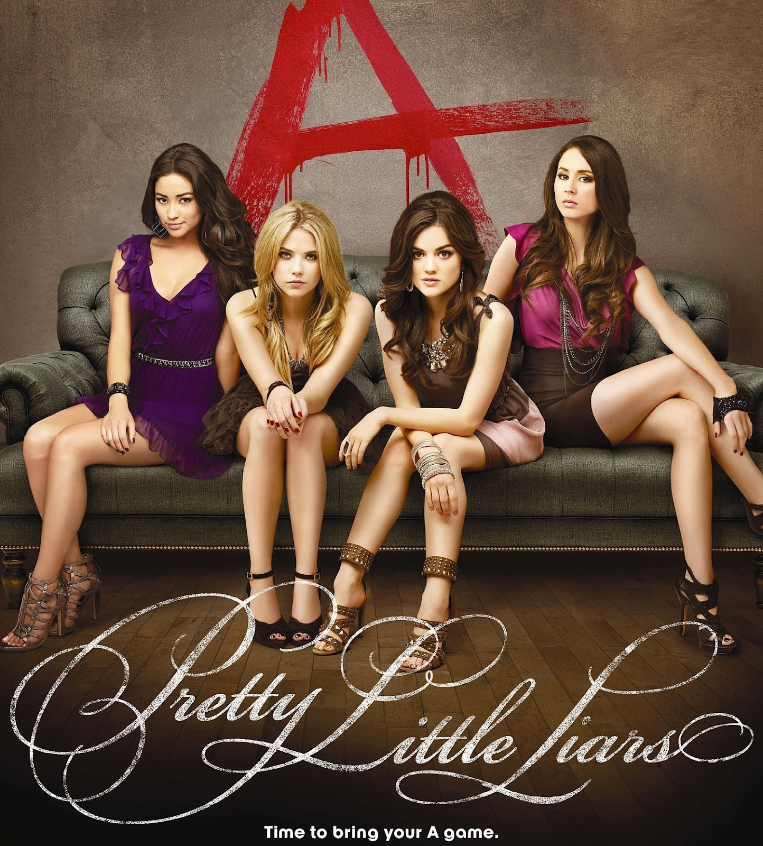
two opposing views
BoUNDARIES
Glorified, romanticized, often scandalous college teacher-student relationships
  The Graduate (1967)
  Notes on a Scandal (2006)
  Pretty Little Liars, Gossip Girl, Glee, etc
Inspirational teacher-student relationships
  Stand and Deliver (1988)
  The Great Debaters (2007)
  Dead Poets Society (1989)

Slide 18
Drawing the line
BOUNDARIES
Developing caring relationships make both teacher and student vulnerable
  Must recognize which boundaries cannot, should not be crossed
  Instructor has power over students; need to use that professionally
Relationships can grow out of an “educative nature”
Must maintain our professionalism, and treat all students fairly and equally
Notes:
Educative nature: one that is built on “Common interest in each other as human beings,” “shared excited in the subject,” the “experience of discovery,” and “the search for further insight and knowledge”
Increased investment and involvement in students’ lives can potentially blur the distinction between faculty and friend
Be wary of favoritism as well

Slide 19
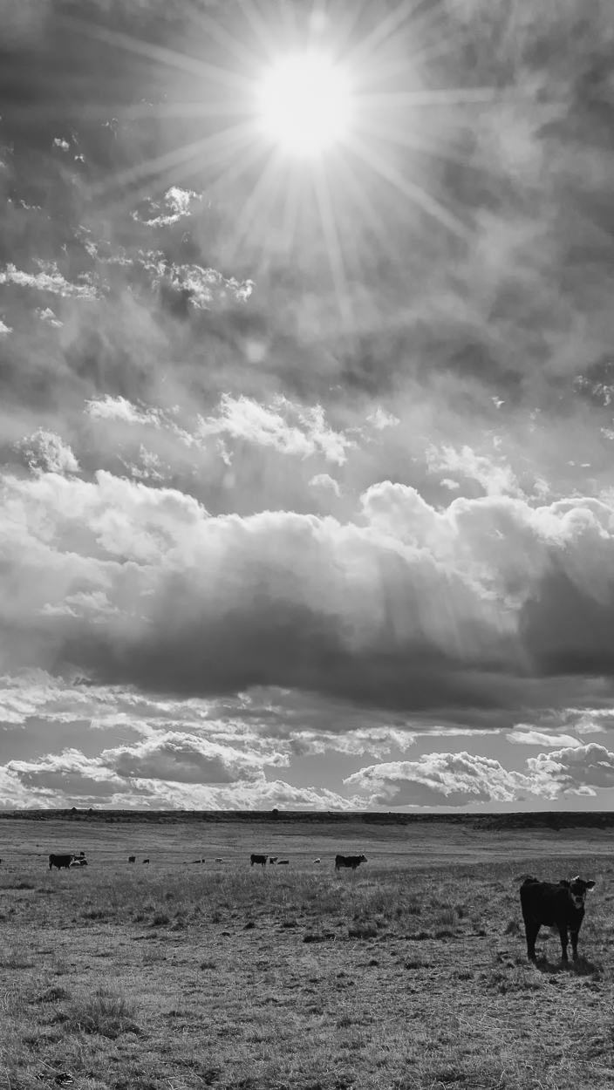
A cautious conclusion

Slide 20
feeling cared-for
A Cautious conclusion
Observable reciprocity may not present, or it may be disguised, but arguably it does not make or break the relationship
  A caring teacher may never know the impact of their caring
While caring theory is not a “magic pill” that dissolves all challenges of teaching, it offers an important place from which to teach
  Emphasizes importance of listening, observing students’ needs carefully, exercising empathy, accentuating mutuality

Slide 21
instructional recommendations
Text
Be open, available, and responsible
Offer help as soon as a problem arises, show compassion, listen to student ideas, get to know them beyond their names
Foster interactions with students
Use class time productively, share personal experiences
Many many more

Slide 22
DISCUSSIOn
Personal experiences with caring (or lack thereof) as a student? As an TA/instructor?
Other challenges to caring not discussed?
Takeaway that you want to apply to your own pedagogy?

Slide 23

Thank you

