Slide 1
Promoting Social Change through Service Learning in the Curriculum
Bowen, Glen. The Journal of Effective Teaching, Vol. 14, No. 1, 2014, 51-62.
Presented by Emmanuel Bello-Ogunu

Slide 2
Service Learning

Slide 3
Service-Learning
High-impact pedagogical strategy embraced by higher education institutions
Enriches curriculum, fosters civic responsibility, and improves communities
Connects community service to course content
Direct service based on a charity paradigm
Social change-oriented service
Notes:
; translates theory into practice

Slide 4
Service-Learning
Avenue for promoting social action/change, but…
Tends to be restricted to direct service in community
Visibility of immediate outcome and impact
Aversion to situations that are too “political”
“Can perpetuate racist, sexist, or classist assumptions”
Notes:
Although desirable and admirable, charity without focus on social justice —> “can perpetuate racist, sexist..and reinforce a colonialist mentality or superiority”
This limits the potential and promise of the pedagogy

Slide 5
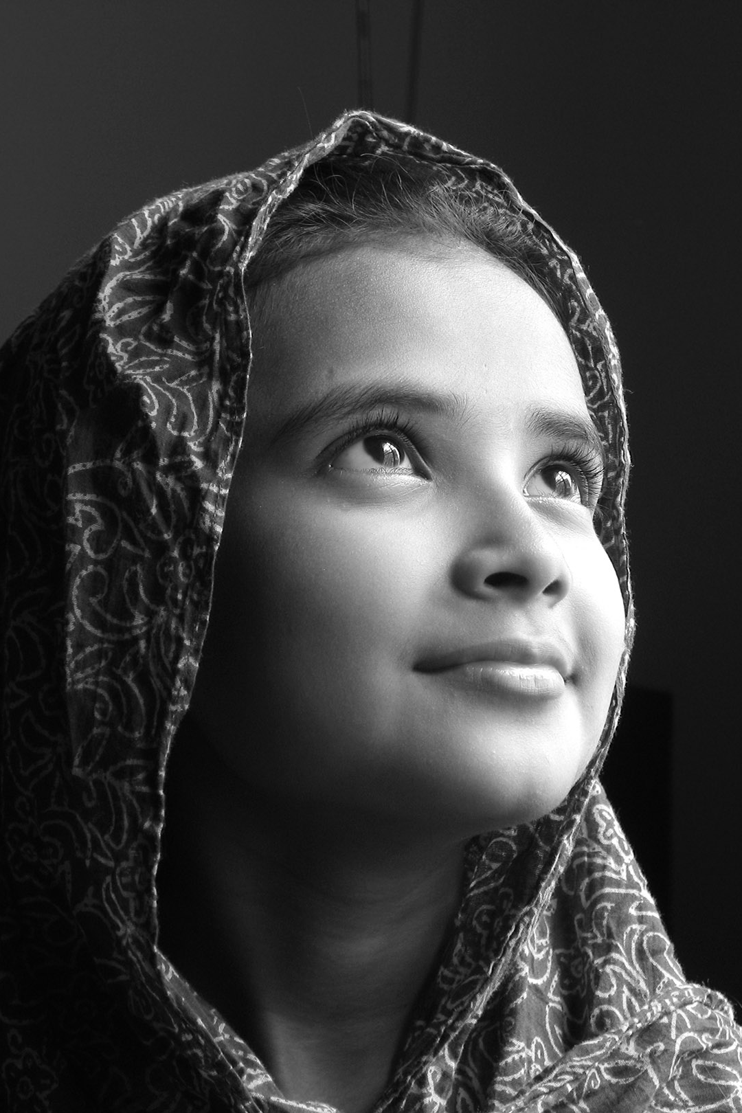
Social Justice & Social Change
Social justice is “the movement of society towards greater equality, economic fairness, acceptance of cultural diversity, and participatory democracy.” (Warren, 1998)
Social change implies beneficial advances in society, including “empowering marginalized communities and changing unjust institutional arrangements” (Lewis, 2004)

Slide 6
#YesAllWomen
#YouOKSis
#BringBackOurGirls
#HeForShe
#StopGamerGate
#BlackLivesMatter
#SOCIALJUSTICE
#AmINext
#ICantBreathe
#IfTheyGunnedMeDown
#WhyIStayed
#ALSIceBucketChallenge
#DudesGreetingDudes
Notes:
A social justice approach redirects focus of service learning from charity to social change, from immediate response to immediate need (as a sort of Band-aid approach, like stacking shelves at a food bank or serving food at a homeless shelter) to longer-term responses that address the root of social problems (such as through community organizing and legislative advocacy to address the causes of hunger).

Slide 7
Social Justice Education
Student-centered
Experiential
Collaborative
Intellectual/analytical
Multicultural
Value-based
Activist
Notes:
Promoting social change through service-learning in the curriculum requires attentiveness to social justice education, and this education involves increasing students’ awareness of social inequalities, identifying the roles that individuals and institutions play in maintaining such inequalities, and taking corrective action.

Slide 8
Social Justice + Service-Learning
“Systemic problems require system solutions” (Cone, 2003)
Connecting awareness to action
Redistribution of resources
Empowering communities
Creating equitable institutional structures in society
Notes:
Does more than just provide introductions to the community.

Slide 9
Objectives
(a) Encourage faculty to accept the dual role of social justice educator/service-learning practitioner
(b) Assist instructors in developing a feasible, change-oriented service-learning strategy

Slide 10
Applying the Social Justice Education Model
Commonly addressed issues: poverty, unemployment, hunger, homelessness, crime, domestic violence, pollution, racial discrimination
Typical courses: sociology, social work, health sciences
Additionally: psychology, public policy, theology

Slide 11
Example 1: Public Health course
Learning objective: identifying conditions that contribution to babies being born with low birth weights
Service objective: rendering supportive services to mothers and newborns
Students required to work with advocates to write a policy statement aimed at adequate/accessible supply of related services for women
Students kept journals reflecting on why women unable to obtain prenatal care; engaged in group discussion, exploring own values, beliefs
Notes:
“Public health” is described as a profession committed to social justice, especially focusing on eliminating disparities in health status. In this case, a class facilitated a community partnership with a local/state health department.
As you can see, the community service is often paired with some form of longer-term service targeting real social change

Slide 12
Example 2: Interdisciplinary program (“Citizen Scholars Program”)
Four-semester service-learning program
Four courses, an elective, and 60 hours of service per sem.
One course, Research as a Tool for Change, focused on developing a framework for analyzing social problems and the process of social change
Required to research a community issue in-depth and implement a plan of action for meaningful change
Notes:
By the end of this course, you will have:
• Considered how knowledge is a form of power, and explored ethical dilemmas involved in creating and accessing knowledge.
• Generated new knowledge in collaboration with a community organization, to help them address community problems.
• Developed and used skills in community-based research.
• Developed and used skills in working as part of a team.
• Explored social justice theory, and used it to analyze your research project, your service experience, and your own social position.

Slide 13
Example 3: Sociology course (developed by the author)
“Social Problems, Social Justice, and Social Change” course
Students expected to identify causes, consequences of social problems
Explored their own values, attitudes, and behaviors in the context of a diverse, multicultural society
Additional goal of assessing the work of social justice/change advocates and activists —> preparing them for an activist role
Notes:
Note, this is all good and well, but it is a daunting task. Teachers and students alike should be warned that it’s unrealistic to expect social change as a result of a semester of work, or even a full academic year.

Slide 14
Preparing a Syllabus
Course Description: indicate “student-centered,” “collaborative,”“experiential service-learning”
Objectives: specific, action-oriented; cover both service and learning objectives
Course content: indicate breadth, depth through required readings on specific issues
Community-based work: explain nature, time commitment, identify community partners
Notes:
Enter the syllabus. Because students may feel overwhelmed by a new instructional approach that requires both classroom- and community-based work, the syllabus should be used to address students’ fears and to temper the challenge of service-learning with words of encouragement. These are the recommended syllabus components for course where social justice and service-learning is integral.
Note that student learning in this setting is best documented through critical reflection activities, so these a clear description of these activities especially important.

Slide 15
Preparing a Syllabus
Assignments and Critical Reflection: journal entries, research papers, presentations
Assessment: criteria, rubrics, procedure for assessing student learning
Support: encourage enthusiasm, sustained interest through resources, diverse learning opportunities

Slide 16
Discussion
What are ways you could integrate social justice learning in a STEM-related course?
What are some foreseeable challenges or barriers to introducing social justice learning?
Opinion: Is there a place for social justice learning in all curriculum? Should there be?
Notes:
Is there a place? —> maybe not. factors that impact include limitation of time and curriculum resources, student preparedness, intended course outcomes, and community partner priorities.
Should be cognizant that social change, as evidenced by genuine community empowerment, is never immediate, nor guaranteed

Slide 17
Conclusion
Course instructors, where possible, have a responsibility to facilitate meaningful social justice experiences through students’ service learning participation
Instructors can equip themselves for the dual role of social justice educator/service-learning practitioner
Shift students’ focus from feel-good charity to effective social change
Notes:
through elements of the syllabus and features of SJ education

Slide 18
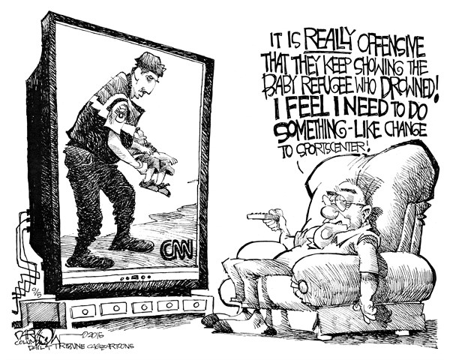
#Questions?

