Slide 1
Team Teaching:
Are Two Better Than One?
Bettencourt, Michelle L., and Weldon, Alice A.
Journal of Excellence in College Teaching, 21(4), 123-150.
Emmanuel Bello-Ogunu
28 January 2014

Slide 2
Outline
Collaboration in Higher Education
Student Attitudes Towards Team Teaching
Study Description
Study Results
Limitations
Discussion / Q&A
Conclusion

Slide 3
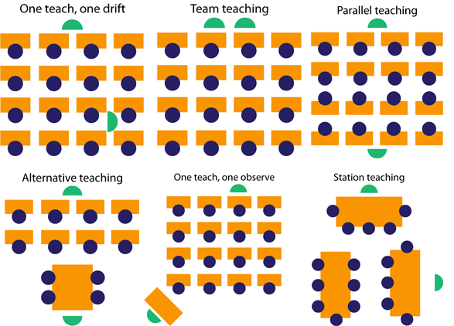
Collaboration in
Higher Education
http://www.artofacquisition.com/templates_and_css/lessons/lesson4a.html
Notes:
There is a growing evidence of a need for collaboration over autonomy; junior, or younger faculty today prefer opportunities to collaborate with senior faculty
Despite the current movement towards collaboration, there also exists work supporting fact that faculty do indeed still desire autonomy, for satisfaction and empowerment

Slide 4
Team Teaching
“a cooperative endeavor that involves common goals, coordinated effort, and outcome or products for which the collaborators share responsibility and credit” (Austin & Baldwin, 1992)
Goals: enhance quality of productivity; maximize use of resources; enhance the quality of teaching and research; maintain motivation; stimulate creativity and risk taking
Barriers: issues of power, influence, professional identity, professional integrity, lack of administrative support

Slide 5
Team Teaching
Jin and Nasara (2000): studied effectiveness of team teaching a technology course
Over 75% of students stated it enhanced their learning
Authors reported great deal more time, energy spent planning and evaluating, but benefits outweighed costs
Bowles (1994): team teaching across different disciplines
Science + Humanities; each participant loses a sense of autonomy, but “better product is hammered out” than when alone
“Positive pressure” to follow “sound pedagogy”
Professional status plays a major role in faculty collaboration

Slide 6
Student Attitudes Toward Team Teaching
Impact of team teaching on students affects its impact on faculty
Students both benefit from and struggle with aspects of team-teaching (Doebler and Smith, 1996)
Benefits: variety of teaching styles, materials, personalities, expertise
Struggles: integrating/synthesizing all the information presented by various faculty members

Slide 7
Student Attitudes Toward Team Teaching
Stepp-Greany (2004): in a single Spanish language course with multiple TAs, students took advantage of the lack of clear communication between TAs; adjusted their behavior based on strictness of each
Student still reported positive attitudes toward the course
McDaniel and Colarulli (1997): students in team-teaching course wanted one “right answer” not multiple perspectives
Communication is the most problematic aspect of team-taught courses for students

Slide 8
Description of Study
This study addresses the following:
What is the perceived impact on a faculty affect of implementing a team-taught course?
What are the advantages and disadvantages of delivering a team-taught course?
What are the perceived effects on students of implementing a team-taught course?
Applied action research: “any systematic inquiry by teachers […] about how their particular schools operate, how they teach, and how well their students learn” (Mills, 2003)

Slide 9
Study Setting & Participants
Department of foreign language studies at UNC-A
Fast-track (FT) beginning-level Spanish course
Two 3-credit hour courses taken in one semester
24 students enrolled, 18-24 years of age
Instructors were colleagues and friends for seven years prior to study
One tenured associate professor, one first semester tenure-track assistant professor

Slide 10
Study Methodology
Initially met in person to plan overall class, then worked independently on individual activity plans
Also met to write and grade all assessment tools
Required negotiation of common grading criteria
After first 3 weeks, constant meetings were not feasible with their schedules; instead rotated planning entire week of lessons, assessments
“Interactive team teaching”: both present in the classroom
During term II, additional adjustment spent more time as a divided class, done to give students individual speaking time and input from other instructors
All adjustments permissible under “action research”
Notes:
Very nature of action research: intimate, open-ended, and often serendipitous.

Slide 11
Data Collection & Analysis
Collected from multiple sources in order to increase construct validity
Teaching diaries/research journals — at first free-form, then updated to record thoughts more systematically, consistently
Summative and formative course evaluations — completed voluntarily and anonymously
Array of misc. documents — included email, lesson plans, class observation notes, to verify, corroborate, or contradict
Interpreted the data first independently, then together
Evaluated on “Guba’s criteria for validity of qualitative research”
Notes:
Guba’s 4 criteria: (1) established credibility by being members of the community, (2) conducting member checks, (3) providing rich description of context, and (4) using a teaching diary

Slide 12
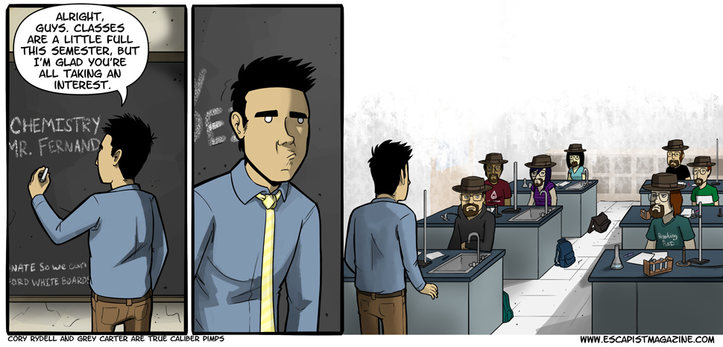
Results
Notes:
Expectations: Impact on faculty would be mostly positive, although challenging at times;
Considered student input to be an important factor in the understanding and experience of team-teaching;
Also expected students to react positively, especially to notion of having different perspectives

Slide 13
Teaching Diaries
Patterns of comparing work styles appeared the most (N=24)
“Polarity of detail vs holistic orientation”
Correcting each other (N=16)
Alice did it often, and worried about it; Michelle expressed negative reactions to it
Impacted confidence levels and relationship
Comments about perceived supportiveness (N=14)
Comments about challenges of time management (N=12)
Consistent inability to keep to time allotments, couldn't be spontaneous
Notes:
Michelle saw a loss of confidence and increased anxiety, mostly connected to being corrected
Alice’s anxiety came from their relationship, and also “vibes” that students preferred Michelle

Slide 14
Teaching Diaries
Competitiveness was recognized by both (N=7)
Followed by issues of domination or power (N=6)
Concerns over differences in family life or home life (N=6)
Alice seldom referred to home life, but referred to frustration of Michelle’s failure to meet agreed-upon deadlines due to outside commitments
Comments about use of English in class and grade books (N=6)
Shared grading had potential for confusion and loss of certain grades
Communication also a commonly mentioned issue (N=10)

Slide 15
Course Evaluations
Initial Needs Assessment (22)
15 expressed positive reaction to taking team teaching course, 6 were neutral, only 1 expressed negative expectation (“competition”)
Mid-Semester Course Evaluation (11)
7 implied positive satisfaction
End-of-Semester Course Evaluation (5)
4/5 (80%) felt positive, stated; 1/5 (20%) felt negative
End-of-Semester Course Eval. from University (17)
4 (24%) students said one instructor only, 2 (12%) said best with two
4 students felt course was disorganized; 3 cited rushed feel; 3 cited advantage of different teaching styles; only 1 mentioned more help available
Notes:
Common praises: energy, encouragement, enthusiasm of teachers; variety of styles; class met every day (not specific to team teaching)
Common complaints: rushed/hectic feel, confusion among expectations/directions, distraction with two instructors; presence of “false beginners” (not specific to team-teaching)
Students mentioned Alice had more proficiency, but Michelle was the “good communicator, fair, fun, even great” teacher. Alice was “impatient, easily frustrated, intimidating, pushy, fast, hard, made some students feel dumb, and was less clear”. Also, 3 students (18%) said Michelle gave in to Alice’s domination

Slide 16
Limitations
Initial model was not feasible for personal, professional schedules
Action research accommodates the realigning of a study based on later discoveries
Sample size: number of student course evaluations fluctuated
22 in initial needs assessment to 5 in end-of-semester evaluation
17 students still responded to University’s end-of-semester evaluation
Students’ reactions endemic, indistinguishable from all intro college Spanish courses

Slide 17
Discussion
Professional
Identity
Faculty
Relationships
Engagement with
Students

Slide 18
Discussion
Besides the mentioned issues of communication, schedule, & professional status, what other factors can come into play in the team-teaching dynamics?
What other limitations do you see in the authors’ team-teaching study?
What do you think about team teaching in the area of CS/SIS? Is it more/less feasible than other disciplines?
If you had to team-teach your course, who would you teach with and why?

Slide 19
Conclusion
“Communicating among all persons involved—students and faculty—while identifying and working with than against individual idiosyncracies, is at the heart of this example of human collaboration, as with all.”

Slide 20
Questions?

