Slide 1
ambient intelligence
Opportunities and Consequences of Its Use in Smart Classrooms
Augusto, Juan Carlos. Innovation in Teaching and Learning in Information and Computer Sciences 8.2 (2009): 53-63.
Emmanuel Bello-Ogunu
2 October 2014

Slide 2
outline
Ambient Intelligence (AmI)
History
How AmI works
Current AmI ecosystems
AmI in Higher Education
Analysis
Discussion/Q&A

Slide 3
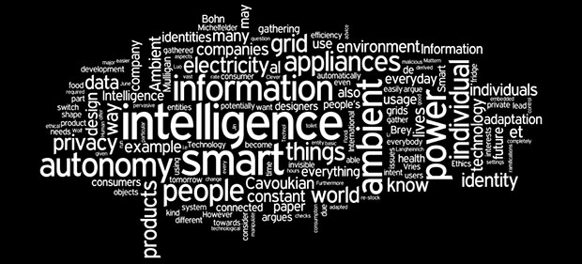
Ambient Intelligence
“A digital environment that proactively, but sensibly, assists people in their daily lives”
Notes:
Ambient Intelligence is not new:
It was Introduced as early as the 60’s. eg… Include Sci-fi movie scenario here
1. The idea of Ambient Intelligences:
By enriching an environment with technology ie. sensors and interconnected through a network
You can build a system that is proactive and sensible, and can make intelligent decisions to the benefit of the individuals in the environment
It does this by gathering real-time information combined with accumulated historical data
2. The idea of AmI is to create an intelligent environment so perfectly woven into the fabric of everyday life that it becomes indistinguishable
*This requires a heavy reliance on AI

Slide 4
evolution of technology
Notes:
1. Computers are now cheaper, readily available and extremely powerful in terms of the variation of resources they provide.

Slide 5
technological development towards AmI
Miniaturization of microprocessors
Embedded in household appliances, phones and cars
Increasing expectations and perceptions of technology
Decentralization of health care
Development of assistive technologies
Smart homes to improve healthcare
Notes:
Miniaturization of microprocessors makes it possible for these powerful computers
to be embedded in numerous household appliances, enabling individuals to accomplish very specific tasks
2. Increased expectations and positive perceptions of technology (used to be fear).
This results in a change in the way services are handled. e.g developing assistive technologies, smart homes
Summary:
a) The widespread availability of these powerful resources in society,
b) The will to change the way society interacts with technology and
c) Available technological knowledge
All form the technological layer for realizing ambient intelligence

Slide 6
confluence of different fields
Security
Notes:
1. AmI is a confluence of different fields:
Each of these areas are relevant to AmI but non of them conceptually covers AmI.
Instead Ami pulls together resources from each of them to provide flexible and intelligent services to users in their environments.
For example:
AmI relies heavily on AI to be proactive and sensible: eg. Agent-based software and robotics
Draws from HCI to handle human interactions with the system

Slide 7
how AmI works
Integration of software, hardware and networks
Perceiving environment state
Reasoning
Perception of environment
Tasks, goals and outcomes
Acting to change state
Actuators or device controllers
Notes:
AmI is an integration of software, hardware and networks to support humans
STEPS
1. Sense-Think-Act
Sensors monitor the environment
The sensors acquire and distribute information
Information is stored in a DB and then
Processed into useful knowledge (actors, models and patterns) using decision making algorithms
Decision action is then communicated to physical components which perform the action

Slide 8
current AmI system: SmartHomes
Domestic appliances
E.g. cooker, fridge
Household items
E.g. Taps, lighting
Temperature Devices
E.g. Air conditioning, heat, radiators
MavHome, Essex iDorm, Domus Lab
Industry-led projects
Siemens, Phillips, Microsoft, Intel
Notes:
Use Timewarner cable example

Slide 9
current AmI system: Healthcare
Automatic activity analysis
Access control for specific areas and devices

Slide 10
current AmI system: Transportation
GPS based spatial location
Vehicle identification
Image processing

Slide 11
current AmI system: Disaster Management
Decrease response time
Preparing the way by altering street services

Slide 12
AmI in Higher Education

Slide 13
The Classroom 2000 Project
Aim:
Capture content to be used a posteriori without disturbing normal classroom development
Developed at Georgia Institute of Technology (1995-2000)
Steps:
Preproduction:
Live capture
Post production
Access
Findings:
Exam performance not affected
Strong preference for captured notes
Attendance was not affected
Quantity of note taking differed drastically
Notes:
1. Preproduction: everything is prepared in the classroom so that meaningful events are stored
2. Live capture: Relevant activities are time stamped.
Interactions with tools demonstrated as well as slides, audio and video recorded during the lecture
are identified and labeled to facilitate post processing
3. Post production: Streams defined and captured are used in the development of interfaces that associate related streams to recorded activities during lecture.
4. Access: Final phase where students have access to recorded activities

Slide 14
The Smart Classroom at Tsinghua University
Use of an interactive whiteboard
Perform traditional handwriting tasks using digital pens on the board
Use of another whiteboard to capture class related items
Software based on multi-agent system
Used for Face-Face or distant education
Features:
A virtual assistant
Natural language recognition capabilities
Translates actions of distant students into uttered sentences
Eg. New student has arrived the virtual room
Captures audio and video
Recognizes gestures and motions
Focuses attention on appropriate material
Notes:
Multi-agent system: Each agent has his own goals but can corporate with others to achieve more complex goal
Features:
Array of cameras is used to understand specific situations and adapt service to that context.
e.g. zooming in on whiteboard when professor is writing and zooming out to the entire class when professor is speaking.

Slide 15
The Intelligent Classroom at Northwestern
Similar to Tsinghua University
Infers intent to control the classroom
Light settings
Play videos
Display slides
No pre-programming required
Natural actions of inhabitants elicit appropriate responses from the environment
Notes:
The system is based on the idea of an efficient assistant.
The software continually tries to discern what the classroom activities are
and assists the lecturer to achieve the task.
E.g zooming in on writing and adjusting lights due to different activities

Slide 16
The JAPELAS and TANGO Systems
Context aware systems
JAPELAS (Japanese Polite Expressions Learning Assisting System)
Provides information on cultural knowledge to students based on context
Enables students to follow cultural protocols for formal & informal communications through the use of PDA’s
TANGO (Tag Added Learning Objects)
Teaches high school students about atypical objects
By adding tags and providing students with tag readers
Developed at the University of Tokushima, Japan
Notes:
JAPELAS:
On PDA, a student receives guidance on how to address the person with whom they interact,
In order to enable them follow cultural protocols for formal & informal communications
TANGO: When a question is posed, using their PDAs, students have to approach the object
so that it can be recognized by the tag reader. This continues until the challenge is over

Slide 17
Mobile Computing at European Universities
University of Nottingham
Phone assisted classroom interaction system
Students give lecturers feedback via SMS using Nokia-PC Suite
Different levels of privacy were considered
Students were not worried about SMS cost
Eriksson
E-learning to M-learning
Supported by Leonardo Da Vinci Programme of the European Union

Slide 18
Analysis

Slide 19
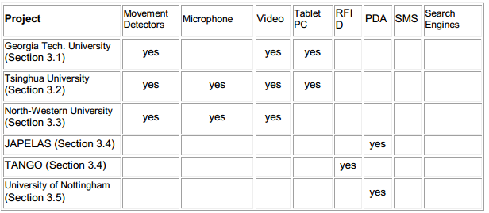
Analysis

Slide 20
Discussion / Q&A
Smart classrooms have great potential to support teaching and learning
Supports collaborative work (both real-time and offline)
Enhances connectivity for distance learning (zooming in and out based on context)
Enables learning by experience (JAPELAS)
Facilitates teaching tasks (slides by voice)
Unexplored opportunities around the globe
Privacy Issues
Do students trust privacy levels of these systems?
Future options to support teaching and learning using smart classrooms
Detecting underperforming students?
Enrich feedback on student activities?
Providing reminders and advice with respect to current activities and performance levels?
Notes:
Privacy levels of systems that demand to know more of them in order to help them.
Smart classrooms is a fertile area with great potential but remains largely unexplored

Slide 21
thank you!

