Slide 1
An Achievement Degree Analysis Approach to Identifying Learning Problems in Object-Oriented Programming
ACM Transactions on Computing Education, Vol. 14, No. 3, Article 20
Presented by: Sterling McLeod

Slide 2
Overview
Topics:
Identifying learning problems
Achievement Degree Analysis
Evaluate how well students comprehend individual concepts in a class to assess a student’s progress in a curriculum
Objectives of work:
Show the limitations of current methods
Propose the Achievement Degree Analysis (ADA) method for diagnosing students’ problems
Apply ADA to a 2nd semester Java class on OOP

Slide 3
Background
Computer-Aided Assessment – objective approach to course assessment
Provide learning suggestions based on comparing concept maps and course objectives
H. C. Chu, G. J. Hwang, J. C. R. Tseng, and G. H. Hwang. 2006. A computerized approach to diagnosing student learning problems in health education. Asian Journal of Health and Information Sciences
G. J. Hwang. 2003. A conceptual map model for developing intelligent tutoring systems. Computers and Education
S. M. Chen and S. M. Bai. 2009. Learning barriers diagnosis based on fuzzy rules for adaptive learning systems. Expert Systems with Applications
Max-min Composition – method for analyzing concepts and test results
Tool that enables Computer-Aided Assessment with MCQ
Analyzes each question on test and gives a score for concept comprehension
H. C. Chu, G. J. Hwang, J. C. R. Tseng, and G. H. Hwang. 2006. A computerized approach to diagnosing student learning problems in health education. Asian Journal of Health and Information Sciences

Slide 4
Background
Handy Instrument for Course Level Assessment (HI-Class)
Maps a course’s learning objectives into the program’s outcomes
Assess the degree of achievement of each student in the program outcomes
Uses max-min results from courses
A. M. Al-Bahi. 2007. HI-Class—a handy instrument for course level assessment. In Proceedings of the 2nd International Conference on Engineering Education and Training.
Main motivation of paper: Max-min composition works well for MCQ, but has never been studied on more complex question formats
Contributions
Show that max-min can be ineffective for complex question types, such as OOP
Achievement Degree Analysis (ADA) Approach = Concept Effect Propagation + HI-Class

Slide 5
Concept-Effect Propagation
Use concept maps to help evaluate tests
Constructing a Concept-Effect Propagation Model (CPM)
Constructing a Test Item-Concept Relationships Table (TIRT)
Diagnosing student learning problems via matrix composition

Slide 6
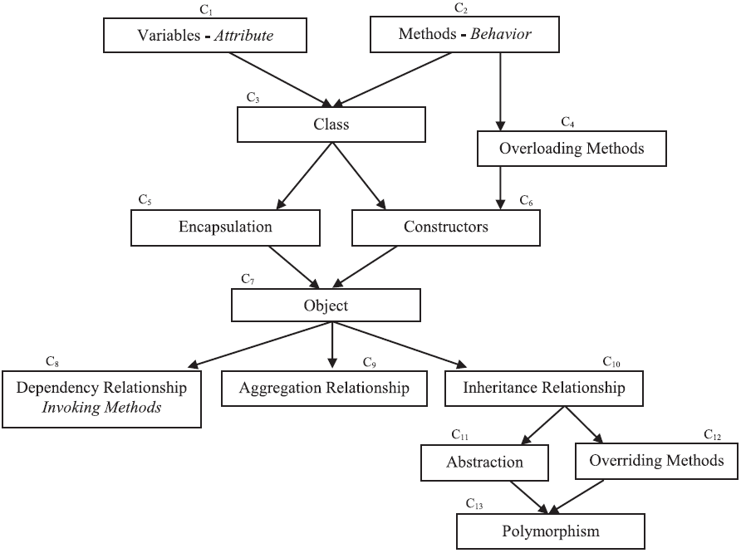
1. Constructing a CPM
Records the concepts in a course that may be influenced by other concepts in the learning process
Helps instructors identify key concepts
OOP Concept-effect Propagation Model

Slide 7
1. Constructing a CPM
Records the concepts in a course that may be influenced by other concepts in the learning process
Helps instructors identify key concepts
With MCQs, we expect to have a direct question to test a single concept.
But in OOP (and many other topics), MCQs will require some knowledge of pre-requisite concepts
Thus, there is not a one-to-one ratio between questions and concepts.
Model is created by course instructors
OOP Concept-effect Propagation Model

Slide 8
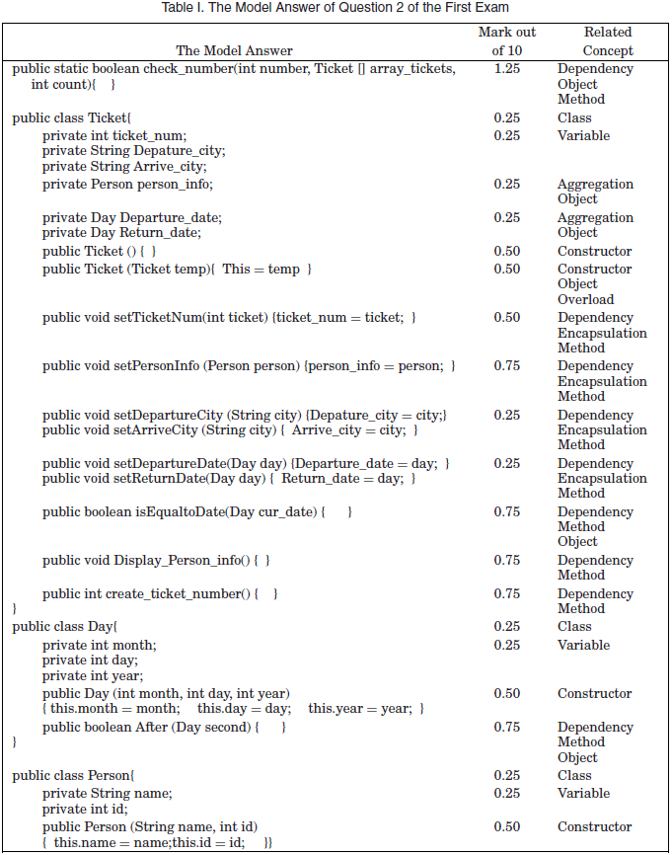
2. Test Item-Concept Relationships Table (TIRT)
Each question has a table representing its distribution of marks and the concepts to be assessed with weights of association

Slide 9
2. Test Item-Concept Relationships Table (TIRT)
Each question has a table representing its distribution of marks and the concepts to be assessed with weights of association
Validity test for the weights – experts assign weights and compare

Slide 10
2. Test Item-Concept Relationships Table (TIRT)
Each question has a table representing its distribution of marks and the concepts to be assessed with weights of association
Validity test for the weights – experts assign weights and compare

Slide 11
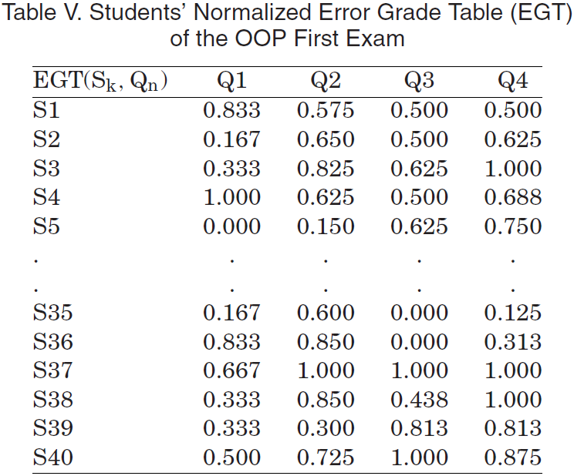
3. Diagnosing student learning problems
Build a table to represent student error
$$EGT\left(S_{k}, Q_{n}\right)=1 −\frac{Origin grade\left(S_{k}, Q_{n}\right)}{Origin Total_{Q_{n}}}$$

Slide 12
3. Diagnosing student learning problems
Build a table to represent student error
$$EGT\left(S_{k}, Q_{n}\right)=1 −\frac{Origin grade\left(S_{k}, Q_{n}\right)}{Origin Total_{Q_{n}}}$$
Use this table to build a connection between test scores and concept understanding

Slide 13
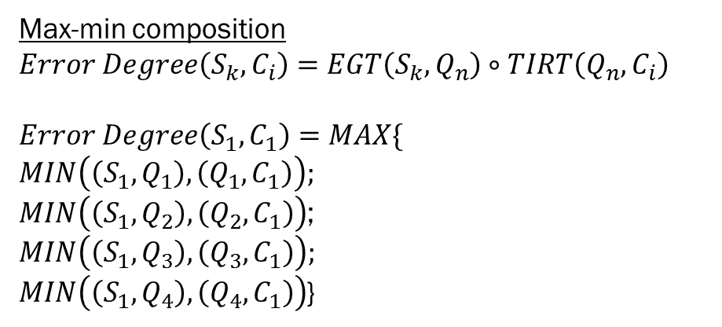
Results
Max-min composition
$$Error Degree\left(S_{k}, C_{i}\right)=EGT\left(S_{k}, Q_{n}\right)∘TIRT\left(Q_{n}, C_{i}\right)$$
$$Error Degree\left(S_{1}, C_{1}\right)=MAX\{$$
$$MIN\left(\left(S_{1}, Q_{1}\right), \left(Q_{1}, C_{1}\right)\right);$$
$MIN\left(\left(S_{1}, Q_{2}\right), \left(Q_{2}, C_{1}\right)\right)$;
$$MIN\left(\left(S_{1}, Q_{3}\right), \left(Q_{3}, C_{1}\right)\right);$$
$MIN\left(\left(S_{1}, Q_{4}\right), \left(Q_{4}, C_{1}\right)\right)$}

Slide 14
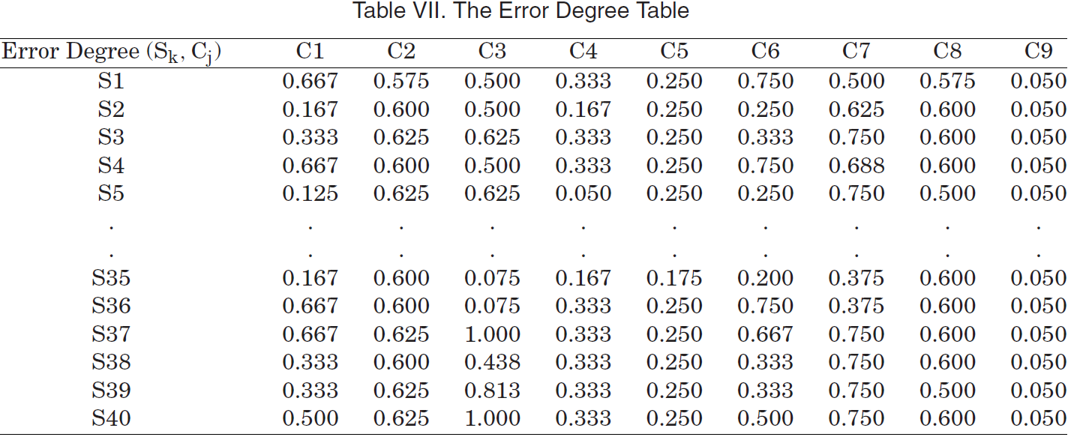
Results
Max-min composition

Slide 15
Results
Max-min composition

Slide 16

Results
$$Error Degree\left(S_{1}, C_{9}\right)=MAX\{$$
$$MIN\left(\left(S_{1}, Q_{1}\right), \left(Q_{1}, C_{9}\right)\right);$$
$MIN\left(\left(S_{1}, Q_{2}\right), \left(Q_{2}, C_{9}\right)\right)$;
$$MIN\left(\left(S_{1}, Q_{3}\right), \left(Q_{3}, C_{9}\right)\right);$$
$MIN\left(\left(S_{1}, Q_{4}\right), \left(Q_{4}, C_{9}\right)\right)$}
Max-min composition

Slide 17
Results
Max-min Problems:
Does not accurately represent comprehension
Does not differentiate between students well
Max-min composition

Slide 18
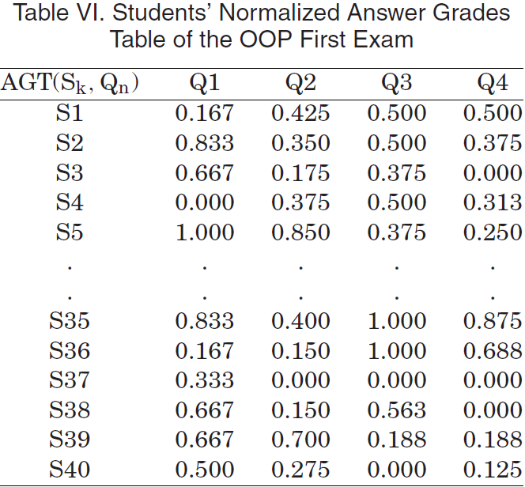
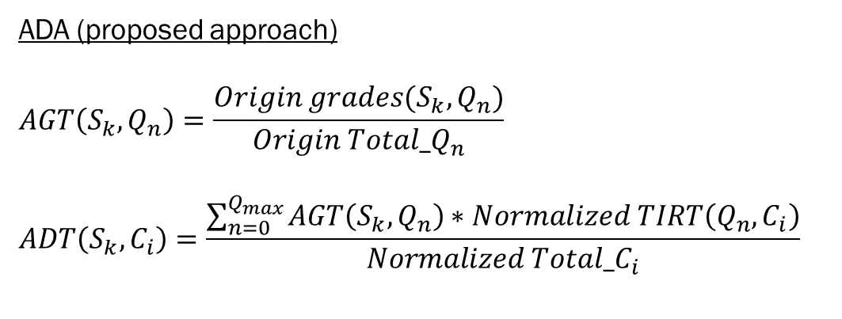
Results
ADA (proposed approach)
$$AGT\left(S_{k}, Q_{n}\right)=\frac{Origin grades(S_{k}, Q_{n})}{Origin Total_Q_{n}}$$
$$ADT\left(S_{k}, C_{i}\right)=\frac{\sum_{n=0}^{Q_{max}}{AGT\left(S_{k}, Q_{n}\right)∗Normalized TIRT\left(Q_{n}, C_{i}\right)}}{Normalized Total_C_{i}}$$
$$ADT\left(S_{1}, C_{1}\right)=\frac{\begin{aligned}AGT\left(S_{1}, Q_{1}\right)∗Normalized TIRT\left(Q_{1}, C_{1}\right)+ \\ AGT\left(S_{1}, Q_{2}\right)∗Normalized TIRT\left(Q_{2}, C_{1}\right)+ \\ …\end{aligned}}{Normalized Total_C_{i}}$$

Slide 19
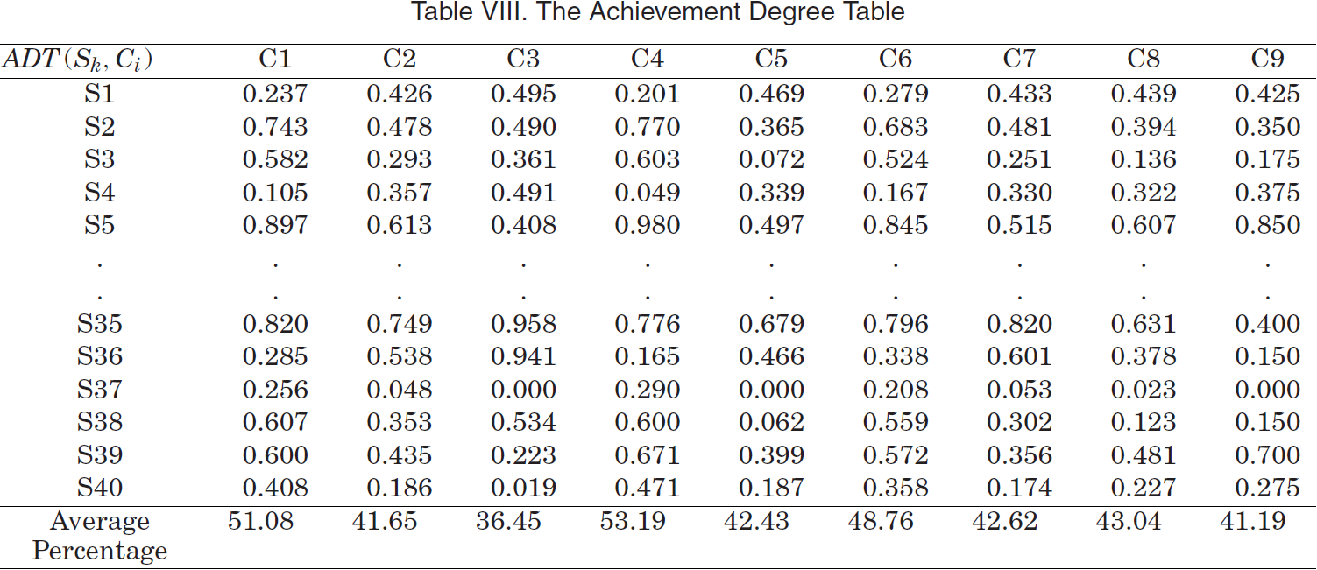
Results
ADA (proposed approach) – More accurately maps S->C understanding

Slide 20
Conclusion
Achievement assessment is measuring student comprehension of individual course concepts
Max-min composition works with MCQ, but not for more advanced question types, such as designing a Java class
Concept-effect Propagation can lead to more robust and accurate evaluation for complex question formats
The proposed method replaces Max-min with concept-effect propagation to promote valid diagnostic inferences about student achievement

