Slide 1
Bioinformatics Curriculum Guidelines: Toward a Definition of Core Competencies
Lonnie Welch, Fran Lewitter, Russell Schwartz, Cath Brooksbank, Predrag Radivojac, Bruno Gaeta, Maria Victoria Schneider

Slide 2
Curriculum Task Force for ISCB Education Committee
Seeks to define curricular guidelines for those who train and educate bioinformaticians.

Slide 3
Crash course in requirements of a bioinformatician and typical educational requirements

Slide 4
Hiring at the Bachelor level
Less frequent occurrence than hiring people with graduate degrees.
Work independently
Good communications and consulting skills
Organized
Passionate about their work
Technical in nature
programming
software engineering
system administration
databases.

Slide 5
Hiring at the Masters level
Far more numerous and varied
More interpretative
Problem solving
Personal traits
independent
Curious
self-motivated.
Technical experience in both biological sciences and computational methods

Slide 6
Major Complaint
New hires often lack experience in the analysis of real biological data.

Slide 7
Hiring at the PhD level
All the skills needed at the Master’s level
Communications skills
Management skills
Ability to help others.

Slide 8
Responsibilities of a Bioinformatician
Data analysis
Software development
Project support
Computational infrastructure support in biological context
next generation sequencing
medical research
regulatory genomics
systems biology).

Slide 9
Skill sets of a bioinformatician
General
Computational
Bioinformatics
Biology
Statistics and mathematics

Slide 10
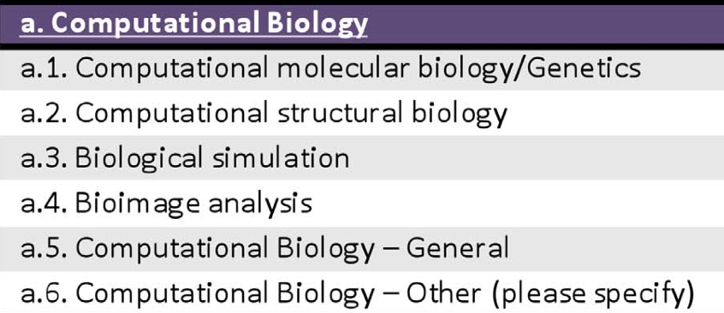
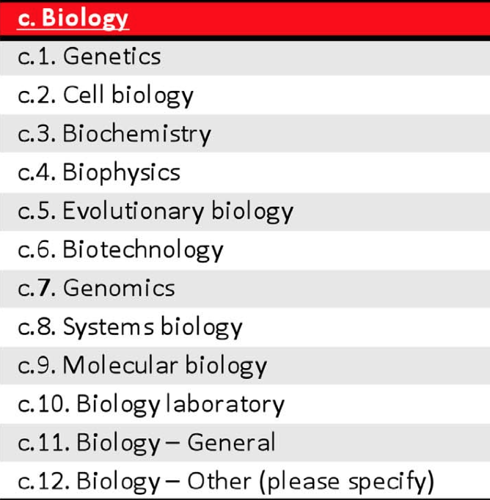
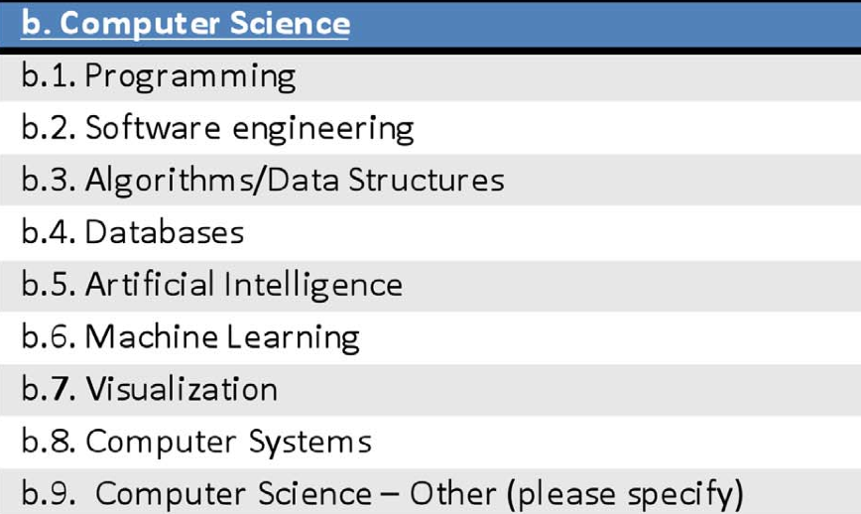
Draft of requirements for various bioinformatics programs

Slide 11
The Curriculum Task force defines:
3 types of bioinformaticians
20 compentencies

Slide 12
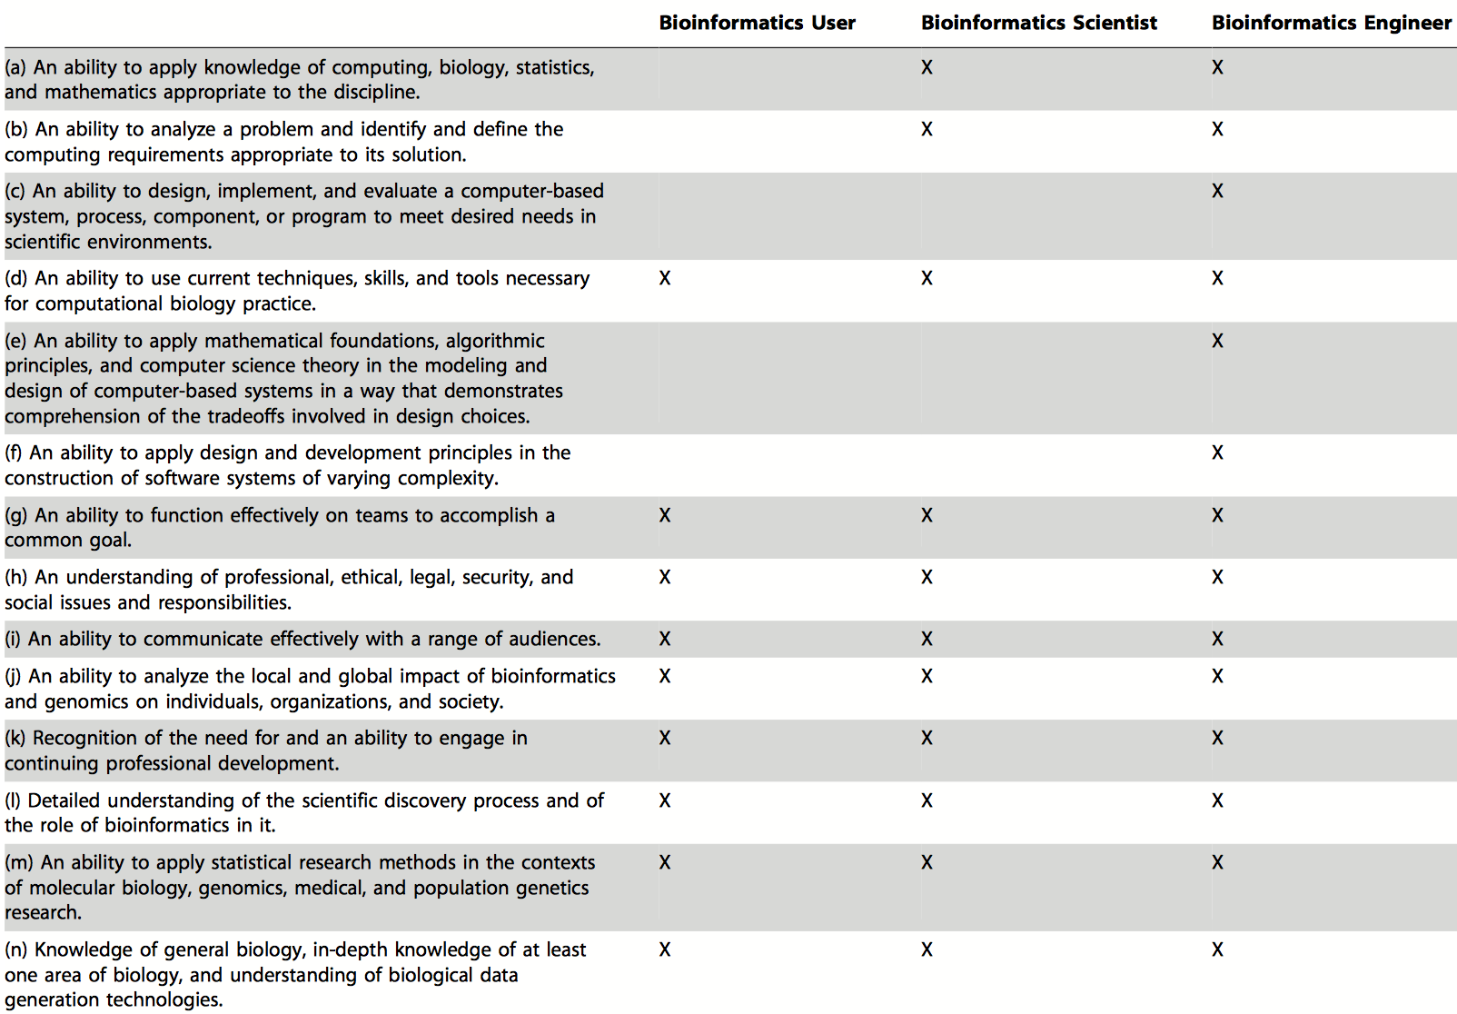

Slide 13
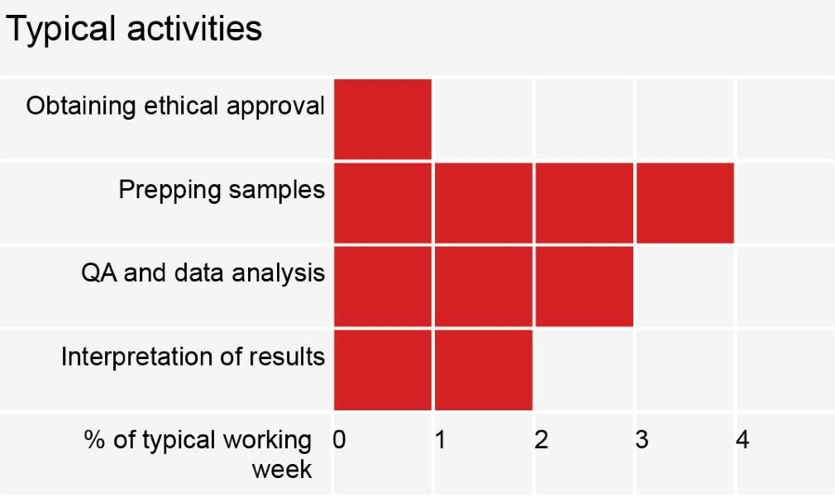

Slide 14
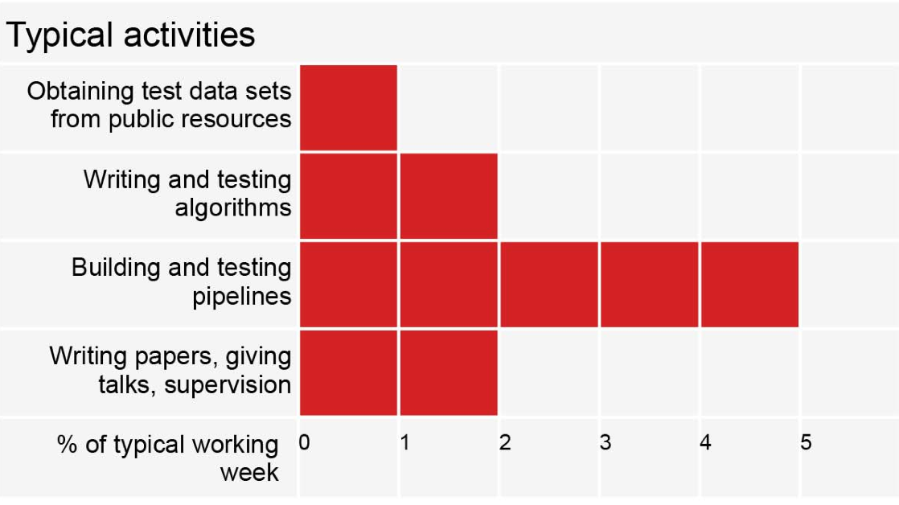

Slide 15
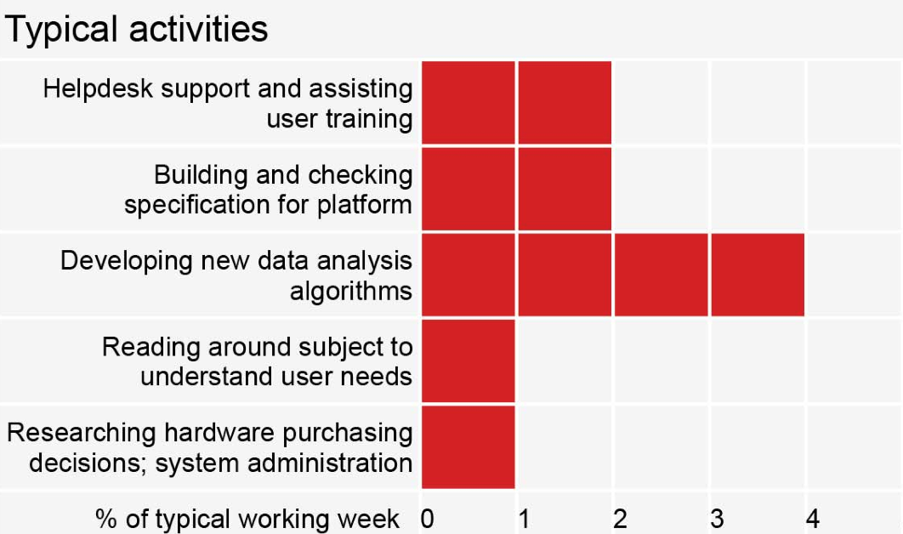

Slide 16
The Problem
What competencies are actually important?
To what extent should they be incorporated?
Who should be required to take this course?
Core competency vs. elective.

Slide 17
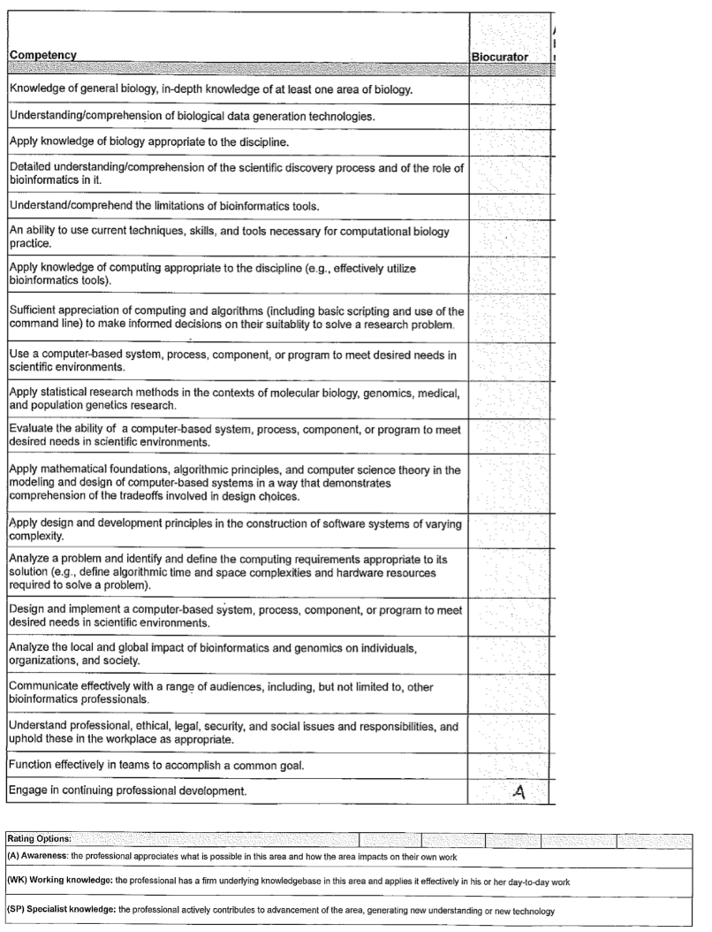
Discussion
What Competencies do you think are important?

Slide 18
ISCB’s Education Committee Curriculum Task Force’s conclusion
Considered bioinformatics and computational biology training and education in a variety of contexts
Defined broad set of core competencies for three different types of individuals.
Hope the concepts presented in the article will be valuable for trainers and educators who wish to design courses and curricula to meet the needs of today’s bioinformaticians.

