Slide 1
Teaching Bioinformatics in Concert
Anya L. Goodman and Alex Dekhtyar
Department of Chemistry and Biochemistry California Polytechnic State University

Slide 2
Can biology students without programming skills solve problems that require computational solutions?

Slide 3
They can if they learn to cooperate effectively with computer science students.
The goal of the in-concert teaching approach is to introduce biology students to computational thinking by engaging them in collaborative projects structured around the software development process.
The approach emphasizes development of interdisciplinary communication and collaboration skills for both life science and computer science students.

Slide 4
But how?
Pevzner and Shamir posed this question as a pedagogical challenge:
How should the research and education community design a bioinformatics course that:
(i) assumes few computational prerequisites
(ii) assumes no knowledge of programming
(iii) instills in students a meaningful understanding of computational ideas and ensures that they are able to apply them

Slide 5
Addressing the challenge
The first approach involves building an introductory programming course into a bioinformatics course, engaging students in the entire process of computational problem solving:
- problem analysis, design, implementation, Evaluation
This requires teaching students a programming language (typically Perl or Python) as the means of expressing their solutions.
The second approach is to focus on a specific aspect in the problem-solving process, working with students on developing a subset of skills.
Notes:
First stage requires students to go through rigourous programming course.. Thrown into the lions den
Second stage allows students to learn the process through a project but they can’t complete the project on their own.

Slide 6
Can there be computational thinking without programming?
YES!
‘‘computational thinking’’ is distinct from the term ‘‘programming’’
Programming is just one part of the software development process that can be roughly divided into four stages:
^{analysis/requirements}
^{design}
^{Implementation}
^{evaluation.}
The first and the last stages do not require any knowledge of programming languages but rely on solid understanding of the problem that needs to be solved.

Slide 7
Course Goal
Course goal for life science students
Develop the ability to analyze a problem and identify and define the computing requirements appropriate to its solution
This includes:
Analyzing problems
Writing program requirements
Evaluating computational solutions and software systems.
Missing Pieces
Program design
Implementation

Slide 8
Course Design
Bioinformatics Applications
(life science curriculum)
Bioinformatics Algorithms
(computer science curriculum)
Students are juniors and seniors who have attained intermediate skills in their respective disciplines.
They attend separate lectures focused on discipline-specific content
collaborate in the laboratory to build software for solving biological problems.

Slide 9
Different Approach
“Computational thinking is the thought processes involved in formulating a problem and expressing its solutions in such a way that a computer—human or machine—can effectively carry out”
-Ato, Cuny, and Snyder
Separates the two core components of the definition from each other
“Formulating a problem” is carried out by the life science students
“Expressing the solution” is the job of the computer science students
Separating the two components and stressing only one for each group of students:
increase the complexity of problems that multidisciplinary student teams can solve
students practice collaboration and communication skills

Slide 10
Teaching in concert
Two discipline-specific courses
Instructors from respective fields
Joint preparation
Physical and temporal co-location
Shared hands-on projects involving teams of students from both classes
Students as experts in their fields
Exposure of students to knowledge from the other discipline

Slide 11
Teaching in concert
Reverse course Design
Course starts with basic concepts of interest and proceeds with joint assignments from which specific material is derived
Inverted Classroom
Can be used for both discipline specific and cross-disciplinary learning
Undergraduate Research
Joint assignments can be part of an undergraduate research experience

Slide 12
CS Students
Bio Students
(1) Convert a biological question into a computational one
(2) Write program requirements describing the function of the software needed to answer the question
(3) Design test cases to verify that the program developed by their CS partners is working correctly
Elicit requirements for new programs
(2) Communicate during the software development process to make sure the software meets the needs of the clients
(3) Maintain/modify the delivered software
Both Groups
(1) Communicate relevant discipline-specific issues to their partners and
(2) Cooperate effectively with colleagues within and outside their own discipline on a project.

Slide 13
Designing the Course

Slide 14
Designing the Course
Choosing The Research Problem
Instructors of in-concert courses need to identify problems that align with the learning objectives and fall within the scope of each course.
The problems have to be complex and interdisciplinary, so that neither group of students can solve them on their own.
Problem must be amenable to analysis by students in a fairly short amount of time.

Slide 15
Designing the Course
Choosing The Research Problem
For this study:
[Faculty are part of the Genomics Education Partnership (GEP)]
Problems related to annotation and comparative analysis of fruit fly genomes
Students studied primarily hetero-chromatic chromosome and a euchromatic region on chromosome 3L.
They compared the two regions based on guanine-cytosine (GC) content, gene characteristics, and repetitive sequences.
They also developed a program for manipulating GEP data and checking the quality of student-submitted annotations.

Slide 16
Designing the Course
BIO students worked on genome annotation projects requiring research skills:
gathering evidence using bioinformatics tools
analyzing data
formulating conclusions

Slide 17
Designing the Course
Alignment with the core content of the CS course:
Simple DNA analysis techniques
GC content
codon bias
and gene content
Global and Local alignment
String comparison
longest common substring
repeat detection
palindrome discovery

Slide 18
Designing the Course
CS students built research tools that required the implementation of:
Data structures
Algorithms
Techniques studied in class
Tailor implementation to specific problem

Slide 19
Designing the Course
Cross-disciplinary peer instruction
Introduction to biological applications from Bio professor to CS students
Introduction to Software engineering from CS professor to Bio students
All other instruction and information was exchanged between students on teams
Encourage Team-work
Peer mentoring
Completing common goal within time limit

Slide 20
This Study
Spring quarter quarter of:
2012 (24 BIO and 35 CS students)
2013 (23 BIO and 26 CS students
Teams consists of 2-3 Bio with 2-3 CS students
BIO Student Backgrounds
students majoring:
molecular and cell biology
biochemistry
Agriculture
biomedical engineering
Some completed statistics
1 student had programming experience.
CS Student Backgrounds
Introductory CS sequence
C and Java
data structures
systems programming
algorithms
Notes:
Bio: Juniors and seniors / CS mostly seniors

Slide 21
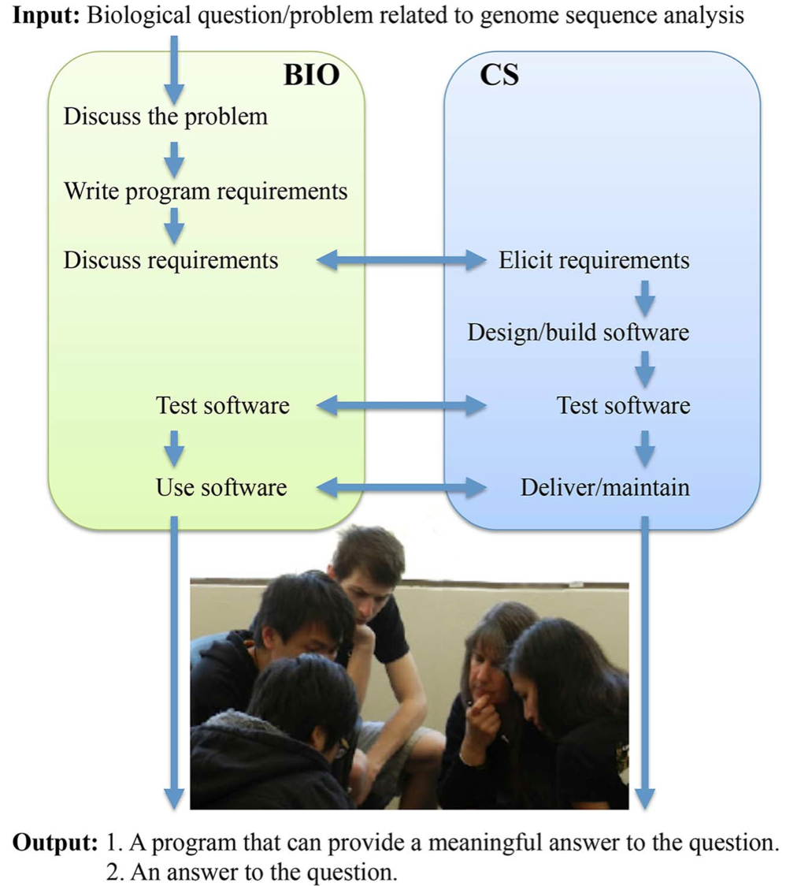

Slide 22
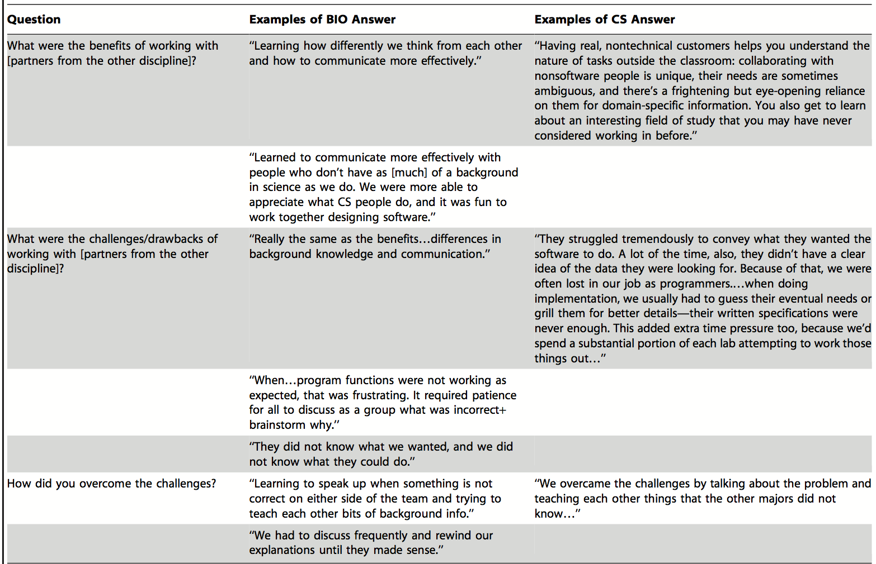

Slide 23
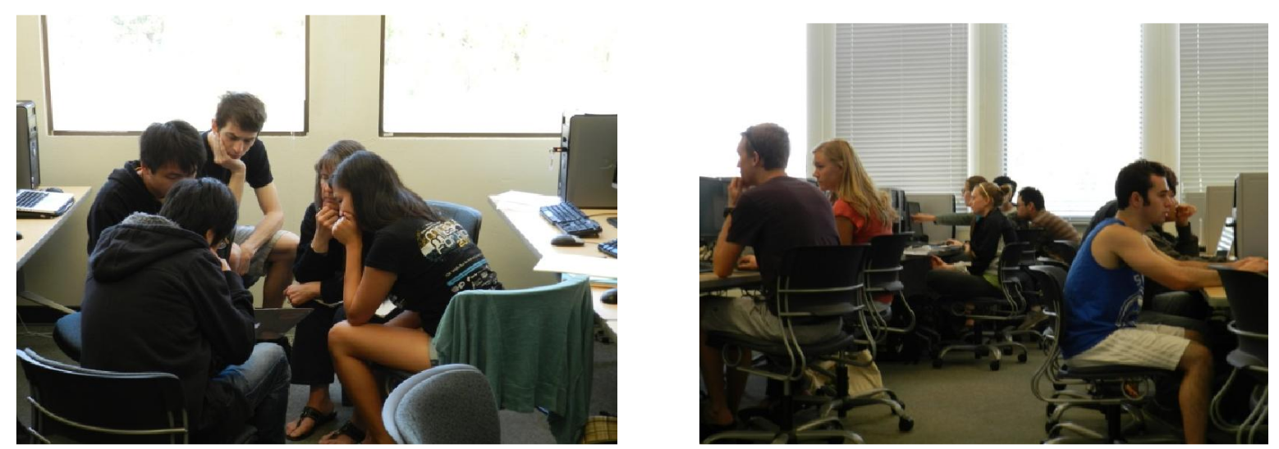
Student Perception of Working on the Interdisciplinary Teams
What Aspect of the project did you enjoy most?
working with partners
working on meaningful projects/real research
learning specific content from their own discipline.
CS students liked working with partners (15/28 or 53% in 2012, 10/18 or 55% in 2013),
BIO students fairly equally distributed between the three categories (~30% for each category).

Slide 24
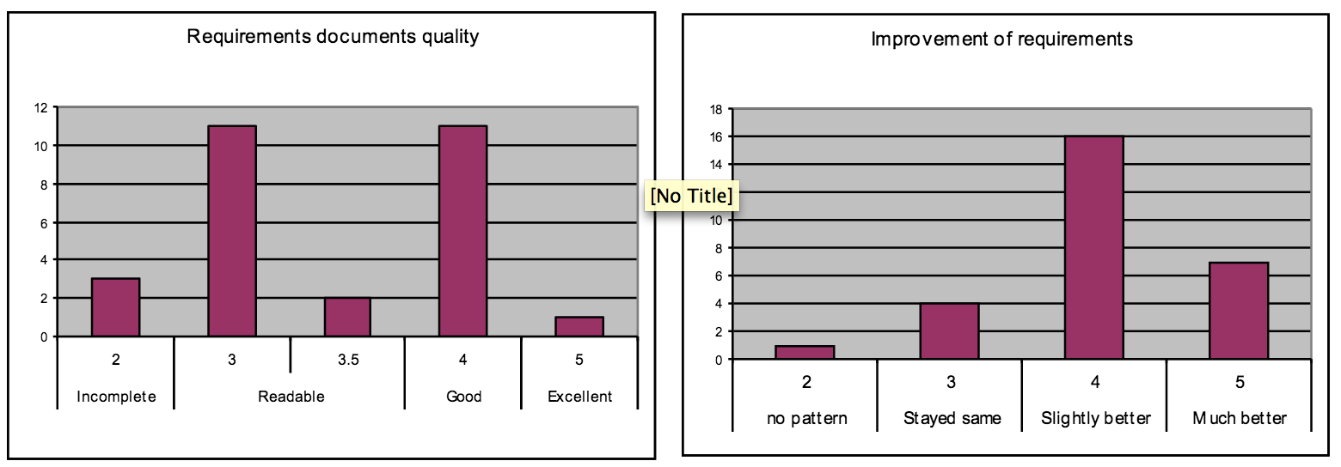
Student Perception of Working on the Interdisciplinary Teams

Slide 25
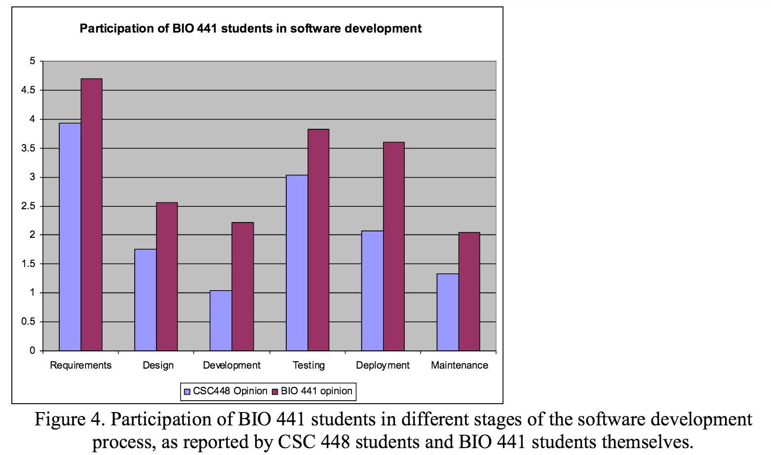
Student Perception of Working on the Interdisciplinary Teams

Slide 26
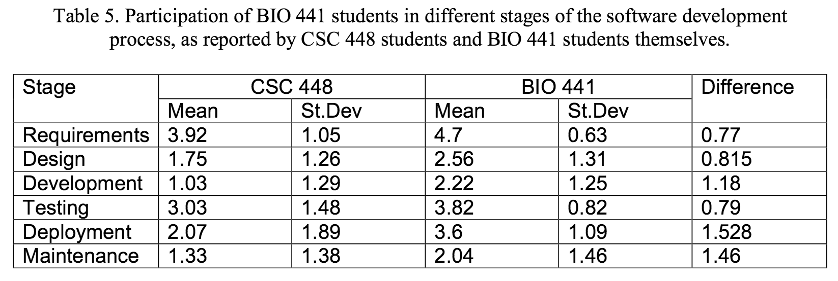
Student Perception of Working on the Interdisciplinary Teams

Slide 27
Student Perception of Working on the Interdisciplinary Teams

Slide 28
Student Perception of Working on the Interdisciplinary Teams

Slide 29
Pedagogical Challenges
(a) The need to align the content of the two courses and to create a meaningful interdisciplinary experience
(b) The need for students to function as experts in their discipline on an interdisciplinary team.
(C) How to assess computational thinking and grade both groups of students fairly.

Slide 30
Pedagogical Challenges
Assessment
BIO students are expected to
Understand the nature of the assignment.
Write software requirements
CS students are expected to:
Be proficient software developers
Understand software requirements
Build the software.
Team members have to get information efficiently across disciplinary boundaries.

Slide 31
Pedagogical Challenges
Assessment
How to assess computational thinking skills independently of programming skills???
BIO students assessed on:
how well they understood the initial problem
translate their understanding into a software specification.
CS students were assessed on:
Software/software scores.
BIO students could request further improvements in the programs throughout the quarter.
All requests and the modified programs.

Slide 32
Conclusion
As students advance through their education, they focus more and more on their specific discipline and rarely interact with students in other disciplines
In most endeavors outside of academia, professionals rarely work in isolation.

Slide 33
Conclusion
Benefits in Education
Acquire communication skills
Deepen knowledge in their own discipline by acting in the roles of experts
Life sciences students are exposed to computational thinking related to requirements specification and software evaluation
Keys to Success
Instructor collaboration is key
Identification of a suitable problem
relevant to the learning objectives
requires expertise from multiple disciplines
cannot be solved by individual an group.

Slide 34
Discussion
Disadvantages?
Advantages?
What other courses may this be applied to?

