Slide 1
Perspectives on presentation and pedagogy in aid of bioinformatics education
Pier Luigi Buttigieg
Briefings in Bioinformatics 2010

Slide 2
Flow of Today’s presentation
Key points of the paper
Quick(ish) demonstration
Discussion

Slide 3
SETTING THE STAGE FOR THE ACADEMIC PRESENTATION
The educational environment must support, engage, and unite the diverse backgrounds expectations typifying bioinformatics audiences by offering them shared challenges

Slide 4
SETTING THE STAGE FOR THE ACADEMIC PRESENTATION
The educational environment must support, engage, and unite the diverse backgrounds expectations typifying bioinformatics audiences by offering them shared challenges
Encourage the assembly of new knowledge by engaging that which is pre-existing
Active strategies encouraging deep cognition
(In contrast to passive style)

Slide 5
The target audience: the value of rapport
Typically Biologists and Computer Scientists
Also Mathematicians and engineers
Presenters must engage the audience’s collective knowledgebase
Connect presented content to values of audience
Improves retention

Slide 6
The target audience: the value of rapport
Biologists
Excited by new technological breakthroughs
Ability to better analyze data
Computationally-aided biological problem solving
Computer Scientists
Presenting data and systems quantitative representation
Challenge if solving problems/algorithm design
Computational processing and ingenious design

Slide 7
The target audience: the value of rapport
Understand audience’s background/make up
Pre-presentation survey
Understand goals and expectations of the audience

Slide 8
Content: addressing coverage, depth and interdisciplinarity
Realism in selecting learning goals and content
Achieve meaningful, functional simplicity
Focus on key concepts and central principles
(Supersedes need for detail)
Train students to recognize patterns in the knowledge they construct

Slide 9
Content: addressing coverage, depth and interdisciplinarity
Delivering curriculum content of greater detail
task-oriented methods
independent reading
practical work
Projects
Switch between the modalities help learners:
construct internal meaning/knowledge-acquisition techniques
continually update their own knowledge and approach problem-solving maturely and creatively.

Slide 10
Content: addressing coverage, depth and interdisciplinarity
Provide an adequate syllabus
Specifying the level detail
the depth of understanding required

Slide 11
Content: addressing coverage, depth and interdisciplinarity
Delivering interdisciplinary instruction
Content presentation from a range of experts native to disparate domains
Drawing on insights generated by disciplines, interdisciplines, or schools of thought
Producing an interdisciplinary understanding of the problem or question
Separating content into thematic units

Slide 12
The medium of the presenter
Appear interested in material
Facial expressions is powerful non-verbal communication
Convey excitement with:
Eye contact
Tone changes
Human interaction is lost when strictly following slides

Slide 13
VISUAL COMMUNICATION
Expand beyond strictly using slides with bullet points
Include coding both in slides and real-time demonstrations
Lessig Method:
Rapid display of short phrases or pictures accompanies and augments presenter’s narrative
Text in slideshow is designed to be decoded visually and in the context of a speaker’s content

Slide 14
CONSCIOUSNESS ENGINEERING IN THE CLASSROOM
Pitching content and presenting learning objectives
presentation should pique audience curiosity by engaging existing knowledgebases while identifying the learning objective
Engaging the audience knowledgebase by stimulating recall
Present content as stimuli

Slide 15
CONSCIOUSNESS ENGINEERING IN THE CLASSROOM
Eliciting performance, feedback and assessment
breaking a lecture’s narrative every 15 min for short sessions of learner activity
Checks for understanding via multiple-choice or short-answer questions may reinforce concepts and help rentention

Slide 16
Promoting sustained learning
Conclude with a broader ‘big-picture’ viewpoint
Discuss in-class learning goals and their ‘real-world’ consequences
Active learning and formative assessment mechanisms provide presenters the material required to conclude in such a tailored manner

Slide 17
Remember the goal?
Developing the factual knowledge of molecular biology alongside the procedural knowledge of computer science and mathematics will grant audiences perspective on ‘why’ and ‘how’ bioinformatics inquiry is conducted.
Maintaining perspective and content cohesiveness translates to increased engagement and integrative learning across a presentation series

Slide 18
Demonstration

Slide 19
BINF101 – Method 1
What is Bioinformatics?
is an interdisciplinary field that develops methods and software tools for understanding biological data.
As an interdisciplinary field of science, bioinformatics combines computer science, statistics, mathematics, and engineering to analyze and interpret biological data.

Slide 20
BINF101
What is the basic knowledgebase needed?
Fundamental understanding of Biology
Fundamental understanding of statistics
Fundamental understanding of algorithms

Slide 21
BINF101
Fundamental Understanding of Biology
Central Dogma of biology
DNA is trasncribed to RNA
RNA is translated to proteins
Proteins perform collaborative functions with other macromolecules to form a living cell
Cells form tissues
Tissues form organs
Organs forms systems

Slide 22
BINF101
Fundamental Understanding of Statistics
Basic concepts of random variables, probability, and Baye’s theorem
Understand P-values in statistical analyses
Understand E-values in database searches
Understand Central Limit Theorem and sampling distributions
Understand statistical significance, hypotheses testing and types of errors

Slide 23
BINF101
Fundamental Understanding of algorithms
Basics of computer programming and scripting
Algorithms to compare DNA and protein sequences
Database structures
Efficient ways to search a databse
Prediction algorithms
Pattern Recognition and content extraction
Mathematical Modeling
Data visualization

Slide 24
BINF101 – Method 2

Slide 25
BINF101
Bioinformatics is an interdisciplinary field which allows you as a computer scientist to apply your areas of expertise to biomedical problem
There are no restrictions… Just creativity
How can apply the to aide in biotechnology and health science?
informatics
databases
mathematical modeling
data visualization

Slide 26
BINF101
How can apply the to aide in biotechnology and health science?
informatics
databases
mathematical modeling
data visualization
Pharmaceutical Company which designs hundreds of drugs a year
Pharmaceutical Company that is trying to re-purpose drugs
Diagnostics center that has thousands of patient records, symptoms, and diseases
Research center mapping gene mutations to diseases

Slide 27
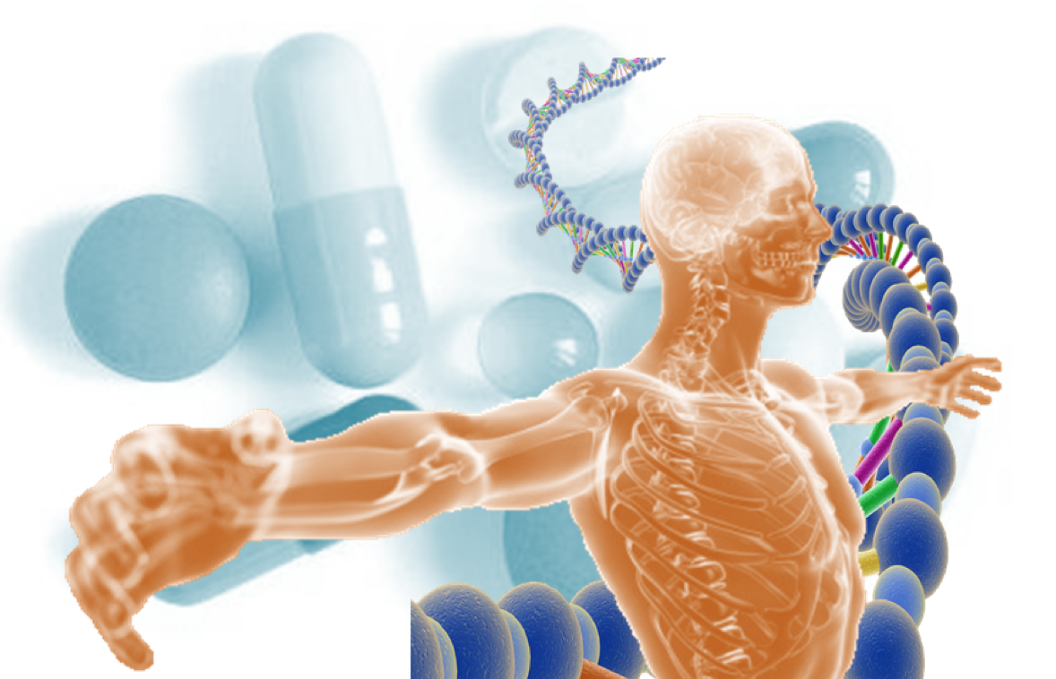
BINF101 – Method 3
RAS Pharmaceuticals
Translational Medicine
Payton Hospital System
Personalized Medicine

Slide 28
BINF101
Symptoms
Diagnostics for Doctors
Best treatment options
Genomes
Drug selection for post-diagnosed
Patients from pharmacy

Slide 29
BINF101
Clinical study with 5000 people (5000 genomes) on various drugs for predefined diseases
Technology to obtain patients’ genomes and perform diagnostics

Slide 30
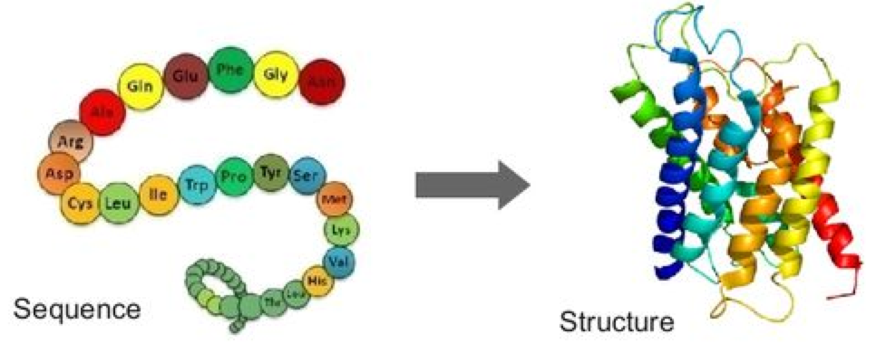
BINF101
Function
DNA
Mutation
Altered
Protein Sequence
Affected protein
structure
Disease or Disorder

Slide 31
BINF101
Symptoms
Diagnostics for Doctors (Web-database)
Best treatment options (Statistical Analysis)
Genomes
Drug selection for post-diagnosed
Patients from pharmacy (App with easy data visualization

Slide 32
Discussion
Which method was most effective?
Which method will help students retain information?
Would a single method be best or a combination of the three methods?

