Slide 1
Student Perceptions of Teaching Transparency
Alecia D. Anderson, Andrea N. Hunt, Rachel E. Powell, and Cindy Brooks Dollar
North Carolina State University, Raleigh, NC
Presented by:
Alvin Farrel
The Journal of Effective Teaching, Vol. 13, No. 2, 2013, 38-47

Slide 2
Active learning
Active learning is a broad concept that is used to describe teaching techniques that directly engage students in the learning process.
It represents a shift from teacher-centered to student-centered learning techniques
Students are encouraged to learn through reading, writing, discussion, and reflection.

Slide 3
Active Learning
While students often enjoy these activities, they may not necessarily understand the intent or purpose of the activity within the course context. One way of avoiding this problem is to be a more transparent teacher.

Slide 4
Transparency
A teaching style that clarifies to students the instructor’s choices for lesson plans
Specifies how those choices relate to course goals.
A way to help students understand how and why the are learning course content in particular ways
It helps instructors be more reflective in order to improve their teaching

Slide 5
Conceptualized Transparency
A way of organizing activities that makes their meaning visible.
Suggests that students need explicit knowledge and resources to move from legitimate peripheral participation to full participation in the learning process.

Slide 6
Elements of Transparency in classroom
Student learning outcomes.
student learning outcomes are a less abstract way to conceptualize the course objectives.
Course goals and objectives
general competencies that students should accomplish and demonstrate.

Slide 7
The Big Question
Can we improve active learning techniques by being more transparent in our teaching?

Slide 8
Methods
Four active learning activities were performed in four separate sociology courses.
Student feedback was collected in each class.
Transparency was integrated into each active learning exercise by discussing the rationale and the goals of the activities at their onset.
As part of the transparency, each instructor explained the value and logic behind using each activity.

Slide 9
Methods
Data was collected from the students voluntarily.
Students filled out forms with open-ended questions concerning their :
Likes
perceived strengths
Dislikes
perceived weaknesses
There were 90 students in the study with a 71% response rate

Slide 10
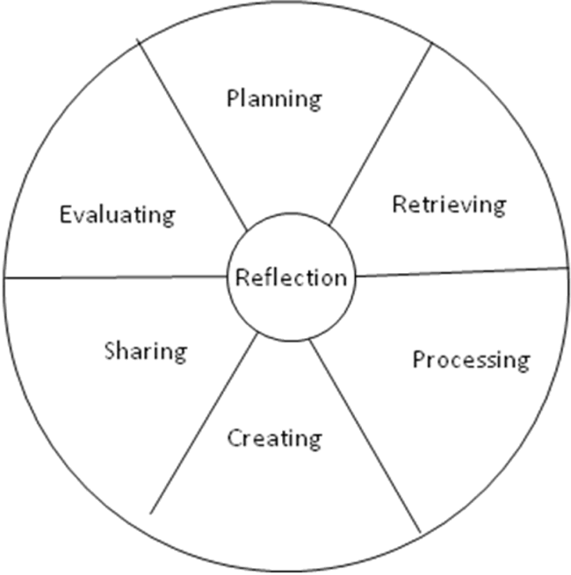
Activity 1
One instructor used inquiry guided learning (IGL) because it is an inductive teaching practice where students are presented “a question to be answered, an observation or data set to be interpreted, or a hypothesis to be tested”.
The instructor explained to students that with this type of active learning, the instructor is the “guide on the side” as students construct an understanding of disciplinary content, methods, and perspectives .

Slide 11
Activity 2
Another instructor chose a group peer teaching exercise because group work is well-documented as an effective means of active learning (Beckman, 1990; Caulfield & Persell, 2010; McKeachie, 2011).
In addition, research shows that group peer teaching is a useful method for learning material as it promotes teamwork, planning abilities and confidence

Slide 12
Activity 3
An additional instructor used an atypical program (e.g. Wordle) that would make the class stand out as fun and interesting, especially since students can see what they and others have written

Slide 13
Activity 4
The last instructor developed a content analysis project to help students recognize gender stereotypes in their respective contexts.

Slide 14
Analysis and Results
Out of 73 responses,
50 were positive (68.5 %),
7 were negative (9.6 %),
16 (21.9 %) did not speak directly to teaching transparency
Students with positive responses indicated that the transparency gave them a better sense of purpose, motivation, clarity and connection to other course material.
Students with negative responses viewed transparency as a waste of time or an insult.

Slide 15
Student Responses Link between Transparency and Motivation
Students liked knowing why the activities were chosen for several reasons.
One wrote that transparency “made class work seem less menial when we know how it was meant to help us.”
Students liked being assured they were not just assigned “busy work.”
Some students felt more confident knowing ahead of time what the instructor’s learning goals were for them
Students responded positively to connecting course goals to the activities. They learned to think critically and were able to recognize that critical thinking is necessary for learning

Slide 16
Student Responses Not All Positive
Some students, however, noted that the transparency did not change the way that they approached and completed the course project assignment.
4 out of the 73 responses described transparency as an insult or manipulation.

Slide 17
Discussion and Conclusion
It is important to note that liking transparency is not the same as developing deep learning.
Being transparent created an environment in which students were more invested in class activities.
In an effort to minimize negative reactions to teaching transparency, instructors might consider keeping transparency disclosures brief.
Transparency disclosures should be discussed in conjunction with learning goals.

Slide 18
Discussion and Conclusion
In response, we argue that transparency should be coupled with active learning
Most of the instructors did not measure student performance as the in-class activities were ungraded. However, the group project was evaluated with a grade.
Transparency helped students to “understand the purpose” which resulted in their motivation to “put in more effort” and work more “efficiently”.

Slide 19
Questions

