Slide 1
Is Truthiness Enough? Classroom Activities for Encouraging Evidence-Based Critical Thinking
Sue Kraus , Sharon R. Sears, and Brian L. Burke
Fort Lewis College, Durango, CO 81301
Presented By:
Alvin Farrel

Slide 2
Truthiness
Truthiness is also defined as "the quality of preferring concepts or facts one wishes to be true, rather than concepts or facts known to be true"

Slide 3
Critical Thinking: Seven Steps
1) What am I being asked to believe or accept?
2) What evidence is available to support the claim?
3) What alternative ways are there to interpret the evidence?
4) Rate the evidence/alternatives on 0-10 scale based on validity/strength
5) What assumptions or biases came up when doing the above steps?
6) What additional evidence would help us evaluate the alternatives?
7) What conclusions are most reasonable or likely?

Slide 4
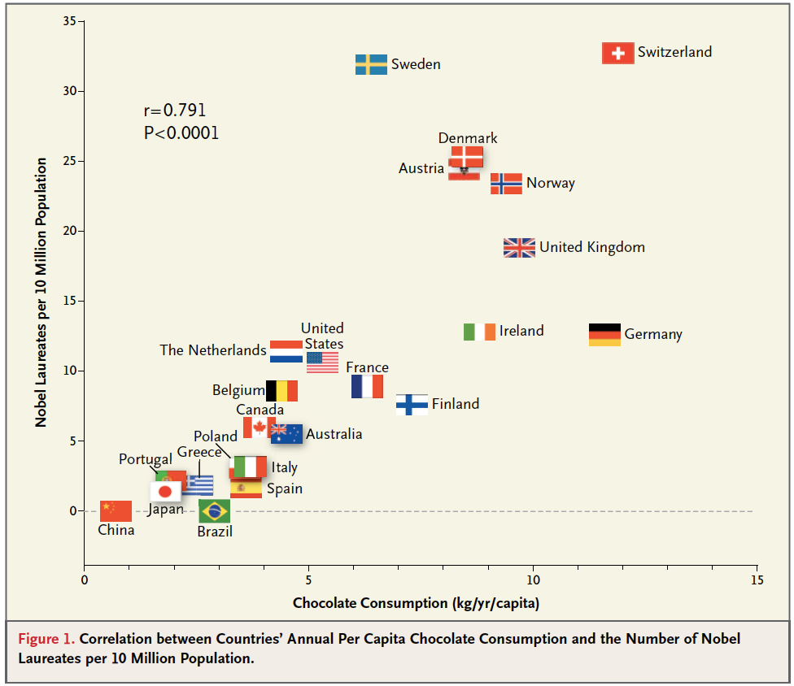

Slide 5
The Study
There were 9 brief critical thinking (CT) modules for use about once per week throughout the semester.
Tested the modules in a wide variety of college psychology classrooms, ranging from introductory to advance classes
Each week built upon the steps that had been the focus of the previous week’s module.

Slide 6
Module 1 Star Wars Force Trainer
There is an educational toy that claims that by “utilizing dry neural sensor technology, the headset reads and interprets your brainwaves”.
The learning guide that accompanies the toy discusses
various types and functions of brain waves
Compares the toy to EEG machines that develop relaxed concentration
Claims that the user’s relaxed brain waves cause a small ball to move up a tube attached to the sensor.
Students read the material that comes with the toy, along with an article on the future of brain-controlled devices that hypothesizes that the future holds help for Alzheimer’s patients and kids with ADHD through these devices that use electrodes to monitor The students then watch a short clip on YouTube to illustrate how the toy work

Slide 7
Module 1 Star Wars Force Trainer

Slide 8
Module 1 Star Wars Force Trainer
What are the claims the manufacturer is making about Force trainer?
Are there any alternative hypothesis of how the force trainer works?
If yes, How can they be tested?

Slide 9
Module 1 Star Wars Force Trainer
Encouraging brainstorming of claims before looking at evidence is
An important first step to critical thinking.
A step that is often overlooked in the rush to judgment.
(Claims the students came up with: The machine is accurately reading and interpreting brain waves, and objects can be moved by developing certain brain waves).
Gather evidence to support the claims
Students to tested the device.
Many students do think that when they concentrate carefully the ball is moved farther
Testimonials from parents of autistic children who claim the force trainer helped their child learn to relate better with others
YouTube evidence also exist to support these claims.
Consider alternative hypotheses that the evidence supports (steps 3 and 6)
Gather other ways to interpret the evidence and ideas for testing alternative hypotheses for how the Force Trainer works
These range from trying the Force Trainer on non-animate trying it on
to trying it on things that conduct electricity but do not have brain waves, like root vegetables.
try the force trainer on other parts of their own bodies.

Slide 10
Module 1 Star Wars Force Trainer
Most students’ knees had the same to move the ball ‘with the force of theta waves’ as their heads.
This is an obvious problem for the manufacturer’s claim (we are not aware of any brain waves in our legs) and a memorable lesson in critical thinking. Students learn that there might be multiple explanations for the evidence they see with their own eyes, and may start to think that critical thinking can be fun and valuable.

Slide 11
Module 2 Photos of Ghosts
The second module also focuses mainly on identifying claims and thinking of alternative explanations for the existing evidence.

Slide 12
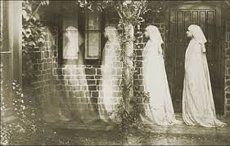
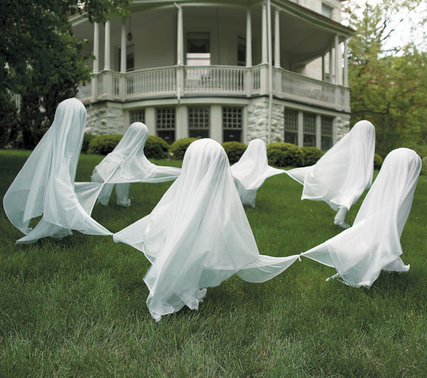
Module 2 Photos of Ghosts
Polls state 31% of adults believe in ghosts.
show a PowerPoint slide show of supposed ghost pictures
What are the claims?

Slide 13
Module 2 Photos of Ghosts
31% of adults believe in ghosts.
ghost pictures and have students evaluate the claims and the evidence.
It is important not to skip the first step of evaluating claims.
Many students want to simplify the claim to state that ghosts exist.
There are more embedded claims.
such as that ghosts can be photographed with certain technology.
Alternative hypotheses for photos
Photoshop.
ghost in question could be smoke from the photographer’s cigarette.
optical illusions
MullerLyer illusion where you ‘see’ something that does not exist by filling in missing parts of a pattern you expect to

Slide 14
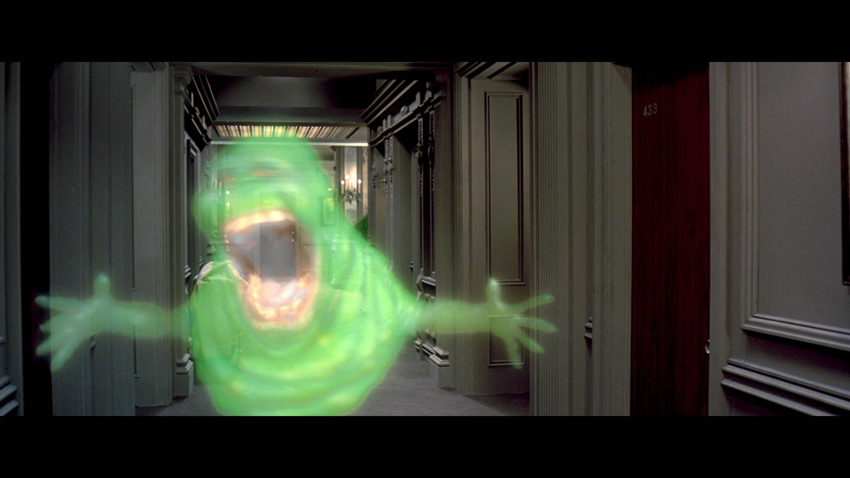
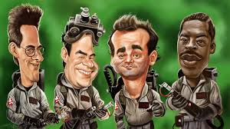
Module 2 Photos of Ghosts
Do ghost’s Exist?

Slide 15
Module 2 Photos of Ghosts
Ask the students whether the alternative explanations for the photographic evidence actually mean that ghosts do not exist.
First students jump directly to ‘ghosts do not exist’ but.
If questioned, they conclude that ghosts may or may not exist.
But they cannot be photographed.
Astute students will point out that we have not supported that claim either, and that we simply think that these photos are probably not of ghosts.

Slide 16
Module 2 Photos of Ghosts
This final discussion is most useful in evaluating claims, evidence, and alternatives
critical thinking does not necessarily mean you cannot believe in paranormal phenomenon
rather, it simply requires you to examine the evidence for your beliefs
As an instructor and scientist, maintaining this openness to possibility is important
especially early in the modules so as not to alienate students.

Slide 17
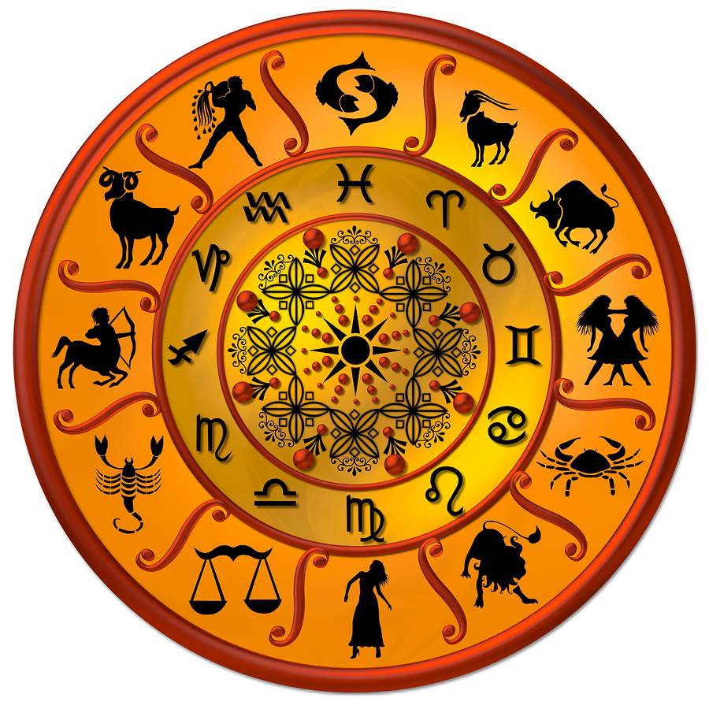
Module 3 Astrology activity
Do you believe in Astrology?
If you do, what are the claims that astrology present?

Slide 18
Module 3 Astrology activity
Many students read their horoscope regularly, with some degree of belief in those predictions
we ask students to brainstorm about the basic claim of astrology (step 1).
One simple claim is that personality types are associated with particular Zodiac signsthere is to support this claim
(step 2). We ask students to tell us what evidence . They generally offer personal anecdotes or stories in which their horoscope was correct or where the description given based on their birth Zodiac sign has been accurate.
step 5, biases and assumptions.
Discuss cognitive biases such as illusory and confirmation.
We then ask students to brainstorm how they could use the scientific method to test the claim (step 6).
Student exercise
Give handout with 12 personality descriptions
Students circled the description that best matches them
Revealed the personality types that matches birthdates and see how the answers matched up
End with a brief review of the scientific literature that shows no empirical support for predicting personality using birth dates.

Slide 19
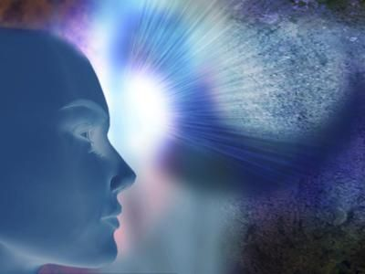
Module 4 Psychic abilities
Do you believe in psychic ability?
What are the claims of psychic ability?
How could you test those claims?

Slide 20
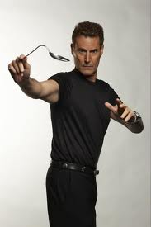
Module 4 Psychic abilities
Showed a video of Uri Geller to introduce the claims of his psychic abilities
13 minute Video was split into 2 segments
First 6 minutes was showed, then a break for the activity

Slide 21
Module 4 Psychic abilities
Showed a video of Uri Geller to introduce the claims of his psychic abilities
Ask students to individually write down what the claim (step 1),
The evidence that supports the claim (step 2),
Alternative explanations for the evidence (step 3),
Create a study design that would fairly evaluate the claim (step 6).

Slide 22
Module 4 Psychic abilities
Show the students the next 7-minutes from the same video that shows Uri Geller failing to produce results on the Tonight Show.
Discuss the ironic finding that after the show aired, belief in psychic ability actually increased
To date, not one single person has been able to prove their psychic abilities in a scientific test.

Slide 23
Module 5 Pit bull Ban
In module 5, we start with a newspaper article about banning pit bull dog breeds in Denver, CO .
As in the previous module, we have students write individual answers for step 1, the claim, and step 2, the evidence provided.
Then focus squarely on step 4, evaluating the existing evidence.
The goal for this module is not to come to a conclusion about the pit bull ban, but rather to recognize that we do not yet have enough information to make a decision.

Slide 24
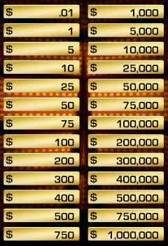
Module 6 Deal or No Deal
In this module, we focus primarily on step 5, the biases that come onto play when making decisions.

Slide 25
Module 6 Deal or No Deal
In this module, we focus primarily on step 5, the biases that come onto play when making decisions.
Show a clip of a contestant who was offered $603,000.00 and ended up with $1.00
directing students to pay particular attention to the biases in the advice given to the contestant.
We then have students make a plan for how they would make decisions in this game, and ask a volunteer to play the game while other students give them solid advice
This is an excellent exercise to show how difficult it is to stick to a rational plan in the face of high emotions and peer pressure.

Slide 26
Module 6 Deal or No Deal
In this module, we focus primarily on step 5, the biases that come onto play when making decisions.
Show a clip of a contestant who was offered $603,000.00 and ended up with $1.00
direct students to pay attention to the biases in the advice given to the contestant.
Have students make a plan for how they would make decisions in this game.
ask a volunteer to play the game while other students give them solid advice
This is an excellent exercise to show how difficult it is to stick to a rational plan in the face of high emotions and peer pressure.

Slide 27
Module 6 Deal or No Deal
If you are playing this game would you make risky decisions or rational decisions? Why?
How can social pressure on decision making be applied to life outside of Deal or No deal?

Slide 28
Module 6 Deal or No Deal
Ironically, risky decisions in this instance lead to both the biggest losses AND the biggest winnings
Rational strategies typically yield more moderate amounts of prize money.
This interactive experience in decision-making may help students identify the pressures that could lead to poor choices in other life situations.
Social pressure to stay at a party and drink, for example, often sways students who have rational plans to get a good night’s sleep or study.
Students can generate their own examples of situations in which
critical decision-making would be valuable.

Slide 29
Module 7 Autism and Vaccines
Show a CBS news segment about a court case in which Michael and Theresa Cedillo tried (and failed) to prove that vaccines were responsible for their child’s severe autism.
The video provides a forum for both sides to present their evidence.
Students were asked to pay close attention to the types of evidence presented by each side, and weigh strengths and weaknesses of these arguments (step 4).
Students then draw conclusions and explain what evidence they used to reach those conclusions (step 7).
Invite students to think about what information they would need to make a sound decision about vaccination for their own families, and, finally, present scientific evidence that children who are vaccinated tend to have lower rates of developmental disorders, including autism (Andrews et al., 2004).

Slide 30
Module 8 and 9 medical marijuana and profiling
The medical marijuana issue is an examination of a recent decision by our college campus to ban the use of medical marijuana, which is legal in our state.
Divide the students into two groups based on their initial leaning for or against the ban.
Students are assigned to argue the alternate point of view from their own initial reaction.
Those who do not have strong feelings pro or con are divided in such a way as to balance group size.
The homework is for all students to bring in at least three pieces of evidence for their assigned side of the debate (step 2).
Have an in-class debate in which each side presents its case, uninterrupted, using their best evidence.
After each group has presented their case, they may directly question each other.
Following the de bate, students are then asked to write an individual essay on their own beliefs, and sup port their view with evidence (steps 4 and 7).
Many mention that arguing a point they did not originally believe caused them to look more closely at the evidence, and many either changed their view, or became more open to the other side’s argument.
The goal was clearly to formulate an informed decision for themselves while being mindful of the evidence used to form this opinion.

Slide 31
Analysis
The effectiveness of these modules were examined with 128 college students and found that they encourage students to use critical thinking more in their daily lives and to critically evaluate their own beliefs, particularly about paranormal phenomena.

Slide 32
Analysis
In this current study, we compared the CT class results to those of an introductory math class, which was used as a control group.
Students who took part in this study increased their scores in the CT assessments in their other classes
Students who had the deductive reasoning with the modules increased their CT scores by an average of 17%.

Slide 33
Discussion and Conclusion
These modules are suggestions for how to get students to exercise their critical thinking muscles.
They can be used individually or as a series of building modules in almost any class—psychology or beyond—that has critical thinking as one of its goals.
Each could be adapted to fit the interests of your students and hot topics of the day.

Slide 34
Questions

