Slide 1
Students Perceptions of Cognitive and Social Learning in Global Virtual Teams: A Pilot Study
Gary F. Kohut and Maria G. Yon
Presentation by Brianna Chen

Slide 2
Why GVT’s?
Globalization of business and increase of communication media
Teams can spend 24 hours a day on a project
Groups contribute to collaborative learning
Instructors act as a facilitator, group members as co-teachers

Slide 3
Why GVT’s?
Disadvantages: cultural nuances, role ambiguity, feelings of isolation, difficulty in decision making

Slide 4
Social Constructivism
Based on the idea of learning as a social group rather than an individual activity
Social Interaction, both face-to-face and virtual, influences cognitive development and is important for improving the quality of learning programs

Slide 5
Goals of the Study
Determine students’ perceptions towards GVT participation towards achievement of course learning outcomes
Identify what students found useful or not useful about the virtual experience
Offer strategies to enhance cognitive and social learning through GVT’s

Slide 6
Case Study
Graduate Course in Executive Communication
Popular MBA elective, taught simultaneously in the U.S. and Taiwan
Students required to participate in case analysis for 25% of their grade
Placed in mixed teams of 5-6

Slide 7
Case Study
Encouraged to use collaborative communication technology
Had to meet deadlines on project milestones
Instructors reviewed milestones and gave feedback
Grading was established by a common grading rubric

Slide 8
Method
Employed both quantitative and qualitative data
Collected demographic data at the beginning (age, gender, etc)
17 groups of 5-6 students were created where country of origin was as equally dispersed as possible

Slide 9
Method
Students responded anonymously to the survey
Students expressed their level of agreement on a 5 point Likert scale: 1 - Strongly Disagree, 5 - Strongly Agree
Open ended questions for students to express likes and dislikes

Slide 10
Findings
76 valid respondents out of 88 - (56 students from the U.S. and 32 from Taiwan)
Females 55%, males 45%
Avg. age: 24.5 years
64% had prior access to communication technology: skype, wikis and Google+

Slide 11
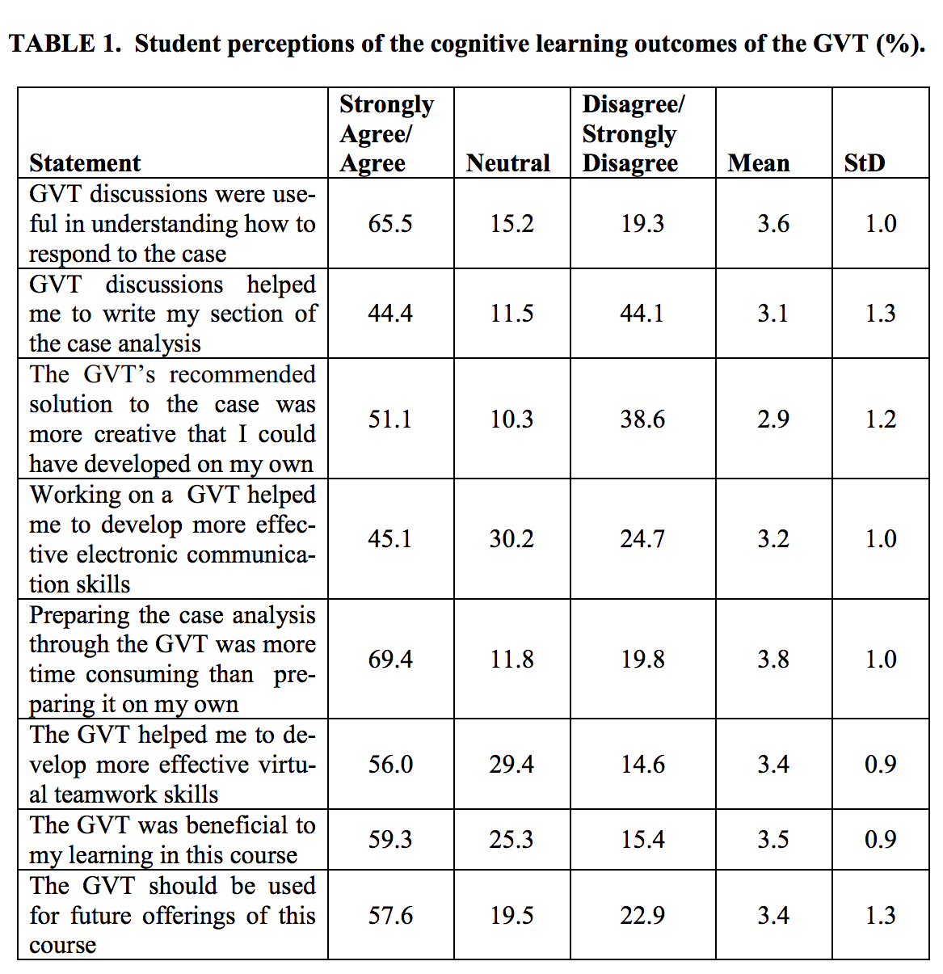

Slide 12
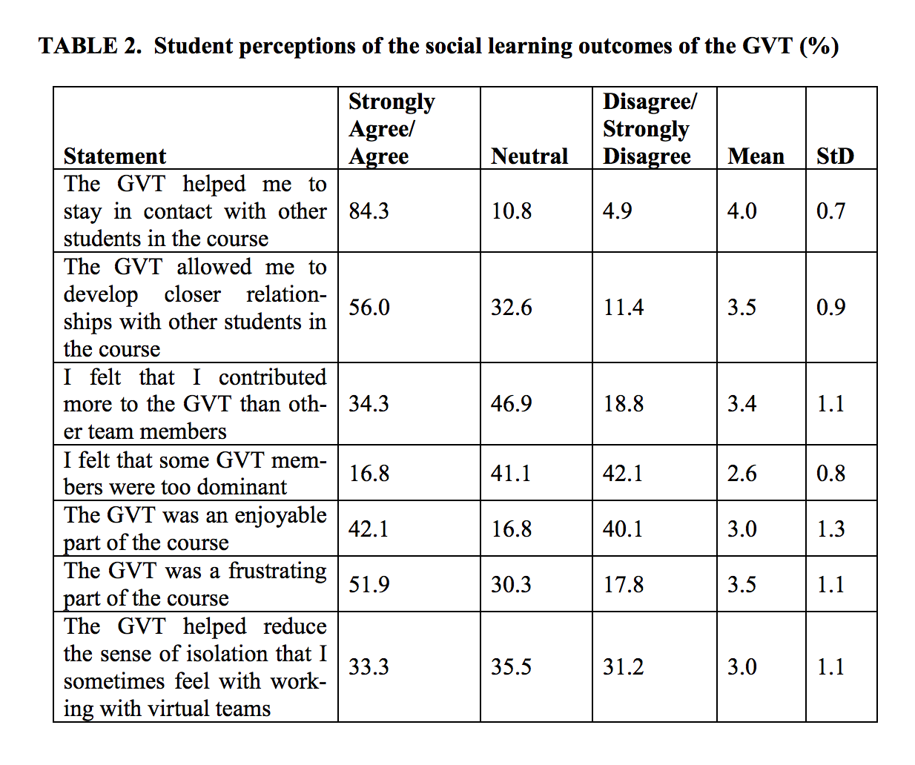

Slide 13
Qualitative Results
What students liked:
Opportunity to develop teamwork skills and get to know individuals from another country/culture (21 students)
Ability to apply and develop communication technology skills to a specific task (9 students)
International aspects of the case (3 students)

Slide 14
Qualitative Results
What students disliked:
Difficulty working with other students (work styles, lack of participation - 12 students)
Difficulty in connecting with global counterparts because of language and time differences (12 students)
Disappearing team members (5 students)
Time task required for only 25% of the course grade (4 students)

Slide 15
Qualitative Results
Suggestions:
Facilitating synchronous discussions (4 students)
Requiring participation from all team members (3 students)
Eliminating other course assignments to counteract the time allocated to the GVT experience (2 students)

Slide 16
Questions?

