Slide 1
Technology and Online Education: Models for Change
Presentation by Brianna Chen
Journal by Catherine W. Cook &
Christian Sonnenberg

Slide 2
Change and Progress
Technology, online education, and students continue to evolve
As progress occurs in technology, progression must occur in online education

Slide 3
Moving Education in the Mobile Direction
Educators must consider different approaches to online design and development that considers mobile responsive
Mobile devices, along with collaboration tools can allow professors, students, and remote experts to connect
With collaborate tools, models of borderless online networks can be created

Slide 4
Technology & Moore’s Law
Moore’s Law (1965) posited that the number of transistors on integrated circuits would double approximately every two years
Law is the guiding principle of progress in electronics and computing since Moore first formulated his prediction
Keeping Moore’s law in mind we need to investigate the technologies supporting the paradigm of online learning that is with us now

Slide 5
Technology Today
Mobile phones, tablets, and laptops are in use for online education
This has allowed for portability and speed
Technology changes lead to a transition that continuously challenges online education
What must be advanced are educational technologies to support new directions for the new e-Learning environment

Slide 6
Internet Communication Tools for Education
1. World Wide Web | 5. Interactive Video Conferencing
2. Electronic Mail | 6. Skype
3. Instant Messaging | 7. Mobile/Smartphones
4.Voice over Internet Protocol (VoIP) | 8. Social Networks
The most favored three internet communication tools for educationalists:
Email
IM (now synchronous with email)
Asynchronous Discussions (text, Web based, messages via email)

Slide 7
Technology and Online Learning
1990 – 2010 ONLINE SYSTEM UTILIZATION
Communication tools and study outcomes of online learning
2010-present MOBILE ONLINE COMPUTING
Streaming media, online video access, fast web site servers, newer mobile computing hardware and software

Slide 8
Evolutionary Trends and Mobile Learning
Rise of mobile devices must be considered the most important shift in business as well as online education
Educators must leverage student desires to use their personal devices for school
Schools can create a more personal relationship with online students

Slide 9
Hardware Improvements
Many trends and innovations are made possible by advancements in computing power, size, and operability
Students will be able to develop a unique mobile signature
Future: Advanced sensors can smartly adjust material based on students surroundings and environmental conditions

Slide 10
Ubiquitous Computing
An environment by which computing is inherently present in all manners of day to day life – Mark Weiser, 1993
The technology must not require the users complete attention. Must be an extension of the user.
Is established further through Cloud computing
Students and educators can now access information from anywhere at anytime, while no longer being restricted to a classroom

Slide 11
Wearable Computing
Extension of Ubiquitous computing to integrate seamlessly with the user
Key Features: Permanence, extensibility, and multi-tasking

Slide 12
Wearable Computing
Existing Devices:
Bluetooth headsets, earpieces, SmartWatches, and Google Glass

Slide 13
The Future of Wearable Computing
BioSkins
-Originally for robotics and prosthetics
One day will be able to include wireless technologies and dynamic interfaces

Slide 14
Augmented Reality
The next step to Ubiquitous computing
Providing seamless access to information without requiring a user’s active input
Utilizes different devices and inputs to provide a user with an overlay of information about their physical environment
EX: Google glass

Slide 15
“Augmented Lecture Feedback System”
Educator wears special glasses that provide overlay for each student
If a student is having trouble with a topic, they indicate so with a mobile device
Relayed to glasses, and a special icon will appear over students head to show they are having trouble
Future: Eliminate mobile devices and rely on gestures and facial expressions

Slide 16
Location-Based Integration
Mobile Devices are optimally designed to take advantage of location-awareness
Ex: Contextual audio feedback
Ex: Apple iBeacon

Slide 17
E-Readers

Slide 18
Micro-Learning
It has been well documented that the Internet has changed the way humans collect and retain information. Mobile devices has further accelerated this shift in cognitive processing
It is essential to divide content into more manageable pieces
Easier for certain subjects than others: IE. Programmers learning a specific sequence of commands vs. a law student understanding an intricate set of rules and regulations

Slide 19
Social Media
Many students have multiple social media outlets
In the future, we can see these merge into a cohesive student profile
Example: Student presents a paper at a conference. Using Google Glass, the audience is able to see this students entire profile.

Slide 20
Integrated Computing
The next step from wearable computing
EX: Bio-skins and micro-sensors
Hot topic in education are the reactions and signals of brain wave patterns.
We may soon be able to monitor these patterns with mobile devices to better understand cognitive development in a classroom setting

Slide 21
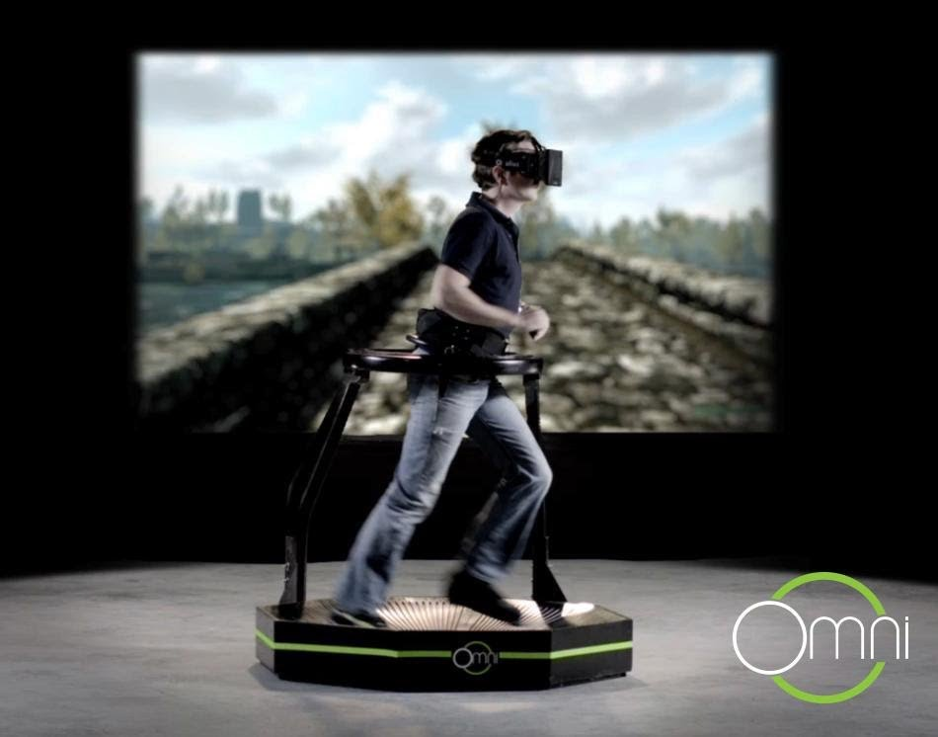
Immersive Technologies
Simulation, Virtual Reality
Several kinds have been in use in military and professional training for years
Ex: Virtuix Omni

Slide 22
Adaptive Courses
The future of online education will incorporate advances in AI
A course will be able to dynamically adjust to a students learning type

Slide 23
Challenges
Usability
Privacy
Limitations of wireless networks
Short term solutions: distribution of more cell towers, offloading data onto wired networks via Wi-Fi, or licensing more parts of the frequency spectrum to accommodate more channels of data.
These solutions may be too cost-prohibitive

Slide 24
Questions

