Slide 1
Constructivist Approaches for Teaching Computer Programming
Tom Wulf
University of Cincinnati
Presented by David Burlinson
1/28/2016

Slide 2
Overview
Introduction and Background
Constructivism
Objectivism
Bloom’s taxonomy
Somatic Learning
Multiple Intelligences
Cognitive Apprenticeships
Constructivist Pedagogy
Goals
Elements of Programming Instruction
Phases of Instruction
Student Reactions and Instructor Concerns
My Experience (so far!)
Discussion

Slide 3
Introduction and Background
Published through SIGITE in 2005
Constructivism vs Objectivism in computer science education
Course design
Classroom activities
Assessment methods
Difficulties encountered
Notes:
The paper covers his ideas about the application of constructivism

Slide 4
‘Social constructivism not only acknowledges the uniqueness and complexity of the learner, but actually encourages, utilizes, and rewards it as an integral part of the learning process.’
– James V. Wertsch

Slide 5
Constructivism
Student-centered
Pedagogical model and theory of knowledge
Humans learn by modifying their ideas based on their interactions and experiences
Rich cognitive learning environments provide opportunity for exploration
Students build knowledge frameworks to guide learning
Notes:
More a knowledge discovery process than transmitting Packages of knowledge
Students view their learning through the paradigm of their knowledge frameworks

Slide 6
Objectivism
Teacher-centric
“Sage on the stage” - Subject matter expert as the primary knowledge source
Lectures and direct instruction

Slide 7
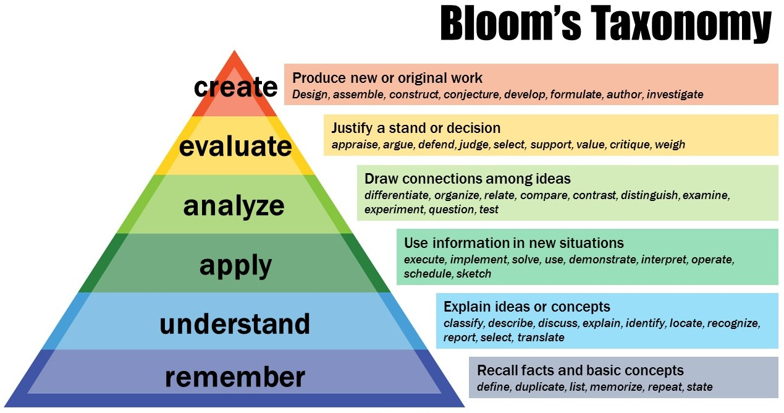
Levels represent the cognitive processes used to work with knowledge
Notes:
Replace original taxonomy (nouns) with verbs – reflecting dynamic nature of learning
We should be structuring our education around this framework – want students to flexibly apply knowledge, not just repeat it
Constructivist Approaches are more suitable to this goal

Slide 8
Somatic Learning, Multiple Intelligences
Somatic Learning – students have a preference for a particular style of learning
Visual
Auditory
Kinesthetic
Instruction should be multimodal to engage all varieties
Dual encoding - engage multiple somatic modalities simultaneously
Varied mental stimulation yields stronger understanding
Multiple Intelligences - Intelligence is not a single construct (IQ)
Spatial, linguistic, logical, (etc) intelligence
‘Profile of intelligences’
Notes:
Somatic learning – could use physical props for things
Dual encoding – learning requires neuronal pathways to form in the brain, stimulating several areas simultaneously contributes to this development more than single mode
Multiple Intelligences (Howard Gardener, 1991) – people have different strengths, so learning and assessment must take this into account

Slide 9
Cognitive Apprenticeships
Models the process of mastery over a subject similarly to a craft or trade guild
Requires more active learning and application than theoretical focus
Industry standards of work environment generally differ from formal classroom settings
Notes:
One form of constructivist pedagogy
Most professional environments require lots of group work and interpersonal discussion, whereas lectures appeal to independence

Slide 10
Constructivist Pedagogy - Goals
Goals of students in computer science institution:
Create computer programs
Mastery of syntax vs professional practice
Become competent practitioners
Lifelong learning skills rather than rote learning
Collaboration activities to reflect industry practices
Non-competitive grading
Use breakpoints rather than curve
Notes:
Are students operational in creating reasonably designed programs using professional dev tools like code generators, rapid development techniques, libraries, etc

Slide 11
Constructivist Pedagogy - elements
Constructivist programming instruction:
Code walkthroughs
Code reading
Code debugging
Scaffolded code authoring
Phases of Instruction
Initial Exposure
Brief Review
Guided Practice Activity
Individual or Group Programming Assignment
Evaluation of learning achievement

Slide 12
Phases of Instruction
Initial Exposure:
Brief framing lecture or document
Learning goals
Provide context
Warn against particular difficulties
Individually assigned readings
Web-based tutorials
Demonstrations
Interactive examples
Need student buy-in for these external methods
Be upfront and explicit about the purposes of the class structure
Brief comprehension quizzes based on the material
Notes:
Readings OR more active stuff
Quizzes address low levels of bloom’s taxonomy

Slide 13
Phases of Instruction
Brief Review
Leads from the initial exposure into guided practice activity
Question/Answer sessions
Student groups can brainstorm together, then summarize thoughts to the class
Direct feedback on readings and material

Slide 14
Phases of Instruction
Guided Practice Activity
Practice application of topics in a structured environment
Impart confidence and comfort with the material
Guided lab
In groups or individually, although the latter is preferable
Could work in pairs to make sure everyone can keep up
Aforementioned elements work well here:
Code reading, debugging, walkthrough, scaffolded programming, etc

Slide 15
Phases of Instruction
Individual or Group Programming Assignment
Demonstrate mastery of a topic
Code a program
From scratch
Scaffolded program
Create subcomponent of larger assignment
If assigning group work, it’s best to facilitate them during class
You can observe the group dynamics
Avoid scheduling issues
Assess progress toward learning goals
Expectations and roles must be explicit
Notes:
Individual assignments are better for lower-level courses, and group work is better in advanced classes

Slide 16
Phases of Instruction
Evaluation of learning achievement
If much of class time is spent on active learning, one can develop an understanding of students’ abilities and issues
Programming assignments can suffice to assess achievement of learning goals in a computer science course
Programs should be balanced with tests
Helps mitigate plagiarism

Slide 17
Student Reactions and Instructor Concerns
Few students have direct experience with a constructivist approach
If it works well, students can feel like they’ve learned a lot without being ‘taught’ anything
(comments about the price of tuition, etc)
Motivation and buy-in is incredibly important
Explicit discussions of the style and expectations
“Many literally believe that they are paying tuition for some expert to talk at them”
From the instructor perspective, it’s a lot of work
Change in awareness of student and instructor roles in the classroom
Synthesizing information for verbal delivery is important, but ultimately it’s not nearly as accessible as a constructivist approach

Slide 18
My Experience (so far!)
Structuring the course around Bloom’s Taxonomy and the aforementioned Phases of Instruction
Reading, interactive examples, multiple sources of information, brief comprehension quizzes, lab assignments/group discussion, problem walkthroughs, scaffolded code assignments, feedback surveys, etc
Difficulties
Student buy-in, attendance, late work
At a fairly early point in the semester, getting everyone on the same page

Slide 19
Discussion
Question 1: How do the phases of instruction fit with the material for the classes you’re taking or teaching this semester?
Question 2: What are your thoughts on increasing student buy-in for an active learning, constructivist paradigm?
Thanks for your attention!

