Slide 1
A Meta-Study of Algorithm Visualization Effectiveness
Christopher Hundhausen, Sarah Douglas, John Stasko
Presented by David Burlinson
8/10/2015

Slide 2
Outline
Introduction and Background
Study Scope
Data
Analysis - Independent Variables
Factors posited to cause effectiveness
Analysis - Dependent Variables
Measurements of effectiveness
Conclusions
Future Research

Slide 3
Introduction and Background
What is algorithm visualization (AV)?
When is it used?
Lectures, learning aides, debugging
Is it effective?
Notes:
AV represent algorithms in action - help students understand how they work
- Interactive, dynamic exploration of animations
Interactive IDEs to quickly construct visualizations of code

Slide 4
Introduction and Background
Why do CS educators tend not to use AV technology?
Time spent learning and creating tools
Takes time away from other activities
Not educationally effective
Notes:
* Commonly cited in the literature as motivation for new, easier, faster AV tech

Slide 5
Introduction and Background
Prior research - taxonomic reviews, experimental studies
Mixed results
Pedagogical advantage? No advantage? Somewhere in between?
This largely explains lack of adoption
Notes:
taxonomic reviews - what kinds of programs can be visualized, what kinds of vis can be produced, how can we make and interact with visualizations?
studies - attempt to determine educational value of AV tech

Slide 6
Introduction and Background
Meta-study
Is AV technology educationally effective?
Impacts and trends of various factors?
How do we measure ‘educational effectiveness?’
What are fruitful directions for future AV research?

Slide 7
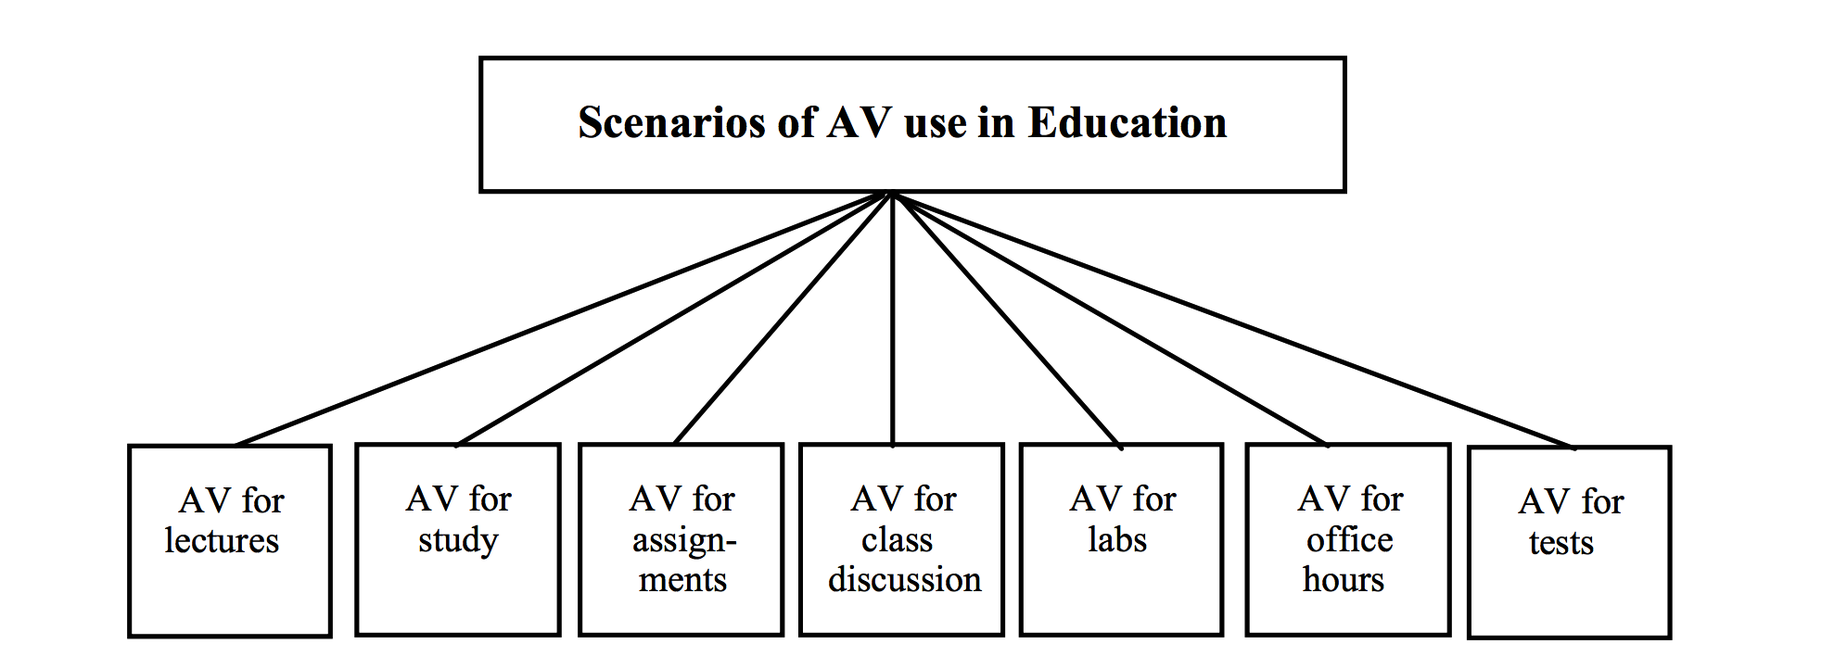
Study Scope
Notes:
Nearly every paper and article cites anecdotal
Programmatic - how few lines can be used to make vis
Analytic - analyze effectiveness without data collection - how few usability problems identified
Empirical - collection of actual human data

Slide 8
Study Scope
Focus on empirical techniques - observable and measurable phenomena
Controlled experimentation
Causal relationship between factors (independent variables) and measures (dependent variables)
Between-subject comparison
Statistically significant differences between groups mean factors affected measures
Notes:
despite many variations on controlled experimentation, ALL had between-subject comparison
Alternative ways to learn about an algorithm

Slide 9
Study Scope
Scope is limited to experimental evaluations
Largest, most mature subset of empirical studies
Evolution of design reveals evolution in thinking about why and how AV technology is effective

Slide 10
Data
24 experimental studies considering AV effectiveness
Study - 22
Evaluated by post-test
Assignment - 2
Evaluated by problem-solving efficacy -
Was the problem solved?
How much time was needed?
Notes:
close to entire population of published studies, if not all

Slide 11
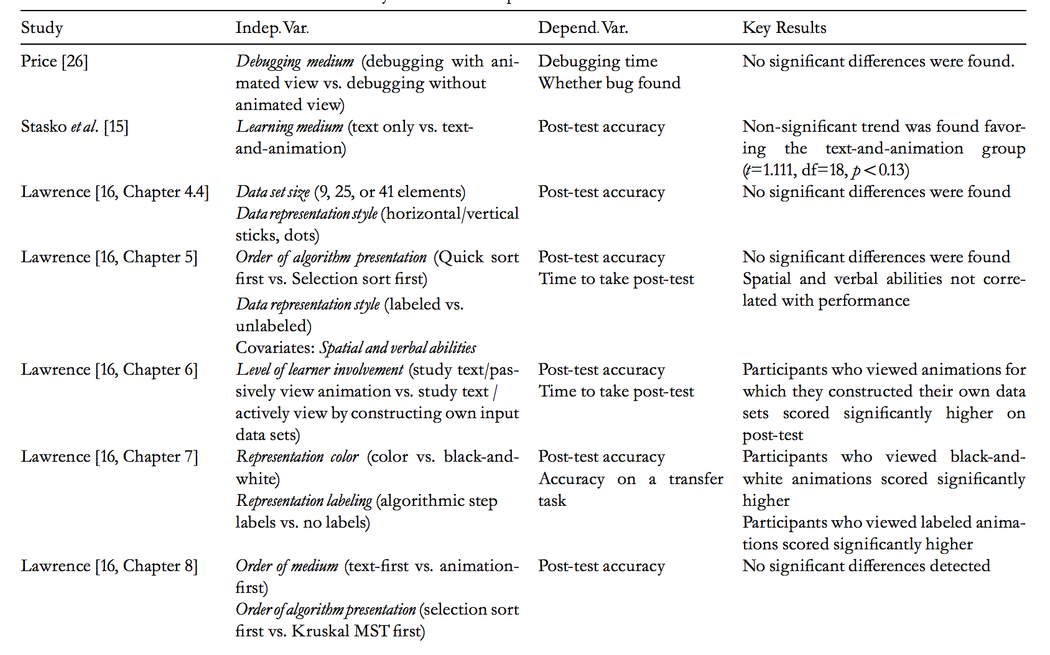
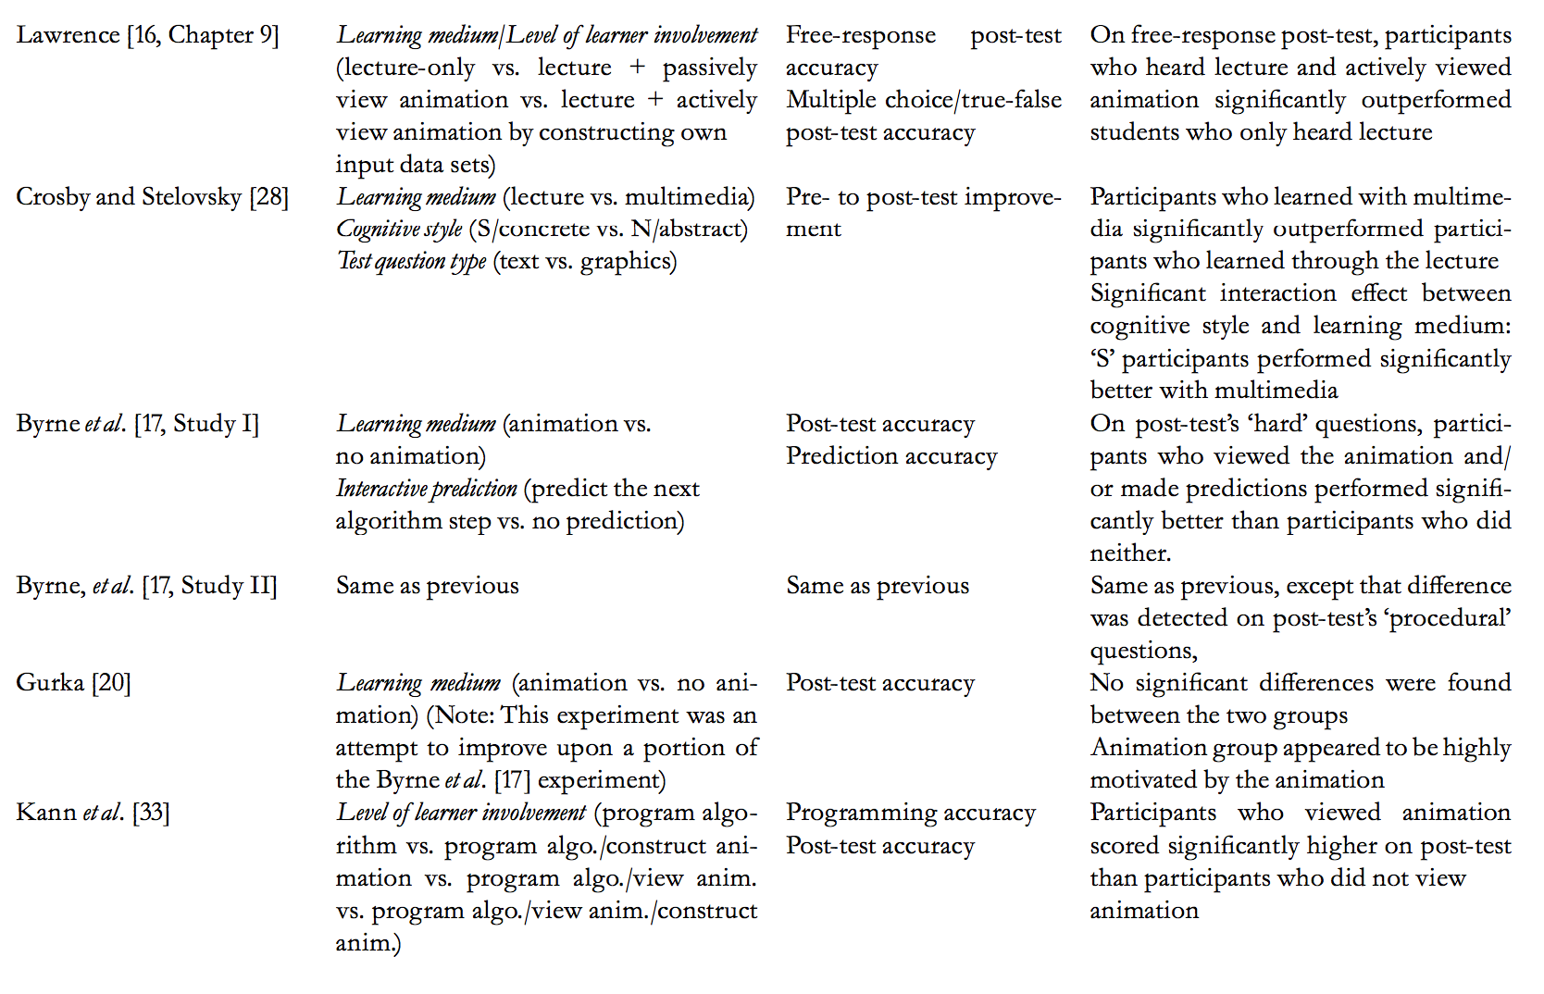
Notes:
studies broken down by variable and key results.

Slide 13
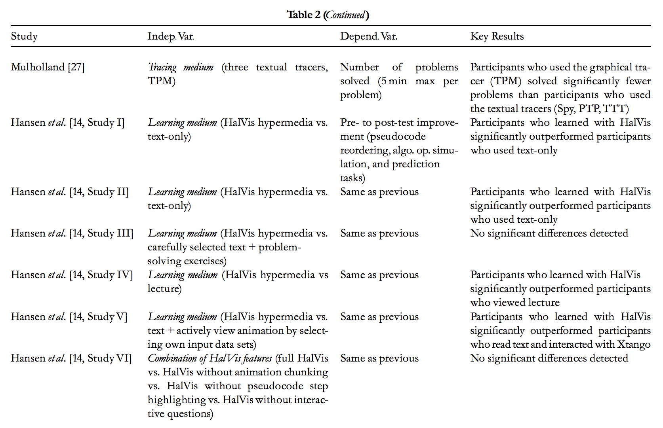
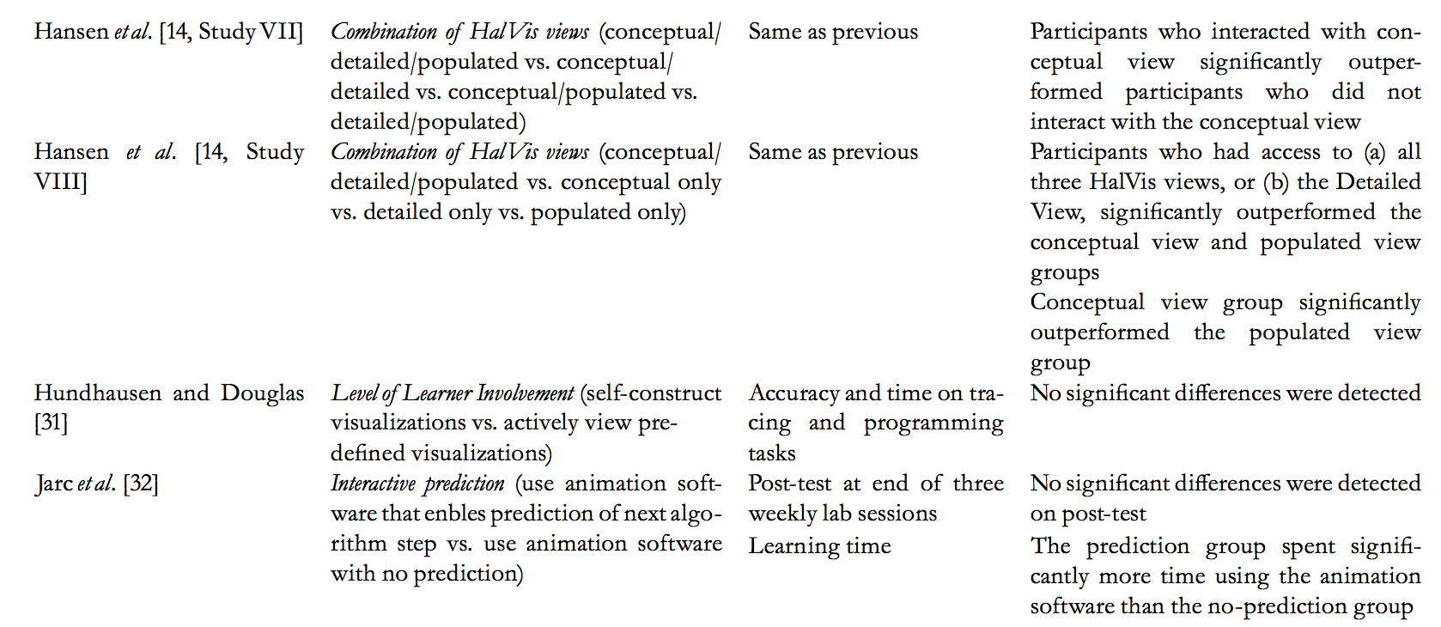

Slide 14
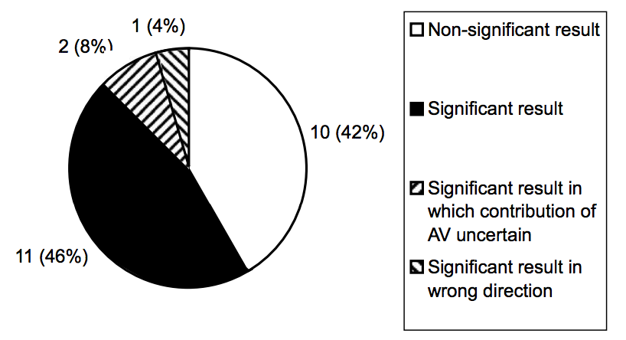
Data

Slide 15
Analysis
Diverse corpus of experimental studies
Similar independent and dependent variables, but very different manipulation and operationalization
AV vs conventional learning material
AV vs other AV
Exam-style post-tests
Program Accuracy
Tracing tasks
Prediction tasks
Notes:
operationalization - strictly defining variables into measurable factors

Slide 16
Analysis - Independent Variables
Selection and usage of independent variables provide insight into theories of effectiveness and knowledge transfer
Epistemic Fidelity
Graphics encode mental models for robust transfer of knowledge
Dual-coding
Representations dually code information (graphics and text)
Individual Differences
Varying cognitive abilities and learning styles enable some to benefit from AV more than others
Cognitive Constructivism
Active engagement with AV constructs one’s own understanding
Notes:
Independent - Factors causing effectiveness
Epistemic Fidelity - humans carry symbolic models of the world, basis for all reasoning and action
Dual-coding - connections between different representations strengthens knowledge
Individual differences - various ratings and classifications along several dimensions
(myers briggs) - concrete learners benefit from AV more than abstract learners
Cognitive Constructivism - no absolute knowledge/models, users construct new understandings by interpreting new experiences within the context of what they already know

Slide 17
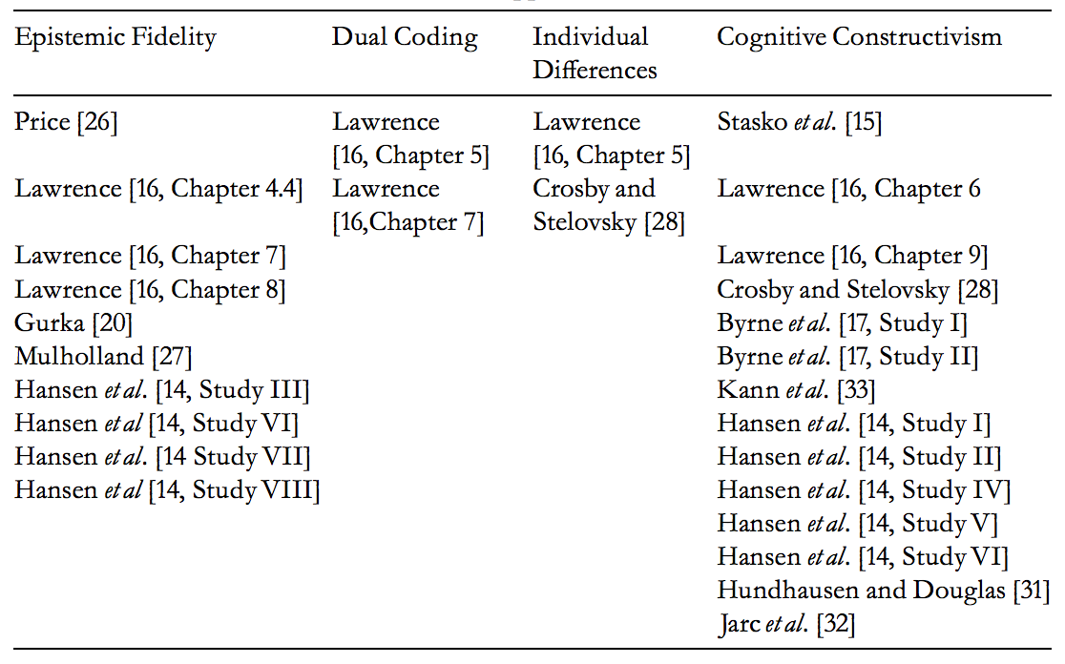
Analysis - Independent Variables
Notes:
E.F. - manipulated representational features or order of presentation
D.C. - compare info in single (graphic only) vs dual (graphics and text labels)
I.D. - consider spatial, cognitive abilities and learning styles
C.C. - used varying activities and forms of engagement rather than representation

Slide 18
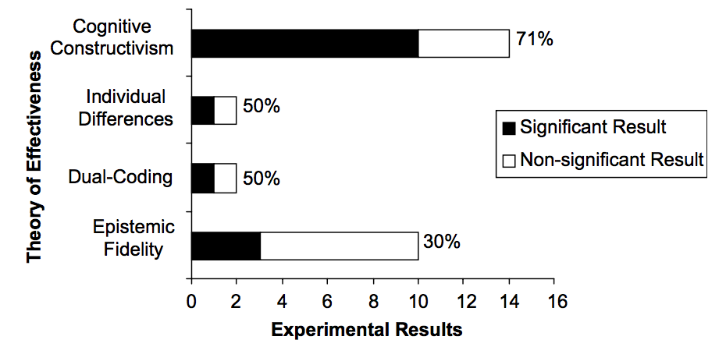
Analysis - Independent Variables

Slide 19
Analysis - Independent Variables
Cognitive Constructivism is more robust and has most empirical support - learner activity matters
Constructing own input data sets
Making predictions for future visualization states
Programming a target algorithm
Answering strategic questions about the visualization
Constructing visualizations

Slide 20
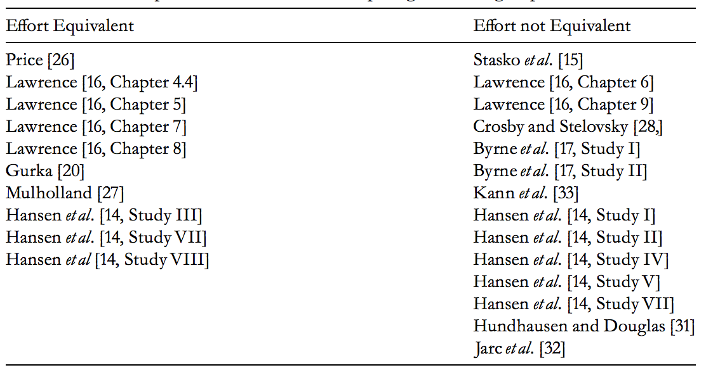
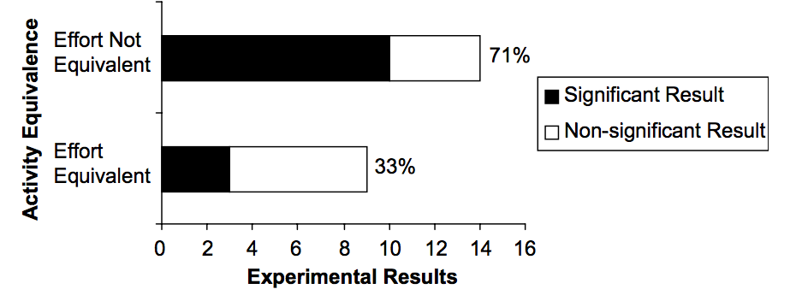
Analysis - Independent Variables
As long as an activity is salient to the target knowledge or skill, the effort is more important than the form of the activity
The more effort required, the more robust the learning
Notes:
Classification of experiments based on effort required to perform activities in competing groups

Slide 21
Analysis - dependent Variables
Differences in what knowledge is measured
Conceptual/Declarative
understanding abstract properties of an algorithm
Big-Oh, range of output, limits on input data
Procedural
understanding the step-by-step behavior of an algorithm
Notes:
Dependent - Ways to measure effectiveness
Independent - Factors causing effectiveness
These forms aren’t necessarily distinct; require both

Slide 22
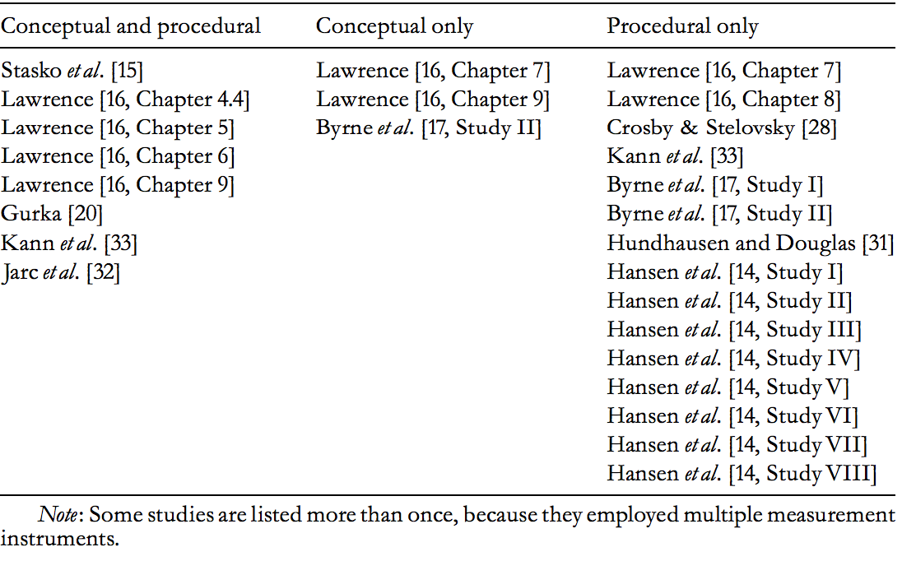
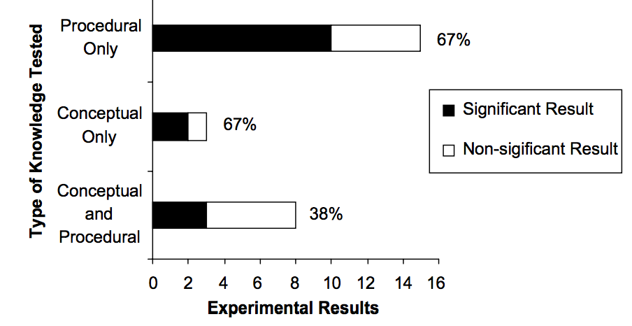
Analysis - dependent Variables
Measures seem equally sensitive to learning effects

Slide 23
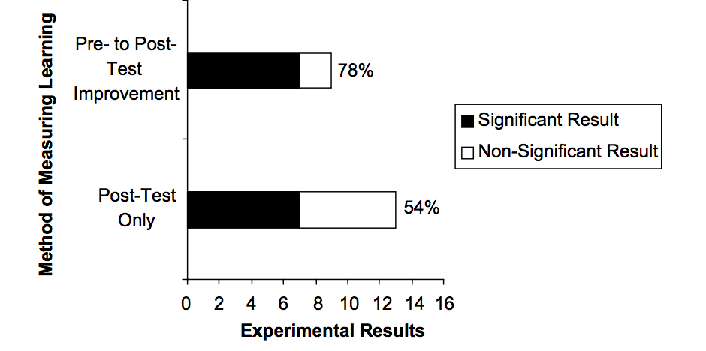
Analysis - dependent Variables
Differences in how knowledge is measured
Post-test vs pre- and post-test

Slide 24
Conclusions
Factors impacting effectiveness
Cognitive Constructivism - AV technology is useful to engage students in active learning
Measures sensitive to effectiveness
Procedural knowledge may be a more sensitive measure of AV’s benefits
Pre- and post-tests increase likelihood of finding improvement
Notes:
How students use AV tech has a greater impact on education effectiveness than what the students see
Bias- pre-test may give participants knowledge of target algorithm, corpus of studies only has a few dependent variables

Slide 25
Conclusions
Is algorithm visualization effective?

Slide 26
Conclusions
Yes and no…

Slide 27
Conclusions
Merely viewing visualizations doesn’t guarantee learning
AV technology is effective as a catalyst for active learning
What-if analysis
Prediction exercises
Programming exercises
Notes:
(epistemic fidelity) AV don’t merely transfer an expert mental model of an algorithm to a student’s brain.. something else is going on in successful applications

Slide 28
Conclusions
In this case, a picture is not worth 1000 words!

Slide 29
Future Research
Dual-coding and Individual Difference theories should be explored further
Situated Action and Sociocultural Constructivism could be examined
Situated action - AV is a communicative resource for building a shared understanding
Sociocultural Constructivism - AV enable people to participate in a community in increasingly central ways
Evaluate more than just exams
Consider more than just experimental studies
Usability, surveys, observational studies, etc
Notes:
Situational action - learners using a visualization to establish shared understanding, analyze conversation to determine if AV is a meditational resource
Sociocultural - evaluate AV as a cultural artifact in a community of practice, evaluated based on its ability to engage learners more fully in community (within course, college, etc)

Slide 30
Thank you for your attention and involvement!

