Slide 1
Can geothermal energy replace coal?
Niraj Patel
August 8th, 2017

Slide 2
Overview
What is geothermal energy
Why coal is bad.
How can geothermal replace coal?

Slide 3
Geothermal energy
Heat energy stored IN THE EARTH!
Thermal conduction from earth’s core
Cost effective, reliable, sustainable, and eco friendly
Limited to areas near tectonic plate boundaries (but changing)

Slide 4
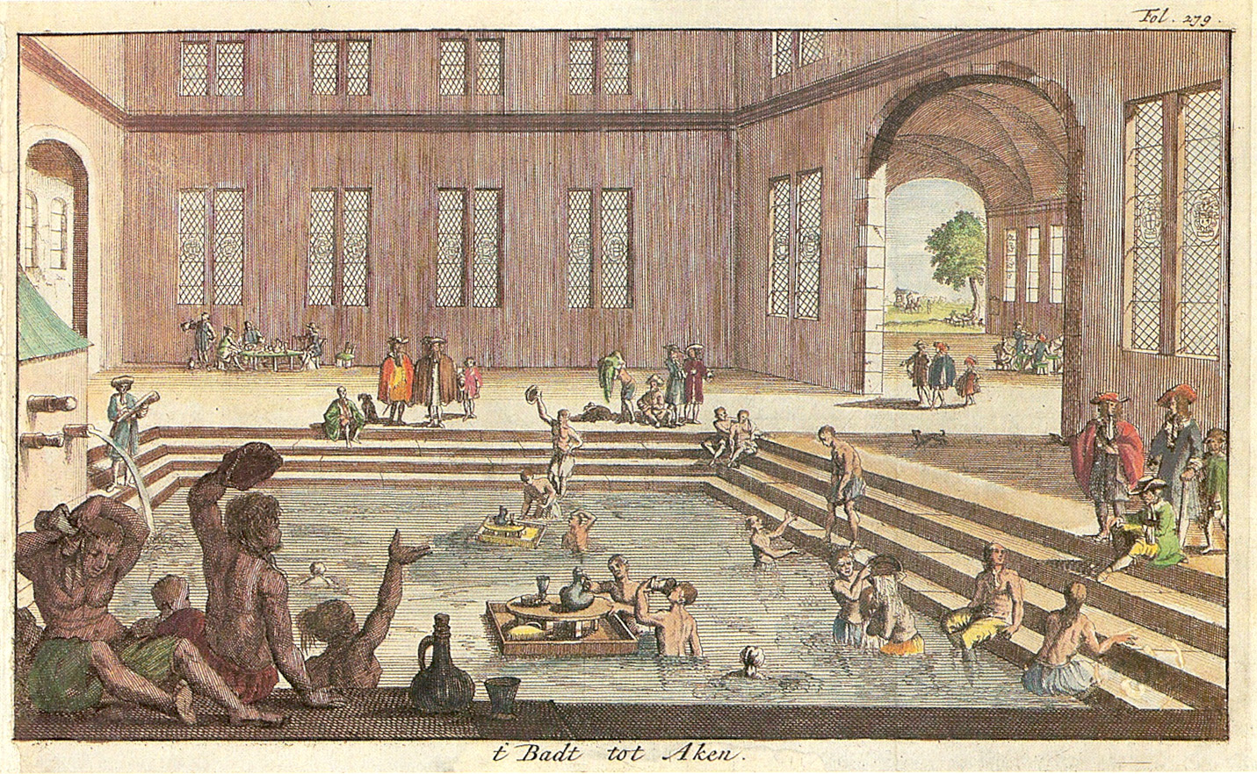
Geothermal energy
Used since paleolithic time
Image of hot springs in Aachen, Germany

Slide 5
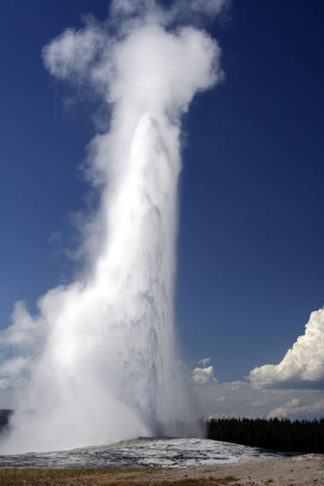
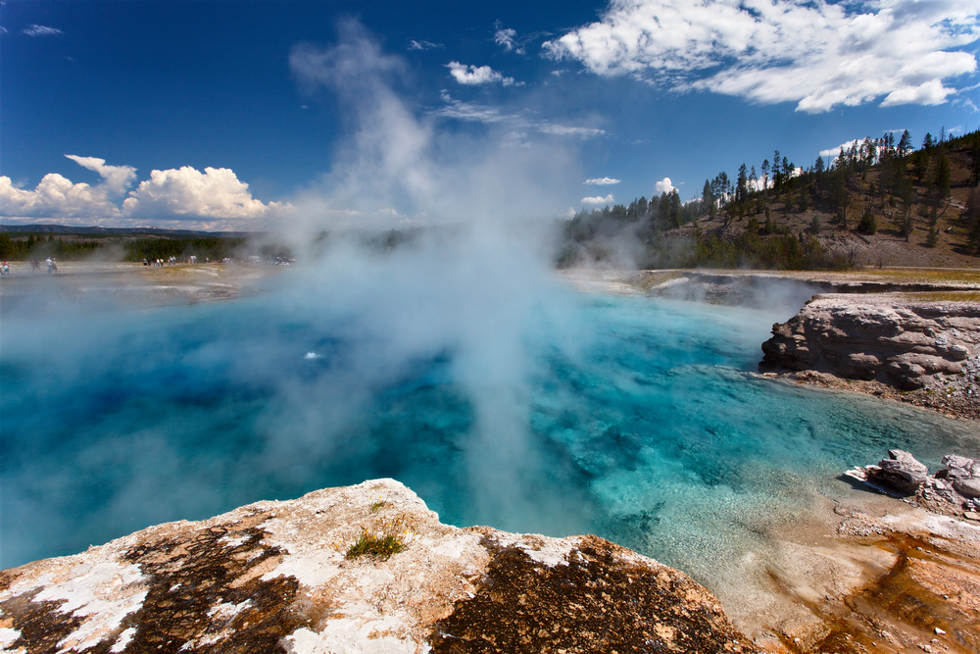
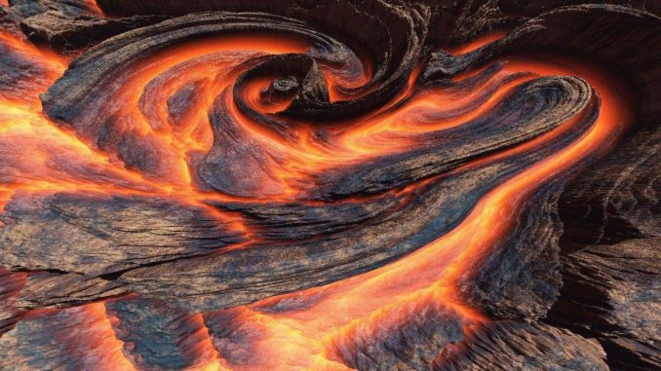
Geothermal energy
Geysers
Thermal Springs
Ground heated by magma

Slide 6
Heat map of America

Slide 7
Geothermal Sustainability
Almost everywhere.
Geothermal energy can make heating and cooling easy.
Can use steam or hot water to power.

Slide 8
Why is coal bad?
Dangerous metals escape in the air.
Large amounts of carbon dioxide.
NONRENEWABLE. Finite

Slide 9
How can geothermal replace coal?
Sources of ground heat are plentiful, coal is not.
Drilling techniques from oil can be applied to geothermal.
Cheaper than coal but no major infrastructure yet.
Unsafe mining practices can be deadly to workers.

Slide 10
Picture Sources
http://grist.org/article/2011-11-07-we-could-replace-coal-power-with-geothermal-ten-times-over/
http://assets.inhabitat.com/wp-content/blogs.dir/1/files/2012/05/thermal-springs.jpg
http://geology.com/articles/geyser/geyser-old-faithful.jpg
http://brwacademy.com/wp-content/uploads/2015/02/lava-magma-1920x1080-wallpaper-2311729-678x381.jpg
https://en.wikipedia.org/wiki/File:Aachen_Kaiserbad_1682.jpg

Slide 11
Sources
Rosen, Marc A. Geothermal energy: Sustainable Heating and Cooling Using the Ground: John Wiley & Sons, 2018. Print.
Mims, Christopher. "Can Geothermal Power Compete with Coal on Price?" Scientific American. Nature America, 2 Mar. 2009. Web. 29 July 2017.
http://www.renewableenergyworld.com/geothermal-energy/tech.html

