Slide 1
Volume-Based Video Representation
Presented by
Anuradha Venkataraman

Slide 2
Table of Contents
Introduction
Existing Approaches
Video Representation
Volume Based Video Representation
Events and Actions
Volume Based Representation and Event Detection Techniques
Video Retrieval of Near–Duplicates using k–Nearest Neighbor Retrieval of Spatio–Temporal Descriptors
Probabilistic Space-Time Video Modeling via Piecewise GMM
Efficient Visual Event Detection using Volumetric Features
Conclusions

Slide 3
Introduction
Increased need for Multimedia information system
Broadband networks
Cheap storage
Easy production of videos
Compression standards
Digital camcorders
Sources of videos
Movies
Television
Ads
Home videos
Sports
Surveillance cams

Slide 4
Introduction
A video retrieval system should
Efficiently store video data
Use techniques to represent video data
Incorporate good indexing techniques
Provide mechanism to retrieve video from database

Slide 5
Existing Approaches
Most of the existing approaches to video indexing today treat video as a string of individual image frames.
The main steps involved are:
Video clip is parsed into video shots using shot detection algorithms
Features from representative frames are extracted and used to index the shots.
Multi modal channels of information are used to extract features.
Use text data (captions, speech transcription)
Image retrieval using keyframes
Face detection
Object detection

Slide 6
Video Representation – 2D
Video has both spatial and temporal dimensions
2D representations of video divide the video into its constituent frames
Perform image retrieval techniques on key frames
Features are extracted only from pixels on the x-y space.
Temporal information is not considered
Detect objects and regions in keyframes
Index video shot based on features extracted from key frames

Slide 7
Deficiencies in 2D Representation
An efficient indexing scheme must capture the spatio-temporal contents of a scene
No attempt to extract temporal relations between keyframes
Loss of information on temporal evolution of the video
Inability to detect events and actions effectively

Slide 8
Volume Based Video Representation – 3D
Not much research on using 3D (spatio-temporal) features
Reason: inability to represent the temporal information compactly and to use it effectively in measuring similarity
Involves description of videos that are characteristics of a stream of video as opposed to snapshots of information
Use motion information
Volume based because both position(x,y) and time(t) is used to extract features

Slide 9
Volume Based Video Representation – 3D
Steps
Parsed in temporal domain into video shots
Extract global shot features such as color, texture and motion
Segment video shot into regions and objects
Perform temporal tracking of regions and objects across shots
Index the video based on regions and objects retrieved

Slide 10
Advantages of Volume Based Representation
Direct and robust way to track moving regions
Solid evidence about salient motion can be accumulated
Video can be better segmented into interesting events

Slide 11
Events and Actions
Segmenting video into events and actions is becoming important
Systems to identify and recognize the occurrence of an action or event in the video shot
Systems should be able to identify events and actions in video in real-time
Systems should index events and actions
Motivation –
Activity recognition
Unusual activity detection
Monitor surveillance cam

Slide 12
Volume Based Representaion and Event Detection
Three Techniques
Video Retrieval of Near–Duplicates using k–Nearest Neighbor Retrieval of Spatio–Temporal Descriptors
Probabilistic Space-Time Video Modeling via Piecewise GMM
Efficient Visual Event Detection using Volumetric Features

Slide 13
Video Retrieval of Near–Duplicates using k–Nearest Neighbor Retrieval of Spatio–Temporal Descriptors
Main Contribution
Compact representation of spatio-temporal features
Retrieval of near duplicates
Action recognition in video sequences

Slide 14
Video Retrieval of Near–Duplicates using k–Nearest Neighbor Retrieval of Spatio–Temporal Descriptors
Motivation:
Recognize near similar videos even if there is obscurity
Retrieve all shots that are similar to a given video query
Detect unusual activity in video data from surveillance camera

Slide 15
Space-Time Descriptors
Summarize half second video clips
Create a 3D volume of pixels by stacking individual frames horizontally
Time axis is vertical and pointing downwards
Moving blocks in video generate cylinders
Thickness of the cylinder is proportional to the size of the pixel region

Slide 16
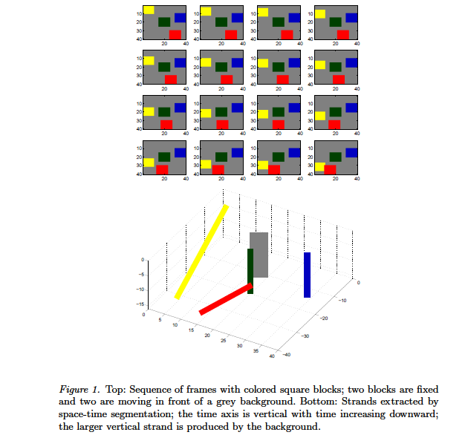
Space Time Descriptors

Slide 17
Features and Regions
7D Feature vector at each pixel describing the position, color and optical flow(motion)
Cluster of points in feature space correspond to same cylinder
The dimensions of the cluster center describe the position, orientation, color of the spine of the cylinder in the video stack
Half second video clips are used in order to keep the motion linear in the clip so that the video strands are straight

Slide 18
Feature Extraction
Pixel P(x,y,t) represents a pixel at x,y on frame at time t.
Pixel P_{t+1} is represented by p(x+u,y+v,t+1)
u and v are displacements
u and v are computed using optical flow techniques proposed by Lucas-Kanade
Projection of motion vector onto the planes t-x and t-y is used to describe the pixel in spatio-temporal form
Projections create angles α_{x}, α_{y} and displacements D_{x},D_{y}
D_{x} and D_{y} are the displacements of the projection lines from the center of the video stack
Features – t, α_{x}, α_{y} , D_{x}, D_{y},x, y

Slide 19
Feature Extraction

Slide 20
Space Time Segmentation
Steps
Extract Features
Map pixels to points in features space
Determine cluster of points in feature space
Assign to each point the index of the cluster to which it belongs, and assign to each pixel of the video stack the index of its mapped point
This ensures tracking of regions from frame to frame
Video clips are described concisely by the 7D center points of all clusters in the clip

Slide 21
Clustering – Hierarchical Mean Shift Analysis
Clustering is performed to group pixels in the video stack using the points in the feature space
This is done to identify coherent regions in the video clip
Hierarchical Mean Shift analysis is used to perform threshold free clustering
Hierarchical mean shift clustering speeds up the normal mean shift analysis to work efficiently for larger radius.

Slide 22
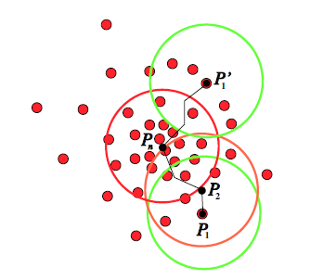
Clustering – Hierarchical Mean Shift Analysis
Mean shift clustering takes a set of background points and a set of starting points, and requires finding centroids of background points contained in spheres of a given radius R centered on starting points, or centered on centroids found at the previous step.

Slide 23
Clustering – Hierarchical Mean Shift Analysis

Slide 24
Clustering – Hierarchical Mean Shift Analysis
first run standard mean shift to completion with a very small radius to create clusters
assign weights to these cluster centers, equal to the sums of the weights of the member points.
consider the set of cluster centers as a new cloud of points
run mean shift using range searching with a larger radius that is a small multiple of the previous radius (we have used a multiplying factor of 1.25 or 1.5). In the centroid computations, the weight of each point is used
repeat the previous two steps until the desired radius size (or the desired number of large regions) is reached

Slide 25
Threshold free segmentation
Cluster radius can keep growing till all points belong to one cluster and we have one big region
What is needed is the right number of clusters/regions to best represent the regions in the video stack
preference to regions that remain immune to merging across the largest range of scales of the fine-to-coarse segmentation

Slide 26
Threshold free segmentation
Steps
Count the numbers of steps of hierarchical clustering during which each cluster center survives intact without being merged to another region(age count)
keep track of the cluster centers that are older than the average age of their children
Once these are merged and die, they will be forgotten and superseded only if a parent or grandparent that contains them is itself able to become older than the average age of its children.
Unless this happens they are at each clustering step remembered and used to define the segmentation borders for the pixels that they comprise.

Slide 27
Indexing and Retrieval
Library of video set needs to be indexed
Similar videos need to be retrieved based on submitted query video clip
Video sequences are parsed into clips
Rank video clips based on similarity to submitted clip
Retrieve most similar clips

Slide 28
Indexing and Retrieval

Slide 29
Indexing and Retrieval
Indexing
Video sequences are chopped into half second video clips
Video strands extracted from clips
The 7D description points of the spines of the video strands are used to index the clips
7D points stored in points database labeled with the address or class of the clip

Slide 30
Indexing and Retrieval
Retrieval
Video strands are extracted from query clip
k-nearest neighbor technique is used to retrieve similar clips from the points database for each point extracted from the query clip
Clips with higher number of votes are more similar to the query clip

Slide 31
Training and Recognition
Represent each clip generated from the library videos by a set of points in a feature vector space, each with the same label describing the clip class (video source or category).
For the query stage, represent the query clip by a set of n query points
For each query point, perform a k-nearest neighbor search to find k neighbor points and their labels showing their class. For the query clip, a total of kn labels will be found.
Tally the classes. Select the class with the highest vote.

Slide 32
k-nearest neighbor rule
Each query is represented by a set of points x_{i}
The nearest-neighbor rule consists of assigning a query point x the label of the point x’ nearest to x.
the k-nearest neighbor rule - a decision is made by examining the labels of the k nearest points and selecting the label that received the most votes.
Tree structure method - reduces the average complexity of a single query from O(N) to O(LogN)

Slide 33
k-nearest neighbor rule

Slide 34
Action Recognition
Train system using sample of actions required
Ignore color feature
Ignore video strands of stationary areas
Label points with the actions that they belong to
Define regions of interest(fixed cams) for each action
Video strands in the defined areas are only compared for an action
Input video is segmented and points are compared and nearest neighbors are retrieved.
Labels of action that are most retrieved determines the action performed.

Slide 35
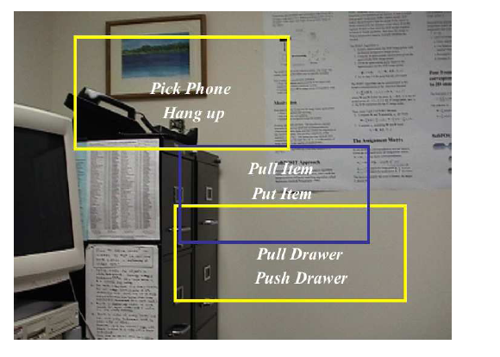
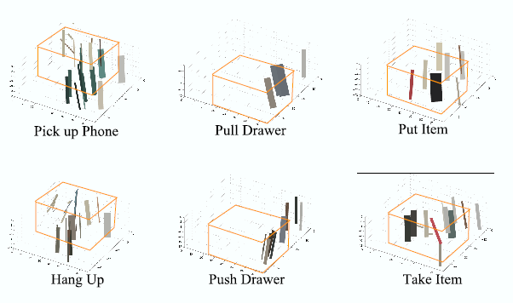
Experiments

Slide 36
Results

Slide 37
Probabilistic Space-Time Video Modeling via Piecewise GMM
Main Contributions
Statistical framework for modeling and segmenting video content into coherent space-time segments within the video frames and across frames
Unsupervised clustering, via Gaussian mixture modeling (GMM), enables the extraction of space-time clusters, or “blobs,” in the representation space and the extraction of corresponding video-regions in the segmentation of the video content
A piecewise GMM framework in which a succession of GMMs are extracted for the video sequence, instead of a single global model for the entire sequence

Slide 38
Gaussian Mixture Model
Model in which independent variables are fractions of a total.
is a probability distribution that is a convex combination of other probability distribution

Slide 39
Feature Extraction
6D feature vector
Color, space, time
Color represented as L, a, b
Space represented as x, y
Time represented as t
Each pixel is represented with the 6D feature vector
Video sequence as a whole is represented by a collection of feature vectors in the 6D space

Slide 40
Grouping – Identifying Regions
pixels are grouped into homogeneous regions, by grouping the feature vectors in the selected 6D feature space
Assumption: image colors and their space-time distribution are generated by a mixture of Gaussians distributions
Each homogeneous region in the image plane is thus represented by a Gaussian distribution, and the set of regions in the image is represented by a Gaussian mixture model

Slide 41
Unsupervised Clustering by learning a Gaussian Mixture Model
Clustering is thereby done by learning the Gaussian mixture model representing the sequence
The Expectation Maximization algorithm is used to determine the maximum likelihood parameters of k Gaussians in the feature space

Slide 42
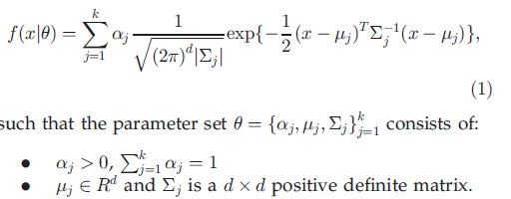
EM algorithm for Gaussian mixture model
Distribution of variable X belongs to a Gaussian Mixture Model if:
Maximum Likelihood estimation given the vectors

Slide 43
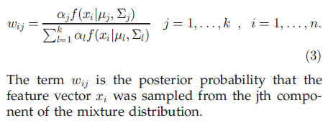
EM algorithm for Gaussian mixture model
The K-means algorithm is utilized to extract the data-driven initialization
Re-estimate the parameters till threshold is reached by iterating through the following steps
Expectation step

Slide 44
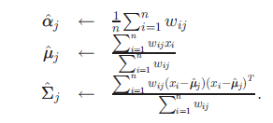
EM algorithm for Gaussian mixture model
Maximization step

Slide 45
Model Selection and Visualization
The number of models(k) in the mixture model is important as it defines the number of regions in the sequence
An optimality criterion for k is based on a tradeoff between performance and number of parameters used for describing the mixture distribution
The Minimum Description Length criterion is used to determine the optimal value of k

Slide 46
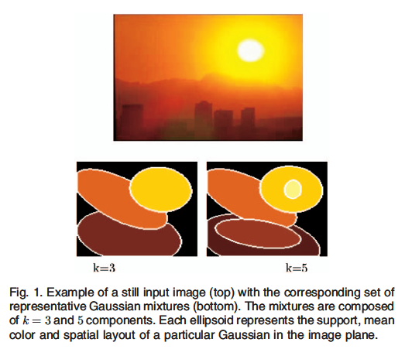
Model Selection and Visualization
The GMM model is learned for a given static image in a 5D feature space
Gaussian mixture is shown as a set of ellipsoids

Slide 47
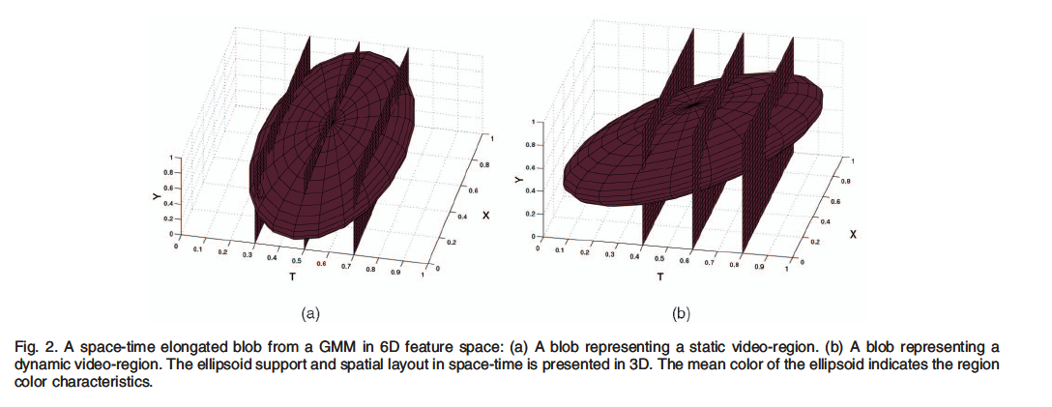
Model Selection and Visualization

Slide 48
Piecewise GMM
Divide the whole video sequence into a succession of identically sized overlapping block of frames (BOF)
Obtain a succession of GMMs
Match adjacent segments and to achieve the temporal tracking of regions throughout the entire video sequence

Slide 49
Piecewise GMM

Slide 50
Piecewise GMM
The input video sequence is divided into a succession of overlapping blocks of frames (BOF). Each BOF is made of N successive frames. N is chosen so that inside each BOF motion can be approximated linearly.
Each BOF is represented by a GMM in the 6D [L, a, b, x, y, t] feature space
A segment-matching stage is used to establish correspondences between adjacent BOF blobs.

Slide 51
Piecewise GMM – learning the GMM for each BOF
Model initial frame using k-means initialization and EM algorithms
For the subsequent frames – use the GMM of the previous frame to initialize the parameters
Update GMM by iterating through EM algorithm
Investigate the appearance and disappearance of new objects in the scene
Model size k is increased by the number of newly created blobs.
Perform EM on this increased model to obtain final GMM
Segment the current frame according to the updated GMM and store the segmentation map

Slide 52
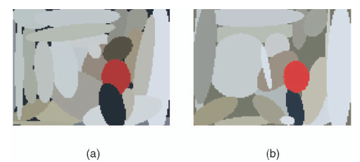
Piecewise GMM – segment matching
Find correspondences between blobs in every pair of adjacent BOFs
Overlap between consecutive BOFs is used
Frame j(center frame of overlap) has two blob lists based on the GMM of the two BOFs it belongs to

Slide 53
Piecewise GMM – segment matching
Euclidean distance between blob centroids is
computed for all possible blob pairs
find the minimum distance blob pairs
matching process is stopped when blob pair distance increases above a threshold
The consecutive indices of each tracked blob are stored along the entire sequence
This helps detect new objects entering a sequence and objects that leave a sequence

Slide 54
Video Segmentation
Segment the video sequence by assigning each pixel of each frame to the most probable Gaussian cluster, i.e., to the component of the model that maximizes a posteriori probability
Pixel in a frame is labeled to a Gaussian or blob
Each Gaussian or blob in the feature space corresponds to a video-region. A video-region is linked to the properties of the corresponding blob

Slide 55
Video Segmentation

Slide 56
DETECTION AND RECOGNITION OF EVENTS
Uses connection between blobs and video events
Covariance matrix of feature in a region over time can be used to detect movements
Large values of covariance between x and t indicate horizontal movement
Large values of covariance between y and t indicate vertical movement
A large value between t and t indicates that the video-region is of extended duration or is present in a majority of the frames that comprise the video sequence.

Slide 57
Efficient Visual Event Detection using Volumetric Features
Main Contribution
Appearance-based framework that employs volumetric features for efficiently analyzing video
Learns activity detectors that perform event detection in real time
Classifies whether an action event occurs or not

Slide 58
Features
Important information to recognize actions can be captured from the optical flow
The appearance features of objects are less important
Optical Flow - is the pattern of apparent motion of objects, surfaces, and edges in a visual scene
Optical Flow is separated into horizontal and vertical components
Volumetric features can be one box or two box.
One box has only one component horizontal or vertical and value is sum of pixels in the volume
Value of two box is the difference of the individual boxes

Slide 59
Features

Slide 60
Features
uses an “integral video” data structure to efficiently calculate the box features
An integral video at pixel location (x, y) and time t is defined as the sum of all pixels at locations less than or equal to (x, y, t)

Slide 61
Learning the classifier to detect actions
sliding-window approach over the video to detect actions
Selects features and their associated thresholds (termed filters), to classify whether an event occurs in a particular detection volume
Uses Cascaded Classifiers

Slide 62
Cascaded Classifier
Given a set of positive examples P, negative examples N, and features F
construct a cascaded classifier that achieves high detection rate on the positive examples and low detection rate on the negative examples
For each node in the cascade
′ Randomly choose a set of negative examples N’ ε N, that have been misclassified by the previous stages, where |N’′| = |P|.
Based on P and N’′,select the optimal threshold i for each feature fi belonging to F that minimizes the classification error rate independent of the other features.
Iteratively add filters to the ensemble to maximize its detection rate or minimize its false positive rate
The stopping criteria for a node in the cascade is when its target detection rate (100%) and false positive rate (less than 20%) are reached
Once the stopping criteria is reached, we eliminate the negative examples that were correctly classified and train the next node in the cascade using the remaining examples.

Slide 63
Detection
Steps
Compute the integral video sequence
scan a detection volume over all locations in space and time
vary the width and height of the detection volume and the associated filters
The number of detections found in a small area in space-time is indicative of the quality of the detections
dense cluster of detections is likely to indicate a true detection, while isolated detections are more likely to be false positives

Slide 64
Evaluation – Action Detection
detector is trained and tested on real videos with the sit-down, stand-up, close-laptop, and grab-cup actions
training set consists of four people performing a total of 60 repetitions of these actions
test set consists of a different group of five people performing 20 repetitions

Slide 65
Results
The sitdown detector detects 86% of the events with no false positives
The stand-up detector achieves 90% recall with 0.6 false positives per minute
The close-laptop detector achieves 78% recall at 0.5 false positives per minute
The grab-cup detector achieves 92% recall at only 0.3 false positives per minute

Slide 66
Conclusion
The techniques discussed propose unique ways to represent video as a volume over space and time
The provide ways to effectively detect event and actions

Slide 67
References
Video Retrieval using Spatio­Temporal Descriptors - Daniel DeMenthon, David Doermann
Video Retrieval of Near–Duplicates using k–Nearest Neighbor Retrieval of Spatio–Temporal Descriptors - Daniel DeMenthon, David Doermann
Efficient Visual Event Detection using Volumetric Features - Yan Ke, Rahul Sukthankar, Martial Hebert
Probabilistic Space-Time Video Modeling via Piecewise GMM - Hayit Greenspan, Jacob Goldberger, and Arnaldo Mayer

Slide 68
Questions?

Slide 69
Thank You

