Slide 2
Neutrality in
Tech Writing
Hunter Heavener

Slide 3
Example One
People For the American Way. "Evolution and Creationism in Public Education // People For the American Way." People For the American Way, Accessed 30 July 2017.

Slide 4
Example One
People For the American Way. "Evolution and Creationism in Public Education // People For the American Way." People For the American Way, Accessed 30 July 2017.

Slide 5
Example Two
People For the American Way. "Evolution and Creationism in Public Education // People For the American Way." People For the American Way, Accessed 30 July 2017.

Slide 6
Example Two
People For the American Way. "Evolution and Creationism in Public Education // People For the American Way." People For the American Way, Accessed 30 July 2017.

Slide 7
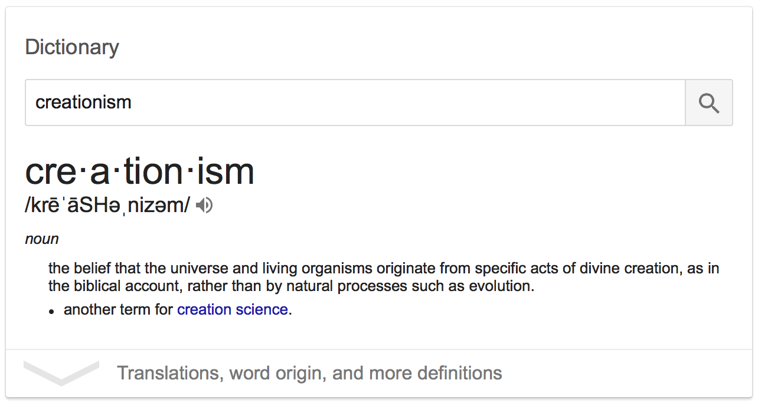
Definition

Slide 8
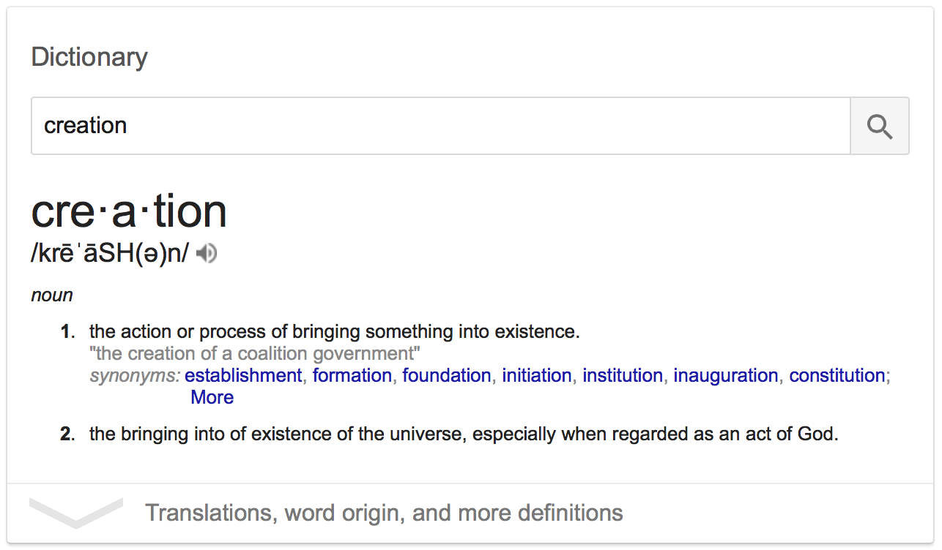
Definition

