Slide 1
3D Printing
Dan Vang

Slide 2
Overview
What 3D Printing is
Brief History
Uses of 3D Printing
Impact

Slide 3
What is 3D printing?

Slide 4
History

Slide 5
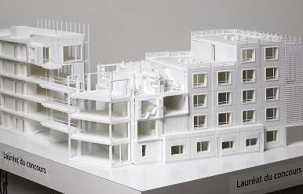
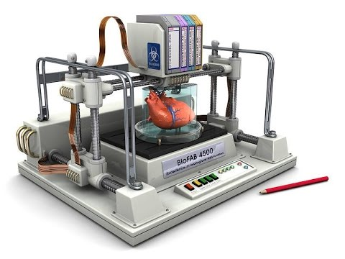
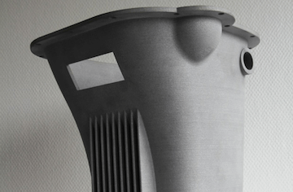
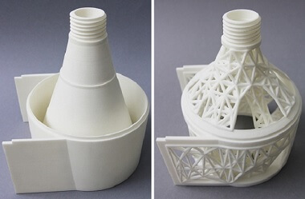
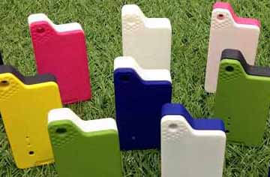
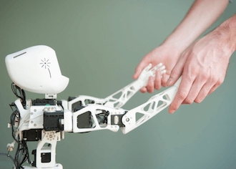
Uses of 3D Printing

Slide 6
Impact of 3D Printing

Slide 7
Sources
https://www.epo.org/learning-events/european-inventor/finalists/2014/hull.html
https://www.sculpteo.com/en/applications/
https://3dprint.com/82272/what-3d-printing-works/

